Slide 1
Compiled & Interpreted Languages
Programming Languages
William Killian
Millersville University

Slide 2
Lecture Outline
The Language Translation Pipeline
  Scanning
  Parsing
  Analysis
  Optimizing
  Code Generation
Running Your Program
The Compiler
The Interpreter

Slide 3
The
Language Translation Pipeline

Slide 4
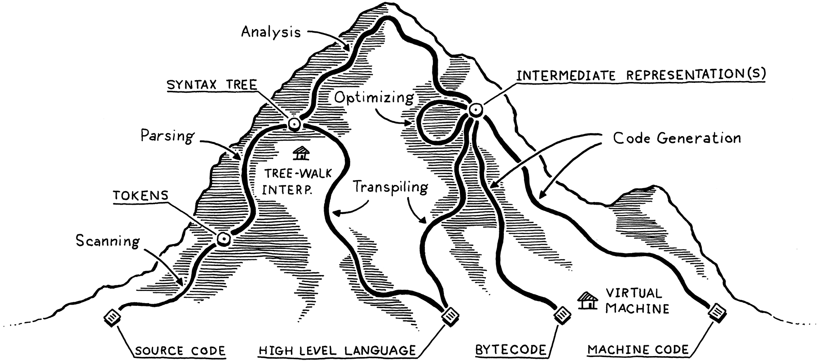
The BIG Picture
Source: Crafting Interpreters (https://craftinginterpreters.com)

Slide 5
Scanning
A scanner takes in the linear stream of characters and chunks them together into tokens
Some characters don’t mean anything.
  Whitespace is often insignificant
  Comments, by definition, are ignored by the language.
  The scanner usually discards these, leaving a clean sequence of meaningful tokens.

Slide 6
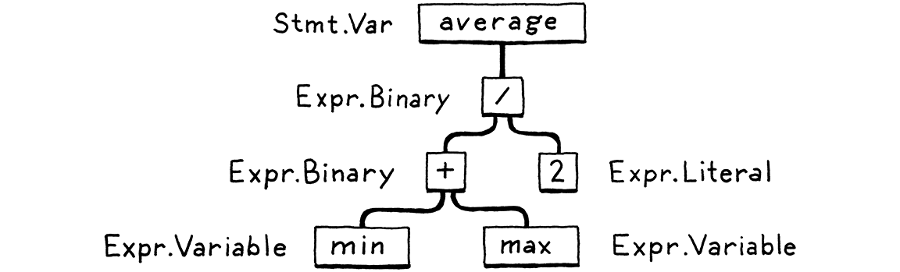
Parsing
A parser takes the sequence of tokens and builds a tree structure that mirrors the grammar.
Programming language experts call these tree structures “syntax trees”, “ASTs”, or just “trees”

Slide 7
Analysis (i.e. Static Analysis)
Binding / Resolution
  For each identifier we find out where its name is defined and wire the two together.
  This is where scope comes into play—the region of source code where a name refers to a declaration.
Type Checking
  Once we know where names are defined, we can also figure out their types. All operations must be valid.
  If operations aren’t supported, we report a type error.

Slide 8
Optimizing
Once we understand what the user’s program means, we can “change it”
Optimizing is a safe change to the program that results in the same semantics (e.g. has the same behavior)
The resulting program is usually more efficient
pennyArea = 3.14159 * (0.75 / 2) * (0.75 / 2);
pennyArea = 0.4417860938;
Example: Constant Folding

Slide 9
Code Generation
The last step
Converting it to a form the machine can run.
  Usually primitive assembly-like instructions a CPU runs and not the kind of “source code” a human reads.
Do we generate instructions for a real CPU or a virtual one?
  Real CPU: Intel x86, ARM AArch64, IBM PowerPC, MIPS
  Virtual CPU: LLVM IR, Microsoft CIL, Java Bytecode, Python bytecode
    Advantages: Portable across Real CPUs
    Disadvantages: Performance penalty

Slide 10
Running
Your
Program

Slide 11
Two Major Components
Virtual Machine
  Only needed for languages that target Virtual CPUs
  Converts from Virtual CPU to Real CPU at runtime
Language Runtime
  Needed by all languages
  The “extra pieces” required to have a language operate

Slide 12
Virtual Machine
When you target a Virtual CPU, you need a program that converts the Virtual CPU instructions to Real CPU instructions
This is done with a Virtual Machine
  A program that emulates a hypothetical chip supporting your virtual architecture at runtime.
Virtual CPU Instructions
Virtual Machine
Real CPU Instructions

Slide 13
Language Runtime
We usually need some services that our language provides while the program is running.
Examples:
  If a language automatically manages memory, we need a garbage collector running to reclaim memory
  If a language supports instanceof, then we need to keep track of the type of each object during execution.
In a compiled language, the code implementing the runtime gets inserted into the resulting executable.
If the language is run inside an interpreter or VM, then the runtime lives there.

Slide 14
Compilers and
Interpreters

Slide 15
Compilers and Interpreters
BOTH must perform all stages in the language translation pipeline
The difference is when certain stages happen
What languages do you think are compiled?
What languages do you think are interpreted?
Which languages do you think can be both?

Slide 16
Compiled/Interpreted Languages
Language | Compiled | Both | Interpreted
Java
C / C++
OCaml
Javascript
Python
C#

Slide 17
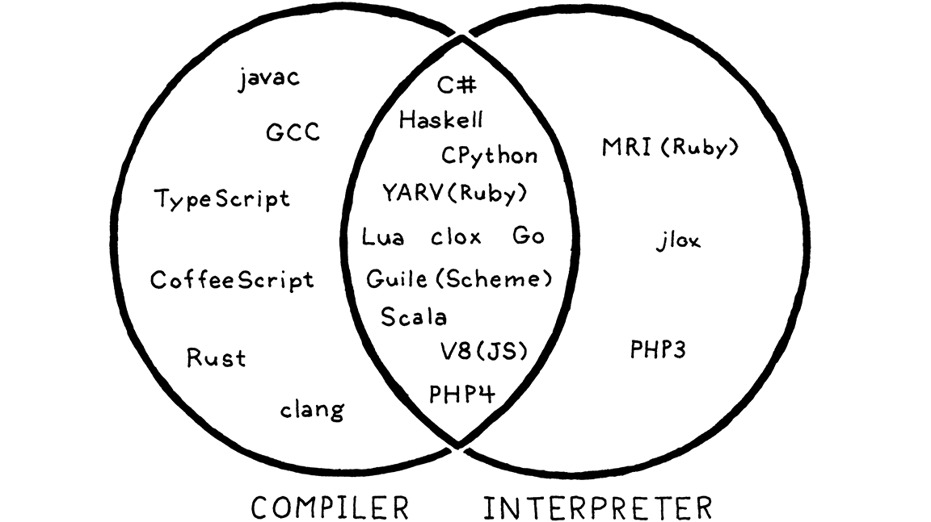
Common Languages

Slide 18
Compiled Languages
Compiling is an implementation technique that involves translating a source language to some other form.
  When you generate bytecode or machine code, you are compiling.
  When you transpile to another high-level language you are compiling too.
When we say a language implementation “is a compiler”, we mean it translates source code to some other form but doesn’t execute it.

Slide 19
Interpreted Languages
When we say a language implementation is an interpreter, we mean it takes in source code and executes it immediately.
It runs programs “from source”.
There is no separate entity created

Slide 20
Language != Implementation
Language Implementations can either be:
  Compiled
  Interpreted
Notice how we didn’t mention a language?
Statements:
  I can write an interpreter for C++ (see cling)
  I can write a compiler for Javascript
  I can write an interpreter for C#
  I can write a compiler for ___________
  I can write an interpreter for ___________

Slide 21
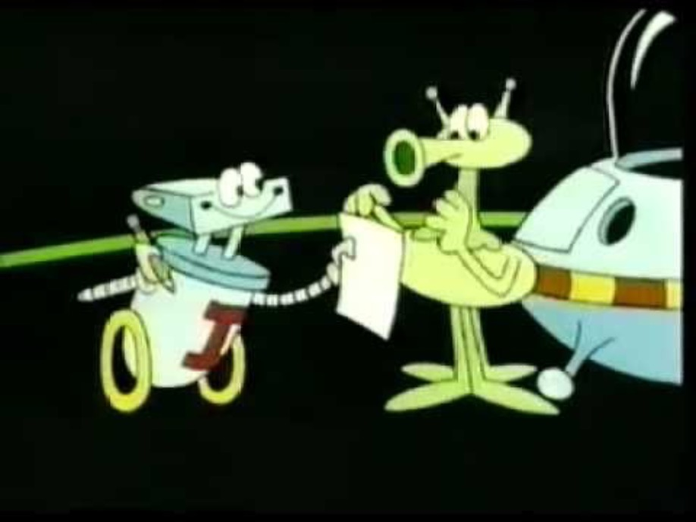
Bonus Video
Interpreters and Compilers (Bits and Bytes, Episode 6)
https://www.youtube.com/watch?v=_C5AHaS1mOA

