Slide 1
Language Design and Evolution
Programming Languages
William Killian
Millersville University

Slide 2
What is a Language?

Slide 3
lan·guage
/ˈlaNGɡwij/
noun
the method of human communication, either spoken or written, consisting of the use of words in a structured and conventional way.
a system of symbols and rules for writing programs or algorithms

Slide 4
Linguistics Definition
the method of human communication, either spoken or written, consisting of the use of words in a structured and conventional way
Does “spoken” make sense for computers?
Is “human communication” feasible with computer programs?

Slide 5
Computer Science Definition
a system of tokens and rules for writing programs or algorithms
What tokens do we use?
What rules do we have?

Slide 6
Tokens
In the domain of language design, we will refer to each word as a unique token
Tokens can come in any order or be anything, but some tokens might have some special meaning
Usually alphanumeric, numeric, or symbolic
What tokens might we have in Java? C++?

Slide 7
Keywords
Keywords are a type of Token
Usually reserved by the language
Only be used in specific locations
Examples:
  int in Java
  void in C++
  const in Javascript
  def in Python
  let in OCaml
Others?

Slide 8
Symbols
Symbols are another type of Token
Usually combinations of punctuation characters
Often used to indicate special operations
Examples:
== in Java
|> in OCaml
... in Javascript
<< in C++
Others?

Slide 9
Identifiers
Identifiers refer to specific entities of our program
Creating a new variable or function
Accessing a data member
Calling a function
Using a library

Slide 10
Rules
Within language design, we will refer to the order in which symbols can be structured as rules
Two main types of rules:
  Syntactic Rules
    The order of all symbols must be well-formed
  Semantic Rules
    The meaning of all symbols must be well-formed
We will talk about these in detail later in the class

Slide 11
Syntax Rules (in English)
The boy went to school.
article
noun
verb
prep.
noun
prepositional phrase
noun phrase
verb phrase
sentence

Slide 12
Syntax Rules (in Java)
class := CLASS ID classArg* LBRACE defs* RBRACE
classArg := (IMPLEMENTS|EXTENDS) nameList
nameList := ID [, nameList]*
defs := [visibility] [STATIC] (varDef SEMI| funDef)
visibility := (PUBLIC|PROTECTED|PRIVATE)
varDef := type ID
funDef := type ID LPAREN [paramList] RPAREN …
paramList := varDef [, paramList]*
type := (primitive | ID)
primitive := (INT | BOOLEAN | DOUBLE | SHORT | LONG | BYTE | FLOAT)

Slide 13
Syntax Rules (in Java)
CAPS means terminal (symbol)
italicized means rule
* - zero or more
[optional]
class := CLASS ID classArg* LBRACE defs* RBRACE
classArg := (IMPLEMENTS|EXTENDS) nameList
nameList := ID [, nameList]*
defs := [visibility] [STATIC] (varDef SEMI| funDef)
visibility := (PUBLIC|PROTECTED|PRIVATE)
varDef := type ID
funDef := type ID LPAREN [paramList] RPAREN …
paramList := varDef [, paramList]*
type := (primitive | ID)
primitive := (INT | BOOLEAN | DOUBLE | SHORT | LONG | BYTE | FLOAT)
(choice1|choice2)

Slide 14
Syntax Rules (in Java)
class := CLASS ID classArg* LBRACE defs* RBRACE
classArg := (IMPLEMENTS|EXTENDS) nameList
nameList := ID [, nameList]*
defs := [visibility] [STATIC] (varDef SEMI| funDef)
visibility := (PUBLIC|PROTECTED|PRIVATE)
varDef := type ID
funDef := type ID LPAREN [paramList] RPAREN …
paramList := varDef [, paramList]*
type := (primitive | ID)
primitive := (INT | BOOLEAN | DOUBLE | SHORT | LONG | BYTE | FLOAT)
What are the tokens in the shown rules?

Slide 15
Syntax Rules (in Java)
class := CLASS ID classArg* LBRACE defs* RBRACE
classArg := (IMPLEMENTS|EXTENDS) nameList
nameList := ID [, nameList]*
defs := [visibility] [STATIC] (varDef SEMI| funDef)
visibility := (PUBLIC|PROTECTED|PRIVATE)
varDef := type ID
funDef := type ID LPAREN [paramList] RPAREN …
paramList := varDef [, paramList]*
type := (primitive | ID)
primitive := (INT | BOOLEAN | DOUBLE | SHORT | LONG | BYTE | FLOAT)
Where are the rules?

Slide 16
Syntax Rules (in Java)
class := CLASS ID classArg* LBRACE defs* RBRACE
classArg := (IMPLEMENTS|EXTENDS) nameList
nameList := ID [, nameList]*
defs := [visibility] [STATIC] (varDef SEMI| funDef)
visibility := (PUBLIC|PROTECTED|PRIVATE)
varDef := type ID
funDef := type ID LPAREN [paramList] RPAREN …
paramList := varDef [, paramList]*
type := (primitive | ID)
primitive := (INT | BOOLEAN | DOUBLE | SHORT | LONG | BYTE | FLOAT)
Exercise: Make a “Point” class with two public members of type double: x and y?

Slide 17
Rosetta Code Examples (Homework)
What problems did you investigate?
What languages did you see?
What languages DON’T you want to see again?

Slide 18
Language Transformation
Computers understand binary
  Sequence of 0’s & 1’s
  See: Computer Architecture
Humans understand languages
  See: Programming Languages
Language
0’s and 1’s
(binary)
?
We need a tool to translate our language to binary

Slide 19
Compilers
Input:
  A program (sequence of instructions) written in a well-defined, predictable language
Output:
  A sequence of bits that a computer architecture can execute
Task:
  Compilers translate from an input language to an output language without loss of functionality
  Mathematically correct

Slide 20

The First Programming Language
Discussion:
What year do you think the first programming language came out?
What did it look like?
What did it run on?
Before 1930
1930 –
1940
1940 –
1950
After
1950

Slide 21
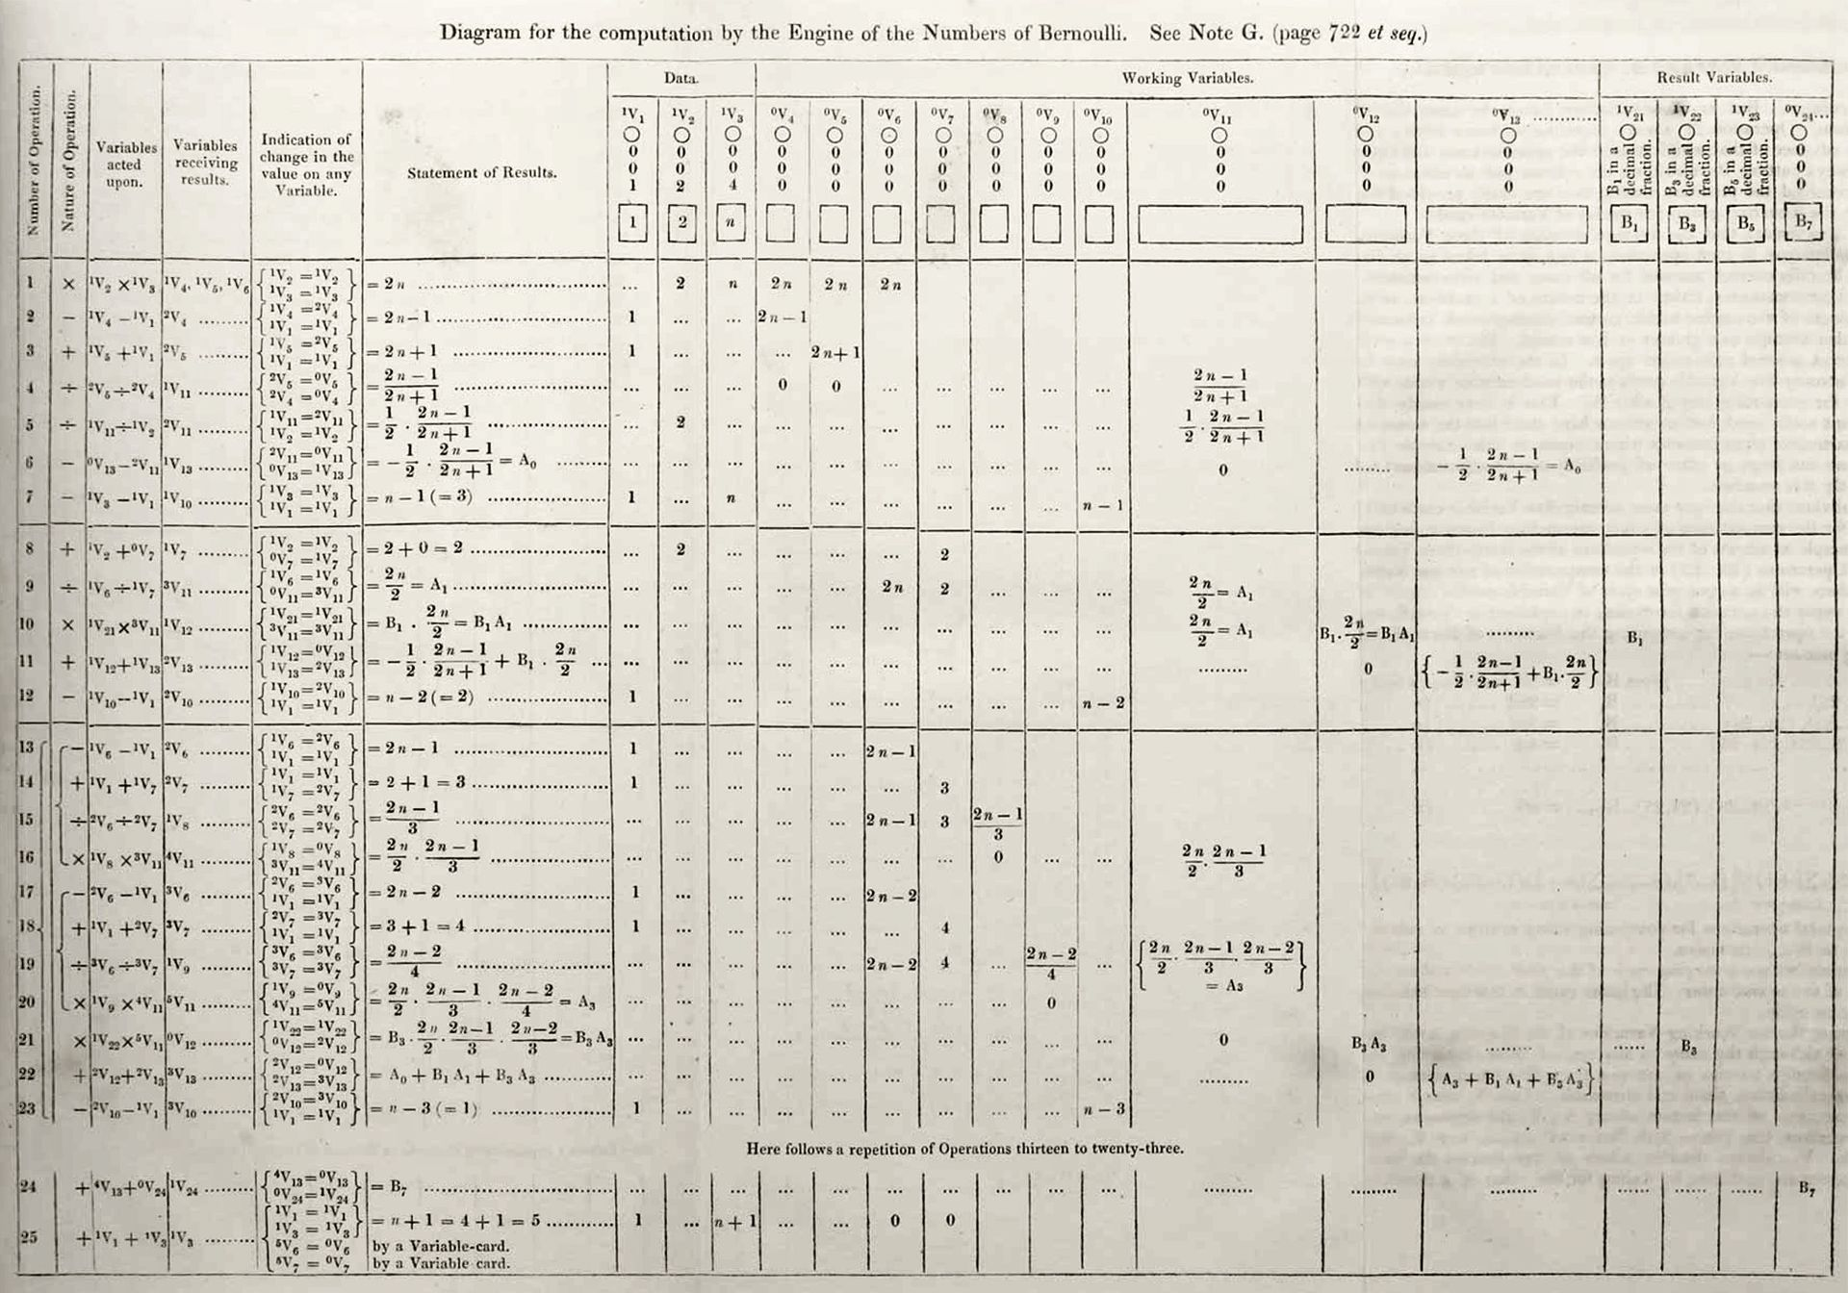
The First Programming Language
Ada Lovelace, 1843
Notes:
It didn’t run on anything
The Babbage analytical engine was never operational

Slide 22
The First Programming Language
Created
Plankalkül (1942-1945)
Konrad Zuse
P1 max3 (V0[:8.0],V1[:8.0],V2[:8.0]) → R0[:8.0]
max(V0[:8.0],V1[:8.0]) → Z1[:8.0]
max(Z1[:8.0],V2[:8.0]) → R0[:8.0]
END
P2 max (V0[:8.0],V1[:8.0]) → R0[:8.0]
V0[:8.0] → Z1[:8.0]
(Z1[:8.0] < V1[:8.0]) → V1[:8.0] → Z1[:8.0]
Z1[:8.0] → R0[:8.0]
END
function max3 (in a linear transcription) that calculates the maximum of three variables

Slide 23
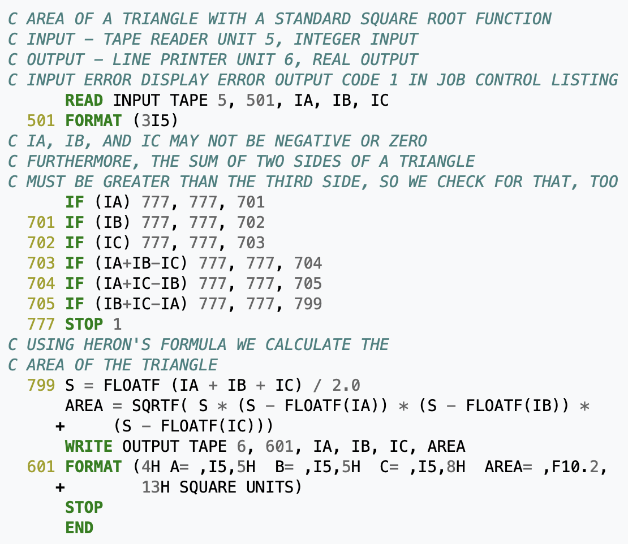
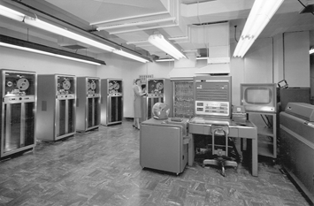
The First Programming Language
Commercial
FORTRAN (1954)
John Backus + IBM

Slide 24
What Was Your First Programming Language?

Slide 25
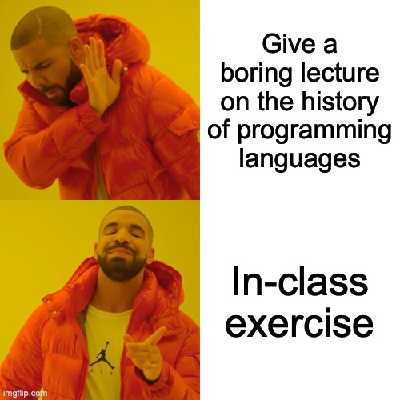
History of Programming Languages

Slide 26
History of Programming Languages
Split up into four groups (randomly)
Group 1: 1960 – 1980
Group 2: 1980 – 1995
Group 3: 1995 – 2010
Group 4: 2010 – Present

Slide 27
History of Programming Languages
Spend approximately 20 minutes in your group searching the internet (Google, Wikipedia).
Identify:
  What languages seem important (that you’ve heard of)?
  What is the “coolest” language?
  What is the origin of the language?
    Research (PhD)
    Industry (IBM, Kodak, HP, Apple, Google, Microsoft, etc)
    Hobby (someone’s fun project)
  Trends of languages during the time period

Slide 28
History of Programming Languages
Regroup after 20 minutes
Have each group give a short presentation with your findings
  Don’t worry -- I’ll help you out

