Slide 1
Classes and Collections
CSCI 162 – Introduction to Programming II
William Killian

Slide 2
Calling another constructor
public class Point {
private int x;
private int y;
public Point() {
this(0, 0); // calls (x, y) constructor
}
public Point(int x, int y) {
this.x = x;
this.y = y;
}
...
}
Avoids redundancy between constructors
Only a constructor (not a method) can call another constructor

Slide 3
Copying Point’s
Convention is to use clone method
Point p1 = new Point (3, 4);
Point p2 = p1.clone ();
Class must implement Cloneable interface
public class Point implements Cloneable {
...
}
Must override Object.clone ()

Slide 4
Copying Point’s
Implementing clone
public Point clone () {
Point p;
try {
p = (Point) super.clone ();
}
catch (CloneNotSupportedException e) {
throw new RuntimeException (“Class doesn’t
implement the Cloneable interface”);
}
// No further work necessary
// Memberwise copy is done by default
return p;
}

Slide 5
Testing for Equality
The “==” operator tests for identity for reference types
Want to test Point objects for equality
Point p1, p2;
...
if (p1.equals (p2)) ...
User may compare Point’s to other Object’s
if (p1.equals (“hi!”)) ...
Want false to be returned

Slide 6
Point Class
public boolean equals (Object obj) {
if (!(obj instanceof Point)) {
return false;
Point p = (Point) obj;
return x == p.x && y == p.y;
}
See Code directory on course page for entire Point class

Slide 7
Static methods/fields

Slide 8
Multi-class systems
Most large software systems consist of many classes
One main class runs and calls methods of the others
Advantages:
code reuse
splits up the program logic into manageable chunks
Main Class #1
main
method1
method2
Class #2
method3
method5
Class #3
method4
method6

Slide 9
Redundant program 1
// This program sees whether some interesting numbers are prime.
public class Primes1 {
public static void main(String[] args) {
int[] nums = {1234517, 859501, 53, 142};
for (int i = 0; i < nums.length; i++) {
if (isPrime(nums[i])) {
System.out.println(nums[i] + " is prime");
}
}
}
// Returns the number of factors of the given integer.
public static int countFactors(int number) {
int count = 0;
for (int i = 1; i <= number; i++) {
if (number % i == 0) {
count++; // i is a factor of the number
}
}
return count;
}
// Returns true if the given number is prime.
public static boolean isPrime(int number) {
return countFactors(number) == 2;
}
}

Slide 10
Redundant program 2
// This program prints all prime numbers up to a maximum.
public class Primes2 {
public static void main(String[] args) {
Scanner console = new Scanner(System.in);
System.out.print("Max number? ");
int max = console.nextInt();
for (int i = 2; i <= max; i++) {
if (isPrime(i)) {
System.out.print(i + " ");
} }
System.out.println();
}
// Returns true if the given number is prime.
public static boolean isPrime(int number) {
return countFactors(number) == 2;
}
// Returns the number of factors of the given integer.
public static int countFactors(int number) {
int count = 0;
for (int i = 1; i <= number; i++) {
if (number % i == 0) {
count++; // i is a factor of the number
} }
return count;
}
}

Slide 11
Classes as modules
module: A reusable piece of software, stored as a class.
Example module classes: Math, Arrays, System
// This class is a module that contains useful methods
// related to factors and prime numbers.
public class Factors {
// Returns the number of factors of the given integer.
public static int countFactors(int number) {
int count = 0;
for (int i = 1; i <= number; i++) {
if (number % i == 0) {
count++;
}
}
return count;
}
// Returns true if the given number is prime.
public static boolean isPrime(int number) {
return countFactors(number) == 2;
}
}

Slide 12
More about modules
A module is a partial program, not a complete program.
It does not have a main. You don't run it directly.
Modules are meant to be utilized by other client classes.
Syntax:
class.method(parameters);
Example:
int factorsOf24 = Factors.countFactors(24);

Slide 13
Using a module
// This program sees whether some interesting numbers are prime.
public class Primes {
public static void main(String[] args) {
int[] nums = {1234517, 859501, 53, 142};
for (int i = 0; i < nums.length; i++) {
if (Factors.isPrime(nums[i])) {
System.out.println(nums[i] + " is prime");
}
}
}
}
// This program prints all prime numbers up to a given maximum.
public class Primes2 {
public static void main(String[] args) {
Scanner console = new Scanner(System.in);
System.out.print("Max number? ");
int max = console.nextInt();
for (int i = 2; i <= max; i++) {
if (Factors.isPrime(i)) {
System.out.print(i + " ");
} }
System.out.println();
}
}

Slide 14
Modules in Java libraries
// Java's built in Math class is a module
public class Math {
public static final double PI = 3.14159265358979323846;
...
public static int abs(int a) {
if (a >= 0) {
return a;
} else {
return -a;
}
}
public static double toDegrees(double radians) {
return radians * 180 / PI;
}
}

Slide 15
Static members
static: Part of a class, rather than part of an object.
Object classes can have static methods and fields.
Fields not copied into each object; shared by all objects
class
state: private static int staticFieldA private static String staticFieldB
behavior: public static void someStaticMethodC() public static void someStaticMethodD()
object #1
state: int field2 double field2
behavior: public void method3() public int method4() public void method5()
object #2
state: int field1 double field2
behavior: public void method3() public int method4() public void method5()
object #3
state: int field1 double field2
behavior: public void method3() public int method4() public void method5()

Slide 16
Static fields
private static type name;
or,
private static type name = value;
Example:
private static int theAnswer = 42;
static field: Stored in the class instead of each object.
A "shared" global field that all objects can access and modify.
Like a class constant, except that its value can be changed.

Slide 17
Accessing static fields
From inside the class where the field was declared:
fieldName // get the value
fieldName = value; // set the value
From another class (if the field is public):
ClassName.fieldName // get the value
ClassName.fieldName = value; // set the value
generally static fields are not public unless they are final
Example: A BankAccount class in which each account is automatically given a unique ID.

Slide 18
BankAccount solution
public class BankAccount {
// Static count of how many accounts are created
// (only one count shared for the whole class)
private static int objectCount = 0;
// Fields (replicated for each object)
private String name;
private int id;
public BankAccount() {
objectCount++; // advance the id, and
id = objectCount; // give number to account
}
...
public int getID() { // return this account's id
return id;
}
}

Slide 19
Static methods
// the same syntax you've already used for methods
public static type name(parameters) {
statements;
}
static method: Stored in a class, not in an object.
Shared by all objects of the class, not replicated.
Does not have any implicit parameter, this; therefore, cannot access any particular object's fields.
Exercise: Make it so that clients can find out how many total BankAccount objects have ever been created.

Slide 20
BankAccount solution
public class BankAccount {
// Static count of how many accounts are created
// (only one count shared for the whole class)
private static int objectCount = 0;
// Clients can call this to find out # accounts created
public static int getNumAccounts() {
return objectCount;
}
// Fields (replicated for each object)
private String name;
private int id;
public BankAccount() {
objectCount++; // advance the id, and
id = objectCount; // give number to account
}
...
public int getID() { // return this account's id
return id;
}
}

Slide 21
Summary of Java classes
A class is used for any of the following in a large program:
a program : Has a main and perhaps other static methods.
example: GuessingGame, Birthday, MadLibs, CritterMain
does not usually declare any static fields (except final)
an object class : Defines a new type of objects.
example: Point, BankAccount, Date, Critter, FratGuy
declares object fields, constructor(s), and methods
might declare static fields or methods, but these are less of a focus
should be encapsulated (all fields and static fields private)
a module : Utility code implemented as static methods.
example: Math

Slide 22
Collections

Slide 23
Exercise
Write a program that reads a file and displays the words of that file as a list.
First display all words.
Then display them with all plurals (ending in "s") capitalized.
Then display them in reverse order.
Then display them with all plural words removed.
Should we solve this problem using an array?
Why or why not?

Slide 24
Naive solution
String[] allWords = new String[1000];
int wordCount = 0;
Scanner input = new Scanner(new File("data.txt"));
while (input.hasNext()) {
String word = input.next();
allWords[wordCount] = word;
wordCount++;
}
Problem: You don't know how many words the file will have.
Hard to create an array of the appropriate size.
Later parts of the problem are more difficult to solve.
Luckily, there are other ways to store data besides in an array.

Slide 25
Collections
collection: an object that stores data
the objects stored are called elements
some collections maintain an ordering; some allow duplicates
typical operations: add, remove, clear, contains (search), size
examples found in the Java class libraries:
ArrayList, LinkedList, HashMap, TreeSet, PriorityQueue
all collections are in the java.util package
import java.util.*;

Slide 26
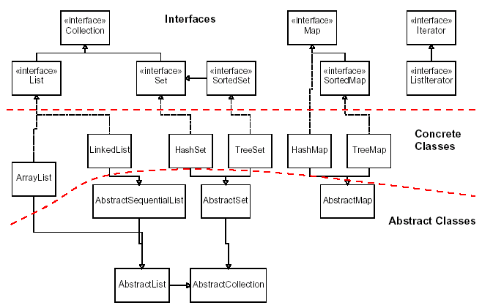
Java Collections Framework

Slide 27
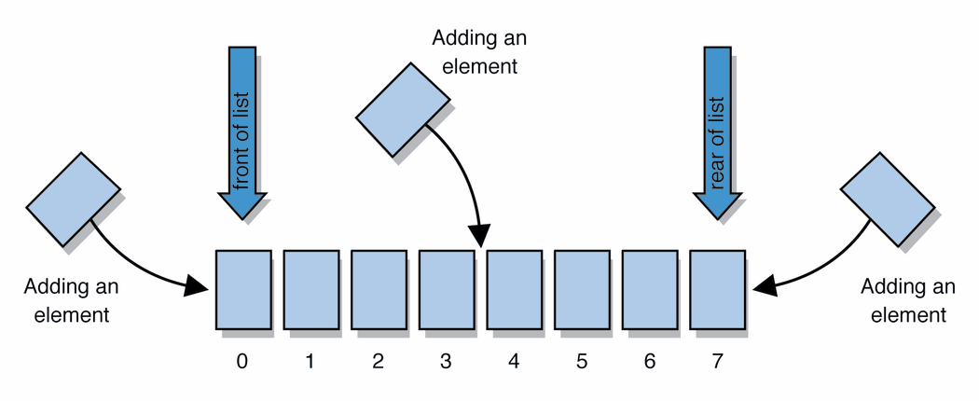
Lists
list: a collection storing an ordered sequence of elements
each element is accessible by a 0-based index
a list has a size
elements can be added to the front, back, or elsewhere
in Java, a list can be represented as an ArrayList object
Notes:
use jGRASP/DrJava Interactions window to create a list and add some elements, get them, check size

Slide 28
Idea of a list
Rather than creating an array of boxes, create an object that represents a "list" of items. (initially an empty list.)
[]
You can add items to the list.
The default behavior is to add to the end of the list.
[hello, ABC, goodbye, okay]
The list object keeps track of the element values that have been added to it, their order, indexes, and its total size.
Think of an "array list" as an automatically resizing array object.
Internally, the list is implemented using an array and a size field.

Slide 29
ArrayList methods
add(value) | appends value at end of list
add(index, value) | inserts given value just before the given index, shifting subsequent values to the right
clear() | removes all elements of the list
indexOf(value) | returns first index where given value is found in list (-1 if not found)
get(index) | returns the value at given index
remove(index) | removes/returns value at given index, shifting subsequent values to the left
set(index, value) | replaces value at given index with given value
size() | returns the number of elements in list
toString() | returns a string representation of the list such as "[3, 42, -7, 15]"

Slide 30
ArrayList methods 2
addAll(list) addAll(index, list) | adds all elements from the given list to this list (at the end of the list, or inserts them at the given index)
contains(value) | returns true if given value is found somewhere in this list
containsAll(list) | returns true if this list contains every element from given list
equals(list) | returns true if given other list contains the same elements
iterator() listIterator() | returns an object used to examine the contents of the list (seen later)
lastIndexOf(value) | returns last index value is found in list (-1 if not found)
remove(value) | finds and removes the given value from this list
removeAll(list) | removes any elements found in the given list from this list
retainAll(list) | removes any elements not found in given list from this list
subList(from, to) | returns the sub-portion of the list between indexes from (inclusive) and to (exclusive)
toArray() | returns the elements in this list as an array

Slide 31
Type Parameters (Generics)
ArrayList<Type> name = new ArrayList<Type>();
When constructing an ArrayList, you must specify the type of elements it will contain between < and >.
This is called a type parameter or a generic class.
Allows the same ArrayList class to store lists of different types.
ArrayList<String> names = new ArrayList<String>();
names.add("Bert");
names.add("Ernie");

Slide 32
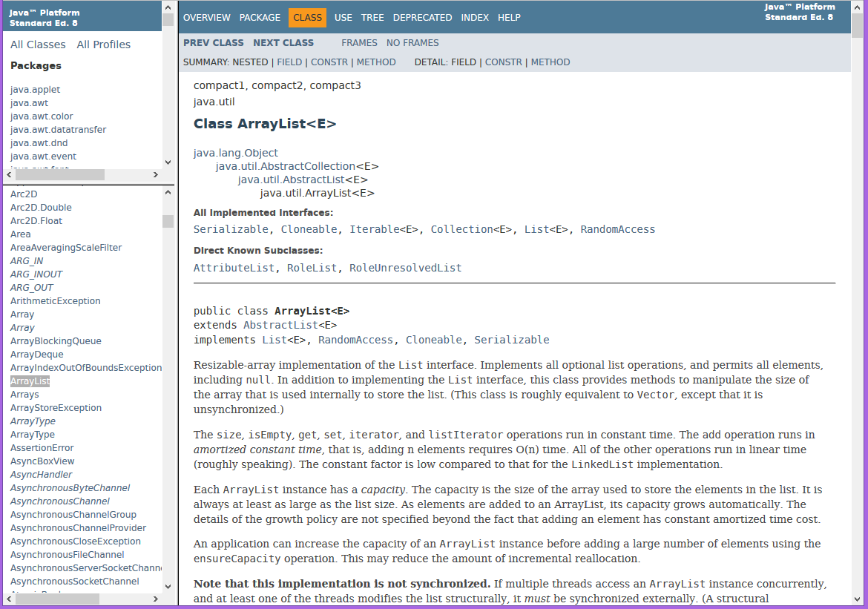
Learning about classes
The Java API Specification is a huge web page containing documentation about every Java class and its methods.
The link to the API Specs is on the instructor web site (under Resources).

Slide 33
ArrayList vs. array
construction
String[] names = new String[5];
ArrayList<String> list = new ArrayList<String>();
storing a value
names[0] = "Jessica";
list.add("Jessica");
retrieving a value
String s = names[0];
String s = list.get(0);

Slide 34
ArrayList vs. array 2
doing something to each value that starts with "B"
for (int i = 0; i < names.length; i++) {
if (names[i].startsWith("B")) { ... }
}
for (int i = 0; i < list.size(); i++) {
if (list.get(i).startsWith("B")) { ... }
}
seeing whether the value "Benson" is found
for (int i = 0; i < names.length; i++) {
if (names[i].equals("Benson")) { ... }
}
if (list.contains("Benson")) { ... }

Slide 35
Exercise, revisited
Write a program that reads a file and displays the words of that file as a list.
First display all words.
Then display them in reverse order.
Then display them with all plurals (ending in "s") capitalized.
Then display them with all plural words removed.

Slide 36
Exercise solution (partial)
ArrayList<String> allWords = new ArrayList<String>();
Scanner input = new Scanner(new File("words.txt"));
while (input.hasNext()) {
String word = input.next();
allWords.add(word);
}
System.out.println(allWords);
// remove all plural words
for (int i = 0; i < allWords.size(); i++) {
String word = allWords.get(i);
if (word.endsWith("s")) {
allWords.remove(i);
i--;
}
}

Slide 37
ArrayList as parameter
public static void name(ArrayList<Type> name) {
Example:
// Removes all plural words from the given list.
public static void removePlural(ArrayList<String> list) {
for (int i = 0; i < list.size(); i++) {
String str = list.get(i);
if (str.endsWith("s")) {
list.remove(i);
i--;
}
}
}
You can also return a list:
public static ArrayList<Type> methodName(params)

Slide 38
ArrayList of primitives?
The type you specify when creating an ArrayList must be an object type; it cannot be a primitive type.
// illegal -- int cannot be a type parameter
ArrayList<int> list = new ArrayList<int>();
But we can still use ArrayList with primitive types by using special classes called wrapper classes in their place.
// creates a list of ints
ArrayList<Integer> list = new ArrayList<Integer>();

Slide 39
Wrapper classes
Primitive Type | Wrapper Type
int | Integer
double | Double
char | Character
boolean | Boolean
A wrapper is an object whose sole purpose is to hold a primitive value.
Once you construct the list, use it with primitives as normal:
ArrayList<Double> grades = new ArrayList<Double>();
grades.add(3.2);
grades.add(2.7);
...
double myGrade = grades.get(0);

Slide 40
Exercise
Write a program that reads a file full of numbers and displays all the numbers as a list, then:
Prints the average of the numbers.
Prints the highest and lowest number.
Filters out all of the even numbers (ones divisible by 2).

Slide 41
Exercise solution (partial)
ArrayList<Integer> numbers = new ArrayList<Integer>();
Scanner input = new Scanner(new File("numbers.txt"));
while (input.hasNextInt()) {
int n = input.nextInt();
numbers.add(n);
}
System.out.println(numbers);
filterEvens(numbers);
System.out.println(numbers);
...
// Removes all elements with even values from the given list.
public static void filterEvens(ArrayList<Integer> list) {
for (int i = list.size() - 1; i >= 0; i--) {
int n = list.get(i);
if (n % 2 == 0) {
list.remove(i);
}
}
}

Slide 42
Other Exercises
Write a method reverse that reverses the order of the elements in an ArrayList of strings.
Write a method capitalizePlurals that accepts an ArrayList of strings and replaces every word ending with an "s" with its uppercased version.
Write a method removePlurals that accepts an ArrayList of strings and removes every word in the list ending with an "s", case-insensitively.

Slide 43
Out-of-bounds
Legal indexes are between 0 and the list's size() - 1.
Reading or writing any index outside this range will cause an IndexOutOfBoundsException.
ArrayList<String> names = new ArrayList<String>();
names.add("Marty"); names.add("Kevin");
names.add("Vicki"); names.add("Larry");
System.out.println(names.get(0)); // okay
System.out.println(names.get(3)); // okay
System.out.println(names.get(-1)); // exception
names.add(9, "Aimee"); // exception
index | 0 | 1 | 2 | 3
value | Marty | Kevin | Vicki | Larry

Slide 44
ArrayList "mystery"
ArrayList<Integer> list = new ArrayList<Integer>();
for (int i = 1; i <= 10; i++) {
list.add(10 * i); // [10, 20, 30, 40, ..., 100]
}
What is the output of the following code?
for (int i = 0; i < list.size(); i++) {
list.remove(i);
}
System.out.println(list);
Answer:
[20, 40, 60, 80, 100]

Slide 45
ArrayList "mystery" 2
ArrayList<Integer> list = new ArrayList<Integer>();
for (int i = 1; i <= 5; i++) {
list.add(2 * i); // [2, 4, 6, 8, 10]
}
What is the output of the following code?
int size = list.size();
for (int i = 0; i < size; i++) {
list.add(i, 42); // add 42 at index i
}
System.out.println(list);
Answer:
[42, 42, 42, 42, 42, 2, 4, 6, 8, 10]
Notes:
What happens if you get rid of the int size variable above and replace it with list.size() ? (infinite loop)

Slide 46
ArrayList as parameter
public static void name(ArrayList<Type> name) {
Example:
// Removes all plural words from the given list.
public static void removePlural(ArrayList<String> list) {
for (int i = 0; i < list.size(); i++) {
String str = list.get(i);
if (str.endsWith("s")) {
list.remove(i);
i--;
}
}
}
You can also return a list:
public static ArrayList<Type> methodName(params)
Notes:
Think of "ArrayList<Integer>" as just all being one atomic token representing the type.

Slide 47
Exercise
Write a method addStars that accepts an array list of strings as a parameter and places a * after each element.
Example: if an array list named list initially stores:
[the, quick, brown, fox]
Then the call of addStars(list); makes it store:
[the, *, quick, *, brown, *, fox, *]
Write a method removeStars that accepts an array list of strings, assuming that every other element is a *, and removes the stars (undoing what was done by addStars above).

Slide 48
Exercise solution
public static void addStars(ArrayList<String> list) {
for (int i = 1; i < list.size(); i += 2) {
list.add(i, "*");
}
}
public static void removeStars(ArrayList<String> list) {
for (int i = 0; i < list.size(); i++) {
list.remove(i);
}
}

Slide 49
Exercise
Write a method intersect that accepts two sorted array lists of integers as parameters and returns a new list that contains only the elements that are found in both lists.
Example: if lists named list1 and list2 initially store:
[1, 4, 8, 9, 11, 15, 17, 28, 41, 59]
[4, 7, 11, 17, 19, 20, 23, 28, 37, 59, 81]
Then the call of intersect(list1, list2) returns the list:
[4, 11, 17, 28, 59]

Slide 50
Other Exercises
Write a method reverse that reverses the order of the elements in an ArrayList of strings.
Write a method capitalizePlurals that accepts an ArrayList of strings and replaces every word ending with an "s" with its uppercased version.
Write a method removePlurals that accepts an ArrayList of strings and removes every word in the list ending with an "s", case-insensitively.

Slide 51
Objects storing collections
An object can have an array, list, or other collection as a field.
public class Course {
private double[] grades;
private ArrayList<String> studentNames;
public Course() {
grades = new double[4];
studentNames = new ArrayList<String>();
...
}
Now each object stores a collection of data inside it.

Slide 52
The compareTo method
The standard way for a Java class to define a comparison function for its objects is to define a compareTo method.
Example: in the String class, there is a method:
public int compareTo(String other)
A call of A.compareTo(B) will return:
a value < 0 if A comes "before" B in the ordering,
a value > 0 if A comes "after" B in the ordering,
or 0 if A and B are considered "equal" in the ordering.

Slide 53
Using compareTo
compareTo can be used as a test in an if statement.
String a = "alice";
String b = "bob";
if (a.compareTo(b) < 0) { // true
...
}
Primitives | Objects
if (a < b) { ... | if (a.compareTo(b) < 0) { ...
if (a <= b) { ... | if (a.compareTo(b) <= 0) { ...
if (a == b) { ... | if (a.compareTo(b) == 0) { ...
if (a != b) { ... | if (a.compareTo(b) != 0) { ...
if (a >= b) { ... | if (a.compareTo(b) >= 0) { ...
if (a > b) { ... | if (a.compareTo(b) > 0) { ...

Slide 54
compareTo and collections
You can use an array or list of strings with Java's included binary search method because it calls compareTo internally.
String[] a = {"al", "bob", "cari", "dan", "mike"};
int index = Arrays.binarySearch(a, "dan"); // 3
Java's TreeSet/Map use compareTo internally for ordering.
Set<String> set = new TreeSet<String>();
for (String s : a) {
set.add(s);
}
System.out.println(s);
// [al, bob, cari, dan, mike]

Slide 55
Ordering our own types
We cannot binary search or make a TreeSet/Map of arbitrary types, because Java doesn't know how to order the elements.
The program compiles but crashes when we run it.
Set<HtmlTag> tags = new TreeSet<HtmlTag>();
tags.add(new HtmlTag("body", true));
tags.add(new HtmlTag("b", false));
...
Exception in thread "main" java.lang.ClassCastException
at java.util.TreeSet.add(TreeSet.java:238)

Slide 56
Comparable
public interface Comparable<E> {
public int compareTo(E other);
}
A class can implement the Comparable interface to define a natural ordering function for its objects.
A call to your compareTo method should return:
a value < 0 if the other object comes "before" this one,
a value > 0 if the other object comes "after" this one,
or 0 if the other object is considered "equal" to this.
If you want multiple orderings, use a Comparator instead

Slide 57
Comparable template
public class name implements Comparable<name> {
...
public int compareTo(name other) {
...
}
}

Slide 58
Comparable example
public class Point implements Comparable<Point> {
private int x;
private int y;
...
// sort by x and break ties by y
public int compareTo(Point other) {
if (x < other.x) {
return -1;
} else if (x > other.x) {
return 1;
} else if (y < other.y) {
return -1; // same x, smaller y
} else if (y > other.y) {
return 1; // same x, larger y
} else {
return 0; // same x and same y
}
}
}

Slide 59
compareTo tricks
subtraction trick - Subtracting related numeric values produces the right result for what you want compareTo to return:
// sort by x and break ties by y
public int compareTo(Point other) {
if (x != other.x) {
return x - other.x; // different x
} else {
return y - other.y; // same x; compare y
}
}
The idea:
if x > other.x, then x - other.x > 0
if x < other.x, then x - other.x < 0
if x == other.x, then x - other.x == 0
NOTE: This trick doesn't work for doubles (but see Math.signum)

Slide 60
compareTo tricks 2
delegation trick - If your object's fields are comparable (such as strings), use their compareTo results to help you:
// sort by employee name, e.g. "Jim" < "Susan"
public int compareTo(Employee other) {
return name.compareTo(other.getName());
}
toString trick - If your object's toString representation is related to the ordering, use that to help you:
// sort by date, e.g. "09/19" > "04/01"
public int compareTo(Date other) {
return toString().compareTo(other.toString());
}

Slide 61
Exercises
Make the HtmlTag class from HTML Validator comparable.
Compare tags by their elements, alphabetically by name.
For the same element, opening tags come before closing tags.
// <body><b></b><i><b></b><br/></i></body>
Set<HtmlTag> tags = new TreeSet<HtmlTag>();
tags.add(new HtmlTag("body", true)); // <body>
tags.add(new HtmlTag("b", true)); // <b>
tags.add(new HtmlTag("b", false)); // </b>
tags.add(new HtmlTag("i", true)); // <i>
tags.add(new HtmlTag("b", true)); // <b>
tags.add(new HtmlTag("b", false)); // </b>
tags.add(new HtmlTag("br")); // <br/>
tags.add(new HtmlTag("i", false)); // </i>
tags.add(new HtmlTag("body", false)); // </body>
System.out.println(tags);
// [<b>, </b>, <body>, </body>, <br/>, <i>, </i>]

Slide 62
Exercise solution
public class HtmlTag implements Comparable<HtmlTag> {
...
// Compares tags by their element ("body" before "head"),
// breaking ties with opening tags before closing tags.
// Returns < 0 for less, 0 for equal, > 0 for greater.
public int compareTo(HtmlTag other) {
int compare = element.compareTo(other.getElement());
if (compare != 0) {
// different tags; use String's compareTo result
return compare;
} else {
// same tag
if ((isOpenTag == other.isOpenTag()) {
return 0; // exactly the same kind of tag
} else if (other.isOpenTag()) {
return 1; // he=open, I=close; I am after
} else {
return -1; // I=open, he=close; I am before
}
}
}
}

