Slide 1
Classes
CSCI 162 – Introduction to Programming II
William Killian

Slide 2
Accessor method questions
Write a method distance that computes the distance between a Point and another Point parameter.
Use the formula:
Write a method distanceFromOrigin that returns the distance between a Point and the origin, (0, 0).
  Modify the client code to use these methods.

Slide 3
Accessor method answers
public double distance(Point other) {
int dx = x - other.x;
int dy = y - other.y;
return Math.sqrt(dx * dx + dy * dy);
}
public double distanceFromOrigin() {
return Math.sqrt(x * x + y * y);
}
// alternative solution that uses distance
public double distanceFromOrigin() {
Point origin = new Point();
return distance(origin);
}

Slide 4
Printing objects
By default, Java doesn't know how to print objects:
  Point p = new Point();
  p.x = 10;
  p.y = 7;
  System.out.println("p is " + p); // p is Point@9e8c34
  // better, but cumbersome; p is (10, 7)
  System.out.println("p is (" + p.x + ", " + p.y + ")");
  // desired behavior
  System.out.println("p is " + p); // p is (10, 7)

Slide 5
The toString method
tells Java how to convert an object into a String
  Point p1 = new Point(7, 2);
  System.out.println("p1: " + p1);
  // the above code is really calling the following:
  System.out.println("p1: " + p1.toString());
Every class has a toString, even if it isn't in your code
  Default: class's name @ object's memory address (base 16)
  Point@9e8c34

Slide 6
toString syntax
  public String toString() {
  code that returns a String representing this object
  }
  Method name, return, and parameters must match exactly.
  Example:
  // Returns a String representing this Point
  // in the form (x, y)
  public String toString() {
  ???
  }

Slide 7
Object initialization: constructors

Slide 8
Initializing objects
Currently it takes 3 lines to create a Point and initialize it:
  Point p = new Point();
  p.x = 3;
  p.y = 8; // tedious
We'd rather specify the fields' initial values at the start:
  Point p = new Point(3, 8); // better!
  We are able to do this with most types of objects in Java.

Slide 9
Constructors
constructor: Initializes the state of new objects.
  public type(parameters) {
  statements;
  }
  runs when the client uses the new keyword
  no return type is specified;
  it implicitly "returns" the new object being created
  If a class has no constructor, Java gives it a default constructor with no parameters that sets all fields to 0.

Slide 10
Constructor example
  public class Point {
  int x;
  int y;
  // Constructs a Point at the given x/y location.
  public Point(int initialX, int initialY) {
  x = initialX;
  y = initialY;
  }
  public void translate(int dx, int dy) {
  x = x + dx;
  y = y + dy;
  }
  ...
  }

Slide 11
Tracing a constructor call
What happens when the following call is made?
  Point p1 = new Point(7, 2);
public Point(int initialX, int initialY) {
x = initialX;
y = initialY;
}
public void translate(int dx, int dy) {
x += dx;
y += dy;
}
p1
x |  | y

Slide 12
Client code, version 3
public class PointMain3 {
public static void main(String[] args) {
// Create two Point objects
Point p1 = new Point(5, 2);
Point p2 = new Point(4, 3);
// Print each point
System.out.println("p1: " + p1);
System.out.println("p2: " + p2);
// Move p2 and then print it again
p2.translate(2, 4);
System.out.println("p2: " + p2);
}
}
OUTPUT:
p1: (5, 2)
p2: (4, 3)
p2: (6, 7)

Slide 13
Multiple constructors
A class can have multiple constructors.
  Each one must accept a unique set of parameters.
Exercise: Write a Point constructor with no parameters that initializes the point to (0, 0).
  // Constructs a new point at (0, 0).
  ...

Slide 14
Common constructor bugs
1. Re-declaring fields as local variables ("shadowing"):
  public Point(int initialX, int initialY) {
  int x = initialX;
  int y = initialY;
  }
  This declares local variables with the same name as the fields, rather than storing values into the fields. The fields remain 0.
2. Accidentally giving the constructor a return type:
  public void Point(int initialX, int initialY) {
  x = initialX;
  y = initialY;
  }
  This is actually not a constructor, but a method named Point

Slide 15
Encapsulation

Slide 16
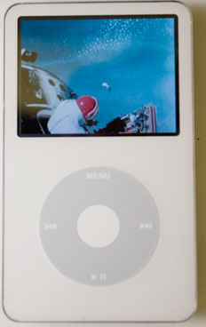
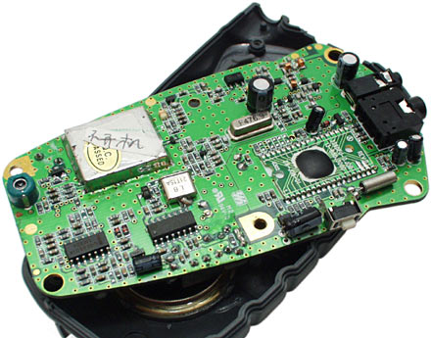
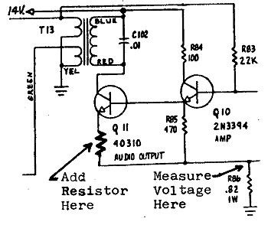
Encapsulation
encapsulation: Hiding implementation details from clients.
  Encapsulation forces abstraction.
    separates external view (behavior) from internal view (state)
    protects the integrity of an object's data

Slide 17
Private fields
A field that cannot be accessed from outside the class
  private type name;
  Examples:
  private int id;
  private String name;
Client code won't compile if it accesses private fields:
  PointMain.java:11: x has private access in Point
  System.out.println(p1.x);
  ^

Slide 18
Accessing private state
  // A "read-only" access to the x field ("accessor")
  public int getX() {
  return x;
  }
  // Allows clients to change the x field ("mutator")
  public void setX(int newX) {
  x = newX;
  }
  Client code will look more like this:
  System.out.println(p1.getX());
  p1.setX(14);

Slide 19
Point class, version 4
  // A Point object represents an (x, y) location.
  public class Point {
  private int x;
  private int y;
  public Point(int initialX, int initialY) {
  x = initialX;
  y = initialY;
  }
  public int getX() {
  return x;
  }
  public int getY() {
  return y;
  }
  public double distanceFromOrigin() {
  return Math.sqrt(x * x + y * y);
  }
  // Can have individual setter’s as well
  public void setLocation(int newX, int newY) {
  x = newX;
  y = newY;
  }
  public void translate(int dx, int dy) {
  setLocation(x + dx, y + dy);
  }
  }

Slide 20
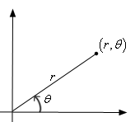
Benefits of encapsulation
Abstraction between object and clients
Protects object from unwanted access
  Example: Can't fraudulently increase an Account's balance.
Can change the class implementation later
  Example: Point could be rewritten in polar
  coordinates (r, θ) with the same methods.
Can constrain objects' state (invariants)
  Example: Only allow Accounts with non-negative balance.
  Example: Only allow Dates with a month from 1-12.

Slide 21
The this keyword
this : Refers to the implicit parameter inside your class.
  (a variable that stores the object on which a method is called)
  Refer to a field: this.field
  Call a method: this.method(parameters);
  One constructor this(parameters);
  can call another:

Slide 22
Variable shadowing
shadowing: 2 variables with same name in same scope.
  Normally illegal, except when one variable is a field.
  public class Point {
  private int x;
  private int y;
  ...
  // This is legal
  public void setLocation(int x, int y) {
  ...
  }
  In most of the class, x and y refer to the fields.
  In setLocation, x and y refer to the method's parameters.

Slide 23
Fixing shadowing
  public class Point {
  private int x;
  private int y;
  ...
  public void setLocation(int x, int y) {
  this.x = x;
  this.y = y;
  }
  }
Inside setLocation,
  To refer to the data field x, say this.x
  To refer to the parameter x, say x

Slide 24
Calling another constructor
  public class Point {
  private int x;
  private int y;
  public Point() {
  this(0, 0); // calls (x, y) constructor
  }
  public Point(int x, int y) {
  this.x = x;
  this.y = y;
  }
  ...
  }
    Avoids redundancy between constructors
    Only a constructor (not a method) can call another constructor

