Slide 1
Complexity and Classes
CSCI 162 – Introduction to Programming II
William Killian

Slide 2
Complexity
Two types
Speed – Relate operations to input size
Space – Relate # bytes to input size
Big-O notation
Machine-independent means for specifying efficiency (complexity)
Concerned with asymptotic behavior
Generally count most significant factor and relate to input size (N)
  Example: if T(N) = 9N2 + 43N + 7 then the algorithm is O(N²)

Slide 3
Complexity
Can analyze
  Best case
  Average
  Worst (default) – maximum # of ops.
Example: linear search time complexity
  int[] A = { … };
  for (int i = 0; i < N; ++i)
  if (A[i] == searchValue)
  break;
  What’s the best case? Worst case? Average case?
  For worst case, T(N) = ? = O(?)

Slide 4
Complexity
for (i = N - 1; i > 0; --i)
for (j = 0; j < i; ++j)
if (A[j] > A[j + 1])
swap (A[j], A[j + 1]);
What type of algorithm is this?
What operation should we count?
What’s the worst case?
  For worst case, T(N) = ? = O(?)

Slide 5
Classes

Slide 6
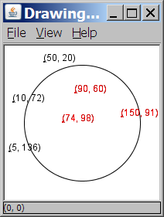
A programming problem
Given a file of cities' (x, y) coordinates,
which begins with the number of cities:
  6
  50 20
  90 60
  10 72
  74 98
  5 136
  150 91
Write a program to draw the cities on a DrawingPanel, then drop a "bomb" that turns all cities red that are within a given radius:
  Blast site x? 100
  Blast site y? 100
  Blast radius? 75
  Kaboom!

Slide 7
A bad solution
  Scanner input = new Scanner(new File("cities.txt"));
  int cityCount = input.nextInt();
  int[] xCoords = new int[cityCount];
  int[] yCoords = new int[cityCount];
  for (int i = 0; i < cityCount; i++) {
  xCoords[i] = input.nextInt(); // read each city
  yCoords[i] = input.nextInt();
  }
  ...
parallel arrays: 2+ arrays with related data at same indexes.
  Sometimes considered poor style

Slide 8
Observations
The data in this problem is a set of points.
It would be better stored as Point objects.
  A Point would store a city's x/y data.
  We could compare distances between Points
  to see whether the bomb hit a given city.
  Each Point would know how to draw itself.
  The overall program would be shorter and cleaner.

Slide 9

Clients of objects
client program: A program that uses objects.
  Example: Bomb is a client of DrawingPanel, Graphics
Bomb.java (client program)
public class Bomb {
main(String[] args) {
new DrawingPanel(...)
new DrawingPanel(...)
...
}
}
DrawingPanel.java (class)
public class DrawingPanel {
...
}

Slide 10
Classes and objects
class: A program entity that represents either:
  1. A program / module, or
  2. A template for a new type of objects.
  The DrawingPanel class is a template for creating DrawingPanel objects.
object: An entity that combines state and behavior.
  object-oriented programming (OOP): Programs that perform their behavior as interactions between objects.

Slide 11
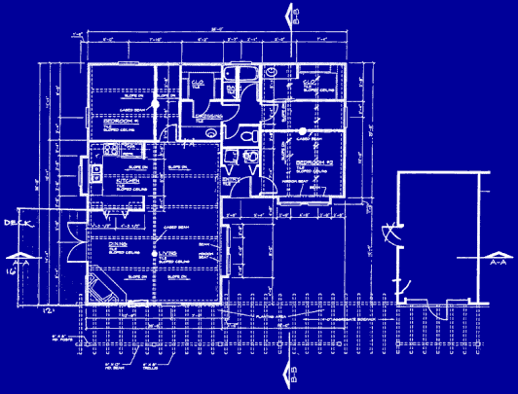
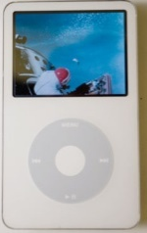
Blueprint analogy
iPod blueprint
state:
current song
volume
battery life
behavior:
power on/off
change station/song
change volume
choose random song
creates
iPod #1
state:
song = “100 Years”
volume = 17
battery life = 2.5 hrs
behavior:
power on/off
change station/song
change volume
choose random song
iPod #2
state:
song = “Nothing Man”
volume = 9
battery life = 3.41 hrs
behavior:
power on/off
change station/song
change volume
choose random song
iPod #3
state:
song = “We Belong”
volume = 24
battery life = 1.8 hrs
behavior:
power on/off
change station/song
change volume
choose random song

Slide 12

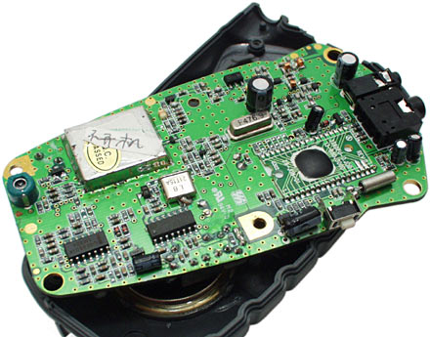
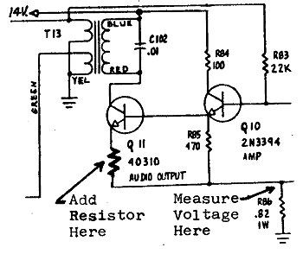
Abstraction
abstraction: A distancing between ideas and details.
  We can use objects without knowing how they work.
abstraction in an iPod?
  You understand its external behavior (buttons, screen).
  You don't understand its inner details, and you don't need to.

Slide 13
Our task
We will implement a Point class as a way of learning about defining classes.
  We will define a type of objects named Point.
  Each Point object will contain x/y data called fields.
  Each Point object will contain behavior called methods.
  Client programs will use the Point objects.

Slide 14
Point objects (desired)
  Point p1 = new Point(5, -2);
  Point p2 = new Point(); // origin, (0, 0)
Data in each Point object:
Methods in each Point object:
Field name | Description
x | the point's x-coordinate
y | the point's y-coordinate
Method name | Description
setLocation(x, y) | sets the point's x and y to the given values
translate(dx, dy) | adjusts the point's x and y by the given amounts
distance(p) | how far away the point is from point p
draw(g) | displays the point on a drawing panel

Slide 15
Point class as blueprint
Point class
state:
int x, y
behavior:
setLocation(int x, int y)
translate(int dx, int dy)
distance(Point p)
draw(Graphics g)
  The class (blueprint) will describe how to create objects.
  Each object will contain its own data and methods.
Point object #1
state:
x = 5, y = -2
behavior:
setLocation(int x, int y)
translate(int dx, int dy)
distance(Point p)
draw(Graphics g)
Point object #2
state:
x = -245, y = 1897
behavior:
setLocation(int x, int y)
translate(int dx, int dy)
distance(Point p)
draw(Graphics g)
Point object #3
state:
x = 18, y = 42
behavior:
setLocation(int x, int y)
translate(int dx, int dy)
distance(Point p)
draw(Graphics g)

Slide 16
Object state: Fields

Slide 17
Point class, version 1
  public class Point {
  int x;
  int y;
  }
  Save this code into a file named Point.java.
The above code creates a new type named Point.
  Each Point object contains two pieces of data:
    an int named x, and
    an int named y.
  Point objects do not contain any behavior (yet).

Slide 18
Fields
field: A variable inside an object that is part of its state.
  Each object has its own copy of each field.
Declaration syntax:
  type name;
  Example:
  public class Student {
  String name;
  double gpa;
  }

Slide 19
Accessing fields
Other classes can access/modify an object's fields.
  access: variable.field
  modify: variable.field = value;
Example:
  Point p1 = new Point();
  Point p2 = new Point();
  System.out.println("the x-coord is " + p1.x);
  p2.y = 13;

Slide 20
A class and its client
Point.java is not, by itself, a runnable program.
  A class can be used by client programs.
Point.java (class of objects)
public class Point {
int x;
int y;
}
PointMain.java (client program)
public class PointMain {
main(String args) {
Point p1 = new Point();
p1.x = 7;
p1.y = 2;
Point p2 = new Point();
p2.x = 4;
p2.y = 3;
...
}
}
x | 7 | y | 2
x | 4 | y | 3

Slide 21
PointMain client example
public class PointMain {
public static void main(String[] args) {
// Create two Point objects
Point p1 = new Point();
p1.y = 2;
Point p2 = new Point();
p2.x = 4;
System.out.println(p1.x + ", " + p1.y); // 0, 2
// Move p2 and then print it
p2.x += 2;
p2.y++;
System.out.println(p2.x + ", " + p2.y); // 6, 1
}
}

Slide 22
Arrays of objects
null : A value that does not refer to any object.
  The elements of an array of objects are initialized to null.
  String[] words = new String[5];
  DrawingPanel[] windows = new DrawingPanel[3];
index | 0 | 1 | 2 | 3 | 4
value | null | null | null | null | null
words
index | 0 | 1 | 2
value | null | null | null
windows

Slide 23
Things you can do with null
store null in a variable or an array element
  String s = null;
  words[2] = null;
print a null reference
  System.out.println(s); // null
ask whether a variable or array element is null
  if (words[2] == null) { ...
pass null as a parameter to a method
  System.out.println(null); // null
return null from a method (often to indicate failure)
  return null;

Slide 24
Null pointer exception
dereference: To access data or methods of an object with the dot notation, such as s.length() .
  It is illegal to dereference null (causes an exception).
  null is not any object, so it has no methods or data.
  String[] words = new String[5];
  System.out.println("word is: " + words[0]);
  words[0] = words[0].toUpperCase(); // ERROR
  Output:
  word is: null
  Exception in thread "main" java.lang.NullPointerException
  at Example.main(Example.java:8)
index | 0 | 1 | 2 | 3 | 4
value | null | null | null | null | null

Slide 25
Looking before you leap
You can check for null before calling an object's methods.
  String[] words = new String[5];
  words[0] = "hello";
  words[2] = "goodbye"; // words[1], [3], [4] are null
  for (int i = 0; i < words.length; i++) {
  if (words[i] != null) {
  words[i] = words[i].toUpperCase();
  }
  }
index | 0 | 1 | 2 | 3 | 4
value | "HELLO" | null | "GOODBYE" | null | null
words

Slide 26
Two-phase initialization
  1) initialize the array itself (each element is initially null)
  2) initialize each element of the array to be a new object
  String[] words = new String[4]; // phase 1
  for (int i = 0; i < words.length; i++) {
  coords[i] = "word" + i; // phase 2
  }
index | 0 | 1 | 2 | 3
value | "word0" | "word1" | "word2" | "word3"
words
Exercise: Modify the Bomb program to use Point objects.

Slide 27
Bomb answer 1
import java.awt.*;
import java.io.*;
import java.util.*;
// Displays a set of cities and simulates dropping a "bomb" on them.
public class Bomb {
public static void main(String[] args) throws FileNotFoundException {
DrawingPanel panel = new DrawingPanel(200, 200);
Graphics g = panel.getGraphics();
Scanner input = new Scanner(new File("cities.txt"));
Point[] cities = readCities(input, g);
// drop the "bomb"
Scanner console = new Scanner(System.in);
// Create a Point object for the bomb
System.out.print("Blast site x? ");
???? = console.nextInt();
System.out.print("Blast site y? ");
???? = console.nextInt();
System.out.print("Blast radius? ");
int radius = console.nextInt();
boom(bomb, radius, cities, g);
}
...

Slide 28
Bomb answer 2
// Reads input file of cities and returns them as array of Points.
public static Point[] readCities(Scanner input, Graphics g) {
int numCities = input.nextInt(); // first line = # of cities
// Create cities array...
for (int i = 0; i < cities.length; i++) {
// Build a point object and place in array
?????? = input.nextInt(); // read city x/y from file
?????? = input.nextInt();
g.fillOval(x, y, 3, 3); // what should x and y be?
g.drawString("(" + x + ", " + y + ")", x, y);
}
return cities;
}
// Simulates dropping a bomb at the given location on the given cities.
public static void boom(Point bomb, int radius, Point[] cities, Graphics g) {
g.setColor(Color.RED);
g.drawOval(bomb.x - radius, bomb.y - radius, 2 * radius, 2 * radius);
for (int i = 0; i < cities.length; i++) {
int dx = cities[i].x - bomb.x;
int dy = cities[i].y - bomb.y;
double distance = Math.sqrt(dx * dx + dy * dy);
if (distance <= radius) {
g.fillOval(cities[i].x, cities[i].y, 3, 3);
g.drawString("(" + cities[i].x + ", " + cities[i].y + ")", cities[i].x, cities[i].y);
}
}
System.out.println("Kaboom!");
}
}

Slide 29
Object behavior: Methods

Slide 30
Client code redundancy
Our client program wants to draw Point
objects:
  // Draw each city
  g.fillOval(cities[i].x, cities[i].y, 3, 3);
  g.drawString("(" + cities[i].x + ", "
  + cities[i].y + ")",
  cities[i].x, cities[i].y);
To draw them in other places, the code must be repeated.
  We can remove this redundancy using a method.

Slide 31
Eliminating redundancy, v1
We can eliminate the redundancy with a static method:
  // Draws the given point on the DrawingPanel.
  public static void draw(Point p, Graphics g) {
  g.fillOval(p.x, p.y, 3, 3);
  g.drawString("(" + p.x + ", " + p.y + ")", p.x, p.y);
  }
main would call the method as follows:
  // draw each city
  draw(cities[i], g);

Slide 32
Problem with static method
We are missing a major benefit of objects: code reuse.
  Every program that draws Points would need a draw method.
The syntax doesn't match how we're used to using objects.
  draw(cities[i], g); // static (bad)
The point of classes is to combine state and behavior.
  The draw behavior is closely related to a Point's data.
  The method belongs inside each Point object.
  cities[i].draw(g); // inside object (better)

Slide 33
Instance methods
instance method (or object method): Exists inside each object of a class and gives behavior to each object.
  public type name(parameters) {
  statements;
  }
  same syntax as static methods, but without static keyword
  Example:
  public void shout() {
  System.out.println("HELLO THERE!");
  }

Slide 34
Instance method example
  public class Point {
  int x;
  int y;
  // Draws this Point object with the given pen.
  public void draw(Graphics g) {
  ...
  }
  }
  The draw method no longer has a Point p parameter.
  How will the method know which point to draw?
    How will the method access that point's x/y data?

Slide 35
Point objects w/ method
Each Point object has its own copy of the draw method, which operates on that object's state:
  Point p1 = new Point();
  p1.x = 7;
  p1.y = 2;
  Point p2 = new Point();
  p2.x = 4;
  p2.y = 3;
  p1.draw(g);
  p2.draw(g);
p1
public void draw(Graphics g) {
// this code can see p1's x and y
}
x | 7 | y | 2
public void draw(Graphics g) {
// this code can see p2's x and y
}
x | 4 | y | 3
p2

Slide 36
The implicit parameter
implicit parameter:
The object on which an instance method is called.
  During the call p1.draw(g);
  the object referred to by p1 is the implicit parameter.
  During the call p2.draw(g);
  the object referred to by p2 is the implicit parameter.
  The instance method can refer to that object's fields.
    We say that it executes in the context of a particular object.
    draw can refer to the x and y of the object it was called on.

Slide 37
Point class, version 2
  public class Point {
  int x;
  int y;
  // Draws this Point object.
  public void draw(Graphics g) {
  g.fillOval(x, y, 3, 3);
  g.drawString("(" + x + ", " + y + ")", x, y);
  }
  }
  Each Point object contains a draw method that draws that point at its current x/y position.

Slide 38
Kinds of methods
accessor: A method that lets clients examine object state.
  Examples: distance, distanceFromOrigin
  often has a non-void return type
mutator: A method that modifies an object's state.
  Examples: setLocation, translate

Slide 39
Mutator method questions
Write a method setLocation that changes a Point's location to the (x, y) values passed.
Write a method translate that changes a Point's location by a given dx, dy amount.
  Modify the Point and client code to use these methods.

Slide 40
Mutator method answers
public void setLocation(int newX, int newY) {
x = newX;
y = newY;
}
public void translate(int dx, int dy) {
x = x + dx;
y = y + dy;
}
// alternative solution that utilizes setLocation
public void translate(int dx, int dy) {
setLocation(x + dx, y + dy);
}

Slide 41
Accessor method questions
Write a method distance that computes the distance between a Point and another Point parameter.
Use the formula:
Write a method distanceFromOrigin that returns the distance between a Point and the origin, (0, 0).
  Modify the client code to use these methods.

