Slide 1
Software Engineering and Algorithm Complexity
CSCI 162 – Introduction to Programming II
William Killian

Slide 2
Data Structures/Algorithms
Programs = Data Structures + Algorithms
Data Structures
  (Efficient) storage and manipulation of (large) data sets
  Arrays, linked lists, trees
  Used to implement abstract data types (ADTs) like set, list
Algorithms
  Operations on data
  Find, insert, erase, sort, reverse
Object-oriented programming (OOP)
  A method of programming that emphasizes information hiding and component reuse

Slide 3
Software Development
Software Engineering
  Study of and an application of engineering to the design, development, and maintenance of software
  Focus: controlling the development process to achieve consistently good results
We want to
  satisfy the client – the person or organization who sponsors the development
  meet the needs of the user – the people using the software for its intended purpose

Slide 4
Software Development

Slide 5
Software Development (Cont’d) [ISO/IEC 12207]
Specification
Design
Implementation
Testing, Debugging, Analysis
Maintenance, Evolution

Slide 6
Specifications and Design
Requirements define needed info, functionality, behavior, and performance of the system
Resources specifies people, equipment, software, time, and money available
Specifications describe precisely what the software should do
Design describes how the software meets the specifications
Implementation: translating the design into a specified programming language(s)
  Follow style guidelines
  Don’t change the design without going to a previous phase

Slide 7
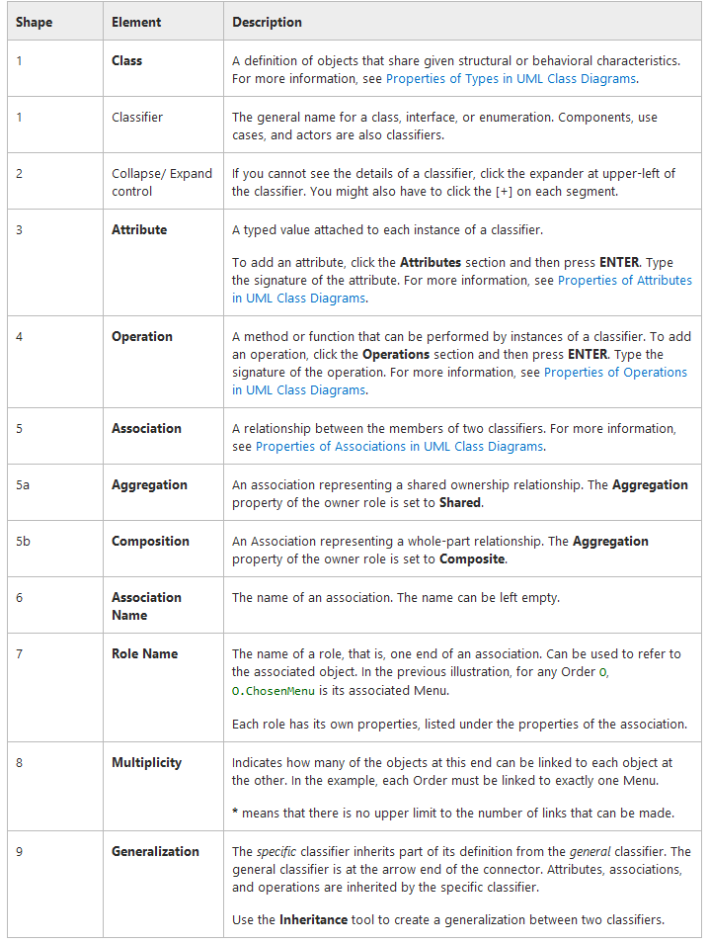
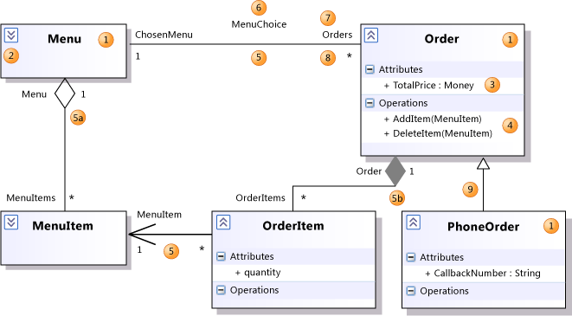
Design Languages like UML

Slide 8
Testing and Analysis
Find bugs before user does
Alpha versus beta testing
Regression testing
Integration testing
Top-down versus bottom-up
Must consider
  Boundary/edge cases (e.g., for sqrt function?)
  Exceptional cases
  Expected error cases
Analysis (or validation): How well does the implementation meet the specifications?

Slide 9
Lubarsky’s Law of Cybernetic Entomology
There’s always one more bug!

Slide 10
Brook’s Law
Adding more programmers to a late software project makes it later.

Slide 11
Deadline-Dan’s Demon
Every task takes twice as long as you think it will. If you double the time you think it will take, it will take 4 times as long.

Slide 12
Gilb’s 2nd Law of Unreliability
Any system that depends on human reliability is inherently unreliable.

Slide 13
Murphy’s Law
Just Kidding ☺
Anything that can go wrong will.

Slide 14
Preconditions and Postconditions
Use preconditions and postconditions
  specifies what a method does
  not how it does it
Precondition
  what must be true before method is called
Postcondition
  what will be true when method finishes

Slide 15
Example
// Precondition: x >= 0.
// Postcondition: The square root of x has
// been written to the standard output.
public void writeSqrt (double x) {
...
}

Slide 16
Example – Which calls are problematic?
writeSqrt (-10);
writeSqrt (0);
writeSqrt (5.6);
If precondition is met, the postcondition MUST be true when the method terminates

Slide 17
Example
// Precondition: letter is an uppercase or
// lowercase letter (in the range 'A'...'Z'
// or 'a'...'z').
// Postcondition: The value returned by the
// method is true if letter is a vowel;
// otherwise the value returned by the method is
// false.
public boolean isVowel (char letter) {
...
}

Slide 18
Example
What does each call return?
isVowel (‘A’);
isVowel (‘Z’);
isVowel (‘?’);
Violating a precondition results in undefined behavior

Slide 19
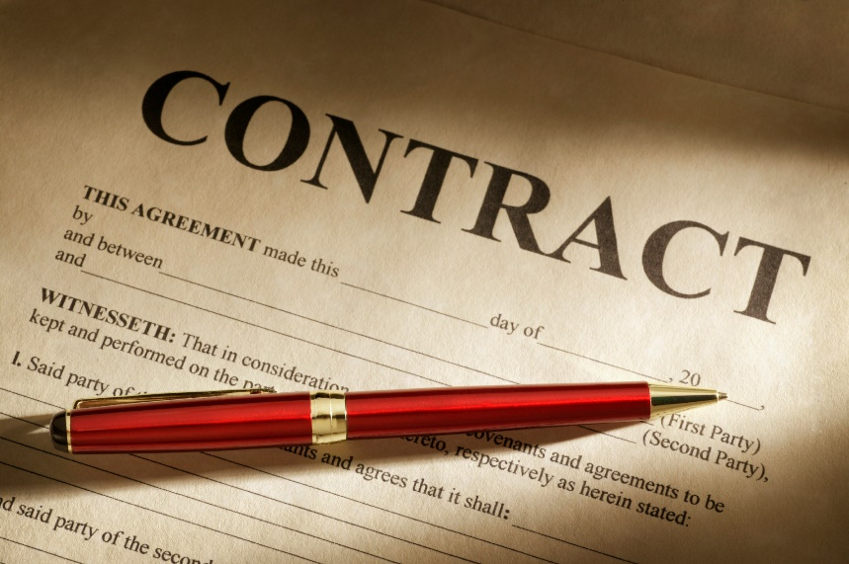
Contracts
Programmer who calls a method
  must ensure the precondition is met
Programmer who writes a method
  may assume the precondition is true
  must ensure that the postcondition becomes true when the method ends

Slide 20
Responsibilities
If you call my writeSqrt method with a negative value, my method is free to reformat your hard drive!
However…

Slide 21

Responsibilities
Make every effort to detect when a precondition has been violated
Emit an error message and/or halt the program if violation detected

Slide 22
Example
// Precondition: x >= 0.
// Postcondition: The square root of x has
// been written to the standard output.
public void writeSqrt (double x) {
if (x < 0)
throw new
IllegalArgumentException (“negative x”);
...
}

Slide 23
Advantages of Preconditions and Postconditions
Succinctly describes the behavior of a method
Doesn’t clutter thoughts with details of how the method works
Allows for later re-implementing the method in a new way
Doesn’t break callers if they only depend on the preconditions/postconditions
Notes:
Here are the primary advantages to using a method such as preconditions/postconditions to specify what a method accomplishes without giving details of how the method works.
One of the important advantages has to do with reimplementations. Often a programmer will think of a better method to accomplish some computation. If the computation is part of a method that includes a precondition/postcondition pair, then the method can be rewritten and the new, better method used instead. Any program which uses the method (and which only depends on the precondition/postcondition contract) can use the new improved method with no other changes.

Slide 24
Summary
Precondition
The programmer who calls a method ensures that the precondition is valid.
The programmer who writes a method can bank on the precondition being true when the method begins execution.
Postcondition
The programmer who writes a method ensures that the postcondition is true when the method finishes executing.

Slide 25
Complexity

Slide 26
Complexity
Two types
Speed – Relate operations to input size
Space – Relate # bytes to input size
Big-O notation
Machine-independent means for specifying efficiency (complexity)
Concerned with asymptotic behavior
Generally count most significant factor and relate to input size (N)
  Example: if T(N) = 9N2 + 43N + 7 then the algorithm is O(N²)

Slide 27
Complexity
Can analyze
  Best case
  Average
  Worst (default) – maximum # of ops.
Example: linear search time complexity
  int[] A = { … };
  for (int i = 0; i < N; ++i)
  if (A[i] == searchValue)
  break;
  What’s the best case? Worst case? Average case?
  For worst case, T(N) = ? = O(?)

Slide 28
Complexity
for (i = N - 1; i > 0; --i)
for (j = 0; j < i; ++j)
if (A[j] > A[j + 1])
swap (A[j], A[j + 1]);
What type of algorithm is this?
What operation should we count?
What’s the worst case?
  For worst case, T(N) = ? = O(?)

