Slide 1
Christopher Daley
GPUs for Science July 2 2019
OpenMP: A technical overview

Slide 2
Overview
OpenMP works extremely well on the CPU:
#pragma omp parallel for [simd?]
for (j=0; j<N; j++)
a[j] = b[j] + scalar*c[j];
How do we use OpenMP on GPUs?
How well does it perform?

Slide 3
OpenMP thread hierarchy for accelerators
#pragma omp target
Execute code on device
#pragma omp teams
No synchronization between thread teams except for atomics
No barrier, critical section or locks
League of N teams
#pragma omp parallel
Model familiar to OpenMP < 4.0 programmers
Team 0
M threads
Team 1
M threads
Team 2
M threads
(Image modified from “OpenMP 4.5 target” by Tom Scogland and Oscar Hernandez. Presented at ECP OpenMP tutorial 06-28-2017)
Notes:
Target: transfers control to the device
Team parallelism: restrictive coarse-grained parallelism – loosely coupled

Slide 4
A 1st OpenMP target offload program
#define N 128
double x[N*N];
int i, j, k;
for (k=0; k<N*N; ++k) x[k] = k;
#pragma omp target
#pragma omp teams distribute
for (i=0; i<N; ++i) {
#pragma omp parallel for
for (j=0; j<N; ++j) {
x[j+N*i] *= 2.0;
}
}
OpenMP implicitly moves data between the host and device:
Array “x” mapped to and from
Scalars are made firstprivate
Distribute for loop iterations between teams
Distribute for loop iterations between threads
Notes:
This is a valid OpenMP offload program

Slide 5
Data management must be explicit when using pointer variables
#define N 100
double *p = malloc(N * sizeof(*p));
#pragma omp parallel for
for (int i=0; i<N; ++i) p[i] = 2.0;
#pragma omp target map(tofrom:p[0:N])
#pragma omp teams distribute parallel for
for (int i=0; i<N; ++i) p[i] *= 2.0;
Value of P[0] at different times
Time | Host | Device
A | 2.0 | N/A
B | 2.0 | 2.0
C | 2.0 | 4.0
D | 4.0 | N/A
A
B
C
D
“target data” can be used to keep data on the device for multiple target regions
Notes:
Same pointer name used in host and device environments
Programmer responsibility to keep the values consistent as needed
Data directives move data between host and device address spaces

Slide 6
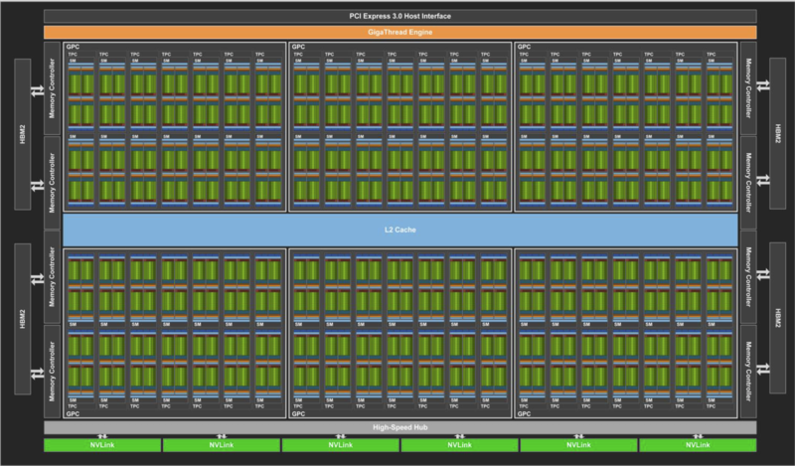
OpenMP on an NVIDIA V100 GPU
80 Streaming Multiprocessors (SMs)
160 CUDA cores per SM
Execute on multiple SMs
OpenMP teams distribute (XL, Clang, Cray, GNU)
Execute on multiple CUDA cores
OpenMP parallel for (XL, Clang)
OpenMP simd (Cray)
OpenMP parallel for simd (GNU)
(Image from “NVIDIA Tesla V100 GPU Architecture” whitepaper)
Notes:
Hardware (left); Software (right)
160 CUDA cores per SM: 64 FP32 / 64 INT32 / 32 FP64 CUDA cores per SM
1/80th of the performance if you don’t use teams distribute
Cray can sometimes auto-parallelize parallel for OpenMP constructs onto GPU threads
GNU maps to GPU warps and threads

Slide 7
Can OpenMP applications achieve high performance on GPUs?
We evaluated 5 OpenMP benchmarks on two platforms with NVIDIA V100 GPUs
STREAM
Matrix transpose
Laplace equation
BerkeleyGW mini-app
SPEC-ACCEL
Cori-GPU
2 x Intel Skylake CPUs
8 x NVIDIA V100 GPUs PGI-19.1 (OpenACC)
Cray-8.7.7
Clang-9.0.0-git
GCC-8.1.1-git Intel-19.0.3.199 (CPU-only)
Summit
2 x IBM Power 9 CPUs
6 x NVIDIA V100 GPUs
XL-16.1.1
Benchmarks always use 1 CPU socket and 1 GPU and fit in GPU memory capacity
Notes:
How does the performance of OpenMP on GPUs compare between compilers?
Can OpenMP applications using OpenMP target directives achieve high performance on CPUs?

Slide 8
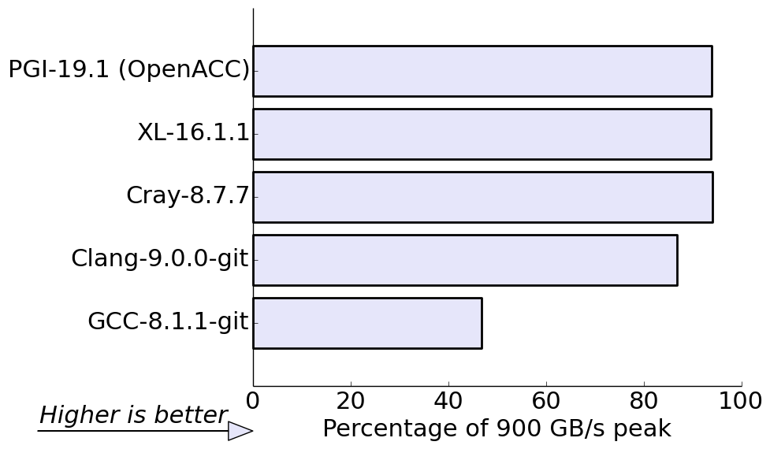
#1 STREAM benchmark: Most compilers obtain close to peak memory bandwidth
#pragma omp target teams distribute parallel for [simd?]
for (j=0; j<N; j++)
a[j] = b[j] + scalar*c[j];
The simd construct is not needed for Cray compiler but is needed for the GCC compiler.
Notes:
Recommended combination of OpenMP directives
GCC results are 17% of peak without simd

Slide 9
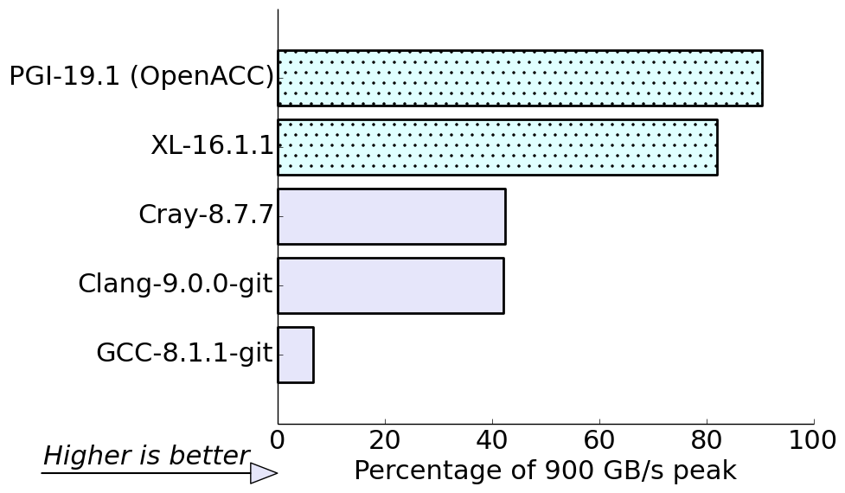
#2 Transpose benchmark: More of a performance difference between compilers
#pragma omp target teams distribute parallel for collapse(2)
for (y = 0; y < NY; ++y)
for (x = 0; x < NX; ++x)
odata[IDX(x,y)] = idata[IDX(y,x)];
Tiling the two loops above improves L1 cache reuse Two compilers can use GPU shared memory to obtain higher performance
PGI – pragma acc cache
XL – team private array
Notes:
A transpose involves either strided reads or writes.
If we stopped at loop tiling then PGI and XL performance would be about the same as Cray and Clang

Slide 10
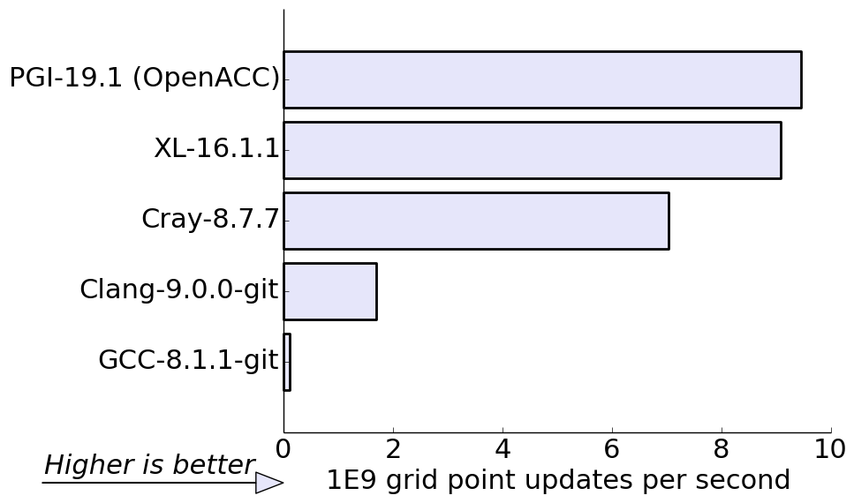
#3 Laplace equation benchmark: Open-source compilers are less competitive
The Jacobi relaxation calculation involves a stencil update and data reduction
Slow kernel launch time and OpenMP reductions in the open-source compilers
Notes:
A Laplace equation benchmark highlights the latency sensitivity of LLVM/Clang compiler; more competitive for larger problem sizes
A relatively small array size of 1000x1000 causes frequent kernel launches and data reductions

Slide 11
Productivity: Can OpenMP target regions run efficiently on the host CPU?
#pragma omp target teams distribute parallel for
versus #pragma omp parallel for
An OpenMP target region will run on the host CPU when
Compiling the application with a compiler flag setting the target device to host
Using an if clause on the OpenMP target construct
Setting the environment variable OMP_TARGET_OFFLOAD to DISABLED (OpenMP-5.0)

Slide 12
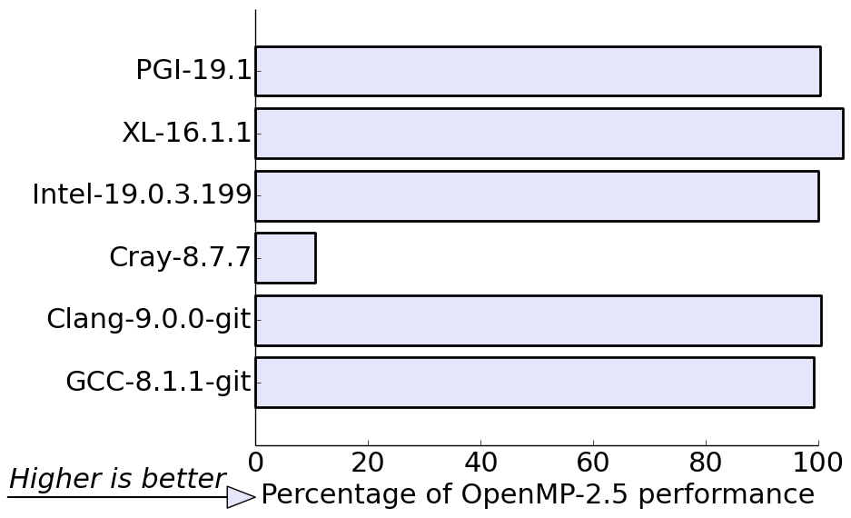
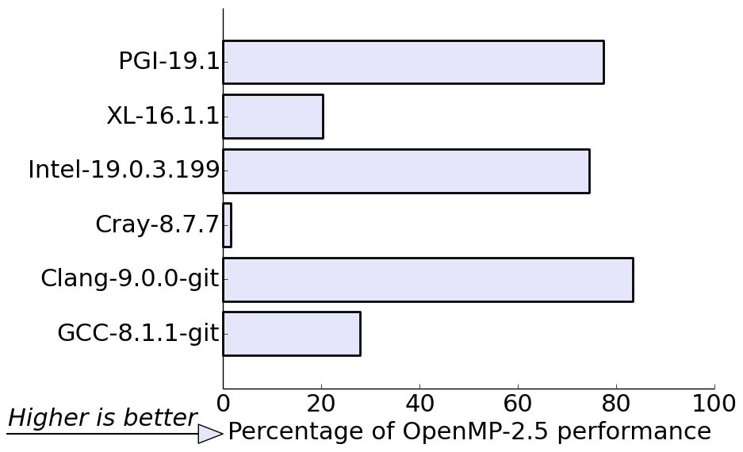
OpenMP target version is slower on the host CPU than OpenMP parallel for loops
STREAM Triad
O(1-10ms) per kernel
Laplace (grid size of 1000²)
O(100µs) per kernel
Slow + incorrect results!
Notes:
Sensitivity to problem size indicates extra latency when using OpenMP target directives on the host

Slide 13
This motivates using different OpenMP constructs for CPU and GPU execution
Using preprocessor:
#ifdef GPU
# pragma omp target teams distribute parallel for
#else
# pragma omp parallel for
#endif
for (i=0; i<N; ++i) y[i] = a*x[i];
Using OpenMP-5.0 metadirective:
#pragma omp metadirective \
when(device={arch(gpu)}: target teams distribute parallel for) \
default( parallel for))
for(i=0; i<N; ++i) y[i] = a*x[i];

Slide 14
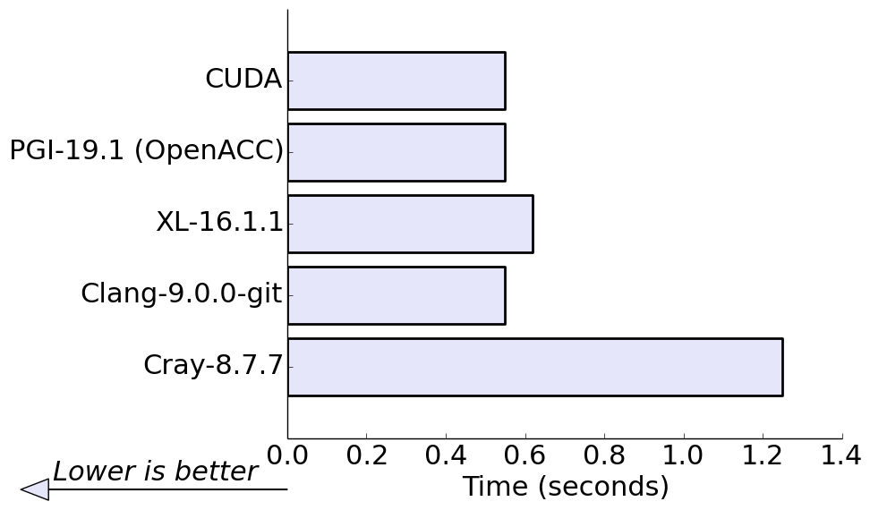
#4 GPP benchmark: 3 compilers are within 15% of tuned CUDA
The GPP mini-app contains the self-energy computation from the material science application, BerkeleyGW
The mini-app has a single compute-bound GPU kernel invoked once
GCC = 28.5s
Results from: Rahul Gayatri, “Optimizing Large Reductions in BerkeleyGW on GPUs Using OpenMP and OpenACC”, NVIDIA GTC-2019
Notes:
BerkeleyGW computes the excited state properties of materials
Single long-running kernel does not reveal slow kernel launch and OpenMP reductions with LLVM/Clang

Slide 15
Placing all OpenMP constructs on 1 line helps GPP performance across compilers
This simplifies compiler code generation and allows us to ignore the compiler-specific mapping of loop constructs to GPU hardware
// The LLVM/Clang compiler refers to this as an “SPMD” code pattern #pragma omp target teams distribute parallel for simd collapse(2) \
reduction(+:ach_re0, ...)
for(...) {
for(...) {
for(...) {
for(...) {
// ...
simd is needed to avoid a 62x slow-down with the Cray compiler. It does not affect XL or Clang performance
Notes:
All threads execute all code vs the team master thread executes all code and wakes up worker threads to execute parallel region

Slide 16
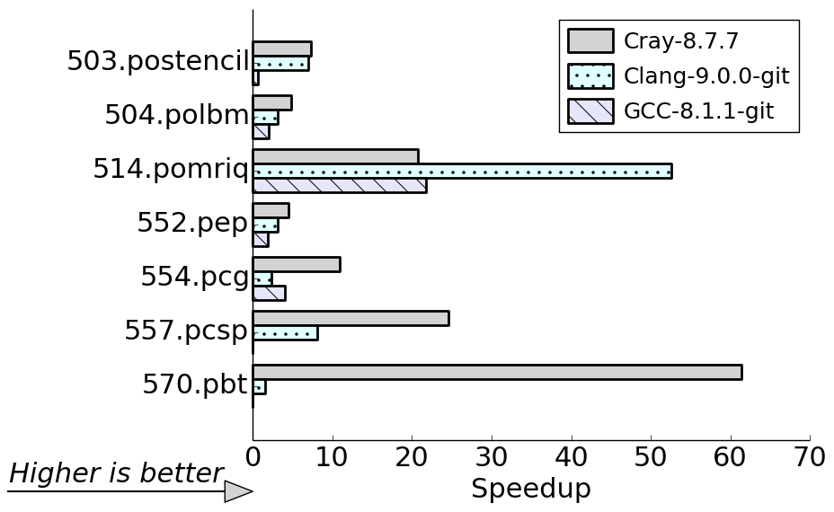
#5 SPEC-ACCEL: Cray and LLVM/Clang correctly run all the C benchmarks
Cray has the highest performance in 6/7 benchmarks
39x performance difference between Cray and LLVM/Clang!
Notes:
OpenMP loop construct placement hurts LLVM/Clang performance
OpenMP C benchmark
503.postencil: Iterative Jacobi solver
504.polbm: Lattice Boltzmann Method (LBM) solver
514.pomriq: Image reconstruction
552.pep: Embarrassingly parallel math w/reduction
554.pcg: Conjugate Gradient solver
557.pcsp: Scalar Penta-diagonal solver
570.pbt: Block Tridiagonal Solver

Slide 17
Loop construct mapping explains 39x performance difference for 570.pbt
Must move “parallel for” to innermost loop for LLVM/Clang
#pragma omp target teams distribute parallel for private(i,k)
for (j = 1; j <= gp12; j++) {
for (i = 1; i <= isize-1; i++) {
#pragma omp simd private(pivot,coeff)
for (k = 1; k <= gp22; k++) {
100 iterations in each of j, i, k loops
 | Before (s) | After (s)
Cray | 5.0 | 5.0
LLVM/Clang | 440.4 | 3.6
Table shows total time in 3 kernels: x_solve.c:708 (code fragment above) y_solve.c:689 z_solve.c:691

Slide 18
Preparing OpenMP applications for the CPU+GPU nodes of Perlmutter
Try to use combined OpenMP compute constructs #pragma omp target teams distribute parallel for simd collapse(N)
Minimize use of double/triple pointers and nested data structures in offloaded code regions
More complicated to map between host and device
Unlikely to perform well
More data transfers between CPU and GPU
Indirection in GPU kernels prevents coalesced memory access
Test your application using the OpenMP compilers on Cori-GPU: we recommend LLVM/Clang for C/C++ and Cray for Fortran
Notes:
It is easier to migrate to OpenMP target offload if you avoid complicated data structures and pointer indirection in offloaded code sections

Slide 19
OpenMP in Perlmutter timeframe
NEW: The PGI compiler will provide OpenMP GPU acceleration
Part of an NRE effort between NERSC and NVIDIA/PGI
The open-source Clang/Flang compilers will continue to improve
OpenMP-5.0 features will help productivity and performance on GPUs
Unified Virtual Memory: Easier to get up and running on the GPU even with codes containing double/triple pointers, nested data structures and C++ STL containers
Please be aware that these programming abstractions may not perform well on the GPU
Memory Allocators: Enables portable use of GPU shared memory

Slide 20
Conclusions
Directive-based programs can perform close to the hardware peak / CUDA
The XL compiler shows that OpenMP performance can be competitive with OpenACC
We expect PGI’s OpenMP compiler to perform well on Perlmutter
Performance portability remains a challenge
Short-running OpenMP target regions are not competitive on CPUs
Compilers map OpenMP constructs to GPUs in different ways
Combined constructs mitigate this issue
Notes:
“SPMD” code patterns can help achieve high performance across compilers

Slide 22
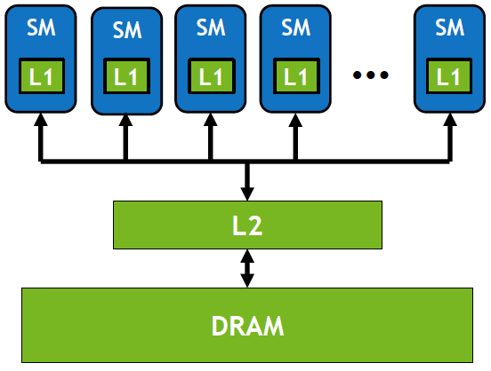
The V100 memory hierarchy and the matrix transpose algorithm
128 KB combined L1 / shared memory per SM
1. Tile loops to use L1 cache
2. Tile loops and do the transpose in a team private array allocated in GPU shared memory -- IBM compiler only
(Image from “VOLTA Architecture and performance optimization” by Guillaume Thomas-Collignon and Paulius Micikevicius at GTC-2018)
Notes:
We can tile the matrix transpose loops into 32x32 tiles (8 KiB) so that the data from multiple thread teams (CUDA thread blocks) can fit into the fast memory

Slide 23
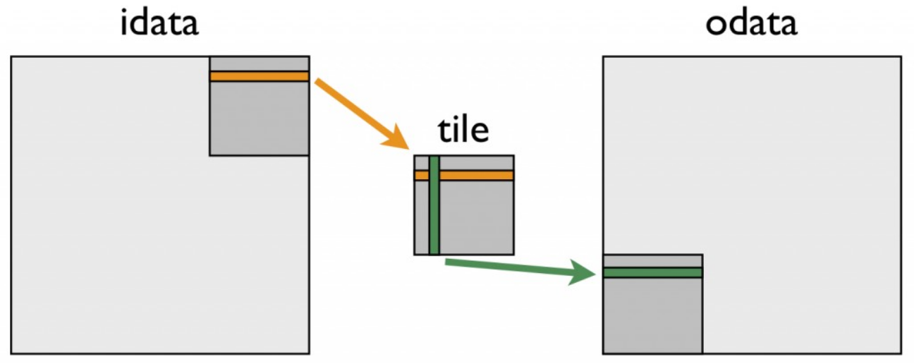
Structuring the matrix transpose to use GPU shared memory with IBM compiler
#pragma omp target teams distribute collapse(2)
for (xtile = 0; xtile < NX; xtile += TILE_DIM) {
for (ytile = 0; ytile < NY; ytile += TILE_DIM) {
double tile[TILE_DIM][TILE_DIM+1];
# pragma omp parallel for collapse(2)
// ... for loops to do the transpose
(Image from “An Efficient Matrix Transpose in CUDA C/C++” by Mark Harris for Nvidia web article)
All strided accesses involve “tile” array only
Notes:
+1 is to stop shared memory bank conflicts. https://devblogs.nvidia.com/using-shared-memory-cuda-cc/ “To minimize bank conflicts, it is important to understand how memory addresses map to memory banks. Shared memory banks are organized such that successive 32-bit words are assigned to successive banks and the bandwidth is 32 bits per bank per clock cycle. For devices of compute capability 1.x, the warp size is 32 threads and the number of banks is 16. A shared memory request for a warp is split into one request for the first half of the warp and one request for the second half of the warp. Note that no bank conflict occurs if only one memory location per bank is accessed by a half warp of threads.”

Slide 24
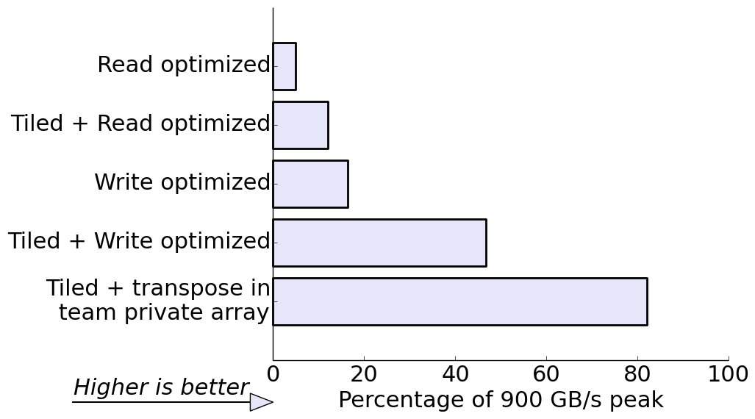
Performance is highest when using the GPU shared memory resource
Matrix transpose with IBM XL-16.1.1
gld_efficiency (%) | gst_efficiency (%)
100 | 25
100 | 25
25 | 100
25 | 100
100 | 100
A 25% efficiency indicates that only 8 bytes are used in each 32 byte memory sector
Notes:
Highest memory bandwidth when reads and writes to global memory are coalesced
Memory system moves data in 32 byte sectors
gld_efficiency and gst_efficiency show the memory access pattern
Tiling does not affect the memory access pattern but more memory requests hit in L1 cache (and thus there are fewer DRAM transactions)

Slide 25
Code-gen paths in LLVM/Clang
SPMD mode (fast) As used in GPP
General mode (slower) As used in 570.pbt
#pragma omp target teams distribute \
parallel for collapse(2)
for (j=0; j<N; ++j) {
for (i=0; i<N; ++i) {
// .. do work ..
#pragma omp target teams distribute
// User code in between target // and parallel regions
for (j=0; j<N; ++j) {
#pragma omp parallel for
for (i=0; i<N; ++i) {
// .. do work ..
All threads execute all code
The team master thread executes all code and wakes up worker threads to execute parallel region

Slide 26
OpenMP target offload compilers on Cori-GPU
LLVM/Clang is the most robust OpenMP offload compiler on Cori-GPU
Upstream: PrgEnv-llvm/9.0.0-git_20190220
Patched branch supports calls to math.h functions in OpenMP target regions: PrgEnv-llvm/9.0.0-git-patched-upstream_20190305
The Cray compiler delivers good performance but sometimes fails to compile relatively simple programs
It is the best option for Fortran applications on Cori-GPU
The GNU compiler generally delivers very poor performance
Please see https://docs-dev.nersc.gov/cgpu/software/

Slide 27
STREAM performance is unaffected by use of Unified Memory
The code fragment shows how to combine OpenMP-4.5 and CUDA to use unified memory
cudaMallocManaged((void**)&a, sizeof(double) * N); cudaMallocManaged((void**)&b, sizeof(double) * N); cudaMallocManaged((void**)&c, sizeof(double) * N); #pragma omp target teams distribute \ parallel for is_device_ptr(a, b, c)
for (j=0; j<N; j++)
a[j] = b[j] + scalar*c[j];
Note: STREAM benchmark excludes data transfer time between CPU and GPU
Notes:
LLVM/Clang achieves ~800 GB/s whether we are using unified memory or not

Slide 28
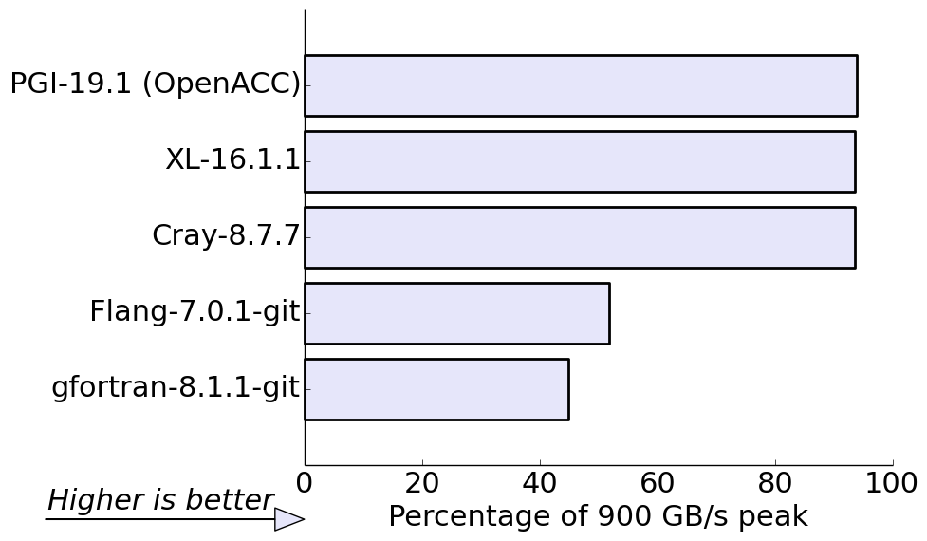
Flang provides an initial implementation of OpenMP target offload to NVIDIA GPUs
STREAM Triad in Fortran
The Flang compiler currently only supports “SPMD” mode
It has many bugs and is not ready for general use yet
It did achieve over 450 GB/s for STREAM Triad on Nvidia V100 - the same as Clang-7.0.1

Slide 29
Programmability concern #1: mapping nested data structures
#define N 10
typedef struct myvec {
size_t len;
double *data;
} myvec_t;
myvec_t *p = init_myvec(N);
#pragma omp target enter data map(p[0:N])
for (int i=0; i<N; ++i) {
#pragma omp target enter data map(p[i].data[0:p[i].len])
}
Bitwise map of N myvec_t structs
For each myvec_t, map host data and attach to device pointer “data”

Slide 30
Programmability concern #2: mapping “multi-dimensional” arrays
#define N 10 double** p;
// ... create dynamic 2d array: p[0:N][0:N]
#pragma omp target enter data map(to:p[0:N])
for (i=0; i<N; i++) {
#pragma omp target enter data map(to:p[i][0:N])
}
#pragma omp target teams distribute parallel for collapse(2)
for (i=0; i<N; i++) {
for (j=0; j<N; j++) {
p[i][j] *= 2.0;
Map N pointers
Attach data to each p[i] pointer
Notes:
OpenMP restriction: must have a contiguous section in a map clause

Slide 31
Programmability concern #3: mapping C++ STL containers
std::vector <double> vec; // C++ STL vector
double *p; size_t len; double vec_sum;
// ... initialize C++ vector
p = vec.data(); len = vec.size();
#pragma omp target map(to:p[0:len]) map(from:vec_sum)
#pragma omp teams distribute parallel for reduction(+:vec_sum)
for (int i=0; i<len; i++) {
vec_sum += p[i];
Can’t map std::vector. Must map a pointer “p” to the vector data
Access vector data through “p”

