Slide 1
Page Rank
CSCI 476: Parallel Programming
Question: How does Google Rank/Display Search Results?

Slide 2
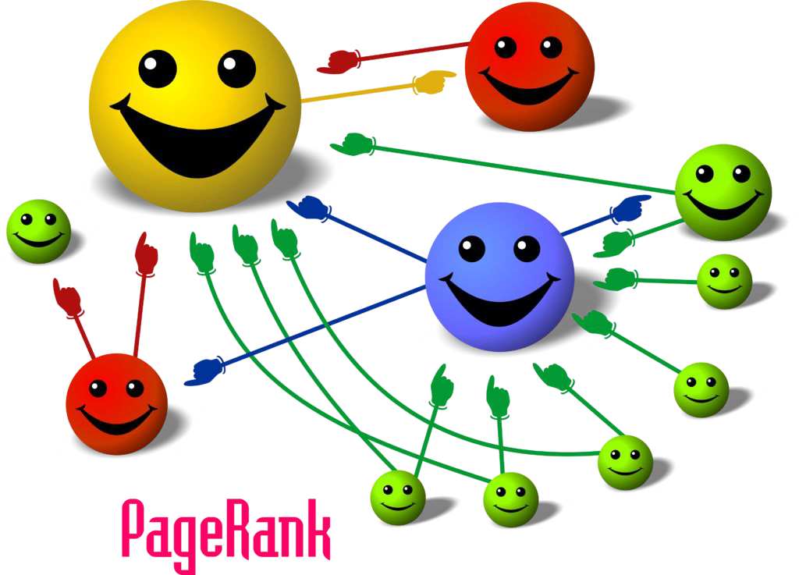
The PageRank Algorithm
Give ranks (scores) based on links to them
A page that has:
  Links from many nodes ⇒ high rank
  Link from a high-ranking node ⇒ high rank

Slide 3
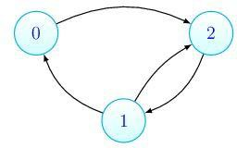
The PageRank Algorithm
The PageRank algorithm can find important or influential vertices in a graph.
Which node is more important or influential?

Slide 4
The PageRank Algorithm
Node 0 passes its score to Node 2.
Node 1 passes its score to Node 0 and Node 2. Node 2 passes its score to Node 1.
Iteration 0
Iteration 1
0.333
0.333
0.191
0.475
0.333
0.333

Slide 5
The PageRank Algorithm
When the score of every node does not change across iterations, we refer to it as the algorithm converged.
Iteration k
Iteration k+1
0.217
0.396
0.217
0.396
0.386
0.386

Slide 6
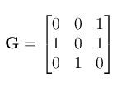


The PageRank Algorithm
Adjacent matrix:
Transition matrix: (row sums to 1)
What if a node has zero outgoing links? Set each element of that row to 1/n,
where n is the number of nodes in the graph.

Slide 7
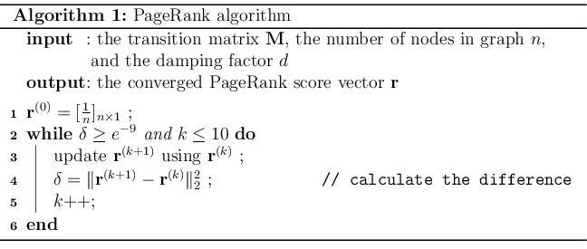
The PageRank Algorithm
PageRank algorithm can usually converge in 10 iterations. Two ways to implement Step 3:
matrix solver
for-loop solver (required)

Slide 8
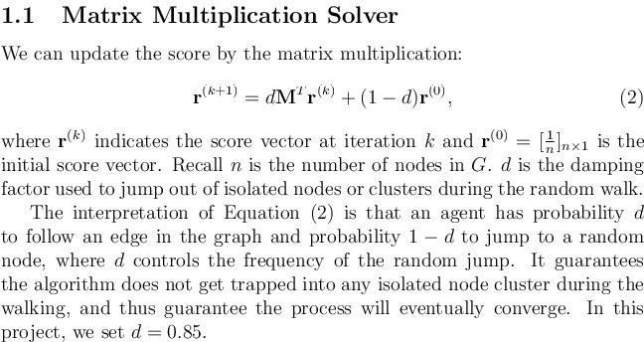
Matrix Solver
Matrix implementation can be very fast. But it might not be applied to very large graphs due to the memory constraint.
Use sparse matrix to store M.

Slide 9
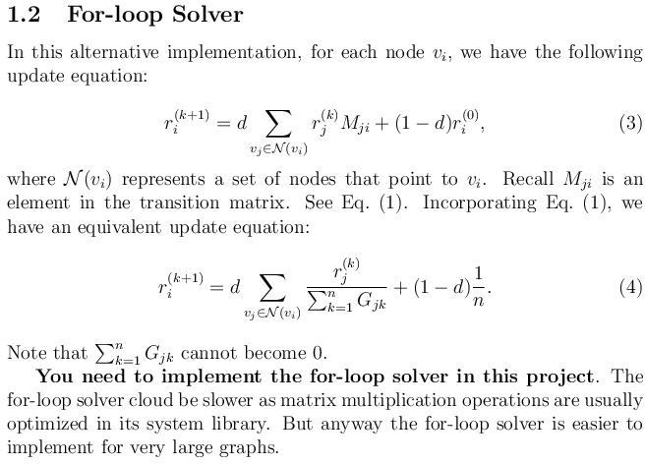
For-loop Solver
Less efficient but scalable to very large graphs.
You are required to implement the for-loop solver.

Slide 10
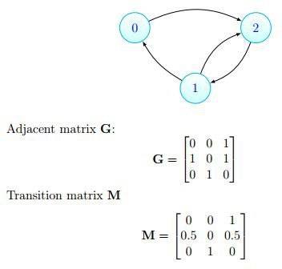
A Toy Example - 1

Slide 11
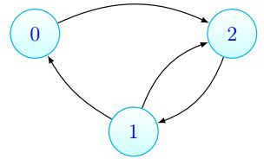


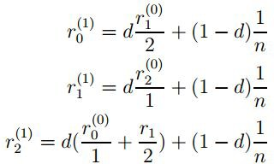
A Toy Example - 1

Slide 12
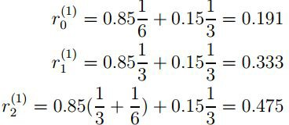
A Toy Example - 1

Slide 13
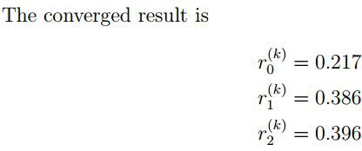
A Toy Example - 1

Slide 14
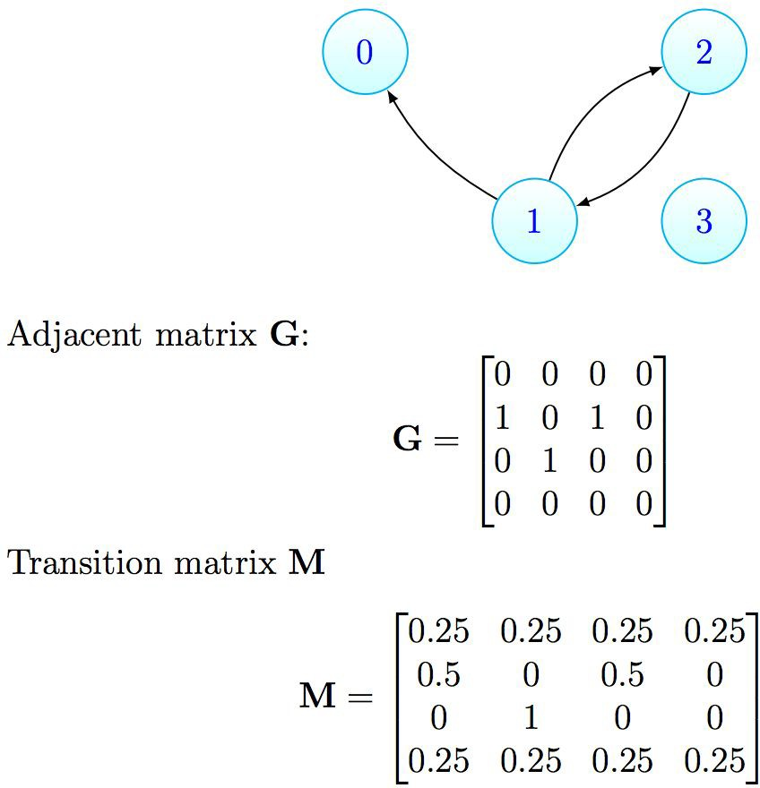


A Toy Example - 2
dangling user
isolated user

Slide 15
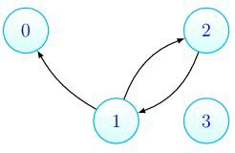

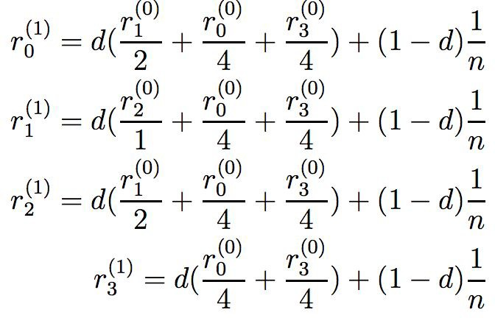
A Toy Example - 2

Slide 16

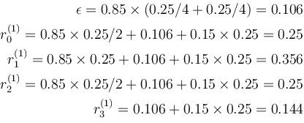
A Toy Example - 2

Slide 17
Bonus Task: Speed up Spark
Hints:
Eliminate repeated calculations in PageRank.
Monitor your instances to make sure they are fully utilized.
Develop a better understanding of RDD manipulations. Understand the "lazy" transformation in Spark.
Spark is a tunable framework where there are many parameters that you can configure to make the best use of the resources.
Be careful with repartition on your RDDs.

Slide 18
PageRank Evaluation
  I have a sample datafile in a prescribed format
  <# sites> <# links>
  [id1] [site1]
  …
  [idN] [siteN]
  [idA] [idB]
  …
  [idX] [idY]
  Check if the sum of PageRank score is 1.0 at each iteration
  Bonus: tune your system to run as fast as possible
18

Slide 19
Lab Handout Coming…

