Slide 1

Ethics
CSCI 420
Software Engineering

Slide 2
The Software Engineering Code of Ethics and Professional Practice
Software Engineering Code of Ethics and Professional Practice (Version 5.2) as recommended by the ACM/IEEE-CS Joint Task Force on Software Engineering Ethics and Professional Practices and jointly approved by the ACM and the IEEE-CS as the standard for teaching and practicing software engineering.

Slide 3
Short Version
The short version of the code summarizes aspirations at a high level of the abstraction;
the clauses that are included in the full version give examples and details of how these aspirations change the way we act as software engineering professionals.
Without the aspirations, the details can become legalistic and tedious;
without the details, the aspirations can become high sounding but empty;
together, the aspirations and the details form a cohesive code.

Slide 4
Short Version (2 of N)
Software engineers shall commit themselves to making the analysis, specification, design, development, testing and maintenance of software a beneficial and respected profession.
In accordance with their commitment to the health, safety and welfare of the public, software engineers shall adhere to the following Eight Principles:

Slide 5
Short Version (3 of N)
PUBLIC
Software engineers shall act consistently with the public interest.
CLIENT AND EMPLOYER
Software engineers shall act in a manner that is in the best interests of their client and employer consistent with the public interest.
PRODUCT
Software engineers shall ensure that their products and related modifications meet the highest professional standards possible.
JUDGMENT
Software engineers shall maintain integrity and independence in their professional judgment.

Slide 6
Short Version (4 of N)
MANAGEMENT
Software engineering managers and leaders shall subscribe to and promote an ethical approach to the management of software development and maintenance.
PROFESSION
Software engineers shall advance the integrity and reputation of the profession consistent with the public interest.
COLLEAGUES
Software engineers shall be fair to and supportive of their colleagues.
SELF
Software engineers shall participate in lifelong learning regarding the practice of their profession and shall promote an ethical approach to the practice of the profession.

Slide 7
Full Version
Principle | Sections | Principle | Sections
Public | 8 | Management | 12
Client and Employer | 9 | Profession | 13
Product | 15 | Colleagues | 8
Judgment | 6 | Self | 9
https://ethics.acm.org/code-of-ethics/software-engineering-code/

Slide 8
Broadening Our View on Ethics
The types of harms the public can suffer as result of this work;
How software engineers contribute to the good life for others;
Who exactly are the ‘public’ to whom the engineer is obligated;
Why the software engineer is obligated to protect the public;
What other ethical obligations software engineers are under;
How software engineers can actually live up to ethical standards;
What is the end goal of an ethical life in software engineering;

Slide 9
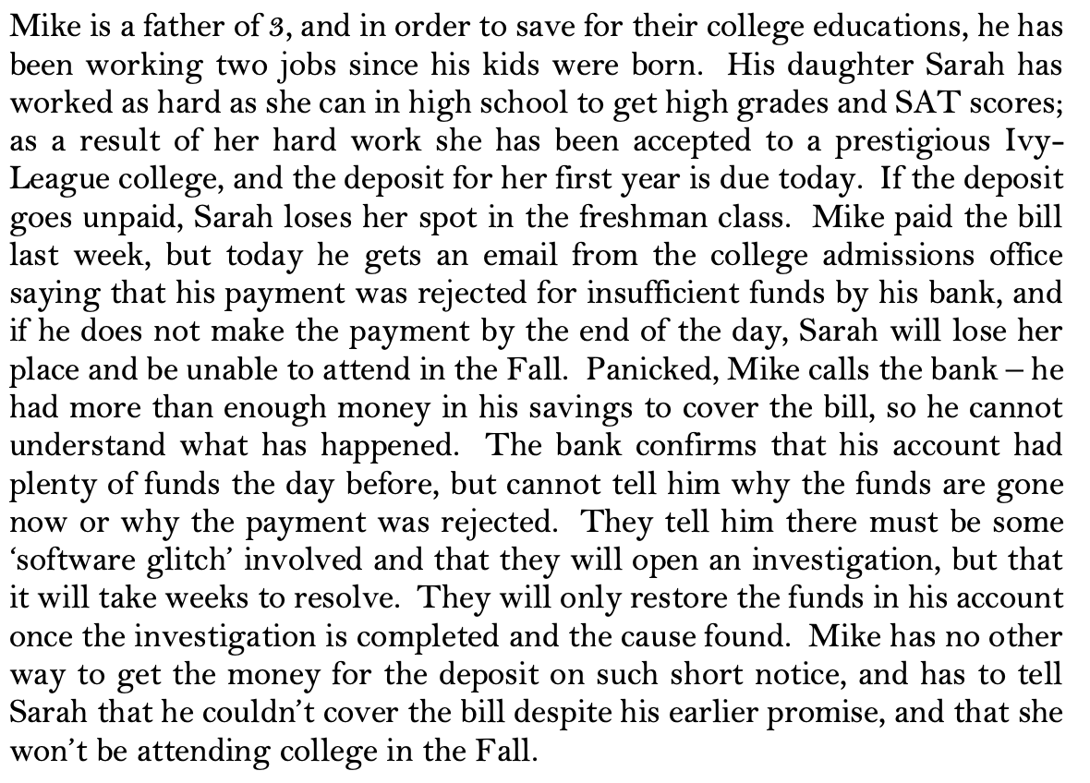
What kinds of harm to the public can software engineers cause?
What kinds of harm can they prevent?
Notes:
What kinds of harm has Mike probably suffered as a result of this incident? What kinds of harm has Sarah probably suffered? (Make your answers as full as possible; identify as many kinds of harm done as you can think of).
Could the problem with Mike’s account have been the result of an action (or a failure to perform an action) by a software engineer? How many possible scenarios/explanations for this event can you think of that involve the conduct of one or more software engineers? Briefly explain the scenarios:
Taking into account what we said about ethics in the introduction, could any of the scenarios you imagined involve an ethical failure of the engineer(s) responsible? How? Explain:
*Note: An ethical failure would be preventable, and one that a good human being with appropriate professional care and concern would and should have prevented (or at least have made a serious effort to prevent).

Slide 10
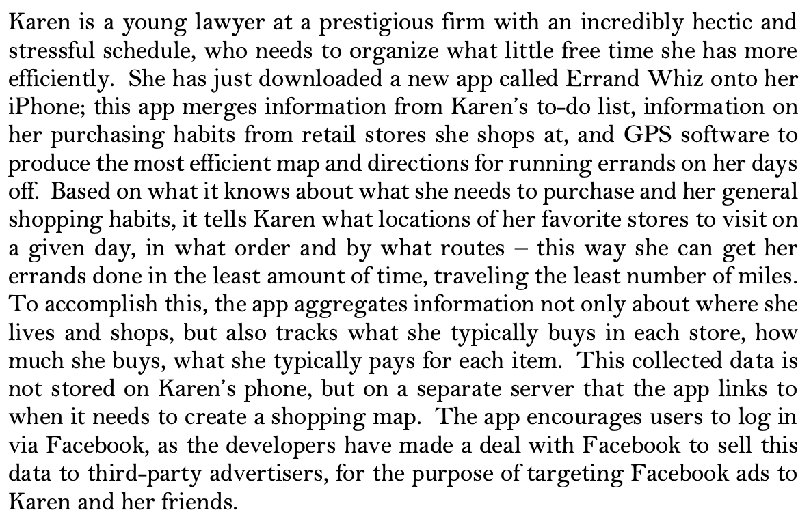
Case Study 2/2
Notes:
Question 1.4: In what ways could Karen potentially be harmed by this app, depending on how it is designed and how her shopping data is handled and used? Identify a few harmful scenarios you can think of, and the types of harm she could suffer in each:
Question 1.5: Which if any of these harms could result from ethical failings on the part of the people who developed Errand Whiz? How, specifically?
Question 1.6: What actions could the people behind Errand Whiz take to prevent these harms? Are they ethically obligated to prevent them? Why or why not? Explain your answer.

Slide 11
To whom are software engineers obligated by their professional ethics?
Who is ‘the public’ that deserves an engineer’s professional concern?
You are a new hire in a product design team for a start-up company that is developing new and more powerful versions of the kind of packet-sniffing and email scanning software systems used by law enforcement agencies and large corporations to monitor data traffic for illegal activities.
This kind of software might, for example, be programmed to detect illegal downloads of copyrighted materials, or to flag for review email keywords like ‘bomb,’ ‘steal,’ or ‘bribe.’
You are a young parent of two small children, with parents and friends who are deeply proud of your achievements.
You are looking forward to using this first job to cultivate a reputation in your industry for being an excellent software engineer.

Slide 12
Case Study 2/3
One day, you happen to overhear your supervisor chatting with another supervisor about a new contract the company has recently received from a foreign government.
You happen to recognize the name of this country as one that is currently run by an oppressive military regime that routinely imprisons its citizens without trial or other due process. In this country, people perceived as political dissidents and their families are often sent to labor camps with deplorable living conditions, without hope of appeal, for an indefinite period.
Your own nation has strongly criticized this country’s human rights record, and many international organizations as well as the United Nations have condemned its practices.

Slide 13
Case Study 3/3
You realize now that the product your team is working on is part of your company’s contract with this government; and in fact, you have been assigned specifically to develop the part of the product that searches for specific keyword strings in private emails, texts, social networking messages, Skype and phone conversations
Reviewing the specs for your task, you realize that your contribution to the product will almost certainly be used to identify for extraction and review conversations between private citizens of this country in which there is any specific discussion of their government or its policies, and especially those in which words like ‘reform,’ ‘injustice,’ ‘corruption,’ ‘due process’ or ‘human rights’ occur.
Notes:
What do you think is your ethical obligation in this situation? What do you think an excellent software engineer would do in this situation? Are they the same thing, or different? Please explain your answer.
Why do software engineers have ethical obligations to the public at all? Where do these obligations come from?
How can software engineers live up to their ethical obligations, both professionally and in their private lives?

Slide 14
Ethically Constructive Habits of Mind and Action:
Self-Reflection / Examination
Looking for Moral Exemplars
Exercising our Moral Imaginations
Acknowledging Your Own Moral Strength
Seeking the Company of Other Moral Persons

Slide 15
Paper on Ethics
Length: Two full pages (can extend to three)
Submission Format: Strongly Recommended LaTeX document
  Why: so you can’t skirt around formatting requirements
Due Date: May 8th by 11:59PM
Handin: D2L (submit generated PDF file)

Slide 16
Paper on Ethics
Historically: analyze a scenario and list all the ethics violations.
I’m changing it up a bit
I want you to find information / press releases on an application you use and:
  Identify how they violate the SE Code of Ethics principles
  Determine (through news reports, etc) whether you feel the company or developers are in violation
  Clearly cite which principle you are referencing (e.g. \S 1.02) – the \S will emit §
Include list of citations at end (DOES NOT GET INCLUDED IN LENGTH)
Low-hanging fruit: consider products from Facebook, Google, Microsoft, Amazon

Slide 17
LaTeX template (use https://www.overleaf.com)
\documentclass[12pt]{article}
\usepackage[utf8]{inputenc}
\usepackage[margin=1in]{geometry}
\usepackage{times}
\usepackage{lipsum}
\setlength{\parindent}{0pt}
\setlength{\parskip}{6pt}
\renewcommand{\baselinestretch}{1.0}
\begin{document}
\begin{flushright}
Your Name Here\\
CSCI 420: Software Engineering\\
Ethics Paper
\end{flushright}
% Paper text goes here.
\lipsum[1-11]
Citation: See \S 1.02
\end{document}

