Slide 1

REST APIs, Microservices, and Scalability
CSCI 420: Software Engineering

Slide 2
REST
REpresentational State Transfer
Architectural style of the web
  Used by websites (AJAX)
Set of design criteria
  NOT the physical structure (or architecture) of the system
  NOT tied to the web or HTTP
“Web” applications are the most prevalent
  Collaboration
  Productivity (MS Office, Google Docs, Github)
  Social Networks

Slide 3
REST Principles
1. The key abstraction of information is a resource which is named by a URI.
  Any information that can be named can be a resource
2. All interactions are context-free
  Each interaction contains all the information necessary to understand the request
  Independent of any request that may have preceded it
3. A resource is just a sequence of bytes, plus representation metadata to describe those bytes
  Specific form of representation can be negotiated between REST components

Slide 4
REST Principles
4. Components perform only a small set of well-defined methods
  Either “produce a representation” (state) or “transfer representation between components” (transfer)
  Methods are “global” to the specific REST architectural instantiation
  All exposed resources are expected to support each operation identically
5. Idempotent operations and representation metadata are encouraged
  (Woah, some 10-cent words there – discussed on future slides)
  Supports caching and representation reuse
6. The presence of intermediaries is promoted
  Filtering or redirection is okay
  Useful when you need to augment, restrict, or modify requests/responses in a manner that is transparent

Slide 5
REST – Resources
Anything that’s important enough to be referenced as a thing in itself
Something that can be stored on a computer and represented as a stream of bits
  A document
  A row in a database
  Output(s) of executing an algorithm
  JSON/YAML/XML

Slide 6
REST – URIs
A URI is an address of a resource
A resource must have at least one URI
  URI → Resource
  No URI means not a resource
URIs should be descriptive and human-parseable
  http://cs.millersville.edu/~wkillian/2019/fall/csci420
  https://autolab.millersville.edu/courses/420-f19/assessments
  https://autolab.millersville.edu/courses/362-f19/assessments/array/submissions/9001/view
“Bad” URIs
  Everything as a query parameter
  http://www.ex.com?software=Prism&release=latest&filetype=tar&method=fetch

Slide 7
REST – Addressability
An application is addressable if it exposes interesting aspects of its data set as resources
An addressable application exposes a URI for every piece of information it might serve
Enables a user to “bookmark” URIs or embed them
  e.g. on a powerpoint slide: http://www.google.com/q?csci+420+millersville
  Rather than a prescribed list of steps

Slide 8
REST – Statelessness
Every request happens in complete isolation
  Server shall NEVER rely on information from prior requests
  There is no specific ordering of client requests
Possible states of a server can be represented as resources and given their own URIs

Slide 9
REST – Representations
Resources != Data
  Abstraction of how information is split for presentation/consumption
Server must respond to a request by sending a payload
  In a specific file format
    XML
    JSON
    HTML
    PDF
  In a specified “language”
    English
    Spanish
    …

Slide 10
REST – Representation Request
Style 1: Distinct URI for each
  ex.com/media/2019-11.en
  ex.com/media/2019-11.fr
Style 2: Content Negotiation
  Expose Platonic form URI:
    ex.com/media/2019-11
  Client sets request headers:
    Accept:
    Accept-Language:

Slide 11
REST – Uniform Interface
HTTP Provides 4 basic methods for CRUD
  (CRUD: Create, Read, Update, Delete)
  GET retrieve representation of resource
  PUT update/modify existing resource (or create a new resource)
  POST create a new resource
  DELETE delete an existing resource
Two additional (less commonly used) methods
  HEAD fetch metadata of representation only
  OPTIONS check which HTTP methods a resource supports

Slide 12
HTTP Request/Response
Method | Request Entity-Body/Representation | Response Entity-Body/Representation
GET | (Usually) Empty Representation/entity-body sent by client | Server returns representation of resource in HTTP Response
DELETE | (Usually) Empty Representation/entity-body sent by client | Server may return entity body with status message or nothing at all
PUT | (Usually) Client’s proposed representation of resource in entity-body | Server may respond back with status message or with copy of representation or nothing at all
POST | Client’s proposed representation of resource in entity-body | Server may respond back with status message or with copy of representation or nothing at all

Slide 13
PUT vs POST
POST
  Commonly used for creating subordinate resources existing in relation to some “parent”
    Parent: /logs/mylog (table in DB)
    Children: /logs/mylog/entries/1 (row in table)
PUT
  Usually used for modifying existing resources
  May be used for creating resources
PUT vs. POST (for creation)
  PUT: client in charge of deciding which URI resource
  POST: server in charge of deciding which URI resource

Slide 14
PUT vs POST (continued)
… In the case of partial updates
  PUT: send completely new representation overwriting current
  POST: create new resource
… In Practice
  PUT for partial works fine
    No evidence/claim for why it can’t (or shouldn’t)
  POST may also be used and some “purists” prefer this
Ultimately, your manager/supervisor will determine requirements for you

Slide 15
REST – Safety and Idempotence
Depends on calls being correctly used
Safety
  The request doesn’t change the server state
  No side effects
  Making 10 requests is the same as making one (or even none!)
Idempotence
  Executing the same operation is the same as executing once
  Deleting an already DELETE-ed resource is still deleted
  Updating an already UPDATE-ed resource with PUT has no effect

Slide 16
Idempotence
When performing an operation again gives the same result
HTTP Method | Idempotence | Safety
GET | YES | YES
HEAD | YES | YES
PUT | YES | NO
DELETE | YES | NO
POST | NO | NO
PATCH | NO | NO

Slide 17
RESTful Architecture: Steps to Success ☺
Figure out the dataset
Split dataset into resources, then for each kind of resource:
  Name resources with URIs
  Expose a subset of uniform interface
  Design representation(s) accepted from client
  Design representation(s) served to client
  Consider typical course of events (sunny-day scenarios)
  Consider alternative/error conditions (rainy-day scenarios)

Slide 18
HTTP Status/Response Codes
HTTP has built-in set of status codes
  2XX – Success (200 OK, 201 Created, etc)
  3XX – Redirection (303 See other)
  4XX – Client error (404 not found)
  5XX – Server error (500 Internal Server Error)
Leverage existing status codes to handle
  Sunny day scenarios
  Rainy day scenarios
Do not try to reinvent the wheel!

Slide 19
RESTful Notes
Authentication/Authorization data sent with every request
Sessions are NOT RESTful (sessions → state)
Cookies (if used appropriately) are RESTful
100% RESTful should not necessarily be a goal
  Login/Logout
Some server frameworks only support GET/POST
  Forces developer to overload POST for PUT/DELETE

Slide 20
Benefits of RESTful Design
Simpler and Intuitive Design
Server doesn’t have to worry about client timeout
Clients can easily service interruptions / server restart
Easily distributed
Scalable
Stateless → easier to cache
Bookmarkable

Slide 21
Microservices
microservice architectural style
  an approach to developing a single application
  as a suite of small services
  each running in its own process and communicating with lightweight mechanisms
  often an HTTP resource API

Slide 22
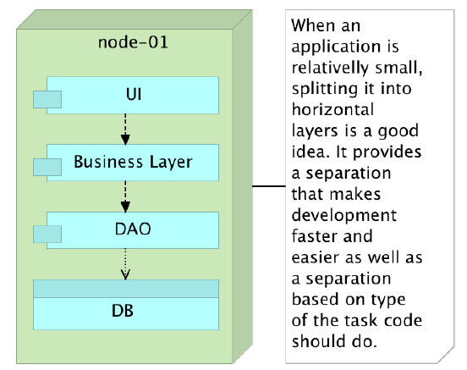
Monolithic Applications

Slide 23
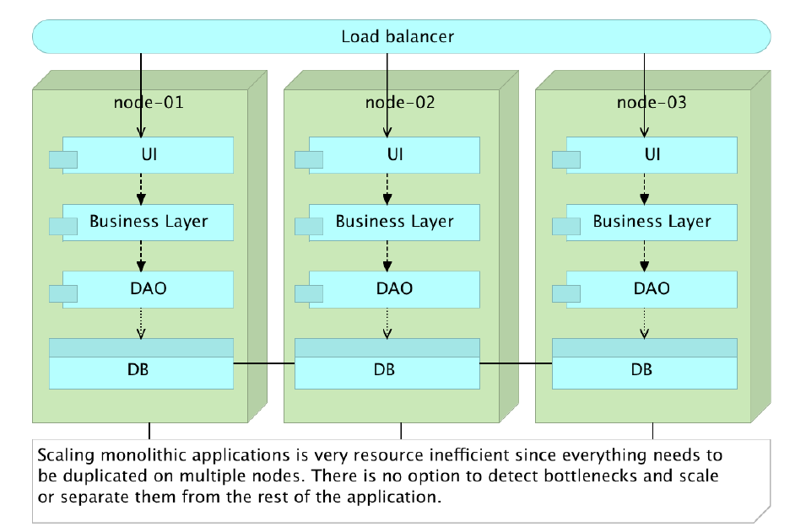
Scaling Monolithic Applications

Slide 24
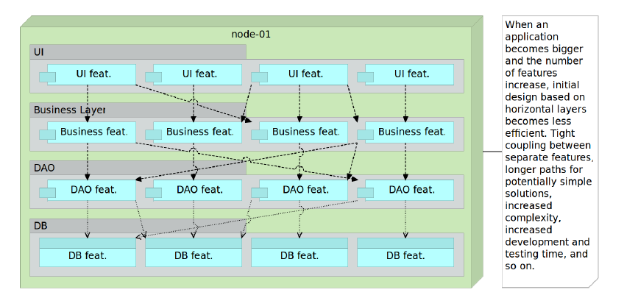
Monolithic Application w/ Increased Features

Slide 25
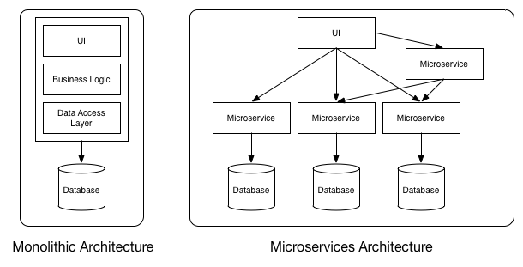
Microservices

Slide 26
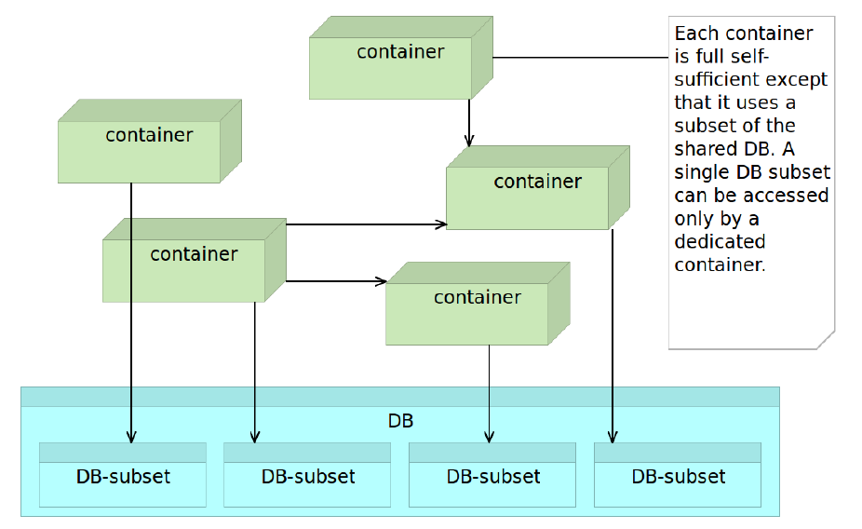
Microservices Accessing Shared DB

Slide 27
Microservices Characteristics
Many smaller (fine grained), clearly scoped services
  Single Responsibility Principle
  Independently Managed
Clear ownership for each service
  Typically need/adopt the “DevOps” model

Slide 28
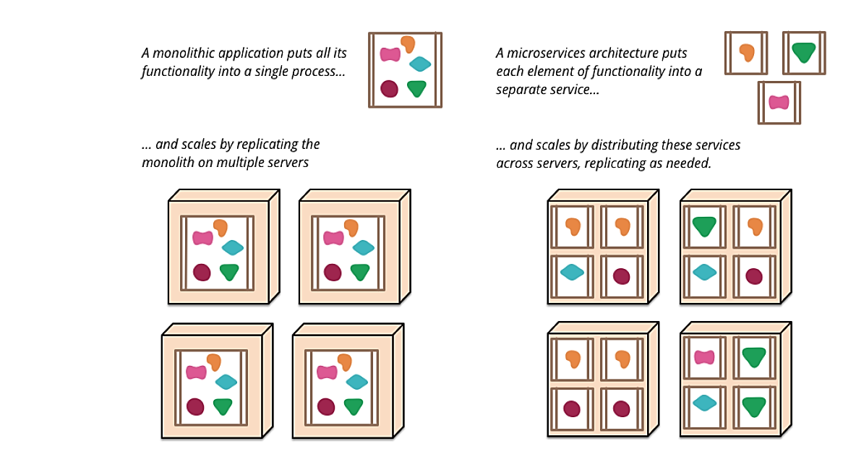
Scalability

Slide 29

How to Scale… Docker?

Slide 30
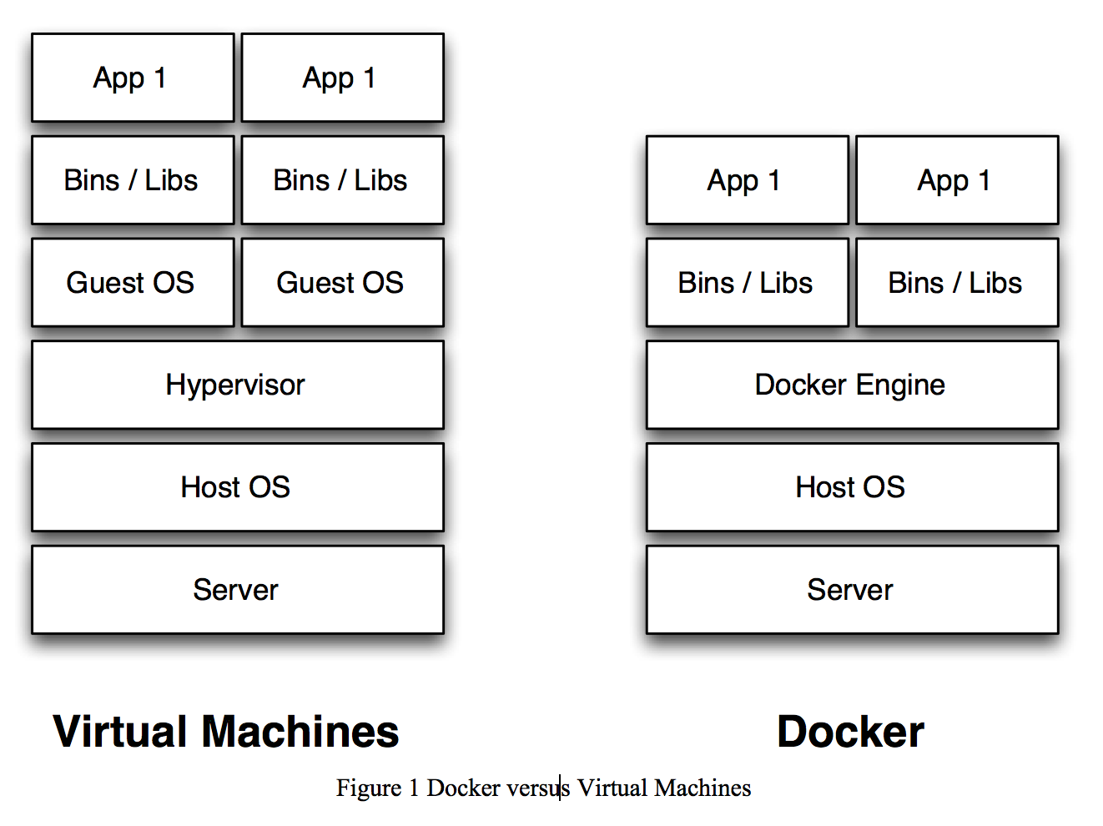
VM vs. Docker

Slide 31
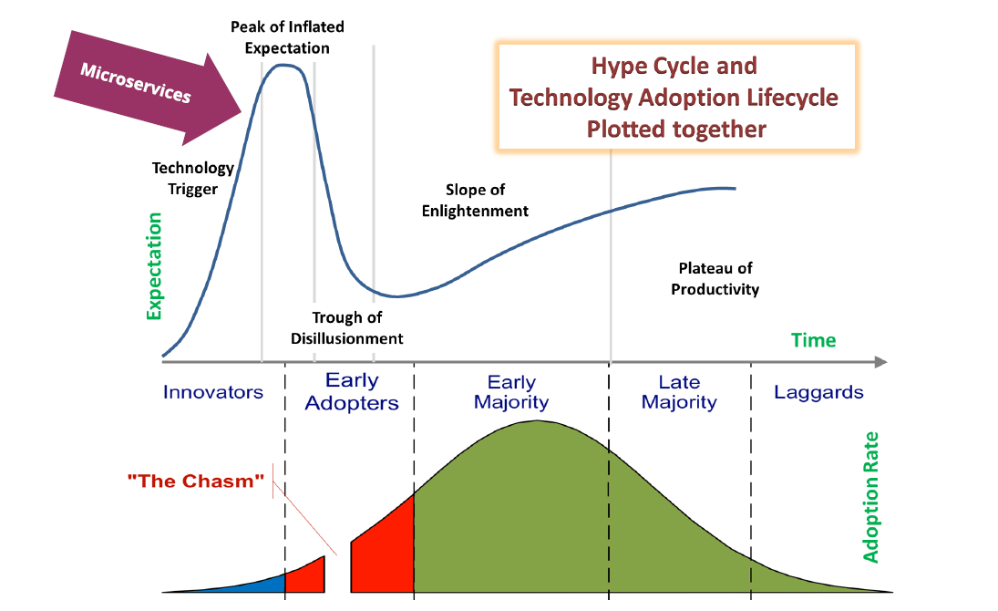

Slide 32
REST Example:
Autolab
  https://autolab.github.io/docs/api-interface/
Tango
  https://autolab.github.io/docs/tango-rest/

