Slide 1
Requirements and Specification
CSCI 420: Software Engineering

Slide 2
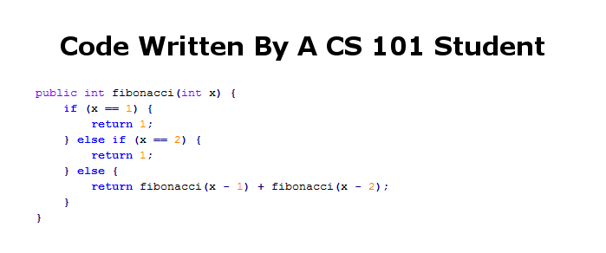
Fibonacci Numbers

Slide 3
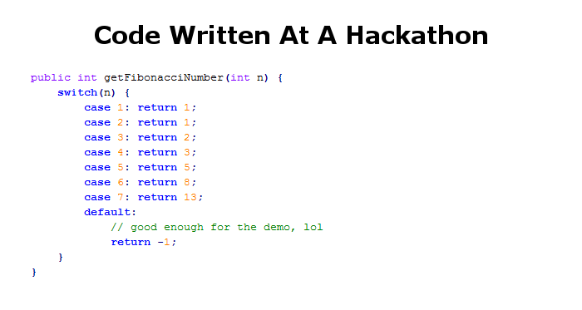
Fibonacci Numbers

Slide 4
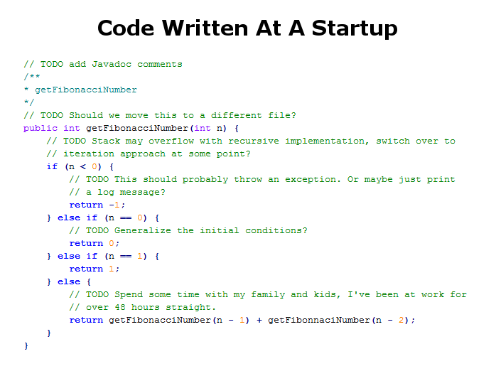
Fibonacci Numbers

Slide 5
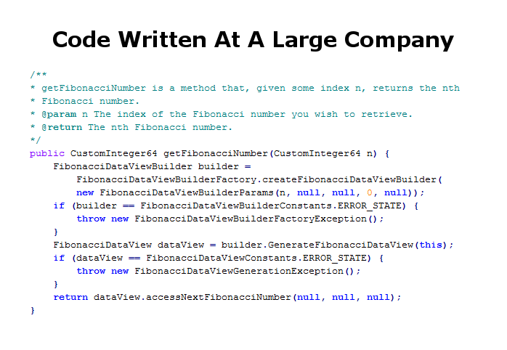
Fibonacci Numbers

Slide 6
Requirements Engineering
The process of establishing the services that the customer requires from a system and the constraints under which it operates and is developed
The requirements themselves are the descriptions of the system services and constraints that are generated during the requirements engineering process

Slide 7
Requirements Engineering
The hardest single part of building a software system is deciding what to build
  Cripples the process if done wrong
  Costly to rectify later
The goal of requirement engineering is to determine (pick one):
  What software client wants?
  What software client needs?

Slide 8
User requirements
Should describe requirements in such a way that they are understandable by system users who don’t have detailed technical knowledge.
User requirements are defined using natural language, tables and diagrams as these can be understood by all users.

Slide 9
Example: Library system (LibSys)
A library system that provides a single interface to a number of databases of articles in different libraries.
Users can search for, download and print these articles for personal study.

Slide 10
Determining Stakeholders and Needs
Must determine stakeholders
  Anyone who benefits from the system developed
  E.g., who’s client and who’s user ?
Try to understand what their needs are
Reconcile different needs/points of view

Slide 11
Techniques for Requirement Gathering
Interviewing
User stories
Strawmen
Prototypes

Slide 12
Interviewing
One path is obvious
  Sit down with client/user and ask questions
  Listen to what they say, and what they don’t say
A less obvious path
  Master-apprentice relationship
  Have them teach you what they do
  Go to workplace and watch them do the task
In all types of interviews, get details
  Ask for copies of reports, logs, emails on process
  These may support, fill in, or contradict what the user said

Slide 13
Extreme Programming – User Stories
Recall: client writes user stories
  Using client vocabulary
Describe usage scenarios of software
  Title, short description
Each user story has acceptance tests
  Clarify the story
  Will tell you when the customer thinks story is done

Slide 14
Disadvantages of Talking
Interviews are useful, but
“I know you believe you understood what you think I said, but I am not sure you realize that what you heard is not what I meant!”
Users/clients may
  Not have the vocabulary to tell you what they need
  Not know enough about computer science to understand what is possible
    Or impossible
  Sometimes may lead to restricted functionality
Good idea to gather requirements in other ways, too

Slide 15
A Straw-mAn Proposal
Sketch the product for the user/client
  Storyboards
  Flowcharts
  HTML mock-ups
  Illustrate major events/interfaces/actions
Anything to convey ideas without writing code!

Slide 16
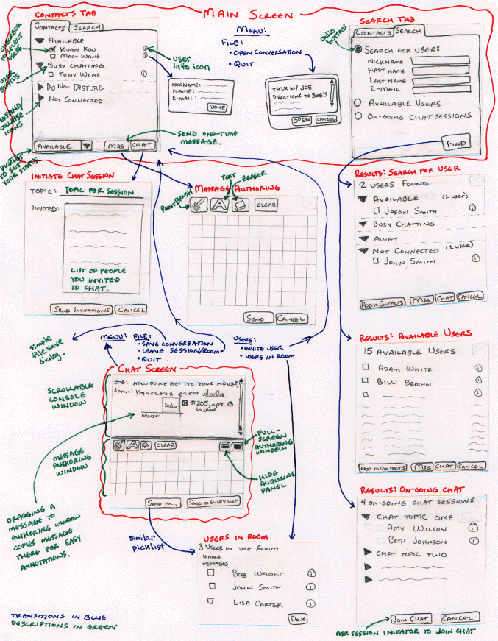

Slide 17
Rapid Prototyping
Write a prototype
  Major functionality, superficially implemented
  Falls down on moderate-to-extreme examples
    No investment in scaling, error handling, etc.
Show prototype to users/clients
  Users have a real system – more reliable feedback
  Refine requirements
  But, significant investment
Notes:
Requirements are wishes

Slide 18
Pitfalls of Rapid Prototyping
Needs to be done quickly
  Remember, this is just the requirements phase!
  Danger of spending too long refining prototype
The prototype becomes the product
  Prototype deliberately not thoroughly thought-out
  Product will inherit the sub-optimal architecture
Prototype serves as the spec
  Prototype is incomplete, maybe even contradictory
When done well, extremely useful

Slide 19
Summary of Requirements Gathering
Find out what users/clients need
  Not necessarily what they say they want
Use
  Interviews
  User stories
  Strawmen
  Rapid prototyping
  As appropriate . . .

Slide 20
Requirement vs Specification
User Requirements
  Statements in natural language plus diagrams of the services the system provides and its operational constraints. Written for customers.
System Specifications
  A structured document setting out detailed descriptions of the system’s functions, services and operational constraints. Defines what should be implemented so may be part of a contract between client and contractor.
The distinction is often glossed over

Slide 21
Specifications
Describe the functionality of the product
  Precisely
  Covering all circumstances
Move from the finite to the infinite
  Finite examples (requirements) to infinite set of possible computations
  This is not easy
Notes:
Mars Climate Orbiter.
Constraints on the product:
Reliability constraint: life support system
Rapid response time: 95% of type 4 requests should be responded within 0.25 seconds.
Timing constraint: a war plane should be able detect an incoming missile in 0.25 seconds with 100% probability
Solution strategy:
Note down strategies that have been discarded and why

Slide 22
Completeness and consistency
In principle, specifications should be unambiguous, complete, and consistent.
Unambiguous: Only one way to interpret the spec
Complete
  Include descriptions of all facilities required.
Consistent
  There should be no conflicts or contradictions in the descriptions of the system facilities.
In practice, it is almost impossible to produce a complete and consistent requirements document.

Slide 23
Different Views of Specifications
Developer’s
  Specification must be detailed enough to be implementable
  Unambiguous
  Self-consistent
Client’s/user’s
  Specifications must be comprehensible
  Usually means: not too technical
Legal
  Specification can be a contract
  Should include acceptance criteria
    If the software passes tests X, Y, and Z, it will be accepted
Notes:
many systems have no detailed specification
government requires detailed spec.
business systems: you do not have specs
XP tries to minimize written documents
documents for library code used by others available from public website
documents are required if you want to be maintained by others.

Slide 24
Informal Specifications
Written in natural language
  E.g., English
Example
  “If sales for current month are below target sales, then report is to be printed, unless difference between target sales and actual sales is less than half of difference between target sales and actual sales in previous month, or if difference between target sales and actual sales for the current month is under 5%”

Slide 25
Problems with Informal Specs
Informal specs of any size inevitably suffer from serious problems
  Omissions
    Something missing
  Ambiguities
    Something open to multiple interpretations
  Contradictions
    Spec says “do A” and “do not do A”
  Amalgamation
    Different requirements mixed together
These problems will be faithfully implemented in the software unless found in the spec

Slide 26
Informal Specifications Revisited
  “If sales for current month are below target sales, then report is to be printed, unless difference between target sales and actual sales is less than half of difference between target sales and actual sales in previous month, or if difference between target sales and actual sales for the current month is under 5%”
  January: target $100K, actual $64K
  February: target $120K, actual $100K
  March: target $100K, actual $95,100

Slide 27
Comments on Informal Specification
Informal specification is universally reviled
  By academics
  By “how to” authors
Informal specification is also widely practiced
  Why?

Slide 28
Why Do People Use Informal Specs?
The common language is natural language
  Customers can’t read formal specs
  Neither can most programmers
  Or most managers / lawyers
  A least-common denominator effect takes hold
Truly formal specs are very time-consuming
  And hard to understand
  And overkill for most projects

Slide 29
Semi-Formal Specs
Best current practice is “semi-formal” specs
  Allows more precision than natural language where desired
Usually a boxes-and-arrows notation
  Must pay attention to:
  What boxes mean
  What arrows mean
  Different in different systems!
We’ll see one example (UML) next time

Slide 30
Functional and non-functional
Functional requirements
  Statements of services the system should provide, how the system should react to particular inputs and how the system should behave in particular situations.
Non-functional requirements
  constraints on the services or functions offered by the system such as timing constraints, constraints on the development process, standards, etc.
Domain requirements
  Requirements that come from the application domain of the system and that reflect characteristics of that domain.

Slide 31
Functional requirements
Describe functionality or system services
Functional user requirements may be high-level statements of what the system should do but functional system specifications should describe the system services in detail.

Slide 32
The LIBSYS system
A library system that provides a single interface to a number of databases of articles in different libraries.
Users can search for, download and print these articles for personal study.

Slide 33
Examples: functional requirements
The user shall be able to search either all of the initial set of databases or select a subset from it.
The system shall provide appropriate viewers for the user to read documents in the document store.
Every order shall be allocated a unique identifier (ORDER_ID) which the user shall be able to copy to the account’s permanent storage area.

Slide 34
Example of Requirements imprecision
Ambiguous requirements may be interpreted in different ways by developers and users.
Consider the term ‘appropriate viewers’
  User intention - special purpose viewer for each different document type;
  Developer interpretation - Provide a text viewer that shows the contents of the document.

Slide 35
Non-functional requirements
These define system properties and constraints e.g. reliability, response time and storage requirements. Constraints are I/O device capability, system representations, etc.
Process requirements may also be specified mandating a particular process, programming language, or development method.
Non-functional requirements may be more critical than functional requirements. If these are not met, the system is useless.

Slide 36
Non-functional classifications
Product requirements
  Requirements which specify that the delivered product must behave in a particular way e.g. execution speed, reliability, etc.
Organizational requirements
  Requirements which are a consequence of organisational policies and procedures e.g. process standards used, implementation requirements, etc.
External requirements
  Requirements which arise from factors which are external to the system and its development process e.g. interoperability requirements, legislative requirements, etc.

Slide 37
Non-functional requirement types
Non-functional
r
equir
ements
Product
Organizational
External
r
equir
ements
r
equir
ements
r
equir
ements
Ef
ficiency
R
elia
bility
P
or
ta
bility
Inter
oper
a
bility
Ethical
r
equir
ements
r
equir
ements
r
equir
ements
r
equir
ements
r
equir
ements
Usa
bility
Deli
v
ery
Implementa
tion
Standar
ds
Leg
isla
ti
v
e
r
equir
ements
r
equir
ements
r
equir
ements
r
equir
ements
r
equir
ements
P
er
f
or
mance
Space
Pri
v
acy
Safety
r
equir
ements
r
equir
ements
r
equir
ements
r
equir
ements

Slide 38
Non-functional requirements examples
Product requirement
  8.1 The user interface for LIBSYS shall be implemented as simple HTML without frames or Java applets.
Organizational requirement
  9.3.2 The system development process and deliverable documents shall conform to the process and deliverables defined in XYZCo-SP-STAN-95.
External requirement
  7.6.5 The system shall not disclose any personal information about customers apart from their name and reference number to the operators of the system.

Slide 39
Goals and requirements
Non-functional requirements/specifications may be very difficult to state precisely and imprecise requirements may be difficult to verify.
Goal
  A general intention of the user such as ease of use.
Verifiable non-functional requirement
  A statement using some measure that can be objectively tested.
Goals are helpful to developers as they convey the intentions of the system users.

Slide 40
Examples
A system goal
  The system should be easy to use by experienced controllers and should be organized in such a way that user errors are minimised
A verifiable non-functional requirement
  Experienced controllers shall be able to use all the system functions after a total of two hours training. After this training, the average number of errors made by experienced users shall not exceed two per day.

Slide 41
Requirements interaction
Conflicts between different non-functional requirements are common in complex systems
Spacecraft system
  To minimise weight, the number of separate chips in the system should be minimised.
  To minimise power consumption, lower power chips should be used.
  However, using low power chips may mean that more chips have to be used. Which is the most critical requirement?

Slide 42
Domain requirements
Derived from the application domain and describe system characteristics and features that reflect the domain.
Domain requirements be new functional requirements, constraints on existing requirements or define specific computations.
If domain requirements are not satisfied, the system may be unworkable.

Slide 43
Library system domain requirements
There shall be a standard user interface to all databases which shall be based on the Z39.50 standard.
Because of copyright restrictions, some documents must be deleted immediately on arrival. Depending on the user’s requirements, these documents will either be printed locally on the system server for manually forwarding to the user or routed to a network printer.

Slide 44
Train protection system
The deceleration of the train shall be computed as:
  D_{train} = D_{control} + D_{gradient}
where D_{gradient} is 9.81ms² * compensated gradient/alpha and where the values of 9.81ms² /alpha are known for different types of train.

Slide 45
Domain requirements problems
Understandability
  Requirements are expressed in the language of the application domain;
  This is often not understood by software engineers developing the system.
Implicitness
  Domain specialists understand the area so well that they do not think of making the domain requirements explicit.

Slide 46
Guidelines for writing requirements
Invent a standard format and use it for all requirements.
Use language in a consistent way. Use shall or must for mandatory requirements, should for desirable requirements
See Reading on the Lectures page

Slide 47
System specifications
More detailed specifications of system functions, services and constraints than user requirements.
Intended to be a basis for designing the system.
May be incorporated into the system contract.

Slide 48
Requirements and design
In principle, requirements should state what the system should do and the design should describe how it does this
In practice, requirements and design are inseparable
  A system architecture may be designed to structure the requirements;
  The system may inter-operate with other systems that generate design requirements;
  The use of a specific design may be a domain requirement.

Slide 49
The requirements document
The requirements document is the official statement of what is required of the system developers.
Should include both a definition of user requirements and a specification of the system requirements.
It is NOT a design document. As far as possible, it should set of WHAT the system should do rather than HOW it should do it

Slide 50
Users of a requirements document

Slide 51
IEEE requirements standard
IEEE/ANSI 830-1998 (IEEE, 1998)
Defines a generic structure for a requirements document that must be instantiated for each specific system.
  Introduction.
  General description.
  Specific requirements.
  Appendices.
  Index.

Slide 52
Key points
Requirements set out what the system should do and define constraints on its operation and implementation
  Functional requirements set out services the system should provide.
  Non-functional requirements constrain the system being developed or the development process.
User requirements are high-level statements of what the system should do
System specifications are intended to communicate the functions that the system should provide
A software requirements document is an agreed statement of the system requirements.

