Slide 1
UML: Unified Modeling Language

Slide 2
Modeling
Describing a system at a high level of abstraction
A model of the system
Used for requirements and specification
Many notations over time
State machines
Entity-relationship diagrams
Dataflow diagrams

Slide 3
History: 1980’s
The rise of object-oriented programming
New class of OO modeling languages
By early ’90’s, over 50 OO modeling languages

Slide 4
History: 1990’s
Three leading OO notations decide to combine
Grady Booch (BOOCH)
Jim Rumbaugh (OMT: Object Modeling Technique)
Ivar Jacobsen (OOSE: OO Soft. Eng)
Why?
Natural evolution towards each other
Effort to set an industry standard
Notes:
･Grady Booch had done a lot of work with Rational Software in developing Ada systems.
Jim Rumbaugh led a team at the research labs at General Electric, which came out with a very popular book about a method called Object Modeling Technique (OMT).
･Ivar Jacobson built his books on his experience with telephone switches for Ericsson and introduced the concept of use cases in the first one. See Jacobson (1992 and 1995).

Slide 5
UML
UML stands for
Unified Modeling Language
Design by committee
Many interest groups participating
Everyone wants their favorite approach to be “in”

Slide 6
UML (Cont.)
Resulting design is huge
Many features
Many loosely unrelated styles under one roof
Could also be called
Union of all Modeling Languages

Slide 7
This Lecture
We discuss
Class Diagrams
Sequence Diagrams
Activity Diagrams
State Diagrams
This is a subset of UML
But probably the most used subset

Slide 8
Class Diagrams
Train
lastStop
nextStop
velocity
doorsOpen?
addStop(stop);
startTrain(velocity);
stopTrain();
openDoors();
closeDoors();
Describe classes
In the OO sense
Class diagrams are static -- they display what interacts but not what happens when they do interact
Each box is a class
List fields
List methods

Slide 9
Class Diagrams: Relationships
Many different kinds of edges to show different relationships between classes
Mention just a couple

Slide 10
Association
Association between two classes
if an instance of one class must know about the other in order to perform its work.
Label endpoints of edge with cardinalities
Use * for arbitrary
Can be directional (use arrows in that case)
Customer
1
*
Order

Slide 11
Aggregation Composition
An association in which one class belongs to a collection
Shared: An object can exist in more than one collections
No ownership implied
Denoted by hollow diamond on the “contains” side
An association in which one class belongs to a collection
No Sharing: An object cannot exist in more than one collections
Strong “has a” relationship
Ownership
Denoted by filled diamond on the “contains” side

Slide 12
Car
Project
1
1
4
1..*
Wheels
Consultant

Slide 13
Composition Aggregation
Car
Project
1
1
4
1..*
Wheels
Consultant

Slide 14
CPSC439
AKW
1
1
*
1..*
Student
classroom

Slide 15
Aggregation Composition
CS439
AKW
1
1
*
1..*
Student
Classroom

Slide 16
Generalization
Inheritance between classes
Denoted by open triangle
Button
RequestButton
EmergencyButton

Slide 17
Generalization
(Think subclassing)
Doctor
Hospital Doctor
General Practitioner
Cardiologist

Slide 18
Composition vs Aggregation in Java
final class Car {
private Engine engine;
void setEngine(Engine engine) {
this.engine = engine;
}
void move() {
if (engine != null)
engine.work();
}
}
final class Car {
private final Engine engine;
Car(EngineSpecs specs) {
engine = new Engine(specs);
}
void move() {
engine.work();
}
}

Slide 19
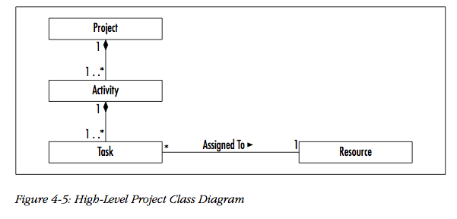

Slide 20
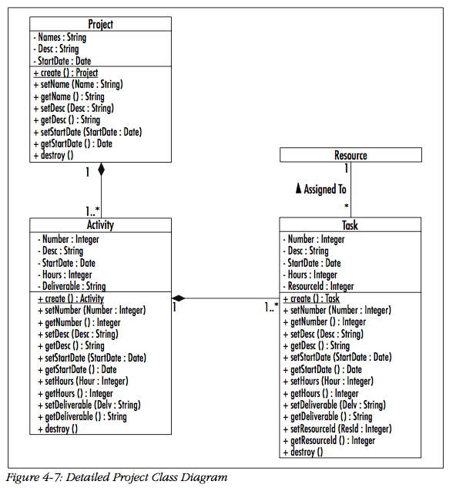

Slide 21
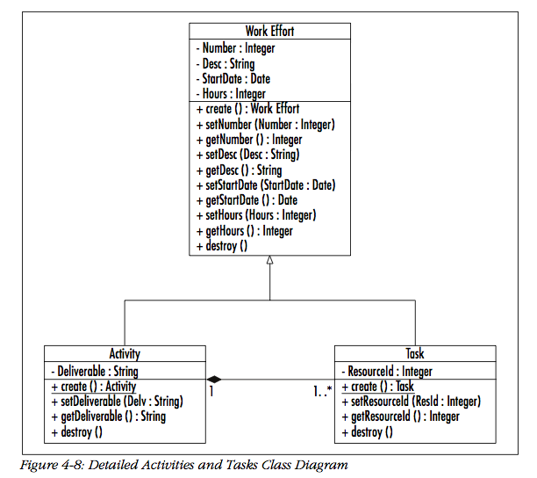

Slide 22
Sequence Diagrams
Sequence diagrams
Refine use cases
Gives view of dynamic behavior of classes
Class diagrams give the static class structure
Not orthogonal to other diagrams
Overlapping functionality
True of all UML diagrams

Slide 23
Sequence Diagrams
Class roles: roles that objects play
Lifelines: the existence of an object over time
Activations: time during which an object is performing an operation
Messages: communications between objects

Slide 24
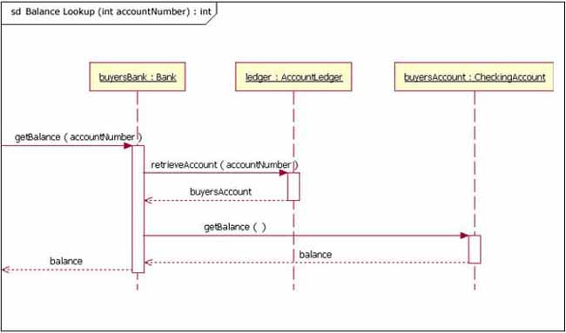
link

Slide 25
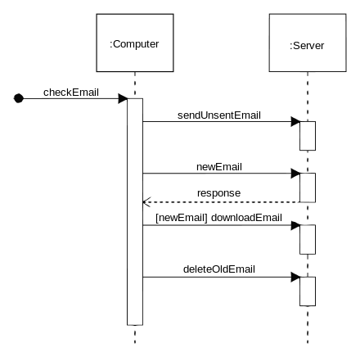
Notes:
Source: Wikipedia

Slide 26
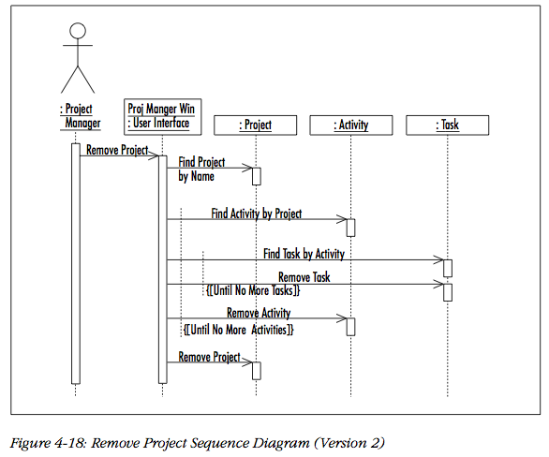

Slide 27
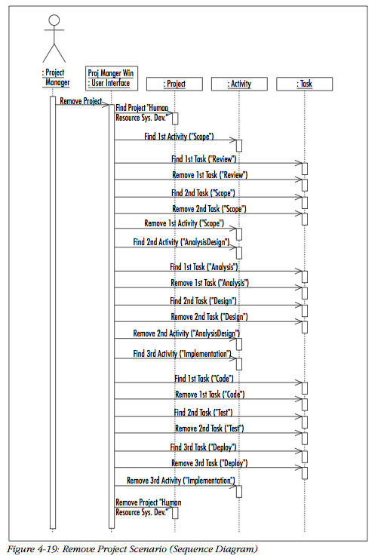

Slide 28
Activity Diagrams
Reincarnation of flow charts
Uses flowchart symbols
Emphasis on control-flow

Slide 29
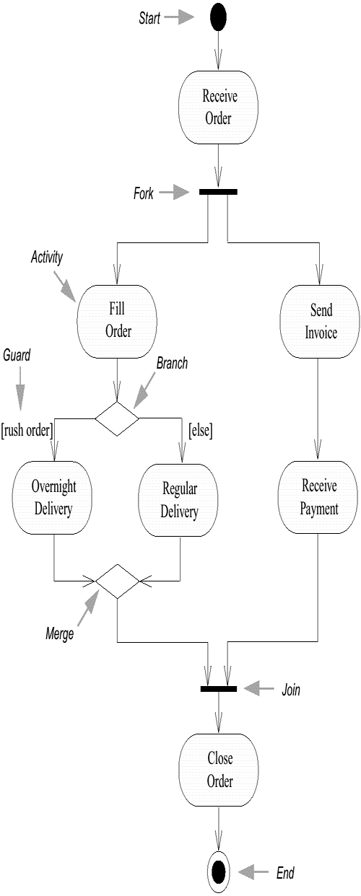

Slide 30
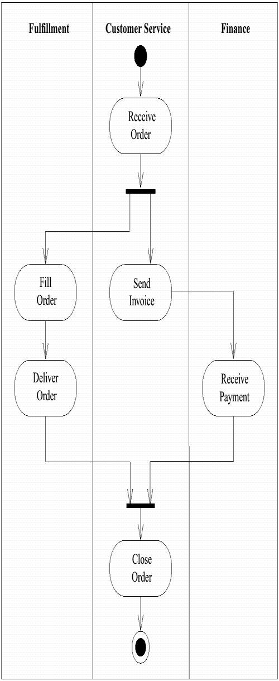

Slide 31
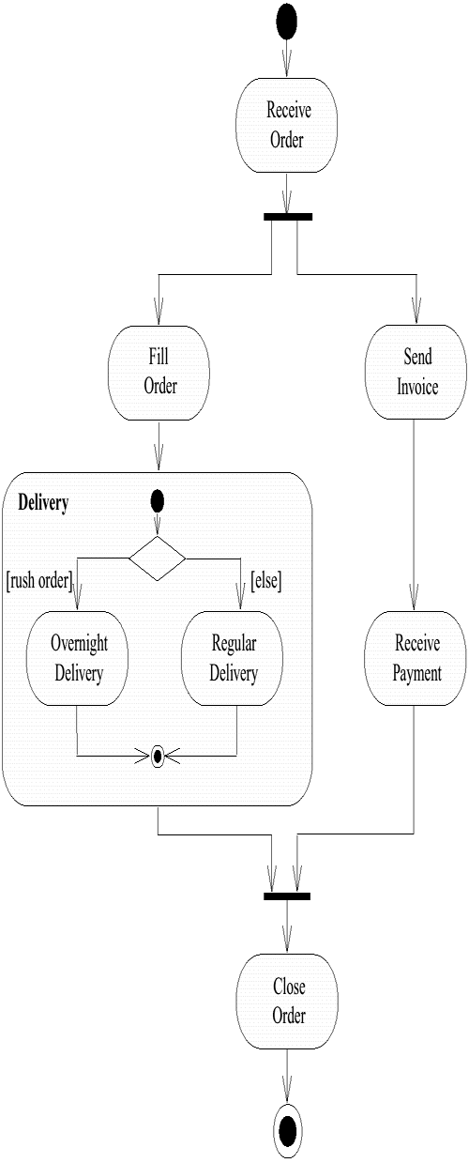
Order (input parameter)
Order (output parameter)

Slide 32
Activity Diagrams
Swimlanes: responsibility of one or more objects
Action states: steps in the execution of an algorithm
Action flows: relationship between the different action states
Object flow: utilization of objects by action states

Slide 34
StateChart Diagrams
Hierarchical finite automata
Invented by David Harel, 1983
Specify automata with many states compactly

Slide 35
Example Simple StateChart
Button
off
depart
push
on

Slide 36
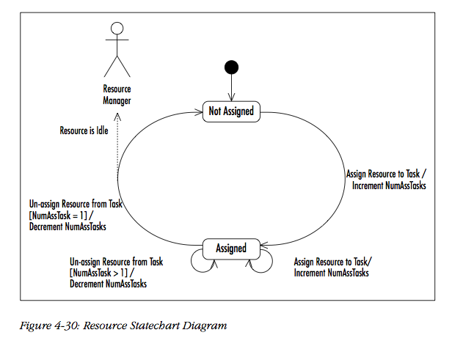

Slide 37
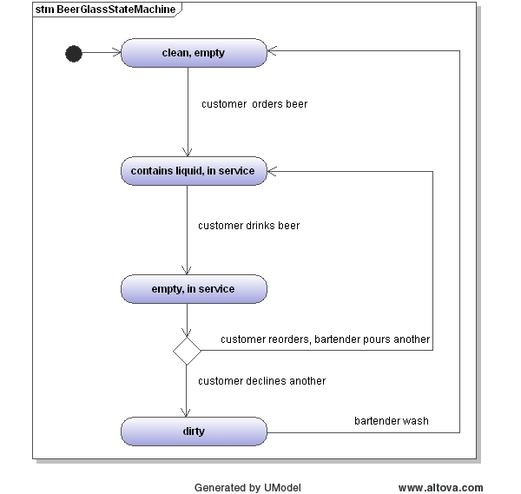

Slide 38
Opinions about UML: What’s Good
A common language
Makes it easier to share requirements, specs, designs
Visual syntax is useful, to a point
A (good) picture is worth 1000 words
For the non-technical, easier to grasp simple diagrams than simple pseudo-code
To the extent UML is precise, it forces clarity
Much better than natural language
Commercial tool support
Something natural language could never have

Slide 39
Opinions On UML: What’s Bad
Hodge-podge of ideas
Union of most popular modeling languages
Sublanguages remain largely unintegrated
Visual syntax does not scale well
Many details are hard to depict visually
Ad hoc text attached to diagrams
No visualization advantage for large diagrams
1000 pictures are very hard to understand

Slide 40
UML is Happening
UML is being widely adopted
By users
By tool vendors
By programmers
A step forward
Seems useful
First standard for high-levels of software process
Expect further evolution, development of UML

