Slide 1

Software Engineering
CSCI 420
Spring 2020

Slide 2
Course Material
There is no compulsory textbook for the course
There will be a list of suggested readings from web resources and research papers on the course website
“Debugging Teams”
Interesting books to read:
  Steve McConnell: "Code Complete: A Practical Handbook of Software Construction", ISBN-10: 0735619670
  Roger Pressman: "Software Engineering: A Practitioner's Approach", ISBN-10: 0073375977
  Ian Sommerville: "Software Engineering", ISBN-10: 0137035152

Slide 3
The Project
The only way to learn “software engineering” is by writing a large piece of code in a group
A BIG project solving a real-world problem
  Can be (almost) anything
Done in teams of 4-6 students
  You do everything
  Gather requirements, design, code, and test in several assignments
  This class should be very close to a startup experience

Slide 4
Project Timeline
Team assignments
Projects will be reviewed and analyzed by each other!
Requirements and specification
Project design & plan
Design review
  Done by instructor, sometimes other teams
Revised design & plan
Testing
  Tests performed by YOU (and me)
  NOT an afterthought!

Slide 5
The Ideas Behind the Project Structure
We will simulate the “real world”
In the real world, you often spend a lot of time maintaining/extending other people’s code
  This is where specifications, interfaces, documentation, etc pays off
  Shows the importance of institutional knowledge

Slide 6
What this course is (not) about?
Do not expect to learn a new language
Do not expect to learn programming tricks
  But you’ll learn techniques for “programming in the large”
Do not expect to learn management skills from the lectures
  Some things you learn by doing, not through lectures!

Slide 7
What this course is about?
Learn how to build a large software system in a team
  Learn how to collect requirements
  Learn how to write specification
  Learn how to design
Reliability is central to software engineering: This constitutes significant part of the course
  Version Control
  Testing
  Debugging
  Dynamic Analysis

Slide 8
What is Software Engineering?
As defined in IEEE Standard 610.12:
  The application of a systematic, disciplined, quantifiable approach to the development, operation, and maintenance of software; that is, the application of engineering to software.
Your opinion?
This definition is descriptive, not prescriptive
  It does not say how to do anything
  It just say what qualities S.E. should have
  As a result many people understand SE differently

Slide 9
Software Engineering Myths: Management
“We have books with rules. Isn’t that everything my people need?”
  Which book do you think is perfect for you?
“If we fall behind, we add more programmers”
  “Adding people to a late software project, makes it later” – Fred Brooks
“We can outsource it”
  If you do not know how to manage and control it internally, you will struggle to do this with outsiders

Slide 10
Software Engineering Myths: Customer
“We can refine the requirements later”
  A recipe for disaster.
“The good thing about software is that we can change it later easily”
  As time passes, cost of changes grows rapidly

Slide 11
Software Engineering Myths: Practitioner
“Let’s write the code, so we’ll be done faster”
  “The sooner you begin writing code, the longer it’ll take to finish”
  60-80% of effort is expended after first delivery
“Until I finish it, I cannot assess its quality”
  Software and design reviews are more effective than testing (find 5 times more bugs)
“There is no time for software engineering”
  But is there time to redo the software?

Slide 12
Our goals for software engineering
We want to build a system
How will we know the system works?
How do we develop system efficiently?
  Minimize time
  Minimize dollars
  Minimize …
How do we make software reliable?

Slide 13
How Do We Know the System Works?
Buggy software is a huge problem
  But you likely already know that
Defects in software are commonplace
  Much more common than in other engineering disciplines
Examples (see “Software Crisis” reading)
This is not inevitable---we can do better!

Slide 14
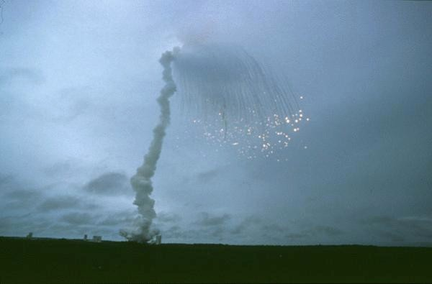
Software BUGs – SPACE disaster
Maiden flight of the Ariane 5 rocket on the 4th of June 1996
The reason for the explosion was a software error (Attempt to cram a 64-floating point number to a 16-bit integer failed)
Financial loss: $500,000,000
(including indirect costs: $2,000,000,000)

Slide 15
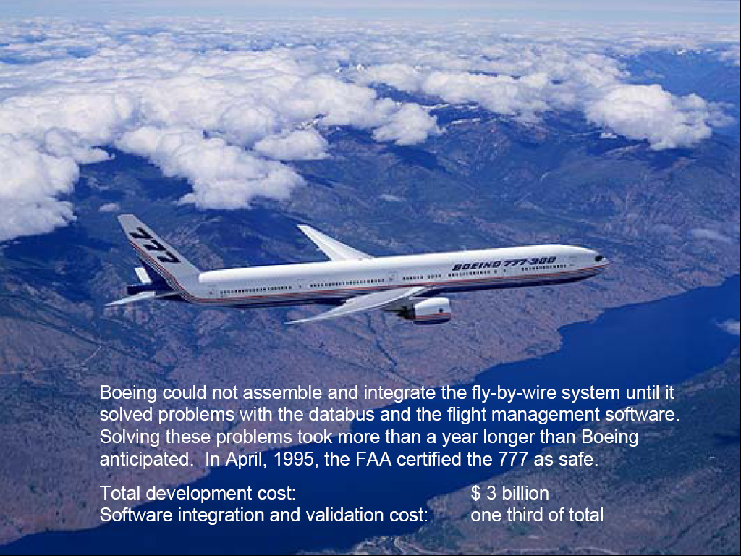
Air Transport

Slide 16
Financial Impact of Software Errors
Recent research at Cambridge University (2013, link) showed that the global cost of software bugs is
around 312 billion of dollars annually
Goal: to increase software reliability

Slide 17
How to identify software bugs?
How do we know behavior is a bug?
Because we have some separate specification of what the program must do
  Separate from the code
Thus, knowing whether the code works requires us first to define what “works” means
  A specification

Slide 18
Teams and Specifications
Do we really need to write specifications?
A typical software team will in general do the following:
  Discuss what to do
  Divide up the work
  Implement incompatible components
  Be surprised when it doesn’t all just work together

Slide 19
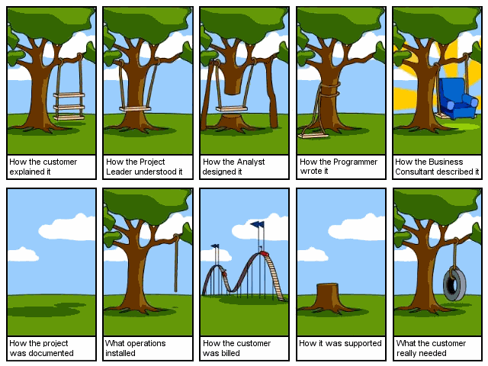
Cartoon

Slide 20
Cartoon

Slide 21
Cartoon

Slide 22
Cartoon

Slide 23
Cartoon

Slide 24
Cartoon

Slide 25
Cartoon

Slide 26
Cartoon

Slide 27
Cartoon

Slide 28
Cartoon

Slide 29
Specification
A specification allows us to:
  Check whether software works
  Build software in teams at all
Actually checking that software works is hard
  Code reviews
  Static analysis tools
  Testing and more testing
  We will examine this problem closely

Slide 30
How Do We Code Efficiently?
Assume we want to minimize time
  Usually the case
  Time-to-market exerts great pressure in software
How can we code faster?
  Obvious answer: Hire more programmers!

Slide 31
Parallel Development
How many programmers can we keep busy?
  As many as there are independent tasks
People can work on different modules
  Thus we get parallelism
  And save time
What are the pitfalls?

Slide 32
Pitfalls of Parallel Development
The problems are the same as in parallel computing
More people = more communication
  Which is hard
Individual tasks must not be too fine-grain
  Increases communication overhead further

Slide 33
Interfaces
The chunks of work must be independent
  But work together in the final system
We need interfaces between the components
  To isolate them from one another
  To ensure that the final system works
The interfaces must not change (much)!

Slide 34
Defining Interfaces
Interfaces are just specifications!
But of a special kind
  Interfaces are the boundaries between components
    And people
Specifying interfaces is most important
  Interfaces should not change a lot
  Effort must be spent ensuring everyone understands the interfaces
  Both things require preplanning and time
But often we can stop at specifying interfaces
  Let individual programmers handle the internals themselves

Slide 35
Efficient software development
Efficient development requires
  Decomposing system into pieces
  Good interfaces between pieces
The pieces should be large
  Don’t try to break up into too many pieces
Interfaces are specifications of boundaries
  Must be well thought-out and well communicated

Slide 36
How to obtain Software Reliability?
Testing, testing, testing, …
  Many software errors are detected this way
  Does not provide any correctness guarantee
  “Murphy’s Law”
Verification
  Provides a formal mathematical proof that a program is correct w.r.t. a certain property
  A formally verified program will work correctly for every given input
  Verification is algorithmically very hard task (problem is in general undecidable)

Slide 37
A Mathematical Proof of Program Correctness?
public void add (Object x)
{
Node e = new Node();
e.data = x;
e.next = root;
root = e;
size = size + 1;
}
Which property are you interested in?
Can you verify my program?

Slide 38
Example Questions in Verification
Will the program crash?
Does it compute the correct result?
Does it leak private information?
How long does it take to run?
How much power does it consume?
Will it turn off automated cruise control?

Slide 39
A Mathematical Proof of Program Correctness?
public void add (Object x)
{
Node e = new Node();
e.data = x;
e.next = root;
root = e;
size = size + 1;
}
I just want to be sure that
no element is lost in the list – if I insert an element, it is really there

Slide 40
A Mathematical Proof of Program Correctness?
//: L = data[root.next*]
public void add (Object x)
{
Node e = new Node();
e.data = x;
e.next = root;
root = e;
size = size + 1;
}
Let L be a set (a multiset) of all elements stored in the list …

Slide 41
A Mathematical Proof of Program Correctness?
//: L = data[root.next*]
//: invariant: size = card L
public void add (Object x)
//: ensures L = old L + {x}
{
Node e = new Node();
e.data = x;
e.next = root;
root = e;
size = size + 1;
}
Annotations

Slide 42
Annotations
Written by a programmer or a software analyst
Added to the original program code to express properties that allow reasoning about the programs
Examples:
  Preconditions:
    Describe properties of an input
  Postconditions:
    Describe what the program is supposed to do
  Invariants:
    Describe properties that have to hold in every program point

Slide 43
Decision Procedures for Collections
//: L = data[root.next*]
//: invariant: size = card L
public void add (Object x)
//: ensures L = old L + {x}
{
Node e = new Node();
e.data = x;
e.next = root;
root = e;
size = size + 1;
}
Prove that the following formula always holds:
∀ X. ∀ L. |X| = 1 → | L ⊎ X | = |L| + 1
Verification condition

Slide 44
Verification Conditions
Mathematical formulas derived based on:
  Code
  Annotations
If a verification condition always holds (valid), then to code is correct w.r.t. the given property
It does not depend on the input variables
If a verification condition does not hold, we should be able to detect an error in the code

Slide 45
Software Verification
correct
annotations
verifier
formulas
theorem prover
program
no

Slide 46

Automation of Verification
Windows XP has approximately 45 millions lines of source code
300.000 DIN A4 papers
12m high paper stack
Verification should be automated!!!

Slide 47
Conclusions
Software engineering boils down to several issues:
  Specification: Know what you want to do
  Design: Develop an efficient plan for doing it
  Programming: Do it
  Validation: Check that you have got what you wanted
Specifications are important
  To even define what you want to do
  To ensure everyone understands the plan

Slide 48
Disclaimer
CS Professors usually good at well-defined technical problems
May not be great at ill-defined non-technical problems
Take everything in this class with a pinch of salt
  Ultimately, the most important things you learn are those you learn through experience

