Slide 1
Graphs: Part II
Topological Sorting
Minimum Spanning Trees
Shortest Path

Slide 2
Topological Sort

Slide 3
Topological Sort
Problem: Given a DAG G=(V,E), output all vertices in an order such that no vertex appears before another vertex that has an edge to it
Example input:
Possible Output: 140 161 162 362 370 330 4XX 380 366 340 420 4XX 4XX
420
330
4XX
140
340
4XX
161
162
362
4XX
366
370
380

Slide 4
Questions and comments
Why do we perform topological sorts only on DAGs?
Because a cycle means there is no correct answer
Is there always a unique answer?
No, there can be 1 or more answers; depends on the graph
Graph with 5 topological orders:
Do some DAGs have exactly 1 answer?
Yes, including all lists
Terminology: A DAG represents a partial order and a topological sort produces a total order that is consistent with it
2
0
4
3
1

Slide 5
Uses
Figuring out how to graduate
Computing an order in which to recompute cells in a spreadsheet
Determining an order to compile files using a Makefile
In general, taking a dependency graph and finding an order of execution
…

Slide 6
An Algorithm for Topological Sort
Label (“mark”) each vertex with its in-degree
Think “write in a field in the vertex”
Could also do this via a data structure (e.g., array) on the side
While there are vertices not yet output:
Choose a vertex v with labeled with in-degree of 0
Output v and conceptually remove it from the graph
For each vertex u adjacent to v (i.e. u such that (v,u) in E), decrement the in-degree of u

Slide 7
Example
Output:
420
330
4XX
140
340
4XX
161
162
362
4XX
366
370
380
Node | 140 | 161 | 162 | 330 | 340 | 362 | 366 | 370 | 380 | 420 | 4XX | 4XX | 4XX
Removed
In-degree | 0 | 0 | 1 | 2 | 2 | 2 | 1 | 2 | 2 | 2 | 1 | 1 | 1

Slide 8
Example
Output:
161
420
330
4XX
140
340
4XX
161
162
362
4XX
366
370
380
Node | 140 | 161 | 162 | 330 | 340 | 362 | 366 | 370 | 380 | 420 | 4XX | 4XX | 4XX
Removed |  | x
In-degree | 0 | 0 | 0 | 2 | 2 | 2 | 1 | 2 | 2 | 2 | 1 | 1 | 1

Slide 9
Example
Output:
161
140
420
330
4XX
140
340
4XX
161
162
362
4XX
366
370
380
Node | 140 | 161 | 162 | 330 | 340 | 362 | 366 | 370 | 380 | 420 | 4XX | 4XX | 4XX
Removed | x | x
In-degree | 0 | 0 | 0 | 1 | 1 | 1 | 1 | 1 | 2 | 2 | 1 | 1 | 1

Slide 10
Example
Output:
161
140
162
420
330
4XX
140
340
4XX
161
162
362
4XX
366
370
380
Node | 140 | 161 | 162 | 330 | 340 | 362 | 366 | 370 | 380 | 420 | 4XX | 4XX | 4XX
Removed | x | x | x
In-degree | 0 | 0 | 0 | 0 | 0 | 0 | 1 | 0 | 2 | 2 | 1 | 1 | 1

Slide 11
Example
Output:
161
140
162
370
420
330
4XX
140
340
4XX
161
162
362
4XX
366
370
380
Node | 140 | 161 | 162 | 330 | 340 | 362 | 366 | 370 | 380 | 420 | 4XX | 4XX | 4XX
Removed | x | x | x |  |  |  |  | x
In-degree | 0 | 0 | 0 | 0 | 0 | 0 | 1 | 0 | 1 | 2 | 1 | 1 | 1

Slide 12
Example
Output:
161
140
162
370
362
420
330
4XX
140
340
4XX
161
162
362
4XX
366
370
380
Node | 140 | 161 | 162 | 330 | 340 | 362 | 366 | 370 | 380 | 420 | 4XX | 4XX | 4XX
Removed | x | x | x |  |  | x |  | x
In-degree | 0 | 0 | 0 | 0 | 0 | 0 | 0 | 0 | 0 | 1 | 0 | 0 | 0

Slide 13
Example
Output:
161
140
162
370
362
366
420
330
4XX
140
340
4XX
161
162
362
4XX
366
370
380
Node | 140 | 161 | 162 | 330 | 340 | 362 | 366 | 370 | 380 | 420 | 4XX | 4XX | 4XX
Removed | x | x | x |  |  | x | x | x
In-degree | 0 | 0 | 0 | 0 | 0 | 0 | 0 | 0 | 0 | 1 | 0 | 0 | 0

Slide 14
Example
Output:
161
140
162
370
362
366
4XX
420
330
4XX
140
340
4XX
161
162
362
4XX
366
370
380
Node | 140 | 161 | 162 | 330 | 340 | 362 | 366 | 370 | 380 | 420 | 4XX | 4XX | 4XX
Removed | x | x | x |  |  | x | x | x |  |  | x
In-degree | 0 | 0 | 0 | 0 | 0 | 0 | 0 | 0 | 0 | 1 | 0 | 0 | 0

Slide 15
Example
Output:
161
140
162
370
362
366
4XX
340
420
330
4XX
140
340
4XX
161
162
362
4XX
366
370
380
Node | 140 | 161 | 162 | 330 | 340 | 362 | 366 | 370 | 380 | 420 | 4XX | 4XX | 4XX
Removed | x | x | x |  | x | x | x | x |  |  | x
In-degree | 0 | 0 | 0 | 0 | 0 | 0 | 0 | 0 | 0 | 1 | 0 | 0 | 0

Slide 16
Example
Output:
161
140
162
370
362
366
4XX
340
330
420
330
4XX
140
340
4XX
161
162
362
4XX
366
370
380
Node | 140 | 161 | 162 | 330 | 340 | 362 | 366 | 370 | 380 | 420 | 4XX | 4XX | 4XX
Removed | x | x | x | x | x | x | x | x |  |  | x
In-degree | 0 | 0 | 0 | 0 | 0 | 0 | 0 | 0 | 0 | 0 | 0 | 0 | 0

Slide 17
Example
Output:
161
140
162
370
362
366
4XX
340
330
380
420
330
4XX
140
340
4XX
161
162
362
4XX
366
370
380
Node | 140 | 161 | 162 | 330 | 340 | 362 | 366 | 370 | 380 | 420 | 4XX | 4XX | 4XX
Removed | x | x | x | x | x | x | x | x | x |  | x
In-degree | 0 | 0 | 0 | 0 | 0 | 0 | 0 | 0 | 0 | 0 | 0 | 0 | 0

Slide 18
Example
Output:
161
140
162
370
362
366
4XX
340
330
380
4XX
420
330
4XX
140
340
4XX
161
162
362
4XX
366
370
380
Node | 140 | 161 | 162 | 330 | 340 | 362 | 366 | 370 | 380 | 420 | 4XX | 4XX | 4XX
Removed | x | x | x | x | x | x | x | x | x |  | x | x
In-degree | 0 | 0 | 0 | 0 | 0 | 0 | 0 | 0 | 0 | 0 | 0 | 0 | 0

Slide 19
Example
Output:
161
140
162
370
362
366
4XX
340
330
380
4XX
420
420
330
4XX
140
340
4XX
161
162
362
4XX
366
370
380
Node | 140 | 161 | 162 | 330 | 340 | 362 | 366 | 370 | 380 | 420 | 4XX | 4XX | 4XX
Removed | x | x | x | x | x | x | x | x | x | x | x | x
In-degree | 0 | 0 | 0 | 0 | 0 | 0 | 0 | 0 | 0 | 0 | 0 | 0 | 0

Slide 20
Example
Output:
161
140
162
370
362
366
4XX
340
330
380
4XX
420
4XX
420
330
4XX
140
340
4XX
161
162
362
4XX
366
370
380
Node | 140 | 161 | 162 | 330 | 340 | 362 | 366 | 370 | 380 | 420 | 4XX | 4XX | 4XX
Removed | x | x | x | x | x | x | x | x | x | x | x | x | x
In-degree | 0 | 0 | 0 | 0 | 0 | 0 | 0 | 0 | 0 | 0 | 0 | 0 | 0

Slide 21
Notice
Needed a vertex with in-degree 0 to start
Will always have at least 1 because no cycles
Ties among vertices with in-degrees of 0 can be broken arbitrarily
Can be more than one correct answer, by definition, depending on the graph

Slide 22
Pseudocode
Using a queue:
Label each vertex with its in-degree, enqueue 0-degree nodes
While queue is not empty
v = dequeue()
Output v and remove it from the graph
For each vertex u adjacent to v (i.e. u such that (v,u) in E), decrement the in-degree of u, if new degree is 0, enqueue it

Slide 23
Running time?
labelAllAndEnqueueZeros();
while queue not empty {
v = dequeue();
put v next in output
for each w adjacent to v {
w.indegree--;
if (w.indegree==0)
enqueue(v);
}
}
What is the worst-case running time?
Initialization: O(|V|+|E|) (assuming adjacenty list)
Sum of all enqueues and dequeues: O(|V|)
Sum of all decrements: O(|E|) (assuming adjacency list)
So total is O(|E| + |V|) – much better for sparse graph!

Slide 24
Minimum Spanning Trees

Slide 25
Idea: Prim’s Algorithm
Central Idea:
Grow a tree by adding an edge from the “known” vertices to the “unknown” vertices.
Pick the edge with the smallest weight that connects “known” to “unknown.”

Slide 26
Pseudocode: Prim's Algorithm
For each node v, set v.cost = ∞ and v.known = false
Choose any node v.
Mark v as known
For each edge (v,u) with weight w, set u.cost = w and u.prev = v
While there are unknown nodes in the graph
Select the unknown node v with lowest cost
Mark v as known and add (v, v.prev) to output
For each edge (v,u) with weight w,
if (w < u.cost) {
u.cost = w;
u.prev = v;
}

Slide 27
Example: Prim's Algorithm
2
A
B
1
1
5
2
1
E
1
D
C
5
3
6
G
vertex | known? | cost | prev
A
B
C
D
E
F
G
10
2
F

Slide 28
Example: Prim's Algorithm
2
A
B
1
1
5
2
1
E
1
D
C
5
3
6
G
vertex | known? | cost | prev
A | Y | 0 | -
B |  | 2 | A
C |  | 2 | A
D |  | 1 | A
E
F
G
10
2
F

Slide 29
Example: Prim's Algorithm
2
A
B
1
1
5
2
1
E
1
D
C
5
3
6
G
vertex | known? | cost | prev
A | Y | 0 | -
B |  | 2 | A
C |  | 2 1 | A D
D | Y | 1 | A
E |  | 1 | D
F |  | 6 | D
G |  | 5 | D
10
2
F

Slide 30
Example: Prim's Algorithm
2
A
B
1
1
5
2
1
E
1
D
C
5
3
6
G
vertex | known? | cost | prev
A | Y | 0 | -
B |  | 2 | A
C | Y | 2 1 | A D
D | Y | 1 | A
E |  | 1 | D
F |  | 6 2 | D C
G |  | 5 | D
10
2
F

Slide 31
Example: Prim's Algorithm
2
A
B
1
1
5
2
1
E
1
D
C
5
3
6
G
vertex | known? | cost | prev
A | Y | 0 | -
B |  | 2 1 | A E
C | Y | 2 1 | A D
D | Y | 1 | A
E | Y | 1 | D
F |  | 6 2 | D C
G |  | 5 3 | D E
10
2
F

Slide 32
Example: Prim's Algorithm
2
A
B
1
1
5
2
1
E
1
D
C
5
3
6
G
vertex | known? | cost | prev
A | Y | 0 | -
B | Y | 2 1 | A E
C | Y | 2 1 | A D
D | Y | 1 | A
E | Y | 1 | D
F |  | 6 2 | D C
G |  | 5 3 | D E
10
2
F

Slide 33
Example: Prim's Algorithm
2
A
B
1
1
5
2
1
E
1
D
C
5
3
6
G
vertex | known? | cost | prev
A | Y | 0 | -
B | Y | 2 1 | A E
C | Y | 2 1 | A D
D | Y | 1 | A
E | Y | 1 | D
F | Y | 6 2 | D C
G |  | 5 3 | D E
10
2
F

Slide 34
Example: Prim's Algorithm
2
A
B
1
1
5
2
1
E
1
D
C
5
3
6
G
vertex | known? | cost | prev
A | Y | 0 | -
B | Y | 2 1 | A E
C | Y | 2 1 | A D
D | Y | 1 | A
E | Y | 1 | D
F | Y | 6 2 | D C
G | Y | 5 3 | D E
10
2
F

Slide 35
Example: Prim's Algorithm
Output:
(A, D) (C, F)
(B, E) (D, E)
(C, D) (E, G)
Total Cost: 9
2
A
B
1
1
5
2
1
E
1
D
C
5
3
6
G
vertex | known? | cost | prev
A | Y | 0 | -
B | Y | 2 1 | A E
C | Y | 2 1 | A D
D | Y | 1 | A
E | Y | 1 | D
F | Y | 6 2 | D C
G | Y | 5 3 | D E
10
2
F

Slide 36
Running time of Prim’s algorithm (without heaps)
Initialization of priority queue (array): O(|V|)
Update loop: |V| calls
Choosing vertex with minimum cost edge: O(|V|)
Updating distance values of unconnected vertices: each edge is considered only once during entire execution, for a total of O(|E|) updates
Overall cost without heaps:
O(|E| + |V| ²)

Slide 37
Prim’s Algorithm Invariant
At each step, we add the edge (u,v) s.t. the weight of (u,v) is minimum among all edges where u is in the tree and v is not in the tree
Each step maintains a minimum spanning tree of the vertices that have been included thus far
When all vertices have been included, we have a MST for the graph!

Slide 38
Idea: Kruskal’s Algorithm
Central Idea:
Grow a forest out of edges that do not grow a cycle, just like for the spanning tree problem.
But now consider the edges in order by weight
Basic implementation:
Sort edges by weight → O(|E| log |E|) = O(|E| log |V|)
Iterate through edges using Disjoint Sets for cycle detection → O(|E| log |V|)

Slide 39
Pseudocode: Kruskal's Algorithm
Put edges in min-heap using edge weights
Create Disjoint Set with each vertex in its own set
While output size < |V|-1
Consider next smallest edge (u,v)
if find(u,v) indicates u and v are in different sets
output (u,v)
union(u,v)
Recall invariant:
u and v in same set if and only if connected in output-so-far

Slide 40
Example: Kruskal's Algorithm
Edges in sorted order:
1: (A,D) (C,D) (B,E) (D,E)
2: (A,B) (C,F) (A,C)
3: (E,G)
5: (D,G) (B,D)
6: (D,F)
10: (F,G)
2
A
B
1
1
5
2
1
E
1
D
C
5
3
6
G
10
2
F
Sets: (A) (B) (C) (D) (E) (F) (G)
Output:
At each step, the union/find sets are the trees in the forest

Slide 41
Example: Kruskal's Algorithm
Edges in sorted order:
1: (A,D) (C,D) (B,E) (D,E)
2: (A,B) (C,F) (A,C)
3: (E,G)
5: (D,G) (B,D)
6: (D,F)
10: (F,G)
2
A
B
1
1
5
2
1
E
1
D
C
5
3
6
G
10
2
F
Sets: (A,D) (B) (C) (E) (F) (G)
Output: (A,D)
At each step, the union/find sets are the trees in the forest

Slide 42
Example: Kruskal's Algorithm
Edges in sorted order:
1: (A,D) (C,D) (B,E) (D,E)
2: (A,B) (C,F) (A,C)
3: (E,G)
5: (D,G) (B,D)
6: (D,F)
10: (F,G)
2
A
B
1
1
5
2
1
E
1
D
C
5
3
6
G
10
2
F
Sets: (A,C,D) (B) (E) (F) (G)
Output: (A,D) (C,D)
At each step, the union/find sets are the trees in the forest

Slide 43
Example: Kruskal's Algorithm
Edges in sorted order:
1: (A,D) (C,D) (B,E) (D,E)
2: (A,B) (C,F) (A,C)
3: (E,G)
5: (D,G) (B,D)
6: (D,F)
10: (F,G)
2
A
B
1
1
5
2
1
E
1
D
C
5
3
6
G
10
2
F
Sets: (A,C,D) (B,E) (F) (G)
Output: (A,D) (C,D) (B,E)
At each step, the union/find sets are the trees in the forest

Slide 44
Example: Kruskal's Algorithm
Edges in sorted order:
1: (A,D) (C,D) (B,E) (D,E)
2: (A,B) (C,F) (A,C)
3: (E,G)
5: (D,G) (B,D)
6: (D,F)
10: (F,G)
2
A
B
1
1
5
2
1
E
1
D
C
5
3
6
G
10
2
F
Sets: (A,B,C,D,E) (F) (G)
Output: (A,D) (C,D) (B,E) (D,E)
At each step, the union/find sets are the trees in the forest

Slide 45
Example: Kruskal's Algorithm
Edges in sorted order:
1: (A,D) (C,D) (B,E) (D,E)
2: (A,B) (C,F) (A,C)
3: (E,G)
5: (D,G) (B,D)
6: (D,F)
10: (F,G)
A
B
1
1
5
2
1
E
1
D
C
5
3
6
G
10
2
F
Sets: (A,B,C,D,E) (F) (G)
Output: (A,D) (C,D) (B,E) (D,E)
At each step, the union/find sets are the trees in the forest

Slide 46
Example: Kruskal's Algorithm
Edges in sorted order:
1: (A,D) (C,D) (B,E) (D,E)
2: (A,B) (C,F) (A,C)
3: (E,G)
5: (D,G) (B,D)
6: (D,F)
10: (F,G)
A
B
1
1
5
2
1
E
1
D
C
5
3
6
G
10
2
F
Sets: (A,B,C,D,E,F) (G)
Output: (A,D) (C,D) (B,E) (D,E) (C,F)
At each step, the union/find sets are the trees in the forest

Slide 47
Example: Kruskal's Algorithm
Edges in sorted order:
1: (A,D) (C,D) (B,E) (D,E)
2: (A,B) (C,F) (A,C)
3: (E,G)
5: (D,G) (B,D)
6: (D,F)
10: (F,G)
A
B
1
1
5
1
E
1
D
C
5
3
6
G
10
2
F
Sets: (A,B,C,D,E,F) (G)
Output: (A,D) (C,D) (B,E) (D,E) (C,F)
At each step, the union/find sets are the trees in the forest

Slide 48
Example: Kruskal's Algorithm
Edges in sorted order:
1: (A,D) (C,D) (B,E) (D,E)
2: (A,B) (C,F) (A,C)
3: (E,G)
5: (D,G) (B,D)
6: (D,F)
10: (F,G)
A
B
1
1
5
1
E
1
D
C
5
3
6
G
10
2
F
Sets: (A,B,C,D,E,F,G)
Output: (A,D) (C,D) (B,E) (D,E) (C,F) (E,G)
At each step, the union/find sets are the trees in the forest

Slide 49
Analysis: Kruskal's Algorithm
Correctness: It is a spanning tree
When we add an edge, it adds a vertex to the tree (or else it would have created a cycle)
The graph is connected, we consider all edges
Correctness: That it is minimum weight
Can be shown by induction
At every step, the output is a subset of a minimum tree
Run-time
O(|E| log |V|)

Slide 50
Greedy Approach
Prim’s and Kruskal’s algorithms are greedy algorithms
We never had to backtrack
The greedy approach works for the MST problem; however, it does not work for many other problems!

Slide 51
So Which Is Better?
Time/space complexities essentially the same
Both are fairly simple to implement
Still, Kruskal's is slightly better
If the graph is not connected, Kruskal's will find a forest of minimum spanning trees

Slide 52
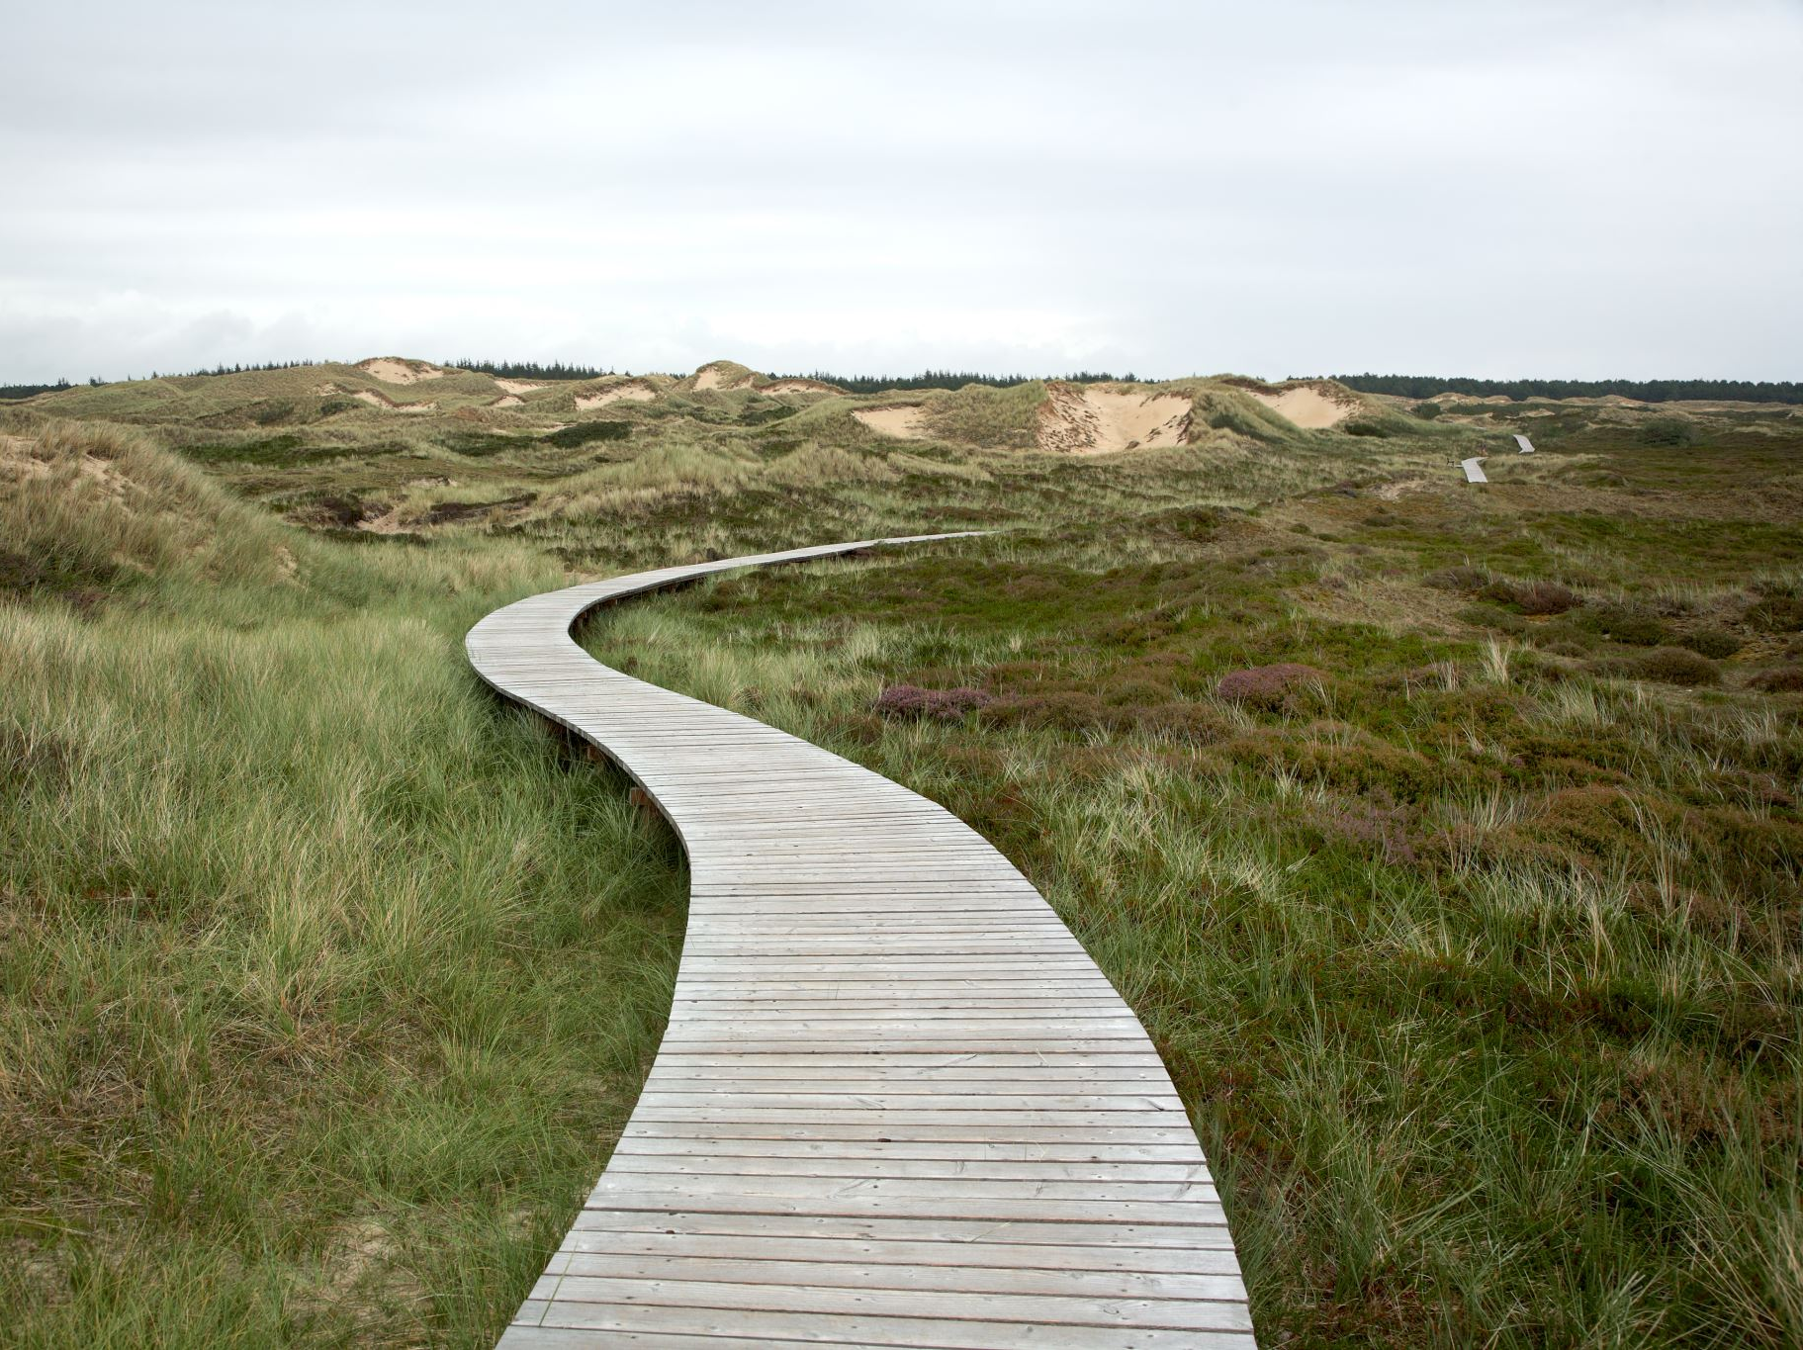
Shortest Path

Slide 53
Shortest Path
Given a weighted directed graph, one common problem is finding the shortest path between two given vertices
Recall that in a weighted graph, the length of a path is the sum of the weights of each of the edges in that path

Slide 54
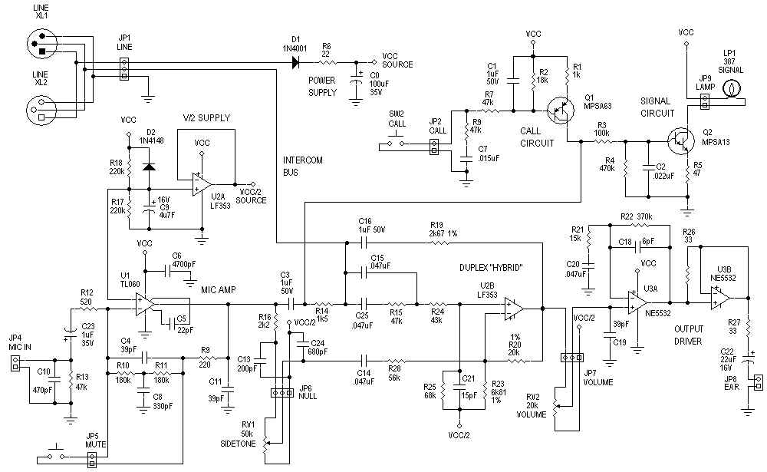
Applications
One application is circuit design: the time it takes for a change in input to affect an output depends on the shortest path
http://www.hp.com/

Slide 55
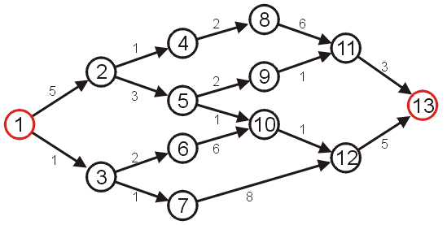
Shortest Path
Given the graph below, suppose we wish to find the shortest path from vertex 1 to vertex 13

Slide 56
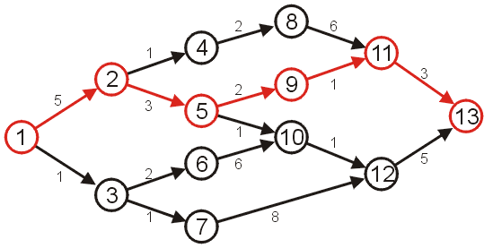
Shortest Path
After some consideration, we may determine that the shortest path is as follows, with length 14
Other paths exists, but they are longer

Slide 57
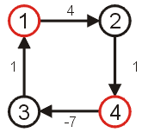
Negative Cycles
Clearly, if we have negative vertices, it may be possible to end up in a cycle whereby each pass through the cycle decreases the total length
Thus, a shortest length would be undefined for such a graph
Consider the shortest path from vertex 1 to 4...
We will only consider non- negative weights.

Slide 58
Shortest Path Example
Given:
Weighted Directed graph G = (V, E).
Source s, destination t.
Find shortest directed path from s to t.
2
23
3
9
Cost of path s-2-3-5-t = 9 + 23 + 2 + 16 = 48.
s
18
14
2
6
6
30
4
19
15
5
11
5
6
20
16
7
t
44

Slide 59
Discussion Items
How many possible paths are there from s to t?
Can we safely ignore cycles? If so, how?
Any suggestions on how to reduce the set of possibilities?
Can we determine a lower bound on the complexity like we did for comparison sorting?
2
23
3
9
s
18
14
2
6
6
30
4
19
15
5
11
5
6
20
16
7
t
44

Slide 60
Key Observation
A key observation is that if the shortest path contains the node v, then:
It will only contain v once, as any cycles will only add to the length.
The path from s to v must be the shortest path to v from s.
The path from v to t must be the shortest path to t from v.
Thus, if we can determine the shortest path to all other vertices that are incident to the target vertex we can easily compute the shortest path.
Implies a set of sub-problems on the graph with the target vertex removed.

Slide 61
Dijkstra’s Algorithm
Works when all of the weights are positive.
Provides the shortest paths from a source to all other vertices in the graph.
Can be terminated early once the shortest path to t is found if desired.

Slide 62
Relaxation
Maintaining this shortest discovered distance d[v] is called relaxation:
Relax(u,v,w) {
if (d[v] > d[u]+w) then
d[v]=d[u]+w;
}
5
2
9
5
2
6
u
Relax
v
u
Relax
v
5
2
7
5
2
6

Slide 63
Dijkstra’s algorithm
d[s] ← 0
for each v ∈ V – {s}
do d[v] ← ∞
Seen ← ∅
Q ← V ⊳ Q is a priority queue maintaining V – Seen
while Q ≠ ∅
do u ← EXTRACT-MIN(Q)
Seen ← Seen ∪ {u}
for each v ∈ Adj[u]
do if d[v] > d[u] + w(u, v)
then d[v] ← d[u] + w(u, v)
p[v] ← u

Slide 64
Dijkstra’s algorithm
d[s] ← 0
for each v ∈ V – {s}
do d[v] ← ∞
Seen ← ∅
Q ← V ⊳ Q is a priority queue maintaining V – Seen
while Q ≠ ∅
do u ← EXTRACT-MIN(Q)
Seen ← Seen ∪ {u}
for each v ∈ Adj[u]
do if d[v] > d[u] + w(u, v)
then d[v] ← d[u] + w(u, v)
p[v] ← u
relaxation step
Implicit DECREASE-KEY

Slide 65
Example of Dijkstra’s algorithm
2
Graph with nonnegative edge weights:
B
D
10
A
8
1
4
7
9
3
C
E
2

Slide 66
Example of Dijkstra’s algorithm
∞
∞
Initialize:
2
B
D
10
A
8
0
1
4
7
9
3
Q:
A
B
C
D
E
C
E
2
0
∞
∞
∞
∞
∞
∞
S: {}

Slide 67
Example of Dijkstra’s algorithm
∞
∞
“A” ← EXTRACT-MIN(Q):
2
B
D
10
A
8
0
1
4
7
9
3
Q:
A
B
C
D
E
C
E
2
0
∞
∞
∞
∞
∞
∞
S: { A }

Slide 68
Example of Dijkstra’s algorithm
10
∞
Relax all edges leaving A:
2
B
D
10
A
8
0
1
4
7
9
3
Q:
A
B
C
D
E
C
E
2
0
∞
∞
∞
∞
3
∞
10
3
∞
∞
S: { A }

Slide 69
Example of Dijkstra’s algorithm
10
∞
“C” ← EXTRACT-MIN(Q):
2
B
D
10
A
8
0
1
4
7
9
3
Q:
A
B
C
D
E
C
E
2
0
∞
∞
∞
∞
3
∞
10
3
∞
∞
S: { A, C }

Slide 70
Example of Dijkstra’s algorithm
7
11
Relax all edges leaving C:
2
B
D
10
A
8
0
1
4
7
9
3
Q:
A
B
C
D
E
C
E
2
0
∞
∞
∞
∞
3
5
10
3
∞
∞
7
11
5
S: { A, C }

Slide 71
Example of Dijkstra’s algorithm
7
11
“E” ← EXTRACT-MIN(Q):
2
B
D
10
A
8
0
1
4
7
9
3
Q:
A
B
C
D
E
C
E
2
0
∞
∞
∞
∞
3
5
10
3
∞
∞
7
11
5
S: { A, C, E }

Slide 72
Example of Dijkstra’s algorithm
7
11
Relax all edges leaving E:
2
B
D
10
A
8
0
1
4
7
9
3
Q:
A
B
C
D
E
C
E
2
0
∞
∞
∞
∞
3
5
10
3
∞
∞
7
11
5
S: { A, C, E }
7
11

Slide 73
Example of Dijkstra’s algorithm
7
11
“B” ← EXTRACT-MIN(Q):
2
B
D
10
A
8
0
1
4
7
9
3
Q:
A
B
C
D
E
C
E
2
0
∞
∞
∞
∞
3
5
10
3
∞
∞
7
11
5
S: { A, C, E, B }
7
11

Slide 74
Example of Dijkstra’s algorithm
7
9
Relax all edges leaving B:
2
B
D
10
A
8
0
1
4
7
9
3
Q:
A
B
C
D
E
C
E
2
0
∞
∞
∞
∞
3
5
10
3
∞
∞
7
11
5
S: { A, C, E, B }
7
11
9

Slide 75
Example of Dijkstra’s algorithm
7
9
“D” ← EXTRACT-MIN(Q):
2
B
D
10
A
8
0
1
4
7
9
3
Q:
A
B
C
D
E
C
E
2
0
∞
∞
∞
∞
3
5
10
3
∞
∞
7
11
5
S: { A, C, E, B, D }
7
11
9

Slide 76
Summary
Given a weighted directed graph, we can find the shortest distance between two vertices by:
starting with a trivial path containing the initial vertex
growing this path by always going to the next vertex which has the shortest current path

Slide 77
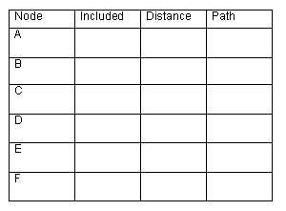
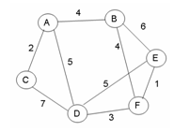
Practice
-
-
t
f
t
4
A
f
t
2
A
f
t
5
A
∞
-
B
F
f
t
10
9
f
t
∞
8
-
B
Give the shortest path tree for node A for this graph using Dijkstra’s shortest path algorithm. Show your work with the 3 arrays given and draw the resultant shortest path tree with edge weights included.

Slide 78
Bellman-Ford Algorithm
BellmanFord()
for each v ∈ V
d[v] = ∞;
d[s] = 0;
for i=1 to |V|-1
for each edge (u,v) ∈ E
Relax(u,v, w(u,v));
for each edge (u,v) ∈ E
if (d[v] > d[u] + w(u,v))
return “no solution”;
Relax(u,v,w): if (d[v] > d[u]+w) then d[v]=d[u]+w
Initialize d[] which
will converge to shortest-path value
Relaxation: Make |V|-1 passes,
relaxing each edge
Test for solution:
have we converged yet? Ie, ∃ negative cycle?

Slide 79
Specialization: DAG Shortest Paths
Bellman-Ford takes O(VE) time.
For finding shortest paths in a DAG, we can do much better by using a topological sort.
If we process vertices in topological order, we are guaranteed to never relax a vertex unless the adjacent edge is already finalized. Thus: just one pass. O(V+E)
DAG-Shortest-Paths(G, w, s)
topologically sort the vertices of G
INITIALIZE-SINGLE-SOURCE(G, s)
for each vertex u, taken in topologically sorted order
do for each vertex v ∈ Adj[u]
do Relax(u, v, w)

Slide 80
Specialization: DAG Shortest Paths

