Slide 1
Implementing Unordered Associative Containers
std::unordered_set and std::unordered_map

Slide 2
Associative Containers
Categories
Ordered (OAC)
set, multiset, map, multimap
Unordered (UAC)
unordered_set, unordered_multiset, unordered_map, unordered_multimap
OACs use red/black BSTs
UACs use hash tables

Slide 3
Unordered Sets and Maps
How do we use the UAC containers?
#include <unordered_set> or <unordered_map>
Classes
unordered_set, unordered_multiset
unordered_map, unordered_multimap
API very similar to ordered containers

Slide 4
Hash Tables

Slide 5
Hash Tables
Hash table
Vector of slots
Each slot holds
One object (open addressing), *or*
Collection of objects (separate chaining)
Average insert, erase, find ops. take O(1)!
Worst case is O(N)
Used by databases, spell checkers, scripting languages (associative arrays)
Notes:
Perl hashes, Python dictionaries, JavaScript non-scalar objects
var dict = { }; dict[k1] = v1; …

Slide 6
Hash Tables (Cont’d)
Main idea
Store key k in slot given by a hash function: hf (k)
hf: KeySet → SlotSet
Issues
| KeySet | >> | SlotSet |, so hf cannot be 1-1
If two keys map to same slot have a collision
Deletion can be tricky

Slide 7
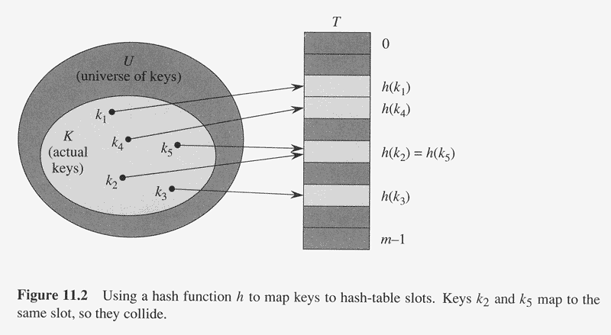
Graphical Overview (Open Addressing)
Table size is m,
which is chosen
to be prime

Slide 8
Collisions
Collision resolution strategies
Open addressing (slot only holds one object)
linear or quadratic probing
double hashing
Separate chaining
In this case slot is called bucket (Usually a singly-linked list)
Approach taken by Standard Library

Slide 9
Open Addressing
Compute slot as follows:
t = hf (k)
slot = t % m
In this example, hf(x) = x
Notes:
Note hash function can be arbitrary. Identity does job here

Slide 10
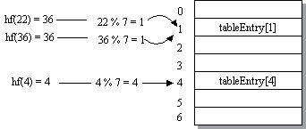
Open Addressing (Cont’d)
Inserting 36 causes collision

Slide 11
Collision Resolution by Open Addressing
Given a key k, try slots
h₀(k), h₁(k), h₂(k), …, h_{i}(k)
h_{i} (k) = (hf (k) + F (i)) % m
F is the collision resolution function
Linear: F(i) = i
Quadratic: F(i) = i²
Double Hashing: F(i) = i * hf₂(k)

Slide 12
Collision Resolution (Open Addressing w/Linear Probing)
Notes:
Keep status: Empty, Full, Erased

Slide 13
Erase and Find (Open Addressing)
How to find a key?
Examine slots h₀(k), h₁(k), … until hit empty slot
How to erase a key?
How does this affect find?
How does this affect insert?

Slide 14
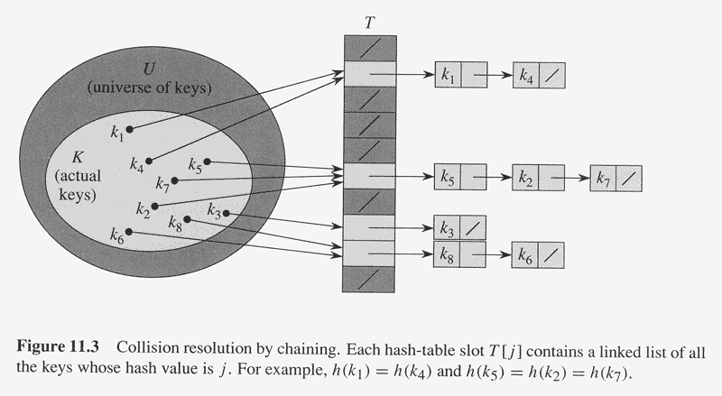
Collision Resolution (Chaining)

Slide 15
Collision Resolution with Chaining
const size_t TABLE_SIZE = 11; // Prime
std::vector<std::list<int>> table (TABLE_SIZE);
// To insert or find a key
size_t index = hf (key) % TABLE_SIZE;
// Walk list at table[index]
Buckets are often
singly-linked lists

Slide 16
Hash Functions
Goals
Distribute keys evenly
Minimize collisions
Fast to compute
Handle non-integral keys
Default for unordered_* containers usually OK
Can supply our own if desired

Slide 17
Hash Functions (Cont’d)
Division Method
Works well in most cases
slot(k) = k % m (where k is an integer from hash fn.)
Can be bad if keys have similar characteristics
Suppose m = 25
0, 25, 50, 75, 100, …, map to 0
5, 30, 55, 80, 105, …, map to 5
10, 35, 60, 85, 110, …, map to 10
15, 40, 65, 90, 115, …, map to 15
20, 45, 70, 95, 120, …, map to 20
Avoid by making m prime!
Notes:
Multiples of 5 cluster

Slide 18
A Hash Function For Strings
struct HashString {
unsigned
operator () (const string& key) const
{
unsigned n = 5381; // Prime
for (unsigned i = 0;
i < key.length (); ++i)
n = (n * 33) + key[i]; // Horner’s Rule
return n;
}
};
// Header <unordered_set>
unordered_set<string, HashString> mySet;
mySet.insert (“ToucanSam”);
Notes:
a0 + a1 x + a2 x^2 + a3 x^3 = a0 + x(a1 + x(a2 + x a3))

Slide 19
Implementing an Iterator
Notes:
hashTable address for debugging only.

Slide 20
Efficiency of Hashing Methods
Load factor λ = N / m
Chaining
λ represents ?
Avg. probes for successful search ≈ 1 + λ/2
Avg. probes for unsuccessful search = λ
Avg. find, insert, erase: O(1)
Open Addressing
λ represents ?
If λ > 0.5, roughly double table size and rehash all elements to new table

Slide 21
Multisets and Multimaps
Both allow duplicates
insert (p) now returns an iterator, not a pair
Why?
count (key) gives # of occurrences of key
find (key) still used to locate
Returns iterator referencing first occurrence
multimap doesn’t allow operator[]

