Slide 1

Model-View-Controller
CSCI 420: Software Engineering
Material Attribution: Alex Mariakakis, Krysta Yousoufian, Kellen Donohue, and James Fogarty

Slide 2
MVC
The classic design pattern
Used for data-driven user applications
Such apps juggle several tasks:
  Loading and storing the data – getting it in/out of storage on request
  Constructing the user interface – what the user sees
  Interpreting user actions – deciding whether to modify the UI or data
These tasks are largely independent of each other
Model, view, and controller each get one task

Slide 3
Model
  talks to data source to retrieve and store data
Which database table is the requested data stored in?
What SQL query will get me the data
I need?

Slide 4
View
  asks model for data and presents it in a user-friendly format
Would this text look better blue or red? In the bottom corner
or front and center?
Should these items go in a dropdown list or radio buttons?

Slide 5
Controller
  listens for the user to change data or state in the UI, notifying the model or view accordingly
The user just clicked the “hide details” button. I better tell the view.
The user just changed the event details. I better let the model know to update the data.

Slide 6
Benefits of MVC
Organization of code
Maintainable, easy to find what you need
Ease of development
Build and test components independently
Flexibility
Swap out views for different presentations of the same data (ex: calendar daily, weekly, or monthly view)
Swap out models to change data storage without affecting user

Slide 7
MVC Flow in Theory
View
Model
Controller

Slide 8
MVC Flow
In theory…
Pattern of behavior in response to inputs (controller) are independent of visual geometry (view)
Controller contacts view to interpret what input events should mean in the context of the view
In practice…
View and controller are so intertwined that they almost always occur in matched pairs (ex: command line interface)
Many architectures combine the two

Slide 9
MVC Flow in Practice
View
Model
Controller

Slide 10
Push vs. Pull
View
Model
Controller

Slide 11
Push vs. Pull Architecture
Push architecture
As soon as the model changes, it notifies all of the views
Pull architecture
When a view needs to be updated, it asks the model for new data

Slide 12
Push vs. Pull Architecture
Advantages for push
Guaranteed to have latest data in case something goes wrong later on
Advantages for pull
Avoid unnecessary updates, not nearly as intensive on the view

Slide 13
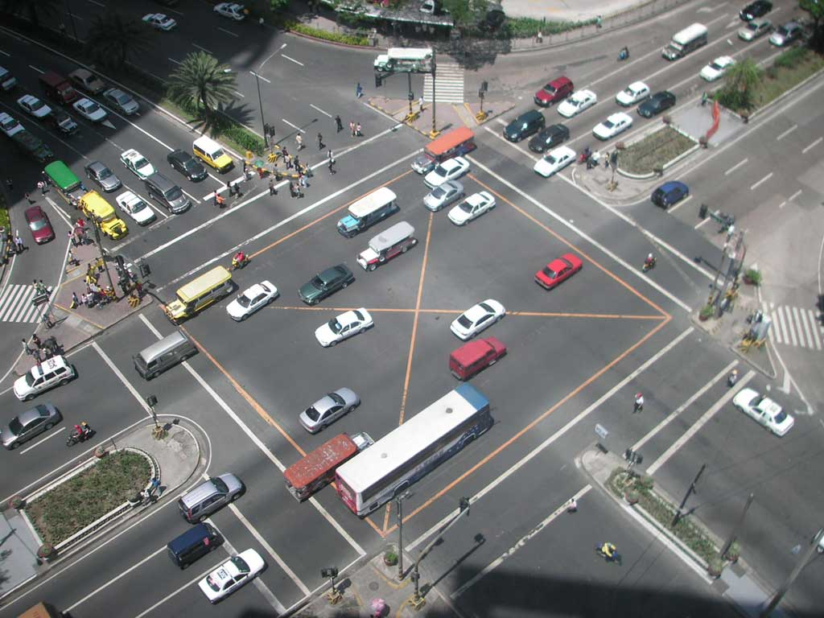
MVC Example – Traffic Signal

Slide 14
Traffic Signal – MVC
Component | Model | View | Controller
Detect cars waiting to enter intersection
Traffic lights to direct car traffic
Regulate valid traffic movements
Manual override for particular lights
Detect pedestrians waiting to cross
Pedestrian signals to direct pedestrians
External timer which triggers changes at set interval

Slide 15
Traffic Signal – MVC
Component | Model | View | Controller
Detect cars waiting to enter intersection |  |  | X
Traffic lights to direct car traffic |  | X
Regulate valid traffic movements | X
Manual override for particular lights |  |  | X
Detect pedestrians waiting to cross |  |  | X
Pedestrian signals to direct pedestrians |  | X
External timer which triggers changes at set interval |  |  | X

Slide 16
Traffic Signal
Model
Stores current state of traffic flow
Knows current direction of traffic
Capable of skipping a light cycle
Stores whether there are cars and/or pedestrians waiting
View
Conveys information to cars and pedestrians in a specific direction
Controller
Aware of model’s current direction
Triggers methods to notify model that state should change

Slide 17
Traffic Signal Code
Model
TrafficModel – keeps track of which lights should be on and off
View
CarLight – shows relevant state of TrafficModel to cars
PedestrianLight – shows relevant state of TrafficModel to pedestrians
Controller
PedestrianButton – notifies TrafficModel that there is a pedestrian waiting
CarDetector – notifies TrafficModel that there is a car waiting
LightSwitch – enables or disables the light
Timer – regulates time in some way, possibly to skip cycles

