Slide 1
Dependency Injection
How to Decouple Your Code Modules

Slide 2
What is dependency injection?
“Put appropriate instances in don’t let the object create them.”
Well, it can be a bit more…

Slide 3
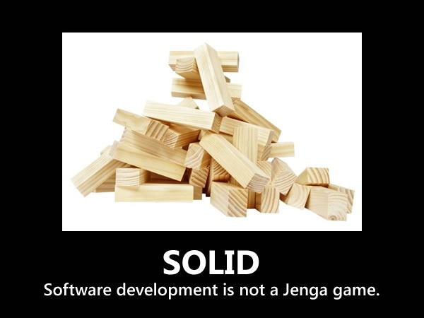
What is SOLID?
S - Single responsibility principle (SRP)
O - Open/closed principle (OCP)
L - Liskov substitution principle (LSP)
I - Interface segregation principle (ISP)
D - Dependency inversion principle (DIP)

Slide 4
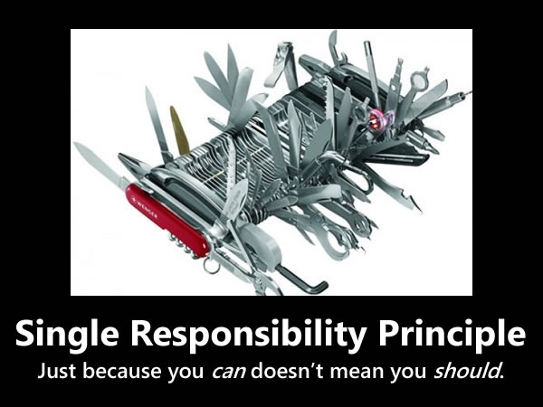
Single responsibility principle
A class should only have one responsibility
having problems finding a name is a sign of a violation
creating things is a responsibility -> factory
related to separation of concerns (SoC)

Slide 5
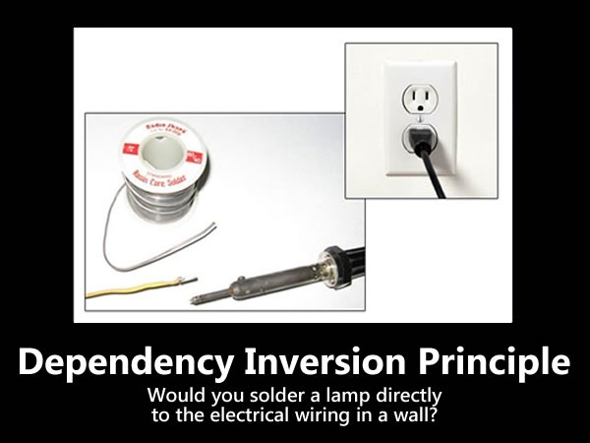
Dependency inversion principle
Abstractions should not depend on details. Details should depend on abstractions
"Code against interfaces (i.e. abstractions) not implementations (details)"

Slide 6

What is dependency injection
"Dependency Injection is a 25-dollar term for a 5-cent concept."
"Don't look for things - ask for them!" (Misko Hevery)

Slide 7

Why Dependency Injection?
Decoupling of software pieces (classes)
  SRP
  Flexibility
    Composability
    Exchangeability
  Testability (mocking)
  Maintainability

Slide 8
Pure DI
Learn and understand how DI works, what patterns and practices are helpful before using an automated way
Try putting your dependencies together manually to get a feeling for how to design your classes and interfaces
Once you‘ve written pages and pages of constructor calls, consider using a DI container

Slide 9
Composition root
The point where DI starts – ideally there is only one and it‘s at the very start of the application
When trying to fit DI into an existing application you might have multiple at first
Move them closer to the start of the application and eventually they will converge

Slide 10

Types of injection
Constructor Injection
  constructor parameters
  mandatory dependencies
Property Injection
  properties/setter
  optional dependencies
  Null-Object pattern
Field Injection
  Use only in exceptional cases –
  this is not possible with pure DI

Slide 11
Testing with Dependency Injection
Refactor classes for DI
For each dependency:
  Extract a “Testable” interface
  Have concrete class implement the interface
  Update the original class to use the interface
  Create a test class that implements the interface – called a Mock object
  Use the mock object for testing

Slide 12
Refactor the class for DI
(before)
public class View {
private Model model;
public View () {
model = new Model();
}
public Model getModel() {
return model;
}
}

Slide 13
Refactor the class for DI
(after)
public class View {
private Model model;
public View (Model m) {
model = m;
}
public Model getModel() {
return model;
}
}

Slide 14
Extract a "testable" interface
What does a model have?
  public interface IModel {
  Expected<Boolean> addClass (String name);
  Expected<Boolean> renameClass (String oldName, String newName);
  Expected<Boolean> removeClass (String name);
  ...
  }

Slide 15
Have the concrete class implement the interface
  public class Model implements IModel {
  public Expected<Boolean> addClass (String name) {
  ...
  }
  public Expected<Boolean> renameClass (String oldName, String newName) {
  ...
  }
  ...
  }

Slide 16
Update the Original Class
public class View {
private IModel model;
public View (IModel m) {
model = m;
}
public IModel getModel() {
return model;
}
}

Slide 17
Create a Mock Object
public class AlwaysErrorModel implements IModel {
  public Expected<Boolean> addClass (String name) {
  return Expected.of(new Exception(”duplicate”));
  }
  public Expected<Boolean> renameClass (String oldName, String newName) {
  return Expected.of(new Exception(”old class name does not exist”));
  }
  ...
}

Slide 18
When to Actually Use Mock Objects?
Testing complex controller logic
Testing UIs (can’t always run the UI)
When you cannot reproduce
When the real object is slow/complex

