Slide 1
Implementing the Associative Containers
Sets and Maps

Slide 2
Associative Containers
Categories
  Ordered (OAC)
    set, multiset, map, multimap
  Unordered (UAC)
    unordered_set, unordered_multiset, unordered_map, unordered_multimap
OACs use red/black BSTs
UACs use hash tables

Slide 3
Unordered Sets and Maps
How do we use the UAC containers?
  #include <unordered_set> or <unordered_map>
  Classes
    unordered_set, unordered_multiset
    unordered_map, unordered_multimap
  API very similar to ordered containers

Slide 4
Hash Tables

Slide 5
Hash Tables
Hash table
  Vector of slots
  Each slot holds
    One object (open addressing), *or*
    Collection of objects (separate chaining)
Average insert, erase, find ops. take O(1)!
  Worst case is O(N)
Used by databases, spell checkers, scripting languages (associative arrays)
Notes:
Perl hashes, Python dictionaries, JavaScript non-scalar objects
var dict = { }; dict[k1] = v1; …

Slide 6
Hash Tables (Cont’d)
Main idea
  Store key k in slot given by a hash function: hf (k)
  hf: KeySet → SlotSet
Issues
  | KeySet | >> | SlotSet |, so hf cannot be 1-1
  If two keys map to same slot have a collision
  Deletion can be tricky

Slide 7
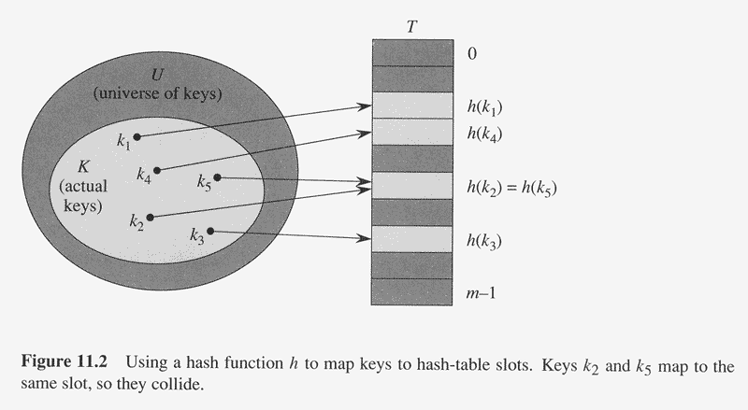
Graphical Overview (Open Addressing)
Table size is m,
which is chosen
to be prime

Slide 8
Collisions
Collision resolution strategies
Open addressing (slot only holds one object)
  linear or quadratic probing
  double hashing
Separate chaining
  In this case slot is called bucket (Usually a singly-linked list)
  Approach taken by Standard Library

Slide 9
Open Addressing
Compute slot as follows:
t = hf (k)
slot = t % m
In this example, hf(x) = x
Notes:
Note hash function can be arbitrary. Identity does job here

Slide 10
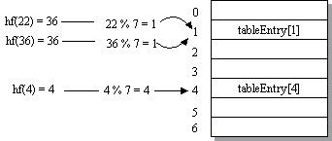
Open Addressing (Cont’d)
Inserting 36 causes collision

Slide 11
Collision Resolution by Open Addressing
Given a key k, try slots
h₀(k), h₁(k), h₂(k), …, h_{i}(k)
h_{i} (k) = (hf (k) + F (i)) % m
F is the collision resolution function
  Linear: F(i) = i
  Quadratic: F(i) = i²
  Double Hashing: F(i) = i * hf₂(k)

Slide 12
Collision Resolution
(Open Addressing w/Linear Probing)
Notes:
Keep status: Empty, Full, Erased

Slide 13
Erase and Find
(Open Addressing)
How to find a key?
  Examine slots h₀(k), h₁(k), … until hit empty slot
How to erase a key?
  How does this affect find?
  How does this affect insert?

Slide 14
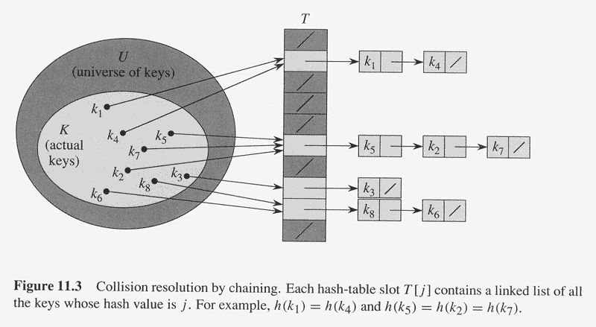
Collision Resolution
(Chaining)

Slide 15
Collision Resolution with Chaining
const size_t TABLE_SIZE = 11; // Prime
std::vector<std::list<int>> table (TABLE_SIZE);
// To insert or find a key
size_t index = hf (key) % TABLE_SIZE;
// Walk list at table[index]
Buckets are often
singly-linked lists

Slide 16
Hash Functions
Goals
  Distribute keys evenly
  Minimize collisions
  Fast to compute
  Handle non-integral keys
Default for unordered_* containers usually OK
  Can supply our own if desired

Slide 17
Hash Functions (Cont’d)
Division Method
  Works well in most cases
  slot(k) = k % m (where k is an integer from hash fn.)
  Can be bad if keys have similar characteristics
    Suppose m = 25
      0, 25, 50, 75, 100, …, map to 0
      5, 30, 55, 80, 105, …, map to 5
      10, 35, 60, 85, 110, …, map to 10
      15, 40, 65, 90, 115, …, map to 15
      20, 45, 70, 95, 120, …, map to 20
Avoid by making
m prime!
Notes:
Multiples of 5 cluster

Slide 18
A Hash Function For Strings
struct HashString {
unsigned
operator () (const string& key) const
{
unsigned n = 5381; // Prime
for (unsigned i = 0;
i < key.length (); ++i)
n = (n * 33) + key[i]; // Horner’s Rule
return n;
}
};
// Header <unordered_set>
unordered_set<string, HashString> mySet;
mySet.insert (“ToucanSam”);
Notes:
a0 + a1 x + a2 x^2 + a3 x^3 = a0 + x(a1 + x(a2 + x a3))

Slide 19
Implementing an Iterator
Notes:
hashTable address for debugging only.

Slide 20
Efficiency of Hashing Methods
Load factor λ = N / m
Chaining
  λ represents ?
  Avg. probes for successful search ≈ 1 + λ/2
  Avg. probes for unsuccessful search = λ
  Avg. find, insert, erase: O(1)
Open Addressing
  λ represents ?
  If λ > 0.5, roughly double table size and
  rehash all elements to new table

Slide 21
Balanced Search Trees

Slide 22
Issues with BSTs
Key operations are O(depth)
Want depth to be close to lg(N)
  But worst case would be?
So how do we maintain balance
(depth ∝ lg(N))?

Slide 23
Two BSTs with Same Keys
Insertion sequence: 5, 15, 20, 3, 9, 7, 12, 17, 6, 75, 100, 18, 25, 35, 40 (N = 15)
BST
Red-black tree?

Slide 24
Notions of Balance
For any node N, depth (N->left) and
depth (N->right) differ by at most 1
  AVL Trees
All leaves exist at same level
  2-3-4 Trees
Number of black nodes on any path from root to leaf is same (black height of tree)
  Red-black Trees

Slide 25
BST, Red-Black Tree, and AVL Tree
Insert 50, 100, 60, 90, 70, 80, 75, 78
Slide 25
Notes:
Doesn’t look like bad case but it is. Depth 7 vs depth 3 for RB and AVL

Slide 26
2-3-4 Trees
Three node types
  2-node: 2 children, 1 key
  3-node: 3 children, 2 keys
  4-node: 4 children, 3 keys
All leaves at same level and
all internal nodes have all possible children
Logarithmic find, insert, erase

Slide 27
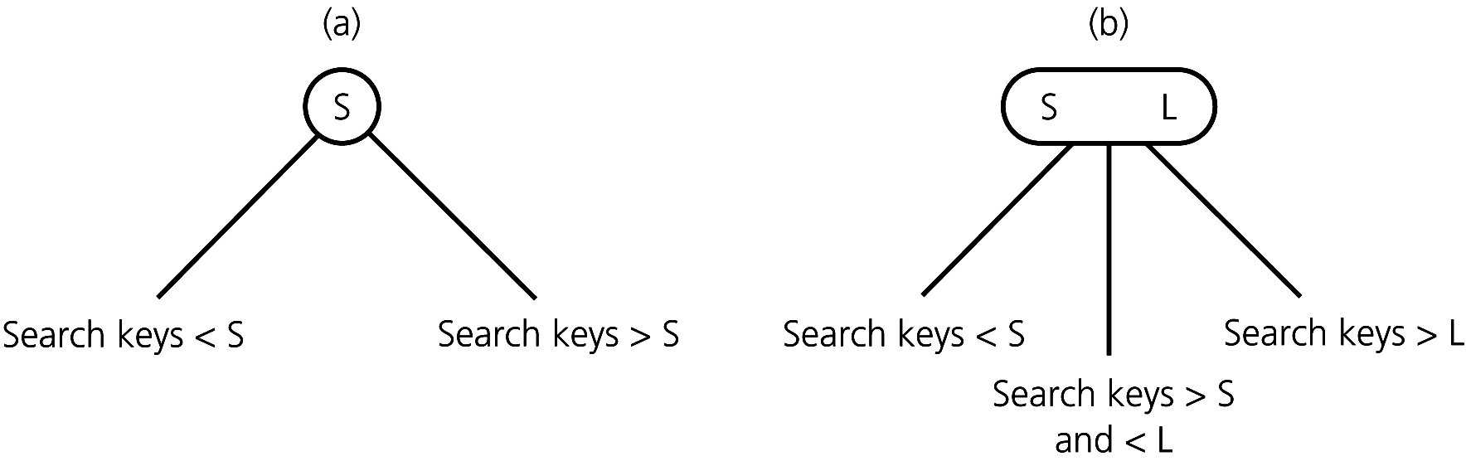
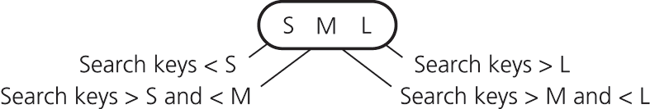
2-3-4 Tree Node Types
2-node
3-node
4-node

Slide 28
2-3-4 Tree
How to search?
How much space for 4-Node?
Notes:
Have to know type of node to search

Slide 29
Insert for a 2-3-4 Tree
Top-down
  Split 4-nodes as you search for insertion point
  Ensures node splits don’t keep propagating upwards
Key operation is split of 4-node
  Becomes three 2-nodes
  Median key is “hoisted up” and added to parent node

Slide 30
Splitting a 4-Node
B
A B C
A
C
S
T
U
V
S
T
U
V

Slide 31
Insertion into 2-3-4 Tree
Insertion Sequence: 2, 15, 12, 4, 8, 10, 25, 35, 55, 11, 9, 5, 7
Insert 4
Insert 8

Slide 32
Insertion (Cont’d)
Insert 10
Insert 25,
35, 55

Slide 33
Insertion (Cont’d)
12
Insert 11
12
4
25
4
25
2
8 10
15
35 55
8 10 11
2
15
35 55
Split 4-node (4, 12, 25)
Insert 11
Insert 9

Slide 34
Insertion into 2-3-4 Tree (Cont’d)
Insert 5
Insert 7

Slide 35
Red-Black Trees
Can represent 2-3-4 tree as binary tree
  Use two colors, red and black
  Red node is “bound” to parent
Properties of red-black tree
  Nodes are red or black
  Root is black
  Red nodes cannot have a red child
  Every path from root to a descendant leaf node has same # of black nodes, called black height of tree
Ensures logarithmic find, insert, erase
More efficient in time and space

Slide 36
Red-Black Repr. of 2-3-4 Tree

Slide 37
Converting a 2-3-4 Tree to Red-Black Tree

Slide 38
Red-Black Tree Ops
Find?
Insertions?
  Insert node as red
  Require splitting of “4-node” (top-down insertion)
  Use color-flip for split (4 cases)
  Require rotations when red node has red child
Deletions?

Slide 39
Four Cases in Splitting of a 4-Node
Case 1
Case 2
Case 3
Case 4
X is root of 4-Node

Slide 40
Left child of a Black Parent P
Case 1 (left child of black parent)

Slide 41
Prior to inserting key 55
Case 2 (right child of black parent)

Slide 42
Oriented left-left from G Using A Single Right Rotation
Case 3
(and G, P, X linear)
P rotated right

Slide 43
Oriented Left-Right From G After the Color Flip
Case 4
(and G, P, X zig-zag)

Slide 44
After X is Double Rotated
(X is rotated left-right)
X
P
G
C
A
B
D

Slide 45
Inserting into Red-Black Tree
Insert node as red
Split “4-node’s” as you go down tree
  4 cases we’ve seen
Require rotations when red node has red child
  Linear arrangement: single rotation (left, right)
  Zig-zag arrangement: double rotation (left-right, right-left)
Ensure root is black

Slide 46
Building A Red-Black Tree
Inserting 15
2
15
right-left
rotate

Slide 47
Building A Red-Black Tree (Cont’d)

Slide 48
Exercises
Determine if the right tree on slide 25 is a red-black tree. Perform the insertion sequence and see if you get the same tree structure (colors aren’t shown).
Show that a valid red-black tree cannot have a red node with a red child. Base your argument on the fact that red-black trees are derived from 2-3-4 trees.

Slide 49
Repr. of Red-Black Node
35

Slide 50
Rotate Routines
// Assume NO parent pointers, colors, or
// nullptr checks
// Note second parameter is a reference
void
rotateRight (Node* n, Node*& p) {
...
}
void
rotateLeft (Node* n, Node*& p) {
...
}

Slide 51
Ordered Associative Containers
Sets and Maps

Slide 52
Associative Containers
Store objects by key
Ordered AC’s
  Iterators access elements in key order
  BST implementation (red/black trees)
  set, multiset – iterators are const_iterator’s
  map, multimap – half const_iterators?

Slide 53
Associative Containers
Unordered AC’s
  Iterators do NOT access elements in key order
  Hash table implementation
  unordered_{set, multiset} – const iters
  unordered_{map, multimap} – hybrid iters like ordered maps

Slide 54
Sets
// Must have less<T> defined
set<int> intSet;
set<time24> timeSet;
set<string> keyword;

Slide 55
Sets of Class Types
class Student {
long mNum; // <== Key
string fName, lName; // Satellite data
Date birth; // ...
public:
...
};
bool
operator< (const Student& s1, const Student& s2) {
return s1.getMNum () < s2.getMNum ();
}
// Exercises
// Declare a set of Student-s
// Insert student ‘s’
// Check if duplicate

Slide 56
Map and Key-Value Pairs
Map stores data as set of key-value pairs
// Defined in <utility>
template<typename T1, typename T2>
struct std::pair {
T1 first;
T2 second;
// ctor’s, etc.
};
// <map>
template<typename _Key, typename _Tp, ...>
class std::map { ...
typedef _Key key_type;
typedef _Tp mapped_type;
typedef std::pair<const _Key, _Tp> value_type;
...

Slide 57
Map Example
map<string, int> degreeMajor;
// What is
// key_type?
// mapped_type?
// value_type?

Slide 58
Map Operations
Insert pair (“Biology”, 400)
  insert or
  operator[]
Update count of CS majors to 230
  find or
  operator[] (not advised, careful!)

Slide 59
Application of Sets
Sieve of Eratosthenes
STL algorithms that operate on set’s
(generally, require ordered ranges)
  In header file <algorithm>
  set_union (In first1, In last1, In first2, In last2,
  Out res)
  set_intersection …
  set_difference …
  bool includes (In first1, In last1, In first2, In last2)
Notes:
Could use with sorted vectors too

Slide 60
Sieve of Eratosthenes
Largest value
of ‘m’ we need
to test?

Slide 61
Algorithm Details
Put numbers 2 through N into set
Point m at first number in set
(m is an iterator which points to p)
Repeat while p * p <= N
  Remove p * k, for k = p, p+1, p+2, …
  Update m to point to next number in set

Slide 62
Multisets and Multimaps
Both allow duplicates
insert (p) now returns an iterator, not a pair
  Why?
count (key) gives # of occurrences of key
find (key) still used to locate
  Returns iterator referencing first occurrence
multimap doesn’t allow operator[]

