Slide 1
System Testing

Slide 2

Outline
Recap: system testing
Integration testing
Performance testing
2

Slide 3
recap
system testing

Slide 4

System testing
System testing: tests the behavior of a system as a whole, with respect to scenarios and requirements
  Functional testing, integration testing
  Load, stress, performance testing
  Acceptance, usability, installation, beta testing
4

Slide 5
System testing
System testing: tests the behavior of a system as a whole, with respect to scenarios and requirements
  Functional testing, integration testing
  Load, stress, performance testing
  Acceptance, usability, installation, beta testing
4

Slide 6
test
integration testing

Slide 7

Integration testing
Integration testing: checking software quality by testing two or more dependent software modules as a group or a (sub)system.
Challenges same as in unit testing, plus:
  Combined units can fail in more places and in more complicated ways.
  How to test a partial system where not all parts exist?
  How to "rig" the behavior of unit A so as to produce a given behavior from unit B?

Slide 8

Stubs: a way to test a partial system
Stub: A controllable replacement for an existing software unit to which your code under test has a dependency.
Useful for simulating difficult-to-control elements:
  network / internet
  time/date-sensitive code
  database, files, io, threads, memory
  brittle legacy code /systems

Slide 9
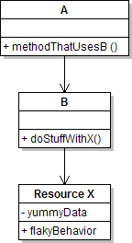
Testing with stubs (1/3)
Identify the external dependency.
  This is either a resource or a class/object.
  If it isn't an object, wrap it up into one.
  (Suppose that Class A depends on Class B.)

Slide 10
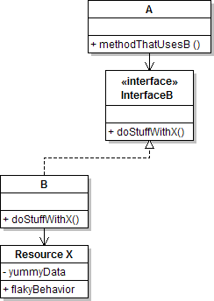
Testing with stubs (2/3)
Extract the core functionality of the object into an interface.
  Create an InterfaceB based on B
  Change all of A's code to work with type InterfaceB, not B

Slide 11
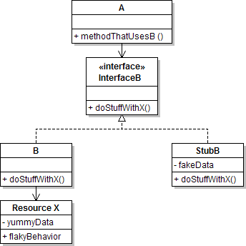
Testing with stubs (3/3)
Write a second "stub" class that also implements the interface, but returns pre- determined fake data.
  Now A's dependency on B is abstracted away and can be tested easily.
  Can focus on how well A integrates with B's external behavior.

Slide 12
Where to inject stubs?
Seams: places to inject the stub so Class A will talk to it.
  at construction (not ideal)
A aardvark = new A(new StubB());
  through a getter/setter method (better)
A apple = new A(...); aardvark.setResource(new StubB());
  just before usage, as a parameter (also better)
aardvark.methodThatUsesB(new StubB());
You should not have to change A's code everywhere (beyond using your interface) in order to use your Stub B. (a "testable design")

Slide 13

Mock objects: a way to test interactions
Mock object: A fake object that decides whether a unit test has passed or failed by watching interactions between objects.
Useful for interaction testing, as opposed to state testing

Slide 14
Stubs vs mocks
A stub (B) gives out data that goes to the object/class under test (A).
  The unit test directly asserts against A, to make sure it gives the right result when fed B’s data.
class under test (A)
communicate
stub (B)
assert
test
13

Slide 15
Stubs vs mocks
A stub (B) gives out data that goes to the object/class under test (A).
  The unit test directly asserts against A, to make sure it gives the right result when fed B’s data.
A mock (B) waits to be called by the class under test (A).
It may have several methods it expects that A should call.
It makes sure that it was called in exactly the right way.
If A interacts with B the way it should, the test passes.
class under test (A)
communicate
stub (B)
class under test (A)
communicate
mock (B)
assert
assert
test
test
13

Slide 16
Mock object frameworks
Stubs are often best created by hand/IDE. Mocks are tedious to create manually.
Mock object frameworks help with the process.
  android-mock, EasyMock, jMock (Java)
  ...
Frameworks provide the following:
  auto-generation of mock objects that implement a given interface
  logging of what calls are performed on the mock objects
  methods/primitives for declaring and asserting your expectations

Slide 17
A jMock example
import org.jmock.integration.junit4.*; import org.jmock.*;
@RunWith(JMock.class)
// Assumes that we are testing
// class A's calls on B.
public class ClassATest {
private Mockery mockery = new JUnit4Mockery(); // initialize jMock
@Test public void testACallsBProperly1() {
// create mock object to mock InterfaceB
final InterfaceB mockB = mockery.mock(InterfaceB.class);
// construct object from class under test; A aardvark = new A(...); aardvark.setResource(mockB);
attach to mock
// declare expectations for how mock should be used
mockery.checking(new Expectations() {{ oneOf(mockB).method1("an expected parameter"); will(returnValue(0.0)); oneOf(mockB).method2();
}});
// execute code A under test; should lead to calls on mockB aardvark.methodThatUsesB();
// assert that A behaved as expected
mockery.assertIsSatisfied();
}
}

Slide 18
Using stubs and mocks together
16

Slide 19
Using stubs and mocks together
Suppose a log analyzer reads from a web service. If the web fails to log an error, the analyzer must send email.
16

Slide 20
Using stubs and mocks together
Suppose a log analyzer reads from a web service. If the web fails to log an error, the analyzer must send email.
How to test to ensure that this behavior is occurring?
  Set up a stub for the web service that intentionally fails.
  Set up a mock for the email service that checks to see whether the analyzer contacts it to send an email message.
LogAnalyzer
logError(String)
StubWebService
sendEmail()
assert
MockEmailSender
test
16

Slide 21
test
performance testing

Slide 22

Acceptance, performance
Acceptance testing: System is shown to the user / client / customer to make sure that it meets their needs.
  A form of black-box system testing.
Performance is important.
  Performance is a major aspect of program acceptance by users.
  Your intuition about what's slow is often wrong.
Premature optimization is the root of all evil.
Donald Knuth

Slide 23
Thinking about performance
19

Slide 24
Thinking about performance
The app is only too slow if it doesn't meet your project’s stated performance requirements.
  If it meets them, DON'T optimize it!
19

Slide 25
Thinking about performance
The app is only too slow if it doesn't meet your project’s stated performance requirements.
  If it meets them, DON'T optimize it!
Which is more important, fast code or correct code?
19

Slide 26
Thinking about performance
The app is only too slow if it doesn't meet your project’s stated performance requirements.
  If it meets them, DON'T optimize it!
Which is more important, fast code or correct code?
What are reasonable performance requirements?
  What are the user's expectations? How slow is "acceptable" for this portion of the application?
  How long do users wait for a web page to load?
  Some tasks (admin updates database) can take longer
19

Slide 27

Profile and measure before optimizing
Runtime / CPU usage
  what lines of code the program is spending the most time in
  what call/invocation paths were used to get to these lines
Memory usage
  what kinds of objects are on the heap
  where were they allocated
  who is pointing to them now
  "memory leaks" (does Java have these?)
Web page load times, requests/minute, …
20

Slide 28

Profile and measure before optimizing
Runtime / CPU usage
  what lines of code the program is spending the most time in
  what call/invocation paths were used to get to these lines
Memory usage
  what kinds of objects are on the heap
  where were they allocated
  who is pointing to them now
  "memory leaks" (does Java have these?)
Web page load times, requests/minute, …
CPU profiling slows down your code (a lot). Design your profiling tests to be very short.
20

Slide 29
Optimization hints: think high-level
21

Slide 30
Optimization hints: think high-level
Focus on high-level optimizations (algorithms, data structures)
  Leave the low-level ones to the compiler
21

Slide 31
Optimization hints: think high-level
Focus on high-level optimizations (algorithms, data structures)
  Leave the low-level ones to the compiler
Some common high-level optimizations
  Lazy evaluation saves you from computing/loading
    don't read / compute things until you need them
  Hashing, caching save you from reloading resources
    combine multiple database queries into one query
    save I/O / query results in memory for later Web page load times, requests/minute, etc.
  Precomputing values and storing them in a lookup table
    the first 1000 primes
21

Slide 32
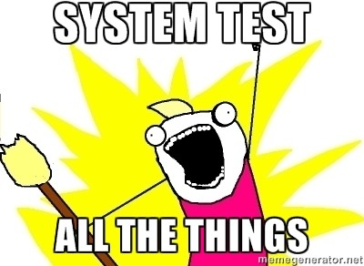
Summary
System testing checks the behavior of a system as a whole.
Integration testing checks software quality by testing two or more dependent software modules as a group.
Performance testing checks that a system meets performance requirements (e.g., responsiveness).
22

