Slide 1
Refactoring

Slide 2
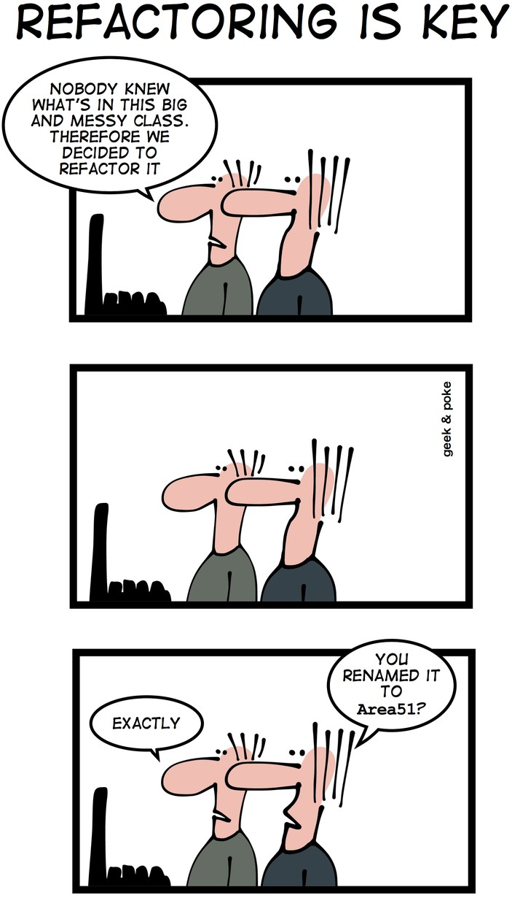
Outline
Problem: code maintenance
Refactoring: when, why, and how
Refactoring in the real world
2

Slide 3
intro
code maintenance is hard

Slide 4
Problem: bit rot
After several months and new versions, many codebases reach one of the following states:
  rewritten: nothing remains from the original code.
  abandoned: the original code is thrown out and rewritten from scratch.
  …even if the code was initially reviewed and well-designed, and even if later checkins are reviewed
Why is this?
  Systems evolve to meet new needs and add new features
  If the code's structure does not also evolve, it will "rot"
4

Slide 5
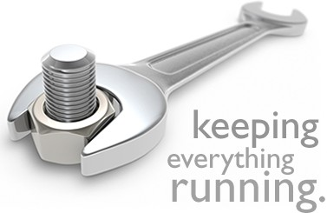
Code maintenance …
Code maintenance: modification of a software product after it has been delivered.
Purposes:
  fixing bugs
  improving performance
  improving design
  adding features
~80% of maintenance is for non-bug-fix-related activities such as adding functionality (Pigosky 1997)
5

Slide 6

Code maintenance is hard
It's harder to maintain code than write new code.
  You must understand code written by another developer, or code you wrote at a different time with a different mindset
  Danger of errors in fragile, hard-to-understand code
Maintenance is how developers spend most of their time
  Many developers hate code maintenance. Why?
It pays to design software well and plan ahead so that later maintenance will be less painful
  Capacity for future change must be anticipated
6

Slide 7
ideal
refactoring: what, when, why, and how

Slide 8

What is refactoring?
Refactoring: improving a piece of software's internal structure without altering its external behavior.
  Incurs a short-term overhead to reap long-term benefits
  A long-term investment in overall system quality.
Refactoring is not the same thing as:
  rewriting code
  adding features
  debugging code

Slide 9

Why refactor?
Why fix a part of your system that isn't broken?
Each part of your system's code has 3 purposes:
  to execute its functionality,
  to allow change,
  to communicate well to developers who read it.
If the code does not do these, it is broken.
Refactoring improves software's design
  to make it more extensible, flexible, understandable, performant, …
  but every improvement has costs (and risks)

Slide 10
When to refactor?
When is it best for a team to refactor their code?
  Best done continuously (like testing) as part of the process
  Hard to do well late in a project (like testing)
Refactor when you identify an area of your system that:
  isn't well designed
  isn't thoroughly tested, but seems to work so far
  now needs new features to be added

Slide 11

Code “smells”: signs you should refactor
Duplicated code; dead code
Poor abstraction
Large loop, method, class, parameter list
Module has too little cohesion
Modules have too much coupling
Module has poor encapsulation
A "middle man" object doesn't do much
A “weak subclass” doesn’t use inherited functionality
Design is unnecessarily general or too specific

Slide 12

Low-level refactoring
Names:
  Renaming (methods, variables)
  Naming (extracting) "magic" constants
Procedures:
Extracting code into a method
Extracting common functionality (including duplicate code) into a module/method/etc.
Inlining a method/procedure
Changing method signatures
See also refactoring.com/ catalog/
Reordering:
  Splitting one method into several to improve cohesion and readability (by reducing its size)
  Putting statements that semantically belong together near each other

Slide 13
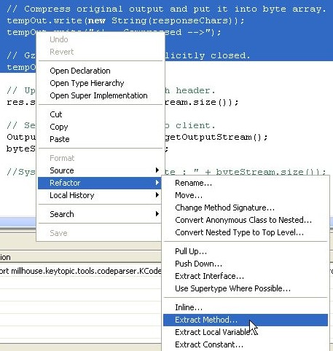
IDE support for low-level refactoring
Eclipse / Visual Studio support:
  variable / method / class renaming
  method or constant extraction
  extraction of redundant code snippets
  method signature change
  extraction of an interface from a type
  method inlining
  providing warnings about method invocations with inconsistent parameters
  help with self-documenting code through auto-completion

Slide 14
High-level refactoring
Deep implementation and design changes
  Refactoring to design patterns
  Exchanging risky language idioms with safer alternatives
  Performance optimization
  Clarifying a statement that has evolved over time or is unclear
Compared to low-level refactoring, high-level is:
  Not as well-supported by tools
  Much more important!

Slide 15

How to refactor?
When you identify an area of your system that:
  is poorly designed
  is poorly tested, but seems to work so far
  now needs new features
What should you do?

Slide 16
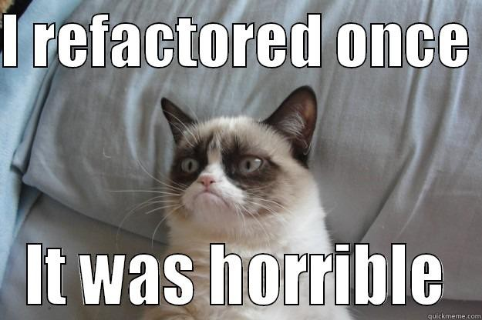
How to refactor? Have a plan!

Slide 17
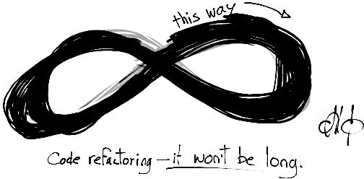
Refactoring plan (1/2)
Write unit tests that verify the code's external correctness.
  They should pass on the current poorly designed code.
  Having unit tests helps make sure any refactor doesn't break existing behavior (regressions).
Analyze the code to decide the risk and benefit of refactoring.
  If it is too risky, not enough time remains, or the refactor will not produce enough benefit to the project, don't do it.

Slide 18
Refactoring plan (2/2)
Refactor the code.
  Some tests may break. Fix the bugs.
Code review the changes.
Check in your refactored code.
  Keep each refactoring small; refactor one unit at a time.
    Helps isolate new bugs and regressions.
  Your checkin should contain only your refactor.
  Your checkin should not contain other changes such as new features, fixes to unrelated bugs, and other tweaks.

Slide 19
reality
refactoring in the real world

Slide 20

Barriers to refactoring: “I don’t have time!”
Refactoring incurs an up-front cost.
  Some developers don't want to do it
  Most managers don't like it, because they lose time and gain “nothing” (no new features).
However …
  Clean code is more conducive to rapid development
    Estimates put ROI at >500% for well-done code
  Finishing refactoring increases programmer morale
    Developers prefer working in a “clean house”

Slide 21
Barriers to refactoring: company/team culture
Many small companies and startups skip refactoring.
  “We're too small to need it!”
  “We can't afford it!”
Reality:
  Refactoring is an investment in quality of the company's product and code base, often their prime assets.
  Many web startups are using the most cutting-edge technologies, which evolve rapidly. So should the code.
  If a key team member leaves (common in startups) …
  If a new team member joins (also common) …

Slide 22
Refactoring and teamwork: communicate!
Amount of overhead/communication needed depends on size of refactor.
  Small: just do it, check it in, get it code reviewed.
  Medium: possibly loop in tech lead or another dev.
  Large: meet with team, flush out ideas, do a design doc or design review, get approval before beginning, and do a phased refactoring.
Avoids possible bad scenarios:
  Two devs refactor same code simultaneously.
  Refactor breaks another dev's new feature they are adding.
  Refactor actually is not a very good design; doesn't help.
  Refactor ignores future use cases, needs of code/app.
  Tons of merge conflicts and pain for other devs.

Slide 23
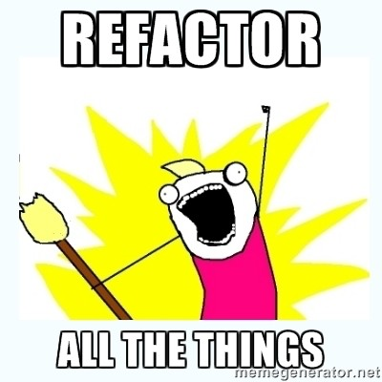
Summary
Refactoring improves internal software structure without altering its external behavior.
  Short-term overhead …
  But many long-term benefits
Have a refactoring plan.
Communicate the plan to your team.

