Slide 1
Test Driven Development (TDD) and
Behavior Driven Development (BDD)
CSCI 420: Software Engineering

Slide 2
Agile Lifecycle Review
Work closely, continuously with stakeholders to develop requirements, tests
  Users, customers, developers, maintenance programmers, operators, project managers, …
Maintain working prototype while deploying new features every iteration
  Typically every 1 or 2 weeks
  Instead of 5 major phases, each months long
Check with stakeholders on what’s next,
to validate building right thing (vs. verify)

Slide 3
BDD+TDD: The Big Picture
Behavior-Driven Design (BDD)
  develop user stories (the features you wish you had) to describe how app will work
  via Cucumber, user stories become acceptance tests and integration tests
Test-Driven Development (TDD)
  step definitions for a new story, may require new code to be written
  TDD says: write unit & functional tests for that code first, before the code itself
  that is: write tests for the code you wish you had

Slide 4
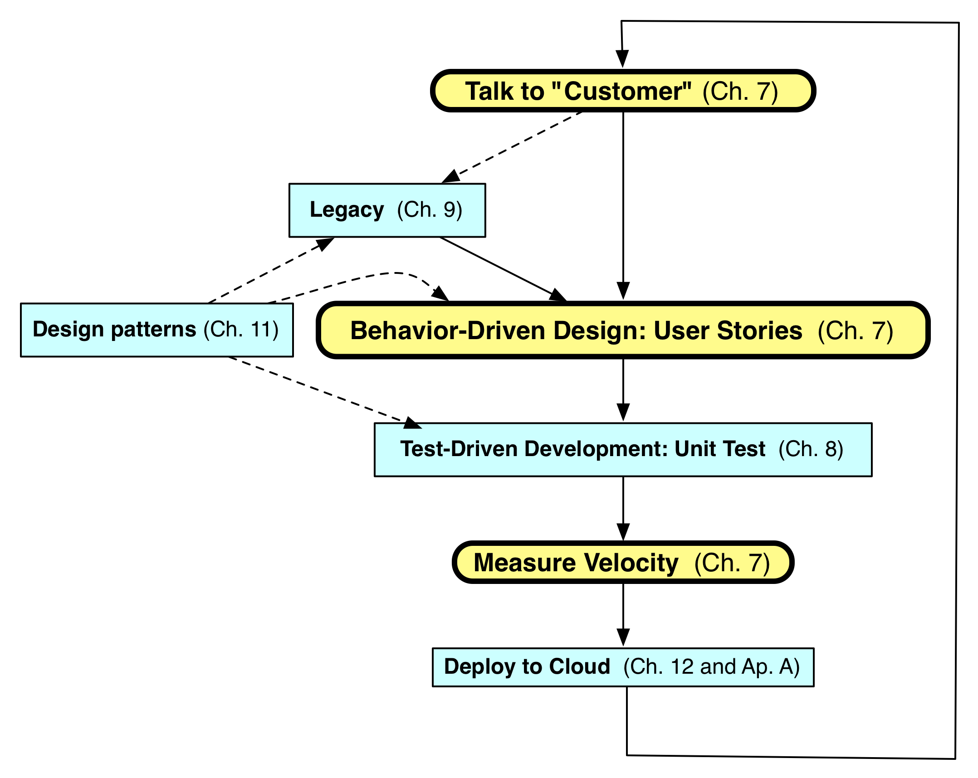
Agile Iteration

Slide 5
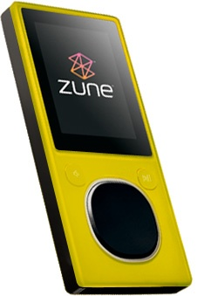

My Zune is a Brick
year = ORIGINYEAR; /* = 1980 */
while (days > 365)
{
if (IsLeapYear(year))
{
if (days > 366)
{
days -= 366;
year += 1;
}
}
else
{
days -= 365;
year += 1;
}
}
12/31/2008
Midnight
Notes:
http://geekswithblogs.net/evjen/archive/2008/12/31/128268.aspx
http://arstechnica.com/information-technology/2008/12/30gb-zunes-prepare-for-new-year-by-locking-up/
Midnight, New Year’s, 2009, Zune bricked due to leap year bug, reboot after noon on 1/1/2009, everything good.
Microsoft Zune 30 into a brick on New Years' Eve of 2008

Slide 6
Quotes
Kent Beck said “Test-first code tends to be more cohesive and less coupled than code in which testing isn’t a part of the intimate coding cycle” [2]
“If you can’t write a test for what you are about to code, then you shouldn’t even be thinking about coding” [2]

Slide 7
TDD Overview (1 of 3)
Made popular by Extreme Programming
Method of developing software not just testing software
Software is Developed in short iterations
Unit Tests are developed FIRST before the code

Slide 8
TDD Overview (2 of 3)
How It Works –
Add a Test
  Use Cases / User Stories are used to understand the requirement clearly
Run all tests and see the new one fail
  Ensures test harness is working correctly
  Ensures that test does not mistakenly pass
Write some code
  Only code that is designed to pass the test
  No additional functionality should be included because it will be untested [4]

Slide 9
TDD Overview (2 of 3)
Run the automated tests and see them succeed
  If tests pass, programmer can be confident code meets all tested requirements
Refactor code
  Cleanup the code
  Rerun tests to ensure cleanup did not break anything
Repeat [4]

Slide 10
Test First vs. Test Last
Pick a piece of functionality
Write a test that expresses a small task that fails
Write production code until test passes
Run all tests
Rework code until all tests pass
Repeat [1]
Pick a piece of functionality
Write production code that implements entire functionality
Write tests to validate all functionality
Run all tests
Rework code until all tests pass [1]

Slide 11
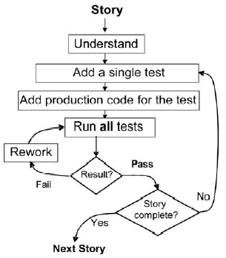
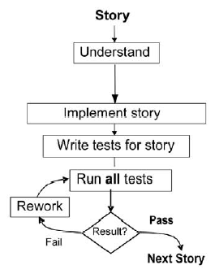
Test First vs. Test Last
[1]
[1]

Slide 12
Research Study #1
“On the Effectiveness of Test-first Approach to Programming”
  H. Erdogmus, T. Morisio – 2005 [1]

Slide 13
Research Study #1 Background
Subjects are 3rd year students
  Had 8 week intensive Java course
    Learned unit testing with JUnit
    Learned basic design concepts
    Learned object orientation
Two groups –
  Control Group – Test-Last
  TDD Group – Test-First
Each group developed a bowling game

Slide 14
Research Study #1 - Hypotheses
Test-First programmers write more test per unit of programming effort [1]
Test-First programmers produce high quality programs [1]
Test-First programmers are more productive overall [1]
Writing more tests improve quality [1]
Writing more tests increase productivity [1]

Slide 15
Research Study #1 Results
Quality
  Test-First subjects did not result in an increase in quality
Productivity
  Better task understanding
  Better task focus
  Faster learning
  Lower rework effort
  Wrote more test per unit of programming
  Higher number of programmer tests lead to proportionally higher levels of productivity
Notes:
- Better task understanding. Writing a test before implementing the underlying functionality requires the programmer to express the functionality unambiguously
- Better task focus. Test-First advances one test case at a time. A single test case has a limited scope. Thus, the programmer is engaged in a decomposition process in which larger pieces of functionality are broken down to smaller, more manageable chunks. While developing the functionality for a single test, the cognitive load of the programmer is lower.
- Faster learning. Less productive and coarser decomposition strategies are quickly abandoned in favor of more productive, finer ones.
- Lower rework effort. Since the scope of a single test is limited, when the test fails, rework is easier. When rework immediately follows a short burst of testing and implementation activity, the problem context is still fresh in the programmer’s mind. With a high number of focused tests, when a test fails, the root cause is more easily pinpointed. In addition, more frequent regression testing shortens the feedback

Slide 16
Research Study #2
“A structured experiment of test-driven of test-driven development”
  B. George, L. Williams – 2003 [2]

Slide 17
Research Study #2 Background
Programmers used pair-programming practices
Two groups –
  Control Group used design-develop-test (waterfall) approach
  TDD Group
Each group developed a bowling game

Slide 18
Research Study #2 Hypotheses
TDD practices would yield code that’s superior to code developed with waterfall-like practices [2]
TDD developers would develop code faster than developers using waterfall-like practices [2]

Slide 19
Research Study #2 – Results
Quality
  TDD pairs’ code passed approximately 18% more test cases than the control groups [2]
  TDD practices appear to yield code with superior external quality [2]
Productivity
  TDD programmers took approximately 16% more time than the control group programmers [2]
Code Coverage
  TDD programmers test cases achieved a mean of 98% method, 92% statement and 97% branch coverage [2]
Notes:
Industry standard coverage is in the range of 80-90%

Slide 20
Research #3
“Assessing Test-Driven Development at IBM”
  E. Maximilien, L. Williams - 2002

Slide 21
Research Study #3 Background
IBM Retail Store Solutions (RSS) is a founding member of Java for Point of Sale (JavaPOS) specification [3]
The JavaPOS defect rate was not being reduced with each revision of the deliverable [3]
The unit test process was not disciplined and was done as an afterthought [3]

Slide 22
Research Study #3
What did IBM want to measure with TDD? [3]
  Defect Rate
  Productivity
  Test Frequency
  Design
  Integration
80% of the important classes were covered by automated unit testing [3]
Notes:
- Defect Rate. How will this rigorous approach affect the defect rate in the short term (current release) and the longer term (future releases)?
- Productivity. What is the impact to developer productivity (lines of code (LOC) per person month)?
- Test Frequency. What will be the ratio of interactive vs. automated tests? How often will each of these types of test be run?
- Design. Does the use of the TDD practice yield systems that have a more robust design? We assess the robustness of design by examining the ease of handling late requirements and supporting new devices and services.
- Integration. Does TDD and its resulting automated regression test assets allow for smoother code integration

Slide 23
Research Study #3 Results (1 of 2)
Defect Rate
  Approximately a 50% reduction in defect density
    7.0 errors/KLOC (thousands of lines of code) before TDD
    3.7 errors/KLOC after TDD
Productivity
  With TDD the productivity was below the 400 LOC/person-month estimate
Test Frequency
  2500 Automated Tests – Run Daily
  400 Interactive Tests – Rarely Run

Slide 24
Research Study #3 Results (2 of 2)
Design
  TDD practice aided in producing a product that would be more easily incorporate late changes
Integration
  Daily Integration
  Problems surfaced earlier

Slide 25
TDD Benefits (1 of 3)
Instant Feedback
  Developer knows instantly if new code works and if it interferes with existing code [1]
Better Development Practices
  Encourages the programmers to decompose the problem into manageable, formalized programming tasks [1]
  Provides context in which low-level design decisions are made [1]
  By focusing on writing only the code necessary to pass tests, designs can be cleaner and clearer than is often achieved by other methods [4]

Slide 26
TDD Benefits (2 of 3)
Quality Assurance
  Having up-to-date tests in place ensures a certain level of quality [1]
  Enables continuous regression testing [2]
  TDD practices drive programmers to write code that is automatically testable [2]
  Whenever a software defect is found, unit test cases are added to the test suite prior to fixing the code [2]

Slide 27
TDD Benefits (3 of 3)
Lower Rework Effort
  Since the scope of a single test is limited, when the test fails, rework is easier
  Eliminating defects early in the process usually avoids lengthy and tedious debugging later in the project [4]
  “Cost of Change” is that the longer a defect remains the more difficult and costly to remove [3]

Slide 28
TDD Limitations (1 of 2)
Counterproductive and hard to learn [1]
Difficult in Some Situations
  GUIs, Relational Databases, Web Service
  Requires mock objects
TDD does not often include an upfront design [2]
  Focus is on implementation and less on the logical structure

Slide 29
TDD Limitations (2 of 2)
Difficult to write test cases for hard-to-test code
  Requires a higher level of experience from programmers [2]
TDD blurs distinct phases of software development
  design, code and test [2]

Slide 30
TDD Survey
Results of a survey conducted by 24 professional programmers [2]
Concern/Sub-concerns | % Agree
Productivity-Aggregate | 78
Facilitates better requirements | 88
Reduces debugging effort | 96
Reduces development time | 50
Effectiveness-aggregate | 80
Yields higher code quality | 92
Promotes simpler design | 79
Is noticeably effective | 71
Difficulties in adoption – aggregate | 40
Getting into TDD mindset | 56
Lack of upfront design a hindrance | 23

Slide 31
Behavior-Driven Design (BDD)
BDD asks questions about behavior of app before and during development to reduce miscommunication
  Validation vs. Verification
Requirements written down as user stories
  Lightweight descriptions of how app used
BDD concentrates on behavior of app vs. implementation of app
  Test Driven Design or TDD (future segments) tests implementation

Slide 32
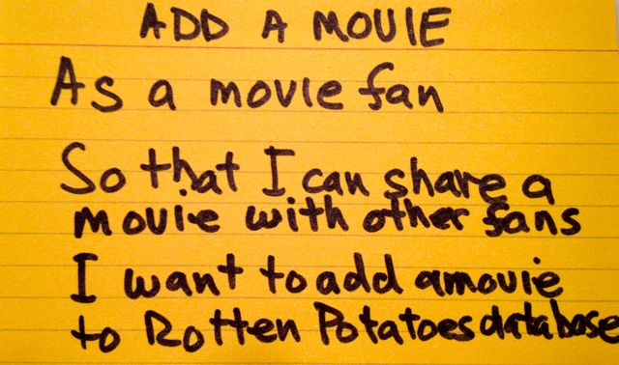
User Stories
1-3 sentences in everyday language
  Fits on 3” x 5” index card
  Written by/with customer
“Connextra” format:
  Feature name
  As a [kind of stakeholder],
  So that [I can achieve some goal],
  I want to [do some task]
  3 phrases must be there, can be in any order
Idea: user story can be formulated as acceptance test before code is written
Notes:
Dave Patterson created this image
Ideas from CHI community

Slide 33
Why 3x5 Cards?
(from User Interface community)
Nonthreatening
  => all stakeholders participate in brainstorming
Easy to rearrange
  => all stakeholders participate in prioritization
Since stories must be short, easy to change during development
  Often get new insights during development

Slide 34
SMART Stories
Specific
Measurable
Achievable
(ideally, implement in
1 iteration)
Relevant
(“the 5 why’s”)
Timeboxed
(know when to give up)

Slide 35

Specific & Measurable
Each scenario testable
  Implies known good input
  and expected results exist
Anti-example:
“UI should be user-friendly”
Example: Given/When/Then
  Given some specific starting condition(s),
  When I do X,
  Then one or more specific thing(s) should happen

Slide 36

Achievable
Complete in 1 iteration
If can’t deliver feature in 1 iteration, deliver subset of stories
  Always aim for working code @ end of iteration
If <1 story per iteration, need to improve point estimation per story

Slide 37
Relevant – Business Value
Discover business value, or kill the story:
  Protect revenue
  Increase revenue
  Manage cost
  Increase brand value
  Making the product remarkable
  Providing more value to your customers

Slide 38

Timeboxed
Stop story when exceed time budget
  Give up or divide into smaller stories or reschedule what is left undone
To avoid underestimating length of project
Pivotal Tracker tracks velocity, helps avoid underestimate

Slide 39
User Stories
=> Acceptance Tests?
Wouldn’t it be great to automatically map 3x5 card user stories into tests for user to decide if accept the app?
How would you match the English text to test code?
How could you run the tests without a human in the loop to perform the actions?
Notes:
Need to map from user stories to acceptance tests for test-driven design

Slide 40
Behavior Driven Development: Big Idea
Tests from customer-friendly user stories
  Acceptance: ensure satisfied customer
  Integration: ensure interfaces between modules consistent assumptions, communicate correctly
Meet halfway between customer and developer
  User stories are not code, so clear to customer and can be used to reach agreement
  Also not completely freeform, so can connect to real tests

Slide 41
Example User Story
1 Feature
Feature: User can manually add movie
Scenario: Add a movie
Given I am on the RottenPotatoes home page
When I follow "Add new movie"
Then I should be on the Create New Movie page
When I fill in "Title" with "Men In Black"
And I select "PG-13" from "Rating"
And I press "Save Changes"
Then I should be on the RottenPotatoes home page
And I should see "Men In Black"
≥1 Scenarios / Feature
3 to 8 Steps / Scenario
Notes:
Note that mapping from 3x5 cards to Cucumber can be erroneous, ultimately need user to test.
This scenario assumes I can leave the movie date blank.

Slide 42
User Story, Feature, and Steps
User story: refers to single feature
Feature: ≥1 scenarios that show different ways a feature is used
  Keywords Feature and Scenario
  identify respective components
Scenario: 3 - 8 steps that describe scenario
Step definitions: code to test steps

Slide 43

5 Step Keywords
Given steps represent state of world before event: preconditions
When steps represent event
  e.g., simulate user pushing a button
Then steps represent expected postconditions; check if true
/ 5. And & But extend previous step

Slide 44
Summary
The research studies results are inconsistent
  Quality
  Productivity
TDD can be effective if you consider
  Goals of your software group
  Kind of software being developed
  The skill level and experience of your developers
BDD can be used for acceptance
  Customer focused
  Plain English description

Slide 45
References
[1] Erdogmus, Hakan; Morisio, Torchiano. On the Effectiveness of Test-first Approach to Programming. Proceedings of the IEEE Transactions on Software Engineering, 31(1). January 2005. (NRC 47445). Retrieved on 2008-01-14.
[2] George, Boby; Williams, Laurie. A Structured experiment of test-driven development. 2003.
[3] E.M. Maximilien, L. Williams; Assessing test-development at IBM, presented at International Conference of Software Engineering, Portland, OR, 2003.
[4] Beck, K. Test-Driven Development by Example, Addison Wesley, 2003 http://en.wikipedia.org/wiki/Test_driven_development#Test-Driven_Development_Cycle

Slide 46
Example: CSCI 362 Array Autograder
C++
Catch2 – BDD style tests
Relies on a “correct” implementation
http://cs.millersville.edu/~wkillian/2019/fall/files/csci420/TestArray.hpp

