Slide 1
Multicore and Thread-level Parallelism
CSCI 370 – Computer Architecture

Slide 2
Architecture Considerations with Multicore
Cache
Execution Units
Anything else?
Notes:
Out of order execution

Slide 3
False Sharing
0
1
2
3
4
5
6
7
psum
Cache Block m
Cache Block m+1
Coherency maintained on cache blocks
To update psum[i], thread i must have exclusive access
Threads sharing common cache block will keep fighting each other for access to block

Slide 4
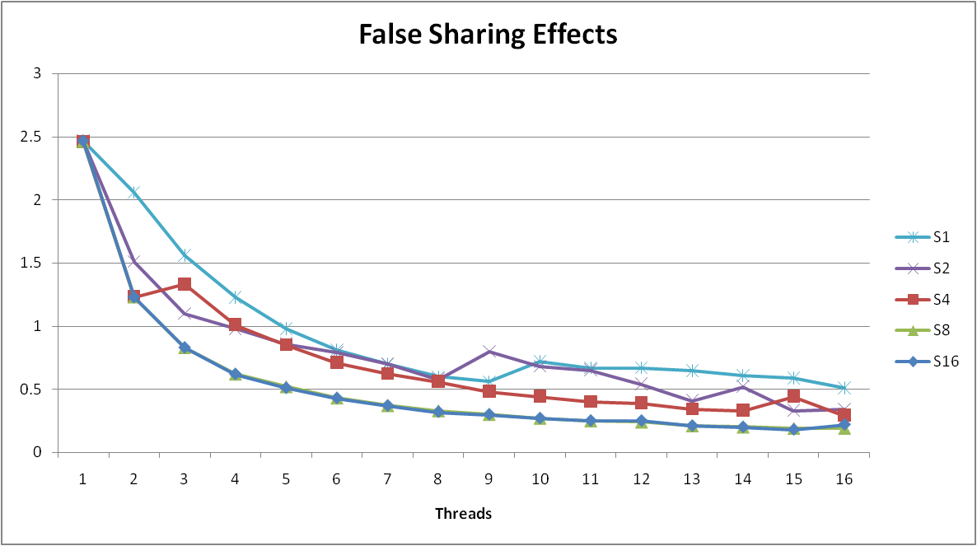
False Sharing Performance
Best spaced-apart performance 2.8 X better than best adjacent
Demonstrates cache block size = 64
8-byte values
No benefit increasing spacing beyond 8

Slide 5
Cache Coherency
A problem even on hierarchical architectures
Processor A writes location X
Processor B reads location X
What value does Processor B get? Before or after the write of A?

Slide 6
Multicore Processor
Core 0
Core n-1
Regs
Regs
L1
d-cache
L1
i-cache
…
L1
d-cache
L1
i-cache
L2 unified cache
L2 unified cache
L3 unified cache
(shared by all cores)
Main memory
Intel Nehalem (and newer) Processor
Multiple processors operating with coherent view of memory

Slide 8
Memory Consistency
int a = 1;
int b = 100;
Thread consistency
constraints
Wa
Rb
Thread1:
Wa: a = 2;
Rb: print(b);
Thread2:
Wb: b = 200;
Ra: print(a);
Wb
Ra
What are the possible values printed?
Depends on memory consistency model
Abstract model of how hardware handles concurrent accesses
Sequential consistency
Overall effect consistent with each individual thread
Otherwise, arbitrary interleaving

Slide 9
Sequential Consistency Example
Thread consistency
constraints
int a = 1;
int b = 100;
Wa
Rb
Thread1:
Wa: a = 2;
Rb: print(b);
Thread2:
Wb: b = 200;
Ra: print(a);
Wb
Ra
Rb
Wb
Ra
100, 2
Wa
Rb
Ra
200, 2
Wb
Ra
Rb
2, 200
Ra
Wa
Rb
1, 200
Wb
Ra
Rb
2, 200
Wa
Rb
Ra
200, 2
Impossible outputs
100, 1 and 1, 100
Would require reaching both Ra and Rb before Wa and Wb

Slide 10
Non-Coherent Cache Scenario
int a = 1;
int b = 100;
Write-back caches, without coordination between them
Thread1:
Wa: a = 2;
Rb: print(b);
Thread2:
Wb: b = 200;
Ra: print(a);
Thread1 Cache
Thread2 Cache
a: 2
b:100
a:1
b:200
print 1
print 100
Main Memory
a:1
b:100

Slide 11
Snoopy Caches
int a = 1;
int b = 100;
Tag each cache block with state
Invalid Cannot use value
Shared Readable copy
Exclusive Writeable copy
Thread1:
Wa: a = 2;
Rb: print(b);
Thread2:
Wb: b = 200;
Ra: print(a);
Thread1 Cache
Thread2 Cache
E
a: 2
E
b:200
Main Memory
a:1
b:100

Slide 12
Snoopy Caches
int a = 1;
int b = 100;
Tag each cache block with state
Invalid Cannot use value
Shared Readable copy
Exclusive Writeable copy
Thread1:
Wa: a = 2;
Rb: print(b);
Thread2:
Wb: b = 200;
Ra: print(a);
Thread1 Cache
Thread2 Cache
E
a: 2
S
a: 2
S
a:2
print 2
S
b:200
S
b:200
E
b:200
print 200
Main Memory
When cache sees request for one of its E-tagged blocks
Supply value from cache
Set tag to S
a:1
b:100

Slide 13
Snoopy Caches
int a = 1;
int b = 100;
Tag each cache block with state
Invalid Cannot use value
Shared Readable copy
Exclusive Writeable copy
Thread1:
Wa: a = 2;
Rb: print(b);
Wa: a = 3;
Thread2:
Wb: b = 200;
Ra: print(a);
Wb: b = 300;
Thread1 Cache
Thread2 Cache
E
a: 3
S
a: 2
I
a:2
S
a:2
print 2
I
b:200
S
b:200
E
b:300
S
b:200
print 200
Main Memory
When cache sees write for one of its S-tagged blocks
Mark other cache’s tag to I
Set tag to E
update value
a:1
b:100

Slide 14
Out-of-Order Processor Structure
Instruction Control
Instruction
Cache
Instruction Decoder
Registers
Op. Queue
PC
Functional Units
Data Cache
Integer
Arith
Integer
Arith
FP
Arith
Load /
Store
Instruction control dynamically converts program into stream of operations
Operations mapped onto functional units to execute in parallel

Slide 15
Hyperthreading
Instruction Control
Instruction
Cache
Instruction Decoder
Reg A
Op. Queue A
Reg B
Op. Queue B
PC A
PC B
Functional Units
Data Cache
Integer
Arith
Integer
Arith
FP
Arith
Load /
Store
Replicate enough instruction control to process K instruction streams
K copies of all registers
Share functional units

Slide 16
A Visual Guide to Hyper-Threading

Slide 17
A Visual Guide to Hyper-Threading

Slide 18
Summary: Creating Parallel Machines
Multicore
Separate instruction logic and functional units
Some shared, some private caches
Must implement cache coherency
Hyperthreading
Also called “simultaneous multithreading” (SMT)
Separate program state
Shared functional units & caches
No special control needed for coherency
Combining
Theoretical speedup of cores * hyperthreads over sequential

Slide 19
A More Interesting Example
Sort set of N random numbers
Multiple possible algorithms

Slide 20
A More Interesting Example
Sort set of N random numbers
Sequential quicksort of set of values [X]
Choose “pivot” p from [X]
Rearrange [X] into
[L] : values <=p
[R] : values >p
Recursively sort [L] to get [L’]
Recursively sort [R] to get [R’]
Return [L’] + [R’]
What can be done independently?

Slide 21
Case Study: Quicksort
void quickSort(long int arr[], int left, int right) {
if (right – left <= 10) {
insertionSort(arr, left, right);
return;
}
int pivot = arr[(left + right) / 2];
int i = left;
int j = right;
partition (arr, &i, &j, pivot);
quickSort(arr, left, j);
quickSort(arr, i, right);
}

Slide 22
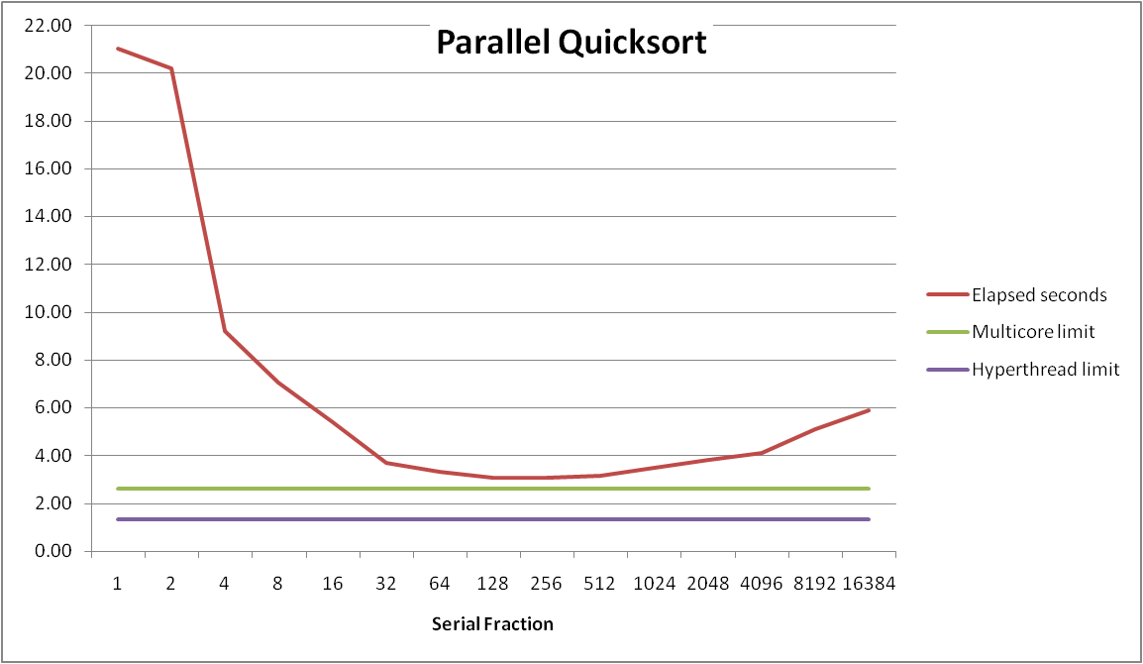
Parallel Quicksort Performance
Sort 2³⁷ (134,217,728) random values
Best speedup = 6.84X

Slide 23
Parallel Quicksort Performance
Good performance over wide range of fraction values
F too small: Not enough parallelism
F too large: Thread overhead + run out of thread memory

