Slide 1
Virtualization
System I/O
CSCI 370 – Computer Architecture

Slide 2
Lecture Outline
Virtualization
  Hardware management
  Sample Configurations
System I/O
  USB
  PCIe
  Thunderbolt

Slide 3
Virtualization

Slide 7
Virtualization – an Overview
A virtual system running concurrently on hardware
Notion of:
Host Operating System
Hypervisor – bridge between hardware and virtual machine
Guest Operating System
Advantages (in 2019):
Cloud computing (IaaS such as EC2, AppEngine, Azure)
Better utilize computing resources (processing power more than enough)
Modern day “mainframes”

Slide 8
But from a hardware perspective, what’s going on?
Just a lot of threads and data
No real difference
Hypervisor (software) manages virtual link to hardware
So how can we map these different threads to different processing cores (and/or sockets)?
Two Approaches: Gang Scheduling and Hypervisors

Slide 9
Method #1: Gang Scheduling
When a multi-vCPU machine requires processor time, all of the vCPUs are “ganged” together
vCPUs are scheduled to perform work against the physical cores
Done to streamline the process, and attempt to keep the processing synchronized
Utilized by VMWare and VirtualBox

Slide 10
Method #2: Hypervisors (Microsoft Hyper-V)
Virtual processors ask for time on the physical cores
Hyper-V quickly determines which core is ready and available
There is no need to group processors together
Guest OS must understand that it is residing inside a virtual machine
Hyper-V understands the CPU calls are coming independently, so oversubscription of the CPU cores is not as big

Slide 11
A Short Example (1)

Slide 12
A Short Example (2)

Slide 13
A Short Example (3)

Slide 14
A Short Example (4)

Slide 15
System IO

Slide 16
USB
Universal Serial Bus

Slide 17
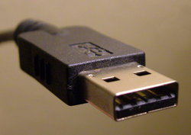
Universal Serial Bus
A representative peripheral interface
Universal Serial Bus (USB) provides a serial bus standard for connecting devices, usually to a computer, but it also is in use on other devices such as set-top boxes, game consoles and PDAs. (wikipedia.org)

Slide 18
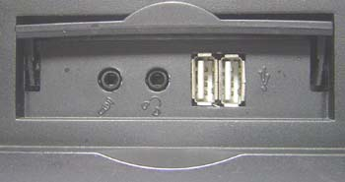

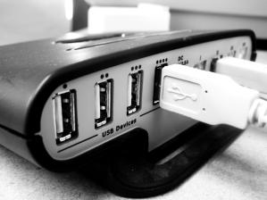
What USB Can Do
USB is a likely solution any time you want to use a computer to communicate with devices outside the computer.
The interface is suitable for one-of-kind and small-scale designs as well as mass-produced, standard peripheral types.
Device, male connector
Computer, female connector
Hub

Slide 19
Comparison
Interface | Format | Number of Devices (maximum) | Length (maximum, feet) | Speed (maximum, bits/sec.) | Typical Use
USB | asynchronous serial | 127 | 16 (or up to 96 ft. with 5 hubs) | 1.5M, 12M, 480M | Mouse, keyboard, disk drive, modem, audio
RS-232 (EIA/TIA-232) | asynchronous serial | 2 | 50-100 | 20k (115k with some hardware) | Modem, mouse, instrumentation
Parallel Printer Port | parallel | 2 (8 with daisy-chain support) | 10–30 | 8M | Printers, scanners, disk drives
IEEE-1394 (FireWire) | serial | 64 | 15 | 400M (increasing to 3.2G with IEEE-1394b | Video, mass storage

Slide 20
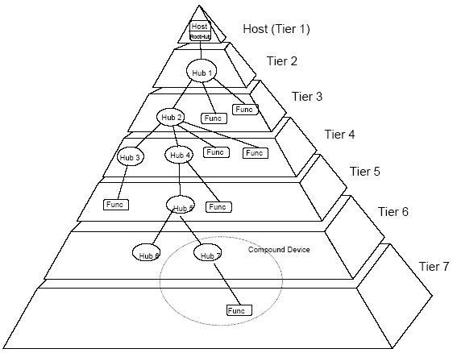
7 Level
Notes:
Up to 127 devices connected.

Slide 21
Benefits for Users
Ease of Use
Ease of use was a major design goal for USB, and the result is an interface that’s a pleasure to use for many reasons:
One interface for many devices.
Automatic configuration.
Hot pluggable
No power supply required (sometimes).
Notes:
USB is versatile enough to be usable with many kinds of peripherals. Instead of having a different connector type and supporting hardware for each peripheral, one interface serves many.
When a user connects a USB peripheral to a computer, its OS automatically detects the peripheral and loads the appropriate software driver.
We can connect and disconnect a peripheral whenever you want, whether or not the system and peripheral are powered, without damaging the PC or peripheral. The operating system detects when a device is attached and readies it for use.
A peripheral that requires up to 500 milliamperes can draw all of its power from the bus instead of having its own supply..

Slide 22

USB
USB 1.0 specification introduced in 1994
USB 2.0 specification finalized in 2001
USB 3.0 specification finalized 2010
USB 4.0 specification finalized Sept 2019
Notes:
IEEE 1394 – high bandwidth, high cost – This refers to accommodating low cost/ low performance peripherals (mouse, keyboard)

Slide 23
USB 2.0
A big step in USB’s evolution was version 2.0
  support for much faster transfers.
  a 40-times increase was found to be feasible, for a bus speed of 480 Megabits per second.
How to use it
  USB 2.0 is backwards compatible with USB 1.1.
  Version 2.0 peripherals can use the same connectors and cables as 1.x peripherals.
  To use the new, higher speed, peripherals must connect to 2.0-compliant hosts and hubs. 2.0 hosts and hubs can also communicate with 1.x peripherals.
  A 2.0-compliant hub with a slower peripheral attached will translate as needed between the peripheral’s speed and high speed.
  This increases the hub’s complexity but makes good use of the bus time without requiring different hubs for different speeds.

Slide 24
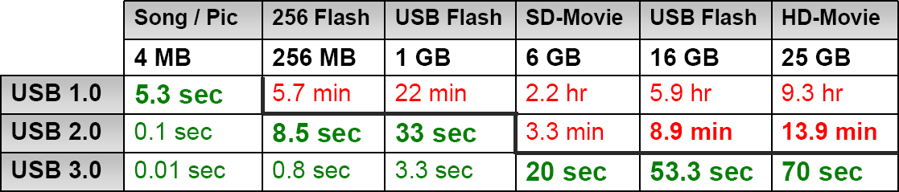
USB 3.0 Overview
Also referred to as SuperSpeed USB
Speeds 10x faster than 2.0 (5 Gbps in controlled test environment)
  Transfer of 25 GB file in approx 70 seconds (see chart)
Extensible – Designed to scale > 25Gbps
Optimized power efficiency
  No device polling (asynchronous notifications)
  Lower active and idle power requirements
Backward compatible with USB 2.0
  USB 2.0 device will work with USB 3.0 host
  USB 3.0 device will work with USB 2.0 host

Slide 25
USB 3.0
"SuperSpeed" bus provides a fourth transfer mode at 5.0 Gbit/s
Communication is full-duplex during SuperSpeed; (in the modes supported previously, by 1.x and 2.0, communication is half-duplex, with direction controlled by the host.)

Slide 26
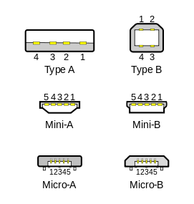
Physical Appearances
Type A connectors on host devices that supply power
Type B connectors on target devices that receive power.

Slide 27
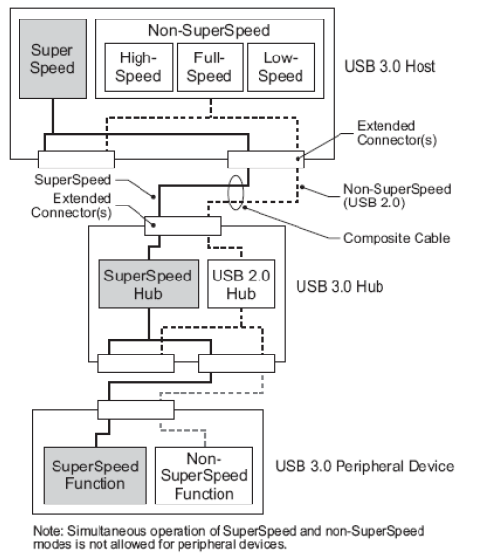
USB 3.0 Bus Architecture
Operates concurrently with USB 2.0 (Dual bus architecture)
  Mechanically and electrically backward/forward compatible
  Devices configured at fastest signaling rate
  Hubs contain additional ports
Speed and power efficiency
  Non polling reduces power consumption
  Additional data lines included to increase speed
  Efficiency of bandwidth – simultaneous communication between host and device
    Dedicated in and out lines allow communication between host and device
Notes:
USB 2.0 uses half duplex method for communication. One line controlling IN and OUT.

Slide 28
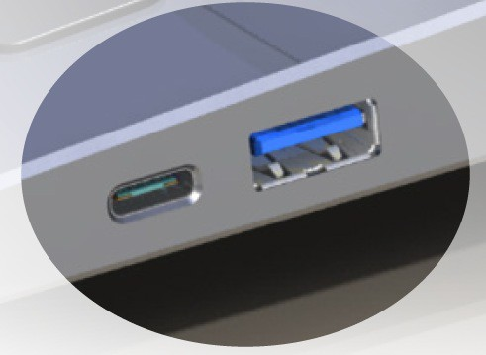
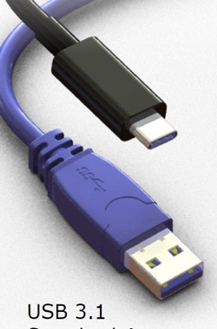
USB 3.1 Type C
New generation of USB connector developed to serve the market for next 20 years
Thin profile suitable for both ultra portable devices and larger devices
Reversible plug orientation & cable direction
  USB 3.1 Gen 2 (10Gbps)
  USB Power delivery, up to 100 watts
  Supports DisplayPort Alternate Mode
USB 3.1
Type-C
USB 3.1
Standard-A

Slide 29
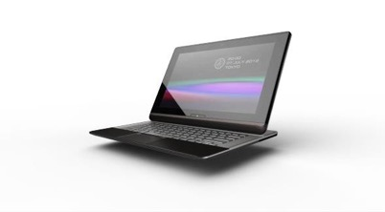
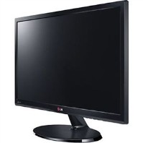
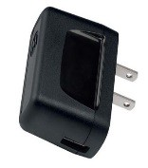
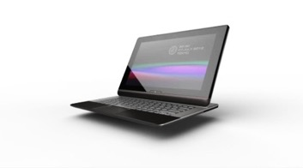
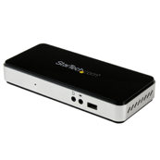

USB Configurations
Either end can serve as USB Host, USB-PD Power Consumer, and DisplayPort Video Source (these services are orthogonal to each other)
Device Charging
USB
Device Charging
USB 2.0 or 3.1 Data
Display Data
Dock
Device Supplying Power
USB 2.0 or 3.1 Data
Display Data

Slide 30
USB Power Delivery

Slide 31
USB 4
Spec | Throughput | Previous Term | Technical Term | Marketing Term
USB 4 | 40 Gbps | N/A | USB 4.0 | Not Announced
USB 3.2 | 20 Gbps | N/A | USB 3.2 Gen 2x2 | SuperSpeed USB 20Gbps
USB 3.1 | 10 Gbps | USB 3.1 Gen 2 | USB 3.2 Gen 2 | SuperSpeed USB 10Gbps
USB 3.0 | 5 Gbps | USB 3.1 Gen 1 | USB 3.2 Gen 1 | SuperSpeed USB
This is why I hate marketing / revisions

Slide 32

Thunderbolt
USB 4

Slide 33
Thunderbolt
Tries to be a universal port
Newer revisions bring increased bandwidth, features
Thunderbolt / Thunderbolt 2
  10Gbps bi-directional → 20Gbps bi-directional
  Supports PCIe and DisplayPort Protocols
  Port used: Mini DisplayPort
Thunderbolt 3
  40Gbps bi-directional (with correct cable)
  Adds support for USB 3.1C

Slide 34
It’s all about the Bandwidth
What can we do with 10Gbps?
  Two external (non-4K) displays
  USB
  Ethernet
  First-generation “real” docking stations
20Gbps?
  4K display
  USB 3.0
  Ethernet
40Gbps?
  Dual 4K displays or 5K display
  USB 3.1
  Ethernet

Slide 36
PCIe
Peripheral Component Interconnect Express

Slide 37
PCI Express Devices
Notes:
Graphical Processing Units
Hubs (USB, Thunderbolt)
Solid State Drives (greater bandwidth)
Wi-Fi Cards
Also for portable systems (M.2)

Slide 38
Communication
Notes:
1x up to 32x by powers of 2.
Representative of bandwidth
Packet based transfer

Slide 39
A Problem with Most Busses
Notes:
Clock is built into data stream
- Clock arrives with data
- No skew because only one data bit is sent
- Receiver can correct for multilane skews

Slide 40
Layout of Bus System

Slide 41
Performance of PCIe
Pattern?
True for Gen4 as well

Slide 42
Bonus: Error Correction

