Slide 1
Recursion

Slide 2
Recursion
recursion: The definition of an operation in terms of itself.
  Solving a problem using recursion depends on solving
  smaller occurrences of the same problem.
recursive programming: Writing methods that call themselves to solve problems recursively.
  An equally powerful substitute for iteration (loops)
  Particularly well-suited to solving certain types of problems

Slide 3
Why learn recursion?
"cultural experience" - A different way of thinking of problems
Can solve some kinds of problems better than iteration
Leads to elegant, simplistic, short code (when used well)
Many programming languages ("functional" languages such as Scheme, ML, and Haskell) use recursion exclusively (no loops)

Slide 4
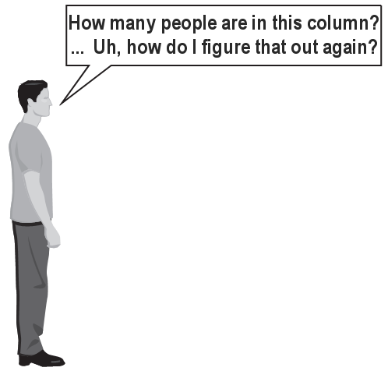
Exercise
How many students total are directly behind you in your "column" of the classroom?
  You have poor vision, so you can
  see only the people right next to you.
  So you can't just look back and count.
  But you are allowed to ask
  questions of the person next to you.
  How can we solve this problem?
  (recursively )

Slide 5
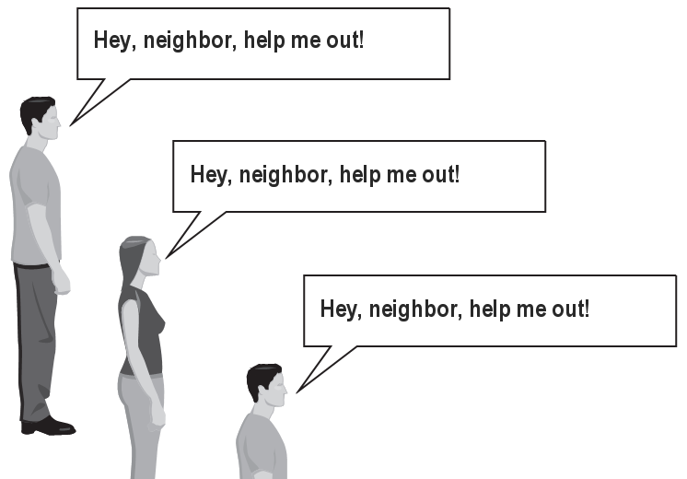
The idea
Recursion is about breaking a big problem into smaller occurrences of that same problem.
  Each person can solve a small part of the problem.
    What is a small version of the problem that would be easy to answer?
    What information from a neighbor might help me?

Slide 6
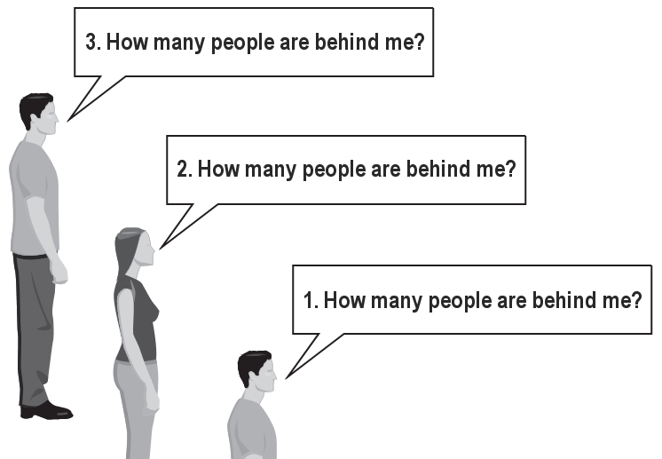
Recursive algorithm
Number of people behind me:
  If there is someone behind me,
  ask him/her how many people are behind him/her.
    When they respond with a value N, then I will answer N + 1.
  If there is nobody behind me, I will answer 0.

Slide 7
Recursion and cases
Every recursive algorithm involves at least 2 cases:
  base case: A simple occurrence that can be answered directly.
  recursive case: A more complex occurrence of the problem that cannot be directly answered, but can instead be described in terms of smaller occurrences of the same problem.
  Some recursive algorithms have more than one base or recursive case, but all have at least one of each.
  A crucial part of recursive programming is identifying these cases.

Slide 8
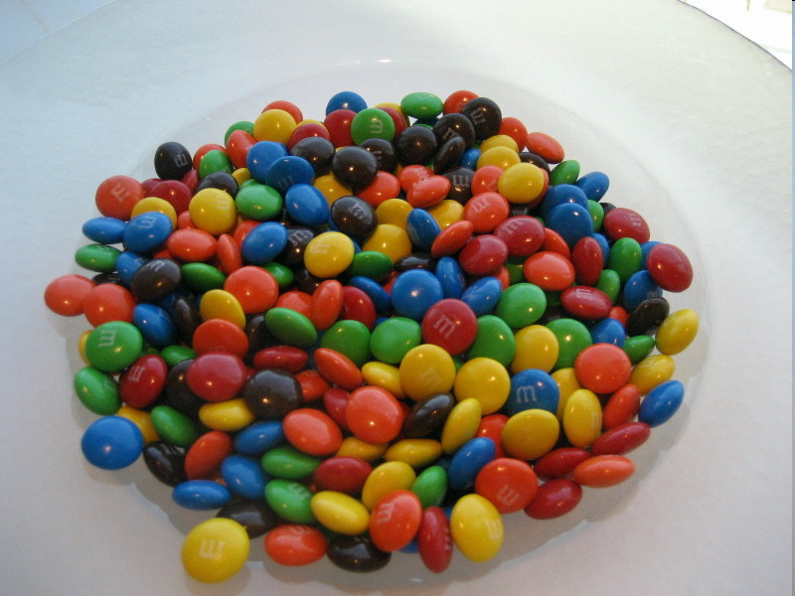
Another recursive task
How can we remove exactly half of the M&M's in a large bowl, without dumping them all out or being able to count them?
  What if multiple people help out with solving the problem?
  Can each person do a small part of the work?
  What is a number of M&M's
  that it is easy to double,
  even if you can't count?
  (What is a "base case"?)

Slide 9
Recursion in Java
Consider the following method to print a line of * characters:
  // Prints a line containing the given number of stars.
  // Precondition: n >= 0
  public static void printStars(int n) {
  for (int i = 0; i < n; i++) {
  System.out.print("*");
  }
  System.out.println(); // end the line of output
  }
Write a recursive version of this method (that calls itself).
  Solve the problem without using any loops.
  Hint: Your solution should print just one star at a time.

Slide 10
A basic case
What are the cases to consider?
  What is a very easy number of stars to print without a loop?
  public static void printStars(int n) {
  if (n == 1) {
  // base case; just print one star
  System.out.println("*");
  } else {
  ...
  }
  }

Slide 11
Handling more cases
Handling additional cases, with no loops (in a bad way):
  public static void printStars(int n) {
  if (n == 1) {
  // base case; just print one star
  System.out.println("*");
  } else if (n == 2) {
  System.out.print("*");
  System.out.println("*");
  } else if (n == 3) {
  System.out.print("*");
  System.out.print("*");
  System.out.println("*");
  } else if (n == 4) {
  System.out.print("*");
  System.out.print("*");
  System.out.print("*");
  System.out.println("*");
  } else ...
  }

Slide 12
Handling more cases 2
Taking advantage of the repeated pattern (somewhat better):
  public static void printStars(int n) {
  if (n == 1) {
  // base case; just print one star
  System.out.println("*");
  } else if (n == 2) {
  System.out.print("*");
  printStars(1); // prints "*"
  } else if (n == 3) {
  System.out.print("*");
  printStars(2); // prints "**"
  } else if (n == 4) {
  System.out.print("*");
  printStars(3); // prints "***"
  } else ...
  }

Slide 13
Using recursion properly
Condensing the recursive cases into a single case:
  public static void printStars(int n) {
  if (n == 1) {
  // base case; just print one star
  System.out.println("*");
  } else {
  // recursive case; print one more star
  System.out.print("*");
  printStars(n - 1);
  }
  }

Slide 14
"Recursion Zen"
The real, even simpler, base case is an n of 0, not 1:
  public static void printStars(int n) {
  if (n == 0) {
  // base case; just end the line of output
  System.out.println();
  } else {
  // recursive case; print one more star
  System.out.print("*");
  printStars(n - 1);
  }
  }
  Recursion Zen: The art of properly identifying the best set of cases for a recursive algorithm and expressing them elegantly.

Slide 15
Recursive tracing
Consider the following recursive method:
  public static int mystery(int n) {
  if (n < 10) {
  return n;
  } else {
  int a = n / 10;
  int b = n % 10;
  return mystery(a + b);
  }
  }
  What is the result of the following call?
    mystery(648)

Slide 16
A recursive trace
mystery(648):
  int a = 648 / 10; // 64
  int b = 648 % 10; // 8
  return mystery(a + b); // mystery(72)
    mystery(72):
    int a = 72 / 10; // 7
    int b = 72 % 10; // 2
    return mystery(a + b); // mystery(9)
      mystery(9):
      return 9;

Slide 17
Recursive tracing 2
Consider the following recursive method:
  public static int mystery(int n) {
  if (n < 10) {
  return (10 * n) + n;
  } else {
  int a = mystery(n / 10);
  int b = mystery(n % 10);
  return (100 * a) + b;
  }
  }
  What is the result of the following call?
    mystery(348)

Slide 18
A recursive trace 2
mystery(348)
  int a = mystery(34);
    int a = mystery(3);
      return (10 * 3) + 3; // 33
    int b = mystery(4);
      return (10 * 4) + 4; // 44
    return (100 * 33) + 44; // 3344
  int b = mystery(8);
    return (10 * 8) + 8; // 88
  return (100 * 3344) + 88; // 334488
  What is this method really doing?

Slide 19
Exercise
Write a recursive method pow accepts an integer base and exponent and returns the base raised to that exponent.
  Example: pow(3, 4) returns 81
  Solve the problem recursively and without using loops.

Slide 20
pow solution
  // Returns base ^ exponent.
  // Precondition: exponent >= 0
  public static int pow(int base, int exponent) {
  if (exponent == 0) {
  // base case; any number to 0th power is 1
  return 1;
  } else {
  // recursive case: x^y = x * x^(y-1)
  return base * pow(base, exponent - 1);
  }
  }

Slide 21
An optimization
Notice the following mathematical property:
  3¹² = 531441 = 9⁶
  = (3²)⁶
  531441 = (9²)³
  = ((3²)²)³
  When does this "trick" work?
  How can we incorporate this optimization into our pow method?
  What is the benefit of this trick if the method already works?

Slide 22
pow solution 2
  // Returns base ^ exponent.
  // Precondition: exponent >= 0
  public static int pow(int base, int exponent) {
  if (exponent == 0) {
  // base case; any number to 0th power is 1
  return 1;
  } else if (exponent % 2 == 0) {
  // recursive case 1: x^y = (x^2)^(y/2)
  return pow(base * base, exponent / 2);
  } else {
  // recursive case 2: x^y = x * x^(y-1)
  return base * pow(base, exponent - 1);
  }
  }

Slide 23
Exercise
Write a recursive method printBinary that accepts an integer and prints that number's representation in binary (base 2).
  Example: printBinary(7) prints 111
  Example: printBinary(12) prints 1100
  Example: printBinary(42) prints 101010
  Write the method recursively and without using any loops.
place | 10 | 1 |  | 32 | 16 | 8 | 4 | 2 | 1
value | 4 | 2 |  | 1 | 0 | 1 | 0 | 1 | 0

Slide 24
Case analysis
Recursion is about solving a small piece of a large problem.
  What is 69743 in binary?
    Do we know anything about its representation in binary?
  Case analysis:
    What is/are easy numbers to print in binary?
    Can we express a larger number in terms of a smaller number(s)?
  Suppose we are examining some arbitrary integer N.
    if N's binary representation is 10010101011
    (N / 2)'s binary representation is 1001010101
    (N % 2)'s binary representation is 1

Slide 25
printBinary solution
  // Prints the given integer's binary representation.
  // Precondition: n >= 0
  public static void printBinary(int n) {
  if (n < 2) {
  // base case; same as base 10
  System.out.println(n);
  } else {
  // recursive case; break number apart
  printBinary(n / 2);
  printBinary(n % 2);
  }
  }
  Can we eliminate the precondition and deal with negatives?

Slide 26
printBinary solution 2
  // Prints the given integer's binary representation.
  public static void printBinary(int n) {
  if (n < 0) {
  // recursive case for negative numbers
  System.out.print("-");
  printBinary(-n);
  } else if (n < 2) {
  // base case; same as base 10
  System.out.println(n);
  } else {
  // recursive case; break number apart
  printBinary(n / 2);
  printBinary(n % 2);
  }
  }

Slide 27
Exercise
Write a recursive method isPalindrome accepts a String and returns true if it reads the same forwards as backwards.
  isPalindrome("madam") → true
  isPalindrome("racecar") → true
  isPalindrome("step on no pets") → true
  isPalindrome("able was I ere I saw elba") → true
  isPalindrome("Java") → false
  isPalindrome("rotater") → false
  isPalindrome("byebye") → false
  isPalindrome("notion") → false

Slide 28
Exercise solution
  // Returns true if the given string reads the same
  // forwards as backwards.
  // Trivially true for empty or 1-letter strings.
  public static boolean isPalindrome(String s) {
  if (s.length() < 2) {
  return true; // base case
  } else {
  char first = s.charAt(0);
  char last = s.charAt(s.length() - 1);
  if (first != last) {
  return false;
  } // recursive case
  String middle = s.substring(1, s.length() - 1);
  return isPalindrome(middle);
  }
  }

Slide 29
Exercise solution 2
  // Returns true if the given string reads the same
  // forwards as backwards.
  // Trivially true for empty or 1-letter strings.
  public static boolean isPalindrome(String s) {
  if (s.length() < 2) {
  return true; // base case
  } else {
  return s.charAt(0) == s.charAt(s.length() - 1)
  && isPalindrome(s.substring(1, s.length() - 1));
  }
  }

Slide 30
Exercise
Write a recursive method reverseLines that accepts a file Scanner and prints the lines of the file in reverse order.
  Example input file: Expected console output:
  Roses are red, Are belong to you.
  Violets are blue. All my base
  All my base Violets are blue.
  Are belong to you. Roses are red,
  What are the cases to consider?
    How can we solve a small part of the problem at a time?
    What is a file that is very easy to reverse?

Slide 31
Reversal pseudocode
Reversing the lines of a file:
  Read a line L from the file.
  Print the rest of the lines in reverse order.
  Print the line L.
If only we had a way to reverse the rest of the lines of the file....

Slide 32
Reversal solution
public static void reverseLines(Scanner input) {
if (input.hasNextLine()) {
// recursive case
String line = input.nextLine();
reverseLines(input);
System.out.println(line);
}
}
  Where is the base case?

Slide 33

Tracing our algorithm
call stack: The method invocations running at any one time.
  reverseLines(new Scanner("poem.txt"));
public static void reverseLines(Scanner input) {
if (input.hasNextLine()) {
String line = input.nextLine(); // "Roses are red,"
reverseLines(input);
System.out.println(line);
}
}
public static void reverseLines(Scanner input) {
if (input.hasNextLine()) {
String line = input.nextLine(); // "Violets are blue."
reverseLines(input);
System.out.println(line);
}
}
public static void reverseLines(Scanner input) {
if (input.hasNextLine()) {
String line = input.nextLine(); // "All my base"
reverseLines(input);
System.out.println(line);
}
}
public static void reverseLines(Scanner input) {
if (input.hasNextLine()) {
String line = input.nextLine(); // "Are belong to you."
reverseLines(input);
System.out.println(line);
}
}
public static void reverseLines(Scanner input) {
if (input.hasNextLine()) { // false
...
}
}
input file:
output:
Roses are red,
Violets are blue.
All my base
Are belong to you.
Are belong to you.
All my base
Violets are blue.
Roses are red,

Slide 34
Exercise
Write a method crawl accepts a File parameter and prints information about that file.
  If the File object represents a normal file, just print its name.
  If the File object represents a directory, print its name and information about every file/directory inside it, indented.
  csci161
  handouts
  syllabus.doc
  lecture_schedule.xls
  labs
  3-rocket
  Rocket.java
  Rocket.class
  recursive data: A directory can contain other directories.

Slide 35
File objects
A File object (from the java.io package) represents
a file or directory on the disk.
Constructor/method | Description
File(String) | creates File object representing file with given name
canRead() | returns whether file is able to be read
delete() | removes file from disk
exists() | whether this file exists on disk
getName() | returns file's name
isDirectory() | returns whether this object represents a directory
length() | returns number of bytes in file
listFiles() | returns a File[] representing files in this directory
renameTo(File) | changes name of file

Slide 36
Public/private pairs
We cannot vary the indentation without an extra parameter:
  public static void crawl(File f, String indent) {
Often the parameters we need for our recursion do not match those the client will want to pass.
  In these cases, we instead write a pair of methods:
  1) a public, non-recursive one with the parameters the client wants
  2) a private, recursive one with the parameters we really need

Slide 37
Exercise solution 2
  // Prints information about this file,
  // and (if it is a directory) any files inside it.
  public static void crawl(File f) {
  crawl(f, ""); // call private recursive helper
  }
  // Recursive helper to implement crawl/indent behavior.
  private static void crawl(File f, String indent) {
  System.out.println(indent + f.getName());
  if (f.isDirectory()) {
  // recursive case; print contained files/dirs
  for (File subFile : f.listFiles()) {
  crawl(subFile, indent + " ");
  }
  }
  }

