Slide 1
Primitive Data and Variables
CSCI 161 – Introduction to Programming I
William Killian

Slide 2

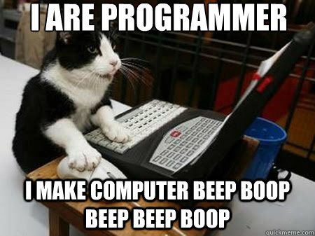
Lab 1 Observations
Spaces in file or project or workspace improperly setup =>
Directory structure
  ~
  ls and cd
AutoLab
You are well on your
way! Keep up the
awesome work

Slide 3
Lab 1 (cont’d)
Labs get harder, and require more time!
But…they become more fun too!

Slide 4
Data types
type: A category or set of data values.
  Constrains the operations that can be performed on data
  Many languages ask the programmer to specify types
  Examples: integer, real number, string
Internally, computers store everything as 1s and 0s
  104 → 01101000
  "hi" → 01101000 01101001

Slide 5
Java's primitive types
primitive types: 8 simple types for numbers, text, etc.
  Java also has object types, which we'll talk about later
  Name Description Examples
  int integers (up to 2³¹ - 1) 42, -3, 0, 926394
  double real numbers (up to 10³⁰⁸) 3.1, -0.25, 9.4e3
  char single text characters 'a', 'X', '?', '\n'
  boolean logical values true, false
  float, byte, short, long
Notes:
5

Slide 6
Expressions
expression: a value or operation that computes a value
  Examples: 1 + 4 * 5
  (7 + 2) * 6 / 3
  42
  The simplest expression is a literal value
  A complex expression can use operators and parentheses

Slide 7
Arithmetic operators
operator: Combines multiple values or expressions
  + addition
  - subtraction (or negation)
  * multiplication
  / division
  % modulus (a.k.a. remainder)
As a program runs, its expressions are evaluated
  1 + 1 evaluates to 2
  System.out.println(3 * 4); prints 12
    How would we print the text 3 * 4 ?

Slide 8
Integer division with /
When we divide integers, the quotient is also an integer.
  14 / 4 is 3, not 3.5
3 4 52
4 ) 14 10 ) 45 27 ) 1425
12 40 135
2 5 75
54
21
More examples:
  32 / 5 is ?
  84 / 10 is ?
  156 / 100 is ?
  Dividing by 0 causes an error when your program runs.

Slide 9
Integer remainder with %
What is the result?
45 % 6
2 % 2
8 % 20
11 % 0
The % operator computes the remainder from integer division.
  14 % 4 is 2
  218 % 5 is 3
  3 43
  4 ) 14 5 ) 218
  12 20
  2 18
  15
  3
Applications of % operator:
  Obtain last digit of a number: 230857 % 10 is 7
  Obtain last 4 digits: 658236489 % ? is 6489
  See whether a number is odd: ?
Notes:
9

Slide 10
Precedence
precedence: Order in which operators are evaluated.
  Generally operators evaluate left-to-right.
  1 - 2 - 3 is (1 - 2) - 3 which is -4
  But * / % have a higher level of precedence than + -
  1 + 3 * 4 is 13
  6 + 8 / 2 * 3
  6 + 4 * 3
  6 + 12 is 18
  Parentheses can force a certain order of evaluation:
  (1 + 3) * 4 is 16
  Spacing does not affect order of evaluation
  1+3 * 4-2 is 11

Slide 11
Precedence examples
1 * 2 + 3 * 5 % 4
\_/
|
2 + 3 * 5 % 4
\_/
|
2 + 15 % 4
\___/
|
2 + 3
\________/
|
5
1 + 8 % 3 * 2 - 9
\_/
|
1 + 2 * 2 - 9
\___/
|
1 + 4 - 9
\______/
|
5 - 9
\_________/
|
-4

Slide 12
Precedence questions
What values result from the following expressions?
  9 / 5
  695 % 20
  7 + 6 * 5
  7 * 6 + 5
  248 % 100 / 5
  6 * 3 - 9 / 4
  (5 - 7) * 4
  6 + (18 % (17 - 12))
Notes:
12
Answers:
1
15
37
47
9
16
-8
9

Slide 13
Real numbers (type double)
Examples: 6.022 , -42.0 , 2.143e17
  Placing .0 or . after an integer makes it a double.
The operators + - * / % () all still work with double.
  / produces an exact answer: 15.0 / 2.0 is 7.5
  Precedence is the same: () before * / % before + -
Notes:
13

Slide 14
Real number example
2.0 * 2.4 + 2.25 * 4.0 / 2.0
\___/
|
4.8 + 2.25 * 4.0 / 2.0
\___/
|
4.8 + 9.0 / 2.0
\_____/
|
4.8 + 4.5
\____________/
|
9.3

Slide 15
Mixing types
When int and double are mixed, the result is a double.
  4.2 * 3 is 12.6
The conversion is per-operator, affecting only its operands.
  7 / 3 * 1.2 + 3 / 2
  \_/
  |
  2 * 1.2 + 3 / 2
  \___/
  |
  2.4 + 3 / 2
  \_/
  |
  2.4 + 1
  \________/
  |
  3.4
  3 / 2 is 1 above, not 1.5.
2.0 + 10 / 3 * 2.5 - 6 / 4
\___/
|
2.0 + 3 * 2.5 - 6 / 4
\_____/
|
2.0 + 7.5 - 6 / 4
\_/
|
2.0 + 7.5 - 1
\_________/
|
9.5 - 1
\______________/
|
8.5

Slide 16
String concatenation
string concatenation: Using + between a string and another value to make a longer string.
  "hello" + 42 is "hello42"
  1 + "abc" + 2 is "1abc2"
  "abc" + 1 + 2 is "abc12"
  1 + 2 + "abc" is "3abc"
  "abc" + 9 * 3 is "abc27"
  "1" + 1 is "11"
  4 - 1 + "abc" is "3abc"
Use + to print a string and an expression's value together.
  System.out.println("Grade: " + (95.1 + 71.9) / 2);
  Output: Grade: 83.5

Slide 17
Variables
Notes:
17

Slide 18
Receipt example
What's bad about the following code?
  public class Receipt {
  public static void main(String[] args) {
  // Calculate total owed, assuming 8% tax / 15% tip
  System.out.println("Subtotal:");
  System.out.println(38 + 40 + 30);
  System.out.println("Tax:");
  System.out.println((38 + 40 + 30) * .08);
  System.out.println("Tip:");
  System.out.println((38 + 40 + 30) * .15);
  System.out.println("Total:");
  System.out.println(38 + 40 + 30 +
  (38 + 40 + 30) * .08 +
  (38 + 40 + 30) * .15);
  }
  }
  The subtotal expression (38 + 40 + 30) is repeated
  So many println statements
Notes:
3 meals

Slide 19

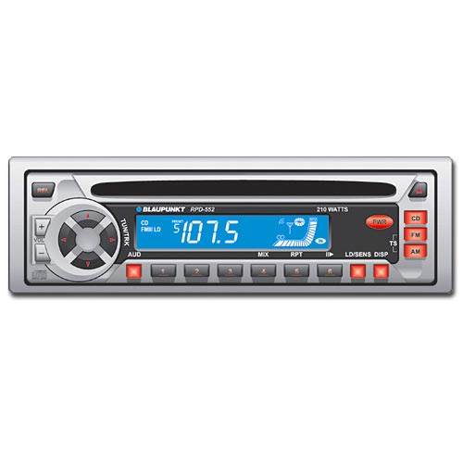
Variables
variable: A piece of the computer's memory that is given a name and type, and can store a value.
  Like preset stations on a car stereo, or cell phone speed dial:
  Steps for using a variable:
    Declare it - state its name and type
    Initialize it - store a value into it
    Use it - print it or use it as part of an expression
Notes:
a variable is also like the MS / MR buttons on a calculator
variables must be declared before they are used, just like methods
19

Slide 20
Declaration
x
myGPA
variable declaration: Sets aside memory for storing a value.
  Variables must be declared before they can be used.
Syntax:
  type name;
    The name is an identifier.
  int x;
  double myGPA;

Slide 21
Assignment
x | 3
myGPA | 3.25
assignment: Stores a value into a variable.
  The value can be an expression; the variable stores its result.
Syntax:
  name = expression;
  int x;
  x = 3;
  double myGPA;
  myGPA = 1.0 + 2.25;

Slide 22
Using variables
x | 3
x | 11
Once given a value, a variable can be used in expressions:
  int x;
  x = 3;
  System.out.println("x is " + x); ?
  System.out.println(5 * x - 1); ?
You can assign a value more than once:
  int x;
  x = 3;
  System.out.println(x + " here"); ?
  x = 4 + 7;
  System.out.println("now x is " + x); ?

Slide 23
Declaration/initialization
myGPA | 3.95
x | 14
A variable can be declared/initialized in one statement.
Syntax:
  type name = value;
  double myGPA = 3.95;
  int x = (11 % 3) + 12;

Slide 24
Assignment and algebra
x | 3
x | 5
Assignment uses = , but it is not an algebraic equation.
  = means, "store the value at right in variable at left"
    The right side expression is evaluated first,
    and then its result is stored in the variable at left.
What happens here?
  int x = 3;
  x = x + 2; // ???
Notes:
24

Slide 25
Assignment and types
myGPA | 4.0
avg | 5.0
A variable can only store a value of its own type.
  int x = 2.5; // ERROR: incompatible types
An int value can be stored in a double variable.
  The value is converted into the equivalent real number.
  double myGPA = 4;
  double avg = 11 / 2;
    Why does avg store 5.0
    and not 5.5 ?

Slide 26
Compiler errors
A variable can't be used until it is assigned a value.
  int x;
  System.out.println(x); // ERROR: x has no value
You may not declare the same variable twice.
  int x;
  int x; // ERROR: x already exists
  int x = 3;
  int x = 5; // ERROR: x already exists
    How can this code be fixed?

Slide 27
Printing a variable's value
Use + to print a string and a variable's value on one line.
  double grade = (95.1 + 71.9 + 82.6) / 3.0;
  System.out.println("Your grade was " + grade);
  int students = 11 + 17 + 4 + 19 + 14;
  System.out.println("There are " + students +
  " students in the course.");
  Output:
  Your grade was 83.2
  There are 65 students in the course.

Slide 28
Receipt question
Improve the receipt program using variables.
public class Receipt {
public static void main(String[] args) {
// Calculate total owed, assuming 8% tax / 15% tip
System.out.println("Subtotal:");
System.out.println(38 + 40 + 30);
System.out.println("Tax:");
System.out.println((38 + 40 + 30) * .08);
System.out.println("Tip:");
System.out.println((38 + 40 + 30) * .15);
System.out.println("Total:");
System.out.println(38 + 40 + 30 +
(38 + 40 + 30) * .15 +
(38 + 40 + 30) * .08);
}
}

Slide 29
Receipt answer
public class Receipt {
public static void main(String[] args) {
// Calculate total owed, assuming 8% tax / 15% tip
int subtotal = 38 + 40 + 30;
double tax = subtotal * .08;
...
System.out.println("Subtotal: " + subtotal);
System.out.println("Tax: " + tax);
...
}
}

