Slide 1
Introduction
CSCI 161 – Introduction to Programming I
William Killian

Slide 2
What is computer science?
Computer Science
  the scientific and practical approach to computation and its applications (Wikipedia)
  Study of algorithms
  Subfields
    Graphics
    Compilers, Operating Systems
    Artificial Intelligence, Natural Language Processing
    Databases, Data Mining
    ...
Computer Engineering
  Overlap with CS and EE; emphasizes hardware

Slide 3
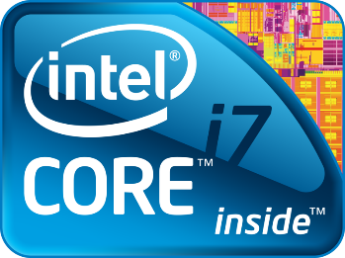
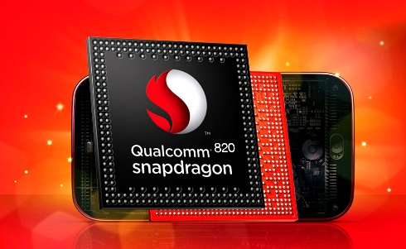
Computers
Components of computer (hardware)
  Processor (CPU) – “brain”; Intel Core i7
  Main memory (RAM) – volatile, short-term memory
  I/O devices – interact w/users
  Storage – non-volatile, long-term memory
Notes:
RAM: stores executing program & data
Storage: hard drive, flash, DVD-ROM

Slide 4
Capacity
Perspective on capacity
  1 B = 8 bits = 1 character (alphabetic, punctuation, etc.)
  1 KB = 2¹⁰ B (~ ½ typewritten page)
  1 MB = 2²⁰ B (novel)
  1 GB = 2³⁰ B (4/Britannica)
  1 TB = 2⁴⁰ B (10/print collection LC)
  1 PB = 2⁵⁰ B (200/all printed material)
  1 EB = 2⁶⁰ B (5/all words ever spoken)
  1 ZB = 2⁷⁰ B (?)
  1 YB = 2⁸⁰ B (??)

Slide 5

What is programming?
Program
set of instructions
to be carried out by a computer; an example of software
Program Execution
act of carrying out the instructions contained in a program
Programming Language
systematic set of rules used to describe computations in a format that is editable by humans; One is used to specify algorithms

Slide 6
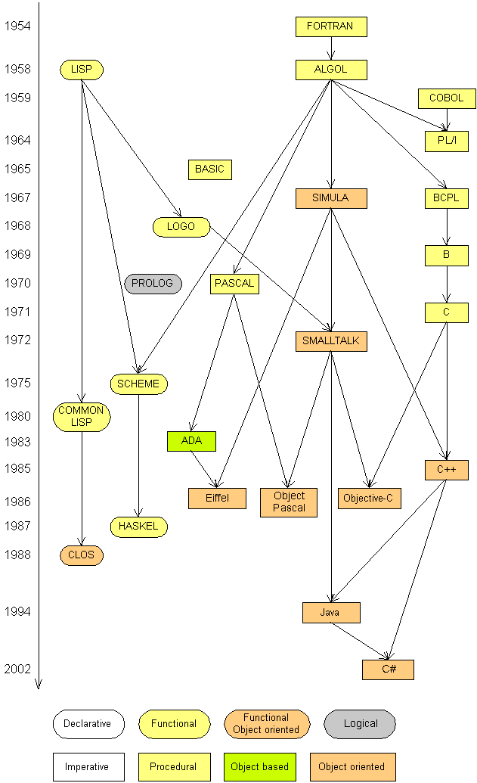
Programming languages
Some influential ones
  FORTRAN
    science / engineering
  COBOL
    business data
  LISP
    logic and AI
  BASIC
    a simple language

Slide 7
Why Take CS?
Why take CSCI 161?
  Learn how to program in Java (plus C/C++, Python, …)
  Learn a very marketable skill!
  Learn how to become a better problem solver
  Learn to become more precise and careful
  Learn patience

Slide 8
Some modern languages
procedural languages: programs are a series of commands
  Pascal (1970): designed for education
  C (1972): low-level operating systems and device drivers
functional programming: functions map inputs to outputs
  Lisp (1958) / Scheme (1975), ML (1973), Haskell (1990)
object-oriented languages: programs use interacting "objects"
  Smalltalk (1980): first major object-oriented language
  C++ (1985): "object-oriented" improvements to C
    successful in industry; used to build major OSes such as Windows
  Java (1995): designed for embedded systems, web apps/servers
    Runs on many platforms (Windows, Mac, Linux, cell phones...)
    The language we’ll use

Slide 9
Basic Java programs with println statements

Slide 10



Compile/run a program
Write it
  code or source code: the set of instructions in a program
Compile it
  compile: translate a program from one language to another
  byte code: Java compiler converts your code into a format named byte code that runs on many computer types
Run (execute) it
  output: messages printed to the user by a program
source code
byte code
output
compile
run

Slide 11
Eclipse
Eclipse is an Integrated Development Environment (IDE)
IDE provides unified framework for software development
Consists of
  Code/Text editor
  Interface to compiler and debugger
  GUI designer (windows, buttons, menus, etc.)
  Console – view textual output
  Project management – organize files related to one application
Eclipse not just for Java (also supports C/C++, PHP, UML, etc.)

Slide 12
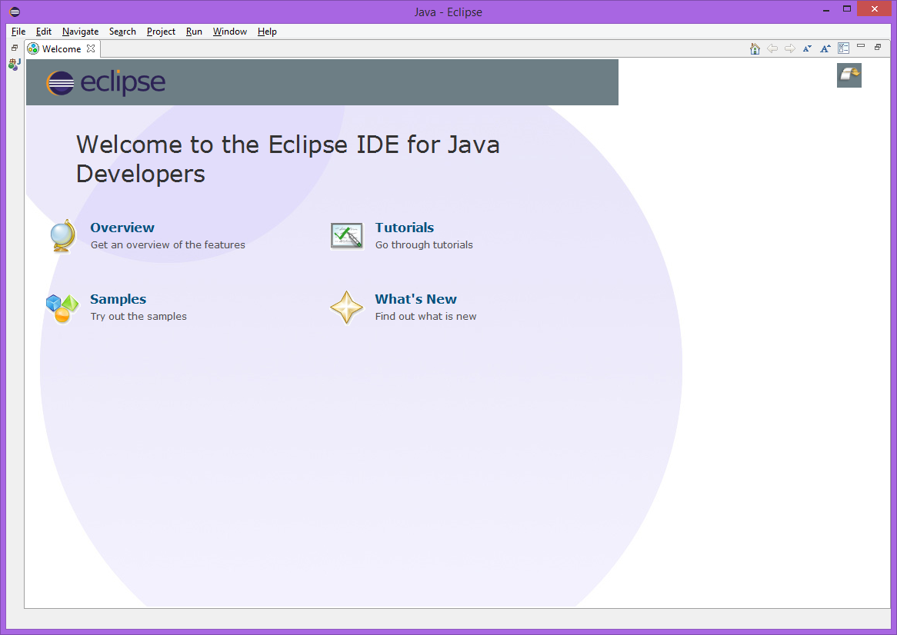

Slide 13
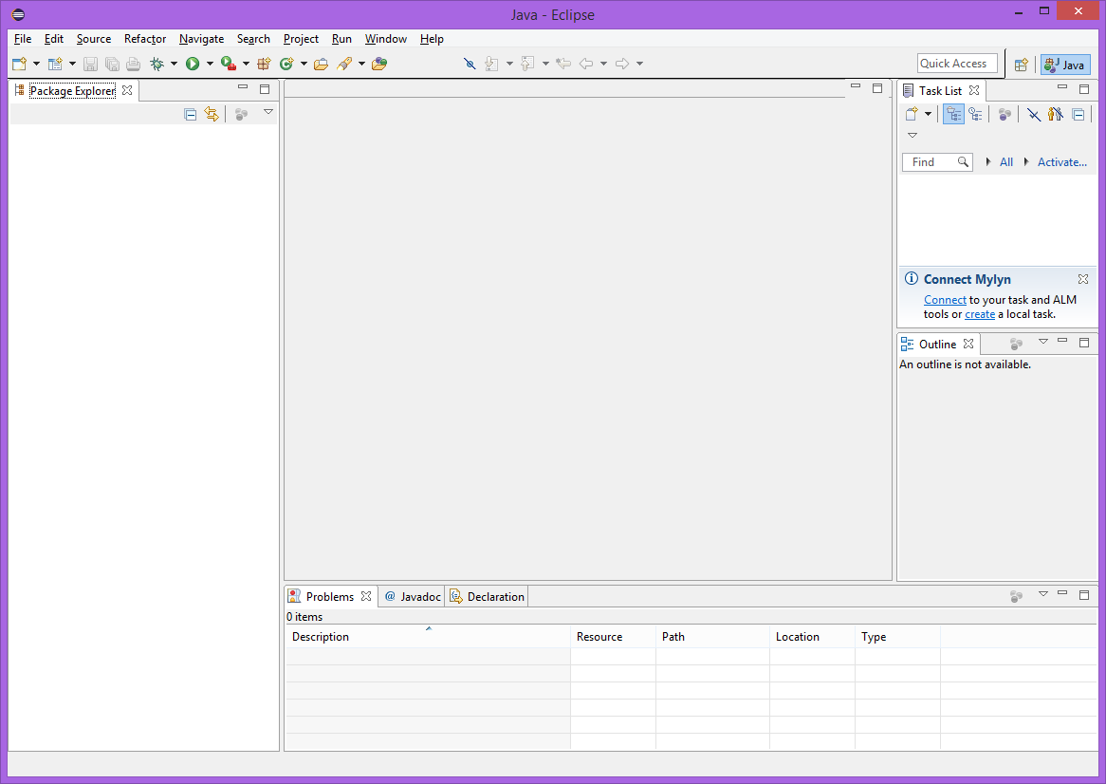

Slide 14
Eclipse (Cont’d)
Eclipse terminology
  Workspace – directory that stores all files
  Workbench – main work area – offers several Perspectives
  Perspective – environment tailored for project type – will use Java perspective (default perspective)
  View – window or tab with related functionality
    Editor, Package Explorer, Console, Search

Slide 15
Eclipse (Cont’d)
On startup,
  Select Workspace – set once; details in Lab 1
  May show “Welcome View” – click arrow to go to full Workbench
  Start a Java Project – details in Lab 1
Eclipse has extensive Help system
Get into trouble w/workbench layout – choose Window ⇒ Reset Perspective

Slide 16
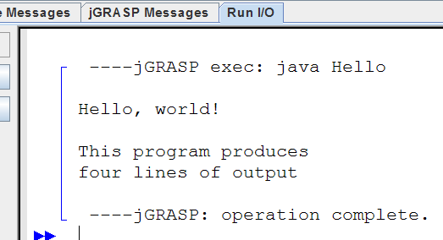
A Java program
public class Hello {
public static void main(String[] args) {
System.out.println("Hello, world!");
System.out.println();
System.out.println("This program produces");
System.out.println("four lines of output");
}
}
Its output:
  Hello, world!
  This program produces
  four lines of output
console: Text box into which
the program's output is printed.

Slide 17
Structure of a Java program
class: a program
public class Name {
public static void main(String[] args) {
statement;
statement;
...
statement;
}
}
Every executable Java program consists of a class,
  that contains a method named main,
    that contains the statements (commands) to be executed.
method: a named group
of statements
statement: a command to be executed

Slide 18
System.out.println
A statement that prints a line of output on the console.
  pronounced "print-line"
Two ways to use System.out.println :
  System.out.println("text");
  Prints the given message as output.
  System.out.println();
  Prints a blank line of output.

Slide 19
Names and identifiers
You must give your program a name.
  public class GangstaRap {
  Naming convention: capitalize each word (e.g. MyClassName)
  Your program's file must match exactly (GangstaRap.java)
identifier: A name given to an item in your program
  must start with a letter or _ or $
  subsequent characters can be any of those or a number
  Are these legal?
    me+u _myName TheCure 49ers side-swipe ANSWER_IS_42 $bling$ Ph.D's

Slide 20
Keywords
keyword: An identifier that you cannot use because it already has a reserved meaning in Java
abstract default if private this
boolean do implements protected throw
break double import public throws
byte else instanceof return transient
case extends int short try
catch final interface static void
char finally long strictfp volatile
class float native super while
const for new switch
continue goto package synchronized

Slide 21
Syntax
syntax: set of legal structures and commands that can be used in a particular language
  Every basic Java statement ends with a semicolon ;
  The contents of a class or method occur between { and }
syntax error (compiler error): A problem in the structure of a program that causes the compiler to fail
  Missing semicolon
  Too many or too few { } braces
  Illegal identifier for class name
  Class and file names do not match
  ...

Slide 22
Syntax error example
1 public class Hello {
2 pooblic static void main(String[] args) {
3 System.owt.println("Hello, world!")_
4 }
5 }
Compiler output:
Hello.java:2: <identifier> expected
pooblic static void main(String[] args) {
^
Hello.java:3: ';' expected
}
^
2 errors
  The compiler shows the line number where it found the error.
  The error messages can be tough to understand!

Slide 23
Strings
string: A sequence of characters to be printed.
  Starts and ends with a " quote " character.
  Examples:
  "o rly?"
  "This is a string. It's very long!"
Restrictions:
  May not span multiple lines.
  "This is not
  a legal String."
  May not contain a " character.
  "This is not a "legal" String either."

Slide 24
Escape sequences
escape sequence: A special sequence of characters used to represent certain special characters in a string.
  \t tab character
  \n new line character
  \" quotation mark character
  \\ backslash character
  Example:
  System.out.println("\\hello\nhow\tare \"you\"?\\\\");
  Output:
  \hello
  how are "you"?\\

Slide 25
Questions
What is the output of the following println statements?
  System.out.println("\ta\tb\tc");
  System.out.println("\\\\");
  System.out.println("'");
  System.out.println("\"\"\"");
  System.out.println("C:\nin\the downward spiral");
Write a println statement to produce this output:
  / \ // \\ /// \\\

Slide 26
Answers
Output of each println statement:
  a b c
  \\
  '
  """
  C:
  in he downward spiral
println statement to produce the line of output:
  System.out.println("/ \\ // \\\\ /// \\\\\\");

Slide 27
Questions
What println statements will generate this output?
  This program prints a
  quote from the Gettysburg Address.
  "Four score and seven years ago,
  our 'fore fathers' brought forth on
  this continent a new nation."
What println statements will generate this output?
  A "quoted" String is
  'much' better if you learn
  the rules of "escape sequences."
  Also, "" represents an empty String.
  Don't forget: use \" instead of " !
  '' is not the same as "

