Slide 1
Thread-Level Parallelism
CSCI 380: Operating Systems
Lecture #18
Instructor:
William Killian

Slide 2
Today
Parallel Computing Hardware
  Multicore
    Multiple separate processors on single chip
  Hyperthreading
    Efficient execution of multiple threads on single core
Thread-Level Parallelism
  Splitting program into independent tasks
    Example 1: Parallel summation
  Divide-and conquer parallelism
    Example 2: Parallel quicksort
Consistency Models
  What happens when multiple threads are reading & writing shared state

Slide 3
Exploiting parallel execution
So far, we’ve used threads to deal with I/O delays
  e.g., one thread per client to prevent one from delaying another
Multi-core/Hyperthreaded CPUs offer another opportunity
  Spread work over threads executing in parallel
  Happens automatically, if many independent tasks
    e.g., running many applications or serving many clients
  Can also write code to make one big task go faster
    by organizing it as multiple parallel sub-tasks

Slide 4
Typical Multicore Processor
Core 0
Core n-1
Regs
Regs
L1
d-cache
L1
i-cache
…
L1
d-cache
L1
i-cache
L2 unified cache
L2 unified cache
L3 unified cache
(shared by all cores)
Main memory
Multiple processors operating with coherent view of memory

Slide 5
Out-of-Order Processor Structure
Instruction Control
Instruction
Cache
Instruction Decoder
Registers
Op. Queue
PC
Functional Units
Data Cache
Int
Arith
Int
Arith
FP
Arith
Load /
Store
Instruction control dynamically converts program into stream of operations
Operations mapped onto functional units to execute in parallel

Slide 6
Hyperthreading Implementation
Instruction Control
Instruction
Cache
Instruction Decoder
Reg A
Op. Queue A
Reg B
Op. Queue B
PC A
PC B
Functional Units
Data Cache
Int
Arith
Int
Arith
FP
Arith
Load /
Store
Replicate enough instruction control to process K instruction streams
K copies of all registers
Share functional units

Slide 7
Benchmark Machine
Get data about machine from /proc/cpuinfo
Shark Machines
  Intel Xeon E5520 @ 2.27 GHz
  Nehalem, ca. 2010
  8 Cores
  Each can do 2x hyperthreading

Slide 8
Example 1: Parallel Summation
Sum numbers 0, …, n-1
  Should add up to ((n-1)*n)/2
Partition values 1, …, n-1 into t ranges
  ⎣n/t⎦ values in each range
  Each of t threads processes 1 range
  For simplicity, assume n is a multiple of t
Let’s consider different ways that multiple threads might work on their assigned ranges in parallel

Slide 9
First attempt: psum-mutex
Simplest approach: Threads sum into a global variable protected by a semaphore mutex.
void *sum_mutex(void *vargp); /* Thread routine */
/* Global shared variables */
long gsum = 0; /* Global sum */
long nelems_per_thread; /* Number of elements to sum */
sem_t mutex; /* Mutex to protect global sum */
int main(int argc, char **argv)
{
long i, nelems, log_nelems, nthreads, myid[MAXTHREADS];
pthread_t tid[MAXTHREADS];
/* Get input arguments */
nthreads = atoi(argv[1]);
log_nelems = atoi(argv[2]);
nelems = (1L << log_nelems);
nelems_per_thread = nelems / nthreads;
sem_init(&mutex, 0, 1);
psum-mutex.c

Slide 10
psum-mutex (cont)
Simplest approach: Threads sum into a global variable protected by a semaphore mutex.
/* Create peer threads and wait for them to finish */
for (i = 0; i < nthreads; i++) {
myid[i] = i;
Pthread_create(&tid[i], NULL, sum_mutex, &myid[i]);
}
for (i = 0; i < nthreads; i++)
Pthread_join(tid[i], NULL);
/* Check final answer */
if (gsum != (nelems * (nelems-1))/2)
printf("Error: result=%ld\n", gsum);
return 0;
}
psum-mutex.c

Slide 11
psum-mutex Thread Routine
Simplest approach: Threads sum into a global variable protected by a semaphore mutex.
/* Thread routine for psum-mutex.c */
void *sum_mutex(void *vargp)
{
long myid = *((long *)vargp); /* Extract thread ID */
long start = myid * nelems_per_thread; /* Start element index */
long end = start + nelems_per_thread; /* End element index */
long i;
for (i = start; i < end; i++) {
P(&mutex);
gsum += i;
V(&mutex);
}
return NULL;
}
psum-mutex.c

Slide 12
psum-mutex Performance
Shark machine with 8 cores, n=2³¹
Threads (Cores) | 1 (1) | 2 (2) | 4 (4) | 8 (8) | 16 (8)
psum-mutex (secs) | 51 | 456 | 790 | 536 | 681
Nasty surprise:
  Single thread is very slow
  Gets slower as we use more cores

Slide 13
Next Attempt: psum-array
Peer thread i sums into global array element psum[i]
Main waits for theads to finish, then sums elements of psum
Eliminates need for mutex synchronization
/* Thread routine for psum-array.c */
void *sum_array(void *vargp)
{
long myid = *((long *)vargp); /* Extract thread ID */
long start = myid * nelems_per_thread; /* Start element index */
long end = start + nelems_per_thread; /* End element index */
long i;
for (i = start; i < end; i++) {
psum[myid] += i;
}
return NULL;
}
psum-array.c

Slide 14
psum-array Performance
Orders of magnitude faster than psum-mutex

Slide 15
Next Attempt: psum-local
Reduce memory references by having peer thread i sum into a local variable (register)
/* Thread routine for psum-local.c */
void *sum_local(void *vargp)
{
long myid = *((long *)vargp); /* Extract thread ID */
long start = myid * nelems_per_thread; /* Start element index */
long end = start + nelems_per_thread; /* End element index */
long i, sum = 0;
for (i = start; i < end; i++) {
sum += i;
}
psum[myid] = sum;
return NULL;
}
psum-local.c

Slide 16
psum-local Performance
Significantly faster than psum-array

Slide 17
Characterizing Parallel Program Performance
p processor cores, T_{k} is the running time using k cores
Def. Speedup: S_{p} = T₁ / T_{p}
  S_{p} is relative speedup if T₁ is running time of parallel version of the code running on 1 core.
  S_{p} is absolute speedup if T₁ is running time of sequential version of code running on 1 core.
  Absolute speedup is a much truer measure of the benefits of parallelism.
Def. Efficiency: E_{p} = S_{p} /p = T₁ /(pT_{p})
  Reported as a percentage in the range (0, 100].
  Measures the overhead due to parallelization

Slide 18
Performance of psum-local
Threads (t) | 1 | 2 | 4 | 8 | 16
Cores (p) | 1 | 2 | 4 | 8 | 8
Running time (T_{p}) | 1.98 | 1.14 | 0.60 | 0.32 | 0.33
Speedup (S_{p}) | 1 | 1.74 | 3.30 | 6.19 | 6.00
Efficiency (E_{p}) | 100% | 87% | 82% | 77% | 75%
Efficiencies OK, not great
Our example is easily parallelizable
Real codes are often much harder to parallelize
  e.g., parallel quicksort later in this lecture

Slide 19
Amdahl’s Law
  Gene Amdahl (Nov. 16, 1922 – Nov. 10, 2015)
Captures the difficulty of using parallelism to speed things up.
Overall problem
  T Total sequential time required
  p Fraction of total that can be sped up (0 ≤ p ≤ 1)
  k Speedup factor
Resulting Performance
  T_{k} = pT/k + (1-p)T
    Portion which can be sped up runs k times faster
    Portion which cannot be sped up stays the same
  Least possible running time:
    k = ∞
    T∞ = (1-p)T

Slide 20
Amdahl’s Law Example
Overall problem
  T = 10 Total time required
  p = 0.9 Fraction of total which can be sped up
  k = 9 Speedup factor
Resulting Performance
  T₉ = 0.9 * 10/9 + 0.1 * 10 = 1.0 + 1.0 = 2.0
  Least possible running time:
    T∞ = 0.1 * 10.0 = 1.0

Slide 21
A More Substantial Example: Sort
Sort set of N random numbers
Multiple possible algorithms
  Use parallel version of quicksort
Sequential quicksort of set of values X
  Choose “pivot” p from X
  Rearrange X into
    L: Values ≤ p
    R: Values ≥ p
  Recursively sort L to get L′
  Recursively sort R to get R′
  Return L′ : p : R′

Slide 22
Sequential Quicksort Visualized
X
p
L
p
R
p2
L2
p2
R2
•
•
•
L′

Slide 23
Sequential Quicksort Visualized
X
L′
p
R
p3
L3
p3
R3
•
•
•
R′
L′
p
R′

Slide 24
Sequential Quicksort Code
void qsort_serial(data_t *base, size_t nele) {
if (nele <= 1)
return;
if (nele == 2) {
if (base[0] > base[1])
swap(base, base+1);
return;
}
/* Partition returns index of pivot */
size_t m = partition(base, nele);
if (m > 1)
qsort_serial(base, m);
if (nele-1 > m+1)
qsort_serial(base+m+1, nele-m-1);
}
Sort nele elements starting at base
  Recursively sort L or R if has more than one element

Slide 25
Parallel Quicksort
Parallel quicksort of set of values X
  If N ≤ Nthresh, do sequential quicksort
  Else
    Choose “pivot” p from X
    Rearrange X into
      L: Values ≤ p
      R: Values ≥ p
    Recursively spawn separate threads
      Sort L to get L′
      Sort R to get R′
    Return L′ : p : R′

Slide 26
Parallel Quicksort Visualized
X
p
L
p
R
p2
p3
L2
p2
R2
p
L3
p3
R3
•
•
•
•
•
•
L′
p
R′

Slide 27
Thread Structure: Sorting Tasks
X
• • •
Task Threads
Task: Sort subrange of data
  Specify as:
    base: Starting address
    nele: Number of elements in subrange
Run as separate thread

Slide 28
Small Sort Task Operation
X
• • •
Task Threads
Sort subrange using serial quicksort

Slide 29
Large Sort Task Operation
X
L
p
R
Partition Subrange
• • •
X
L
p
R
Spawn 2 tasks
• • •

Slide 30
Top-Level Function (Simplified)
void tqsort(data_t *base, size_t nele) {
init_task(nele);
global_base = base;
global_end = global_base + nele - 1;
task_queue_ptr tq = new_task_queue();
tqsort_helper(base, nele, tq);
join_tasks(tq);
free_task_queue(tq);
}
Sets up data structures
Calls recursive sort routine
Keeps joining threads until none left
Frees data structures

Slide 31
Recursive sort routine (Simplified)
/* Multi-threaded quicksort */
static void tqsort_helper(data_t *base, size_t nele,
task_queue_ptr tq) {
if (nele <= nele_max_sort_serial) {
/* Use sequential sort */
qsort_serial(base, nele);
return;
}
sort_task_t *t = new_task(base, nele, tq);
spawn_task(tq, sort_thread, (void *) t);
}
Small partition: Sort serially
Large partition: Spawn new sort task

Slide 32
Sort task thread (Simplified)
/* Thread routine for many-threaded quicksort */
static void *sort_thread(void *vargp) {
sort_task_t *t = (sort_task_t *) vargp;
data_t *base = t->base;
size_t nele = t->nele;
task_queue_ptr tq = t->tq;
free(vargp);
size_t m = partition(base, nele);
if (m > 1)
tqsort_helper(base, m, tq);
if (nele-1 > m+1)
tqsort_helper(base+m+1, nele-m-1, tq);
return NULL;
}
Get task parameters
Perform partitioning step
Call recursive sort routine on each partition

Slide 33
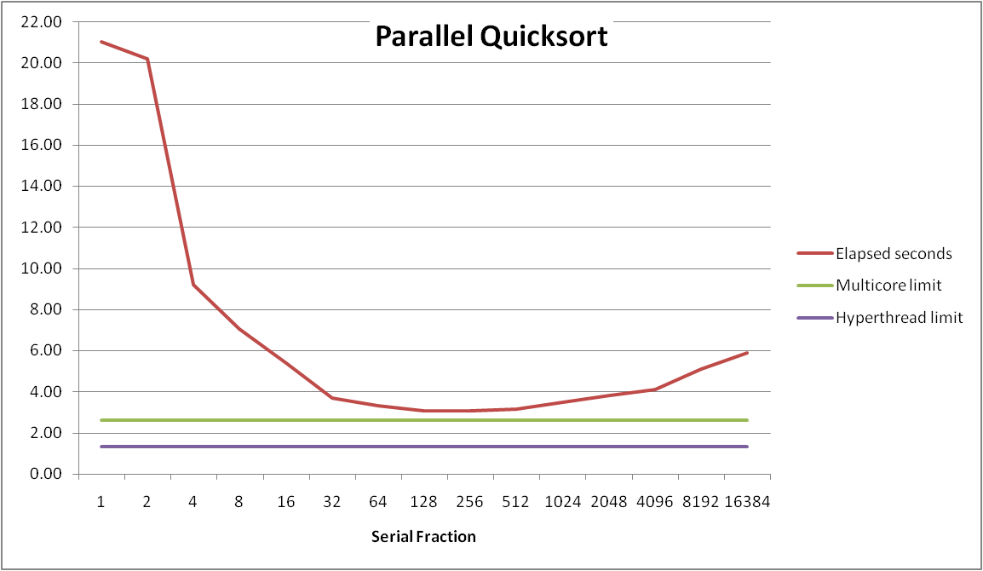
Parallel Quicksort Performance
Serial fraction: Fraction of input at which do serial sort
Sort 2²⁷ (134,217,728) random values
Best speedup = 6.84X

Slide 34
Parallel Quicksort Performance
Good performance over wide range of fraction values
  F too small: Not enough parallelism
  F too large: Thread overhead + run out of thread memory

Slide 35
Amdahl’s Law & Parallel Quicksort
Sequential bottleneck
  Top-level partition: No speedup
  Second level: ≤ 2X speedup
  k^{th} level: ≤ 2^{k-1}X speedup
Implications
  Good performance for small-scale parallelism
  Would need to parallelize partitioning step to get large-scale parallelism
    Parallel Sorting by Regular Sampling
      H. Shi & J. Schaeffer, J. Parallel & Distributed Computing, 1992

Slide 36
Parallelizing Partitioning Step
X₁
X₂
X₃
X₄
p
Parallel partitioning based on global p
L₁
R₁
L₂
R₂
L₃
R₃
L₄
R₄
Reassemble into partitions
L₁
L₂
L₃
L₄
R₁
R₂
R₃
R₄

Slide 37
Experience with Parallel Partitioning
Could not obtain speedup
Speculate: Too much data copying
  Could not do everything within source array
  Set up temporary space for reassembling partition

Slide 38
Lessons Learned
Must have parallelization strategy
  Partition into K independent parts
  Divide-and-conquer
Inner loops must be synchronization free
  Synchronization operations very expensive
Beware of Amdahl’s Law
  Serial code can become bottleneck
You can do it!
  Achieving modest levels of parallelism is not difficult
  Set up experimental framework and test multiple strategies

Slide 39
Memory Consistency
int a = 1;
int b = 100;
Thread consistency
constraints
Wa
Rb
Thread1:
Wa: a = 2;
Rb: print(b);
Thread2:
Wb: b = 200;
Ra: print(a);
Wb
Ra
What are the possible values printed?
  Depends on memory consistency model
  Abstract model of how hardware handles concurrent accesses
Sequential consistency
  Overall effect consistent with each individual thread
  Otherwise, arbitrary interleaving

Slide 40
Sequential Consistency Example
Thread consistency
constraints
int a = 1;
int b = 100;
Wa
Rb
Thread1:
Wa: a = 2;
Rb: print(b);
Thread2:
Wb: b = 200;
Ra: print(a);
Wb
Ra
Rb
Wb
Ra
100, 2
Wa
Rb
Ra
200, 2
Wb
Ra
Rb
2, 200
Ra
Wa
Rb
1, 200
Wb
Ra
Rb
2, 200
Wa
Rb
Ra
200, 2
Impossible outputs
  100, 1 and 1, 100
  Would require reaching both Ra and Rb before Wa and Wb

Slide 41
Non-Coherent Cache Scenario
int a = 1;
int b = 100;
Write-back caches, without coordination between them
Thread1:
Wa: a = 2;
Rb: print(b);
Thread2:
Wb: b = 200;
Ra: print(a);
Thread1 Cache
Thread2 Cache
a: 2
b:100
a:1
b:200
print 1
print 100
Main Memory
a:1
b:100

Slide 42
Snoopy Caches
int a = 1;
int b = 100;
Tag each cache block with state
  Invalid Cannot use value
  Shared Readable copy
  Exclusive Writeable copy
Thread1:
Wa: a = 2;
Rb: print(b);
Thread2:
Wb: b = 200;
Ra: print(a);
Thread1 Cache
Thread2 Cache
E
a: 2
E
b:200
Main Memory
a:1
b:100

Slide 43
Snoopy Caches
int a = 1;
int b = 100;
Tag each cache block with state
  Invalid Cannot use value
  Shared Readable copy
  Exclusive Writeable copy
Thread1:
Wa: a = 2;
Rb: print(b);
Thread2:
Wb: b = 200;
Ra: print(a);
Thread1 Cache
Thread2 Cache
E
S
a: 2
a: 2
S
a:2
print 2
S
b:200
E
S
b:200
b:200
print 200
Main Memory
When cache sees request for one of its E-tagged blocks
  Supply value from cache
  Set tag to S
a:1
b:100

