Slide 1
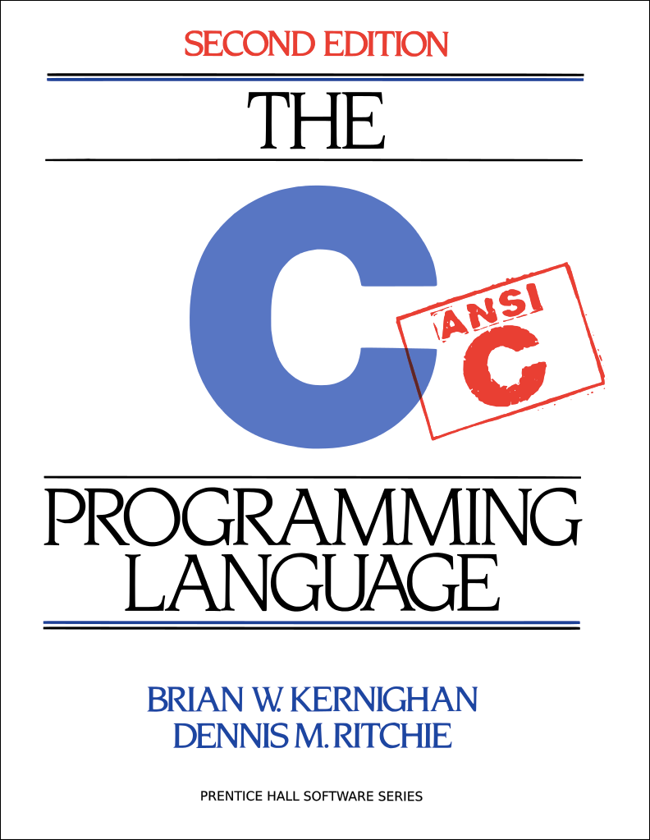
C Boot Camp

Slide 2
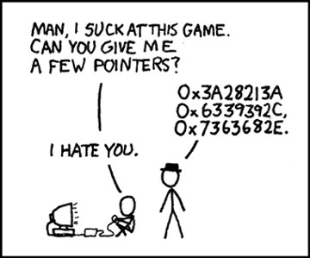
Agenda
C Basics
C Libraries
Debugging Tools
Version Control
Compilation
Demo

Slide 3
C Basics

Slide 4
C Basics
The minimum you must know to do well in this class
  You have seen these concepts before
  Make sure you remember them.
Summary:
  Pointers/Arrays/Structs/Casting
  Memory Management
  Function pointers/Generic Types
  Strings
  GrabBag (Macros, typedefs, header guards/files, etc)

Slide 5
Pointers
Stores address of a value in memory
  eg int*, char*, int**, etc
  Access the value by dereferencing (*a); can be used to read value or write value to given address
  dereferencing NULL causes a runtime error
Pointer to type a references a block of sizeof(a) bytes
Get the address of a value in memory with the ‘&’ operator
Can alias pointers to same address
Demo Time!

Slide 6
Call by Value vs Call by Reference
Call-by-value: Changes made to arguments passed to a function aren’t reflected in the calling function
Call-by-reference: Changes made to arguments passed to a function are reflected in the calling function
C is a call-by-value language
To cause changes to values outside the function, use pointers
  Do not assign the pointer to a different value (that won’t be reflected!)
  Instead, dereference the pointer and assign a value to that address
void swap(int* a, int* b) {
int temp = *a;
*a = *b;
*b = temp;
}
int x = 42;
int y = 54;
swap(&x, &y);
printf(“%d\n”, x); // 54
printf(“%d\n”, y); // 42
Demo Time!

Slide 7
Pointer Arithmetic
Can add/subtract from an address to get a new address
  Only perform when absolutely necessary (i.e., malloc)
  Result depends on the pointer type
A+i, where A is a pointer = 0x100, i is an int (x86-64)
  int* A: A+i = 0x100 + sizeof(int) * i = 0x100 + 4 * i
  char* A: A+i = 0x100 + sizeof(char) * i = 0x100 + i
  int** A: A + i = 0x100 + sizeof(int*) * i = 0x100 + 8 * i
Rule of thumb: cast pointer explicitly to avoid confusion
  Prefer (char*)(A) + i vs A + i, even if char* A
  Absolutely do this in macros (i.e., malloc)

Slide 8
Structs
Collection of values placed under one name in a single block of memory
  Can put structs, arrays in other structs
Given a struct instance, access the fields using the ‘.’ operator
Given a struct pointer, access the fields using the ‘->’ operator
struct foo_s {
int a;
char b;
};
struct bar_s {
char ar[10];
foo_s baz;
};
bar_s biz; // bar_s instance
biz.ar[0] = ‘a’;
biz.baz.a = 42;
bar_s* boz = &biz; // bar_s ptr
boz->baz.b = ‘b’;

Slide 9
Arrays/Strings
Arrays: fixed-size collection of elements of the same type
  Can allocate on the stack or on the heap
  int A[10]; // A is array of 10 int’s on the stack
  int* A = calloc(10, sizeof(int)); // A is array of 10 int’s on the heap
Strings: Null-character (‘\0’) terminated character arrays
  Null-character tells us where the string ends
  All standard C library functions on strings assume null-termination.

Slide 10
Casting
Can cast a variable to a different type
Integer Type Casting:
  signed <-> unsigned: change interpretation of most significant bit
  smaller signed -> larger signed: sign-extend (duplicate the sign bit)
  smaller unsigned -> larger unsigned: zero-extend (duplicate 0)
Cautions:
  cast explicitly, out of practice. C will cast operations involving different types implicitly, often leading to errors
  never cast to a smaller type; will truncate (lose) data
  never cast a pointer to a larger type and dereference it, this accesses memory with undefined contents

Slide 11
Malloc, Free, Calloc
Handle dynamic memory
void* malloc (size_t size):
  allocate block of memory of size bytes
  does not initialize memory
void* calloc (size_t num, size_t size):
  allocate block of memory for array of num elements, each size bytes long
  initializes memory to zero values
void free(void* ptr):
  frees memory block, previously allocated by malloc, calloc, realloc, pointed by ptr
  use exactly once for each pointer you allocate
size argument:
  should be computed using the sizeof operator
  sizeof: takes a type and gives you its size
  e.g., sizeof(int), sizeof(int*)

Slide 12
Memory Management Rules
Malloc what you free, free what you malloc
  client should free memory allocated by client code
  library should free memory allocated by library code
Number mallocs = Number frees
  Number mallocs > Number Frees: definitely a memory leak
  Number mallocs < Number Frees: definitely a double free
Free a malloced block exactly once
  Should not dereference a freed memory block

Slide 13
Stack Vs Heap Allocation
Local variables and function arguments are placed on the stack
  deallocated after the variable leaves scope
  do not return a pointer to a stack-allocated variable!
  do not reference the address of a variable outside its scope!
Memory blocks allocated by calls to malloc/calloc are placed on the heap
Globals, constants are placed elsewhere
Example:
  // a is a pointer on the stack to a memory block on the heap
  int* a = malloc(sizeof(int));

Slide 14
Typedefs
Creates an alias type name for a different type
Useful to simplify names of complex data types
struct list_node {
int x;
};
typedef int pixel;
typedef struct list_node* node;
typedef int (*cmp)(int e1, int e2);
pixel x; // int type
node foo; // struct list_node* type
cmp int_cmp; // int (*cmp)(int e1, int e2) type

Slide 15
Macros
Fragment of code given a name; replace occurrence of name with contents of macro
  No function call overhead, type neutral
Uses:
  defining constants (INT_MAX, ARRAY_SIZE)
  defining simple operations (MAX(a, b))
  122-style contracts (REQUIRES, ENSURES)
Warnings:
  Use parentheses around arguments/expressions, to avoid problems after substitution
  Do not pass expressions with side effects as arguments to macros
#define INT_MAX 0x7FFFFFFFF
#define MAX(A, B) ((A) > (B) ? (A) : (B))
#define REQUIRES(COND) assert(COND)
#define WORD_SIZE 4
#define NEXT_WORD(a) ((char*)(a) + WORD_SIZE)

Slide 16
Generic Types
void* type is C’s provision for generic types
  Raw pointer to some memory location (unknown type)
  Can’t dereference a void* (what is type void?)
  Must cast void* to another type in order to dereference it
Can cast back and forth between void* and other pointer types
// stack usage:
int x = 42; int y = 54;
stack S = stack_new():
push(S, &x);
push(S, &y);
int a = *(int*)pop(S);
int b = *(int*)pop(S);
// stack implementation:
typedef void* elem;
stack stack_new();
void push(stack S, elem e);
elem pop(stack S);

Slide 17
Header Files
Includes C declarations and macro definitions to be shared across multiple files
  Only include function prototypes/macros; no implementation code!
Usage: #include <header.h>
  #include <lib> for standard libraries (eg #include <string.h>)
  #include “file” for your source files (eg #include “header.h”)
  Never include .c files (bad practice)
// list.h
struct list_node {
int data;
struct list_node* next;
};
typedef struct list_node* node;
node new_list();
void add_node(int e, node l);
// list.c
#include “list.h”
node new_list() {
// implementation
}
void add_node(int e, node l) {
// implementation
}
// stacks.h
#include “list.h”
struct stack_head {
node top;
node bottom;
};
typedef struct stack_head* stack
stack new_stack();
void push(int e, stack S);

Slide 18
Header Guards
Double-inclusion problem: include same header file twice
//grandfather.h
//father.h
#include “grandfather.h”
//child.h
#include “father.h”
#include “grandfather.h”
Error: child.h includes grandfather.h twice
Solution: header guard ensures single inclusion
//grandfather.h
#ifndef GRANDFATHER_H
#define GRANDFATHER_H
#endif
//father.h
#ifndef FATHER_H
#define FATHER_H
#endif
//child.h
#include “father.h”
#include “grandfather.h”
Okay: child.h only includes grandfather.h once

Slide 19
Odds and Ends
Prefix vs Postfix increment/decrement
  a++: use a in the expression, then increment a
  ++a: increment a, then use a in the expression
Switch Statements:
  remember break statements after every case, unless you want fall through (may be desirable in some cases)
  should probably use a default case
Variable/function modifiers:
  global variables: defined outside functions, seen by all files
  static variables/functions: seen only in file it’s declared in
  Refer to K&R for other modifiers and their meanings

Slide 20
C Libraries

Slide 21
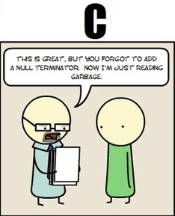
string.h: Common String/Array Methods
One the most useful libraries available to you
Used heavily in shell/proxy labs
Important usage details regarding arguments:
  prefixes: str -> strings, mem -> arbitrary memory blocks.
  ensure that all strings are ‘/0’ terminated!
  ensure that dest is large enough to store src!
  ensure that src actually contains n bytes!
  ensure that src/dest don’t overlap!

Slide 22
string.h: Common String/Array Methods
Copying:
  void* memcpy (void* dest, void* src, size_t n): copy n bytes of src into dest, return dest
  char* strcpy(char* dest, char* src): copy src string into dest, return dest
Concatenation:
  char * strcat (char * dest, char* src): append copy of src to end of dest, return dest
Comparison:
  int strcmp (char * str1, char * str2): compare str1, str2 by character (based on ASCII value of each character, then string length), return comparison result
  str1 < str2: -1,
  str1 == str2: 0,
  str1 > str2: 1

Slide 23
string.h: Common String/Array Methods (Continued)
Searching:
  char* strstr (char * str1, char * str2): return pointer to first occurrence of str2 in str1, else NULL
  char* strtok (char * str, char * delimiters): tokenize str according to delimiter characters provided in delimiters, return the next token per successive stroke call, using str = NULL
Other:
  size_t strlen ( const char * str ): returns length of the string (up to, but not including the ‘\0’ character)
  void * memset (void* ptr, int val, size_t n ): set first n bytes of memory block addressed by ptr to val (use this for setting bytes only; don’t use to set int arrays or anything else!)

Slide 24
stdlib.h: General Purpose Functions
Dynamic memory allocation:
  malloc, calloc, free
String conversion:
  int atoi(char* str): parse string into integral value (return 0 if not parsed)
System Calls:
  void exit(int status): terminate calling process, return status to parent process
  void abort(): aborts process abnormally
Searching/Sorting:
  provide array, array size, element size, comparator (function pointer)
  bsearch: returns pointer to matching element in the array
  qsort: sorts the array destructively
Integer arithmetic:
  int abs(int n): returns absolute value of n
Types:
  size_t: unsigned integral type (store size of any object)

Slide 25
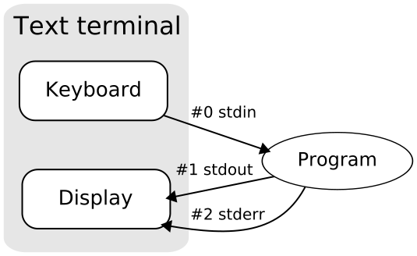
stdio.h
Another really useful library.
Used heavily in cache/shell/proxy labs
Used for:
  argument parsing
  file handling
  input/output

Slide 26
stdio.h: Common I/O Methods
FILE* fopen (char* filename, char* mode): open the file with specified filename in specified mode (read, write, append, etc), associate it with stream identified by returned file pointer
int fscanf (FILE* stream, char* format, ...): read data from the stream, store it according to the parameter format at the memory locations pointed at by additional arguments.
int fclose (FILE* stream): close the file associated with the stream
int fprintf (FILE* stream, char* format, ... ): write the C string pointed at by format to the stream, using any additional arguments to fill in format specifiers.

Slide 27
Getopt
Need to include getopt.h and unistd.h to use
Used to parse command-line arguments.
Typically called in a loop to retrieve arguments
Switch statement used to handle options
  colon indicates required argument
  optarg is set to value of option argument
Returns -1 when no more arguments present
Very useful for Cache lab!
int main(int argc, char** argv){
int opt, x;
/* looping over arguments */
while(-1 != (opt = getopt(argc, argv, “x:"))){
switch(opt) {
case 'x':
x = atoi(optarg);
break;
default:
printf(“wrong argument\n");
break;
}
}
}

Slide 28
Note about Library Functions
These functions can return error codes
  malloc could fail
  a file couldn’t be opened
  a string may be incorrectly parsed
Remember to check for the error cases and handle the errors accordingly
  may have to terminate the program (eg malloc fails)
  may be able to recover (user entered bad input)

Slide 29
Debugging
GDB, Valgrind

Slide 30
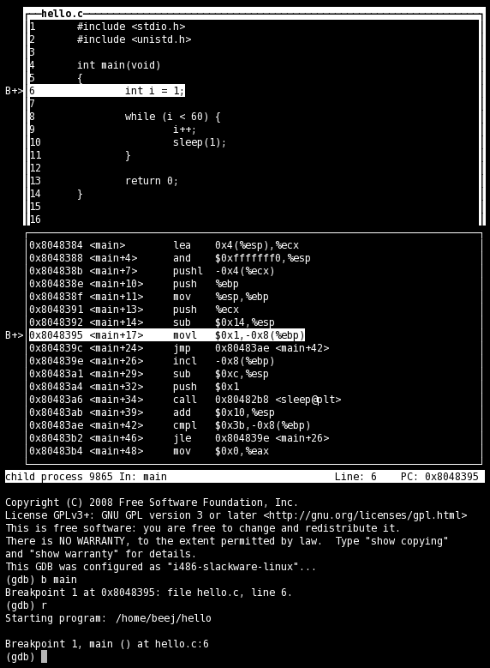
GDB
No longer stepping through assembly!
  Use the step/next commands
  break on line numbers, functions
  Use list to display code at line-numbers and functions
  Use print with variables
Use gdbtui
  Nice display for viewing source/executing commands

Slide 31
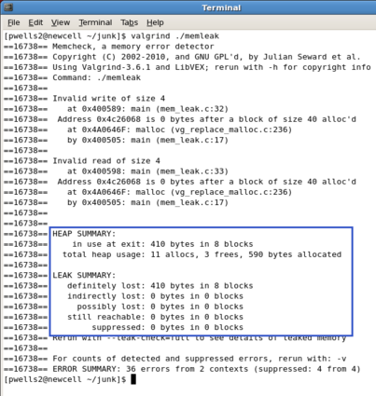
Valgrind
Find memory errors, detect memory leaks
Common errors:
  Illegal read/write errors
  Use of uninitialized values
  Illegal frees
  Overlapping source/destination addresses
Typical solutions
  Did you allocate enough memory?
  Did you accidentally free stack variables/something twice?
  Did you initialize all your variables?
  Did use something that you just free’d?
--leak-check=full
  Memcheck gives details for each definitely/possibly lost memory block (where it was allocated

Slide 32
Compilation
GCC, Make Files

Slide 33
GCC
Used to compile C/C++ projects
  List the files that will be compiled to form an executable
  Specify options via flags
Important Flags:
  -g: produce debug information (important; used by GDB/valgrind)
  -Werror: treat all warnings as errors (this is our default)
  -Wall/-Wextra: enable all construction warnings
  -pedantic: indicate all mandatory diagnostics listed in C-standard
  -O0/-O1/-O2: optimization levels
  -o <filename>: name output binary file ‘filename’
Example:
  gcc -g -Werror -Wall -Wextra -pedantic foo.c bar.c -o baz

Slide 34
Make Files
Command-line compilation becomes inefficient when compiling many files together
Solution: use make-files
  Single operation to compile files together
  Only recompiles updated files
# Makefile for the malloc lab driver
#
CC = gcc
CFLAGS = -Wall -Wextra -Werror -O2 -g -DDRIVER -std=gnu99
OBJS = mdriver.o mm.o memlib.o fsecs.o fcyc.o clock.o ftimer.o
all: mdriver
mdriver: $(OBJS)
$(CC) $(CFLAGS) -o mdriver $(OBJS)
mdriver.o: mdriver.c fsecs.h fcyc.h clock.h memlib.h config.h mm.h
memlib.o: memlib.c memlib.h
mm.o: mm.c mm.h memlib.h
fsecs.o: fsecs.c fsecs.h config.h
fcyc.o: fcyc.c fcyc.h
ftimer.o: ftimer.c ftimer.h config.h
clock.o: clock.c clock.h
clean:
rm -f *~ *.o mdriver

Slide 35
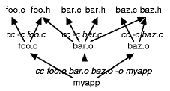
Make File Rules
Comments start with a ‘#’, Commands start with a TAB.
Common Make File Format:
  target: source(s)
  TAB: command
  TAB: command
Macros: similar to C-macros, find and replace:
  CC = gcc
  CCOPT = -g -DDEBUG -DPRINT
  foo.o: foo.c foo.h
  $(CC) $(CCOPT) -c foo.c
See http://www.andrew.cmu.edu/course/15-123-kesden/index/lecture_index.html for more details

