Slide 1
Containers and Docker
William Killian
CSCI 380 – Operating Systems

Slide 2
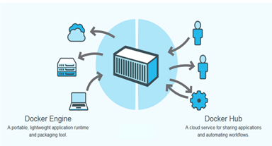
Docker
Open platform for developers and system administrators to build and test cloud applications

Slide 3
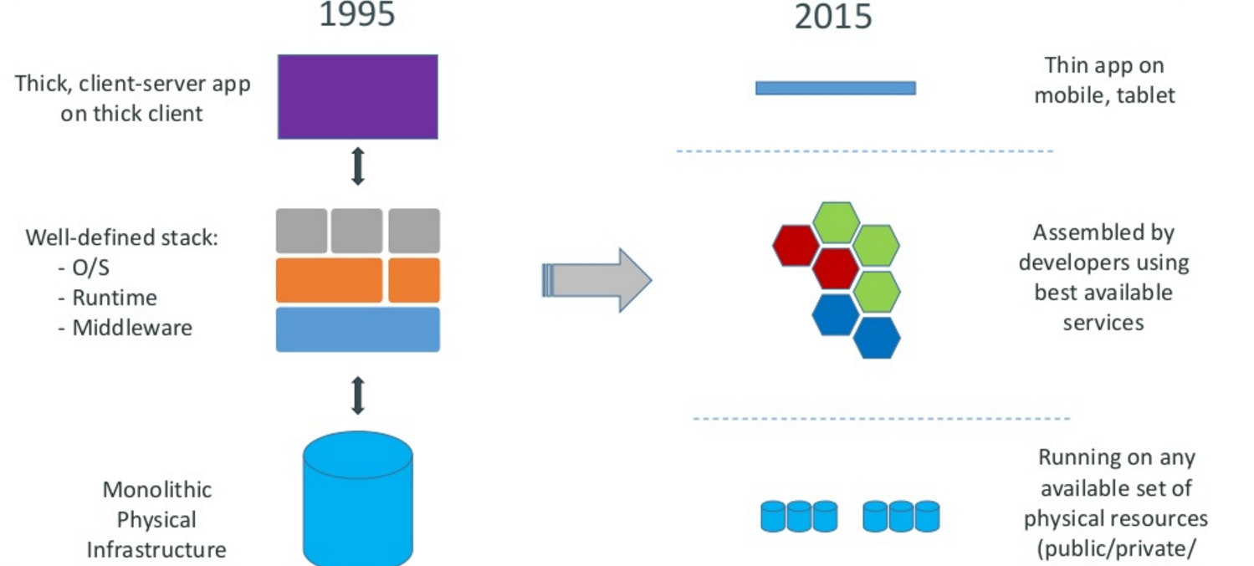
Motivation

Slide 4
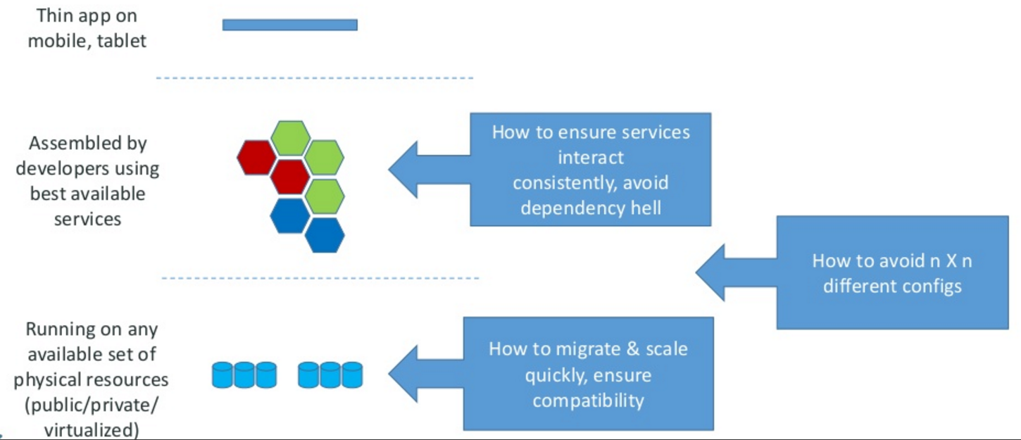
Motivation –the challenge

Slide 5
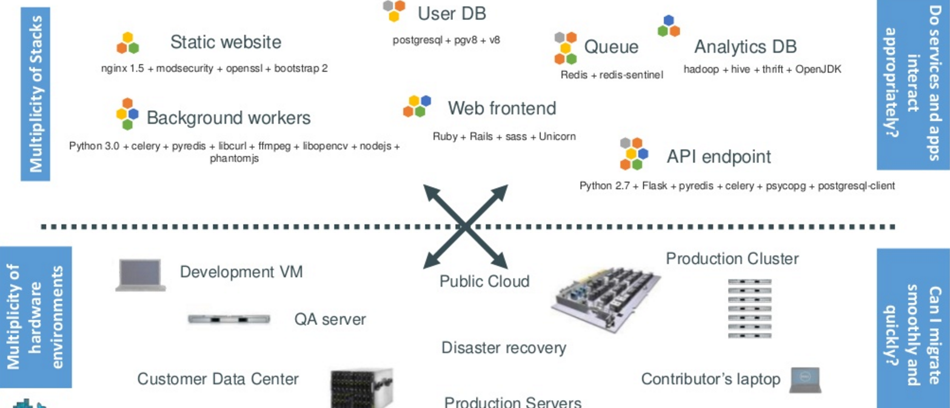
The challenge continued
Notes:
Static web: nginx is a fast webserver, generally faster than Apache
Queue: Redis = in-memory data structure store, used as a database, cache and message broker.
Analytics DB: Hadoop = Hive = Hadoop based Database, Thrift =

Slide 6
PAUSE: What were some of these technologies
Static web: nginx is a fast webserver, generally faster than Apache
Queue: Redis = in-memory data structure store, used as a database, cache and message broker.

Slide 7
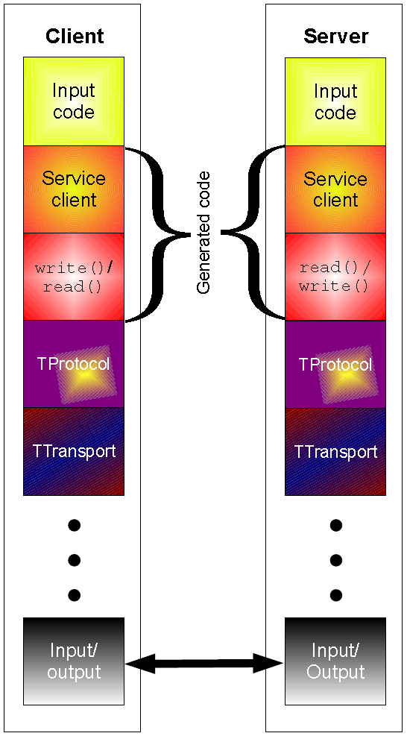
PAUSE:
Analytics DB:
Hadoop = distributed storage and processing of dataset of big data using MapReduce programming model
Hive = Hadoop based Database, offer SQL-like interfaces with HDFS-based data
---allows these database developers or data analysts to use Hadoop without knowing the Java programming language or MapReduce. Now, instead of challenging MapReduce code, you can design a star schema data warehouse or a normalized database.
Thrift = used to define and create services for numerous languages.^{[2]}
It is used as a remote procedure call (RPC) framework and was developed at Facebook for "scalable cross-language services development".

Slide 8
The challenge continued
Notes:
Static web: nginx is a fast webserver, generally faster than Apache
Queue: Redis = in-memory data structure store, used as a database, cache and message broker.
Analytics DB: Hadoop = Hive = Hadoop based Database, Thrift =

Slide 9
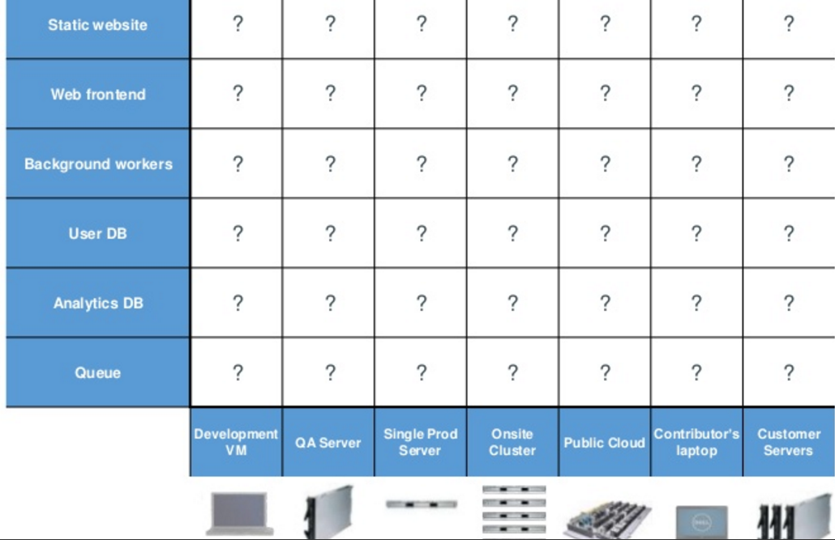
Looking for all kinds of solutions…
Too many to consider

Slide 10
THE ANSWER
Something called a CONTAINER ----which is the business Docker has created.

Slide 11
Huh??? Container
Here is an analogy that Docker use’s to let you understand….

Slide 12
Understanding….an analogy …cargo transport pre-1960

Slide 13
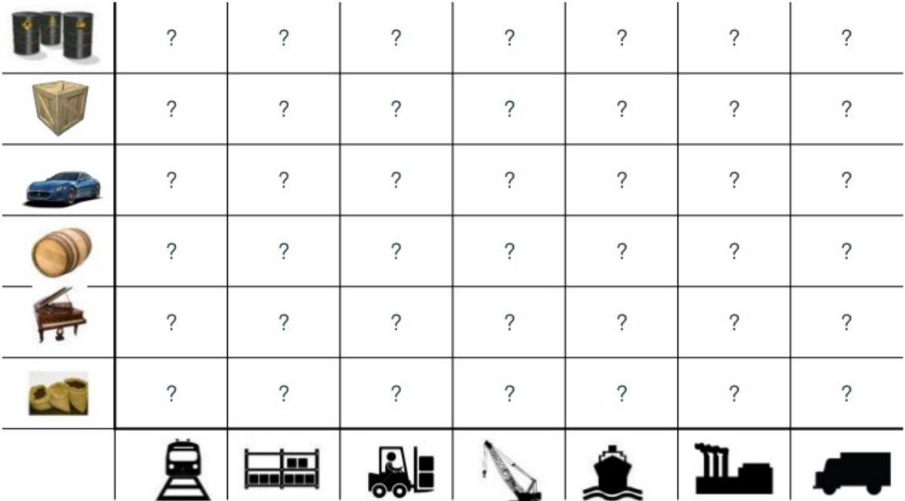
What are the possibilities

Slide 14
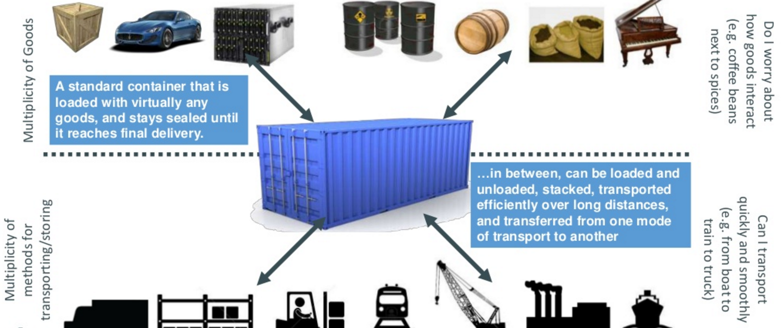
SOLUTION—shipping containers

Slide 15
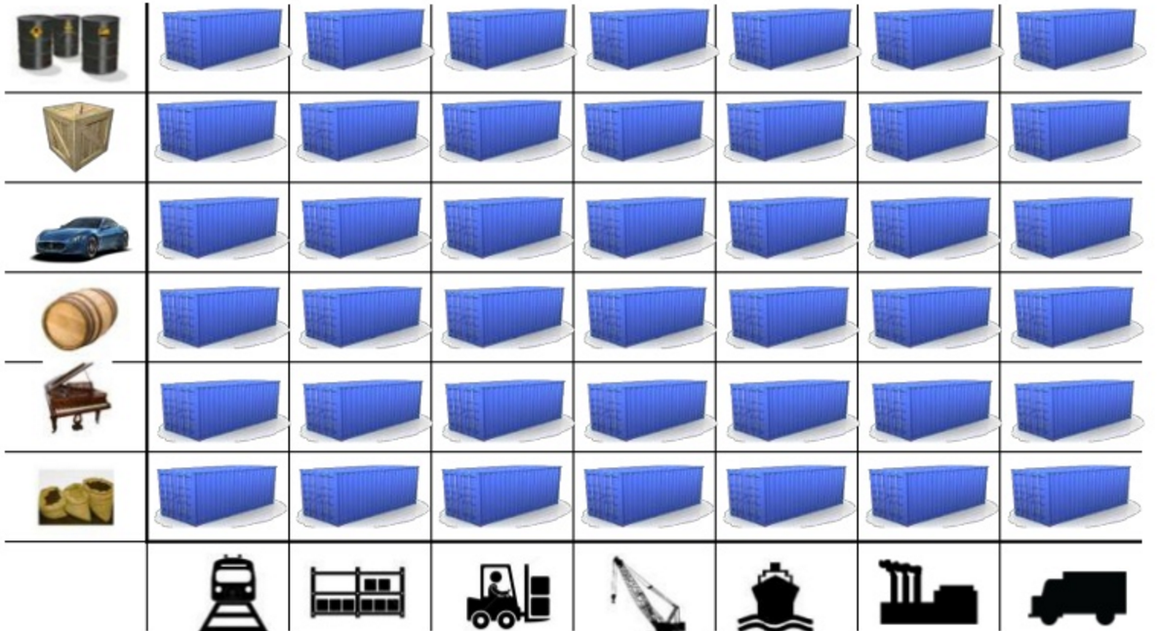
This solved the problem

Slide 16
Today shipping is done with containers

Slide 17
How does this container idea translate to our problem

Slide 18
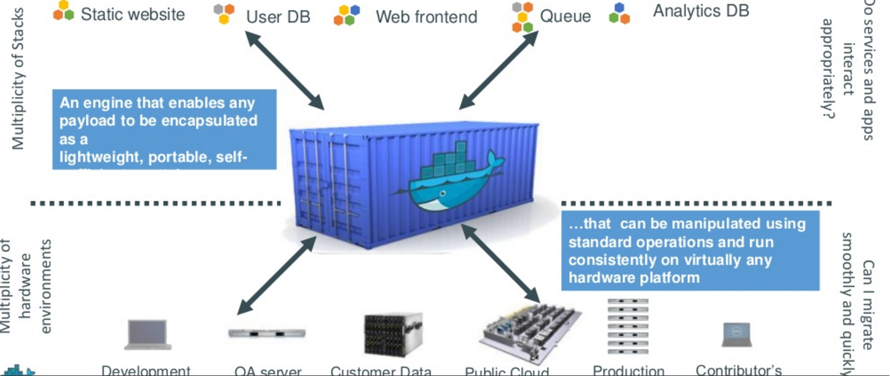
How does this container idea translate to our problem—container for code????

Slide 19
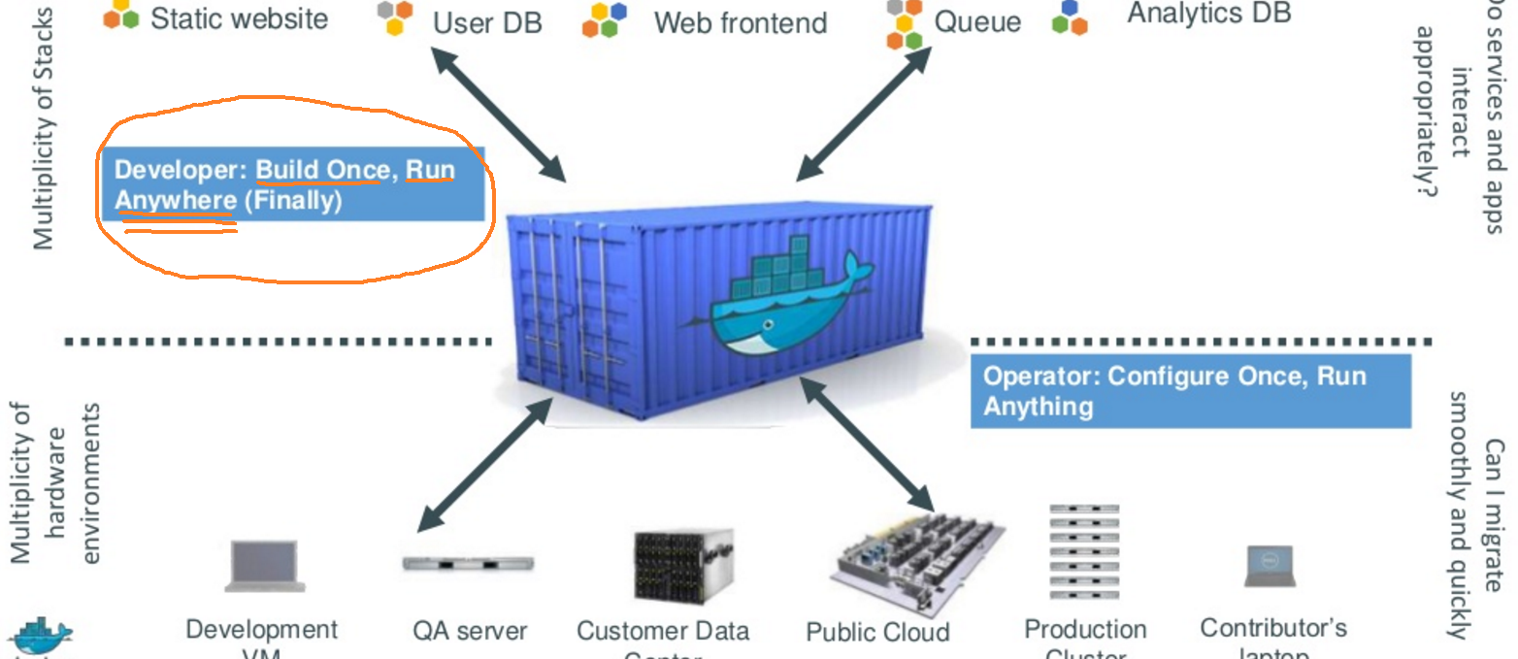
Do once run anywhere

Slide 20
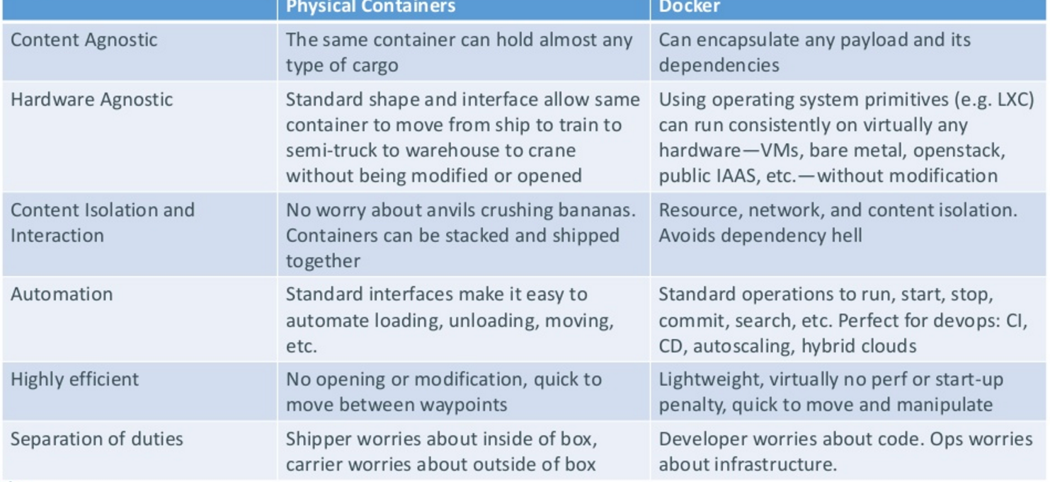
Docker’s container ---the concept (and relation to our shipping container)
CI/CD =continuous integration & continuous delivery
….go here to see on AWS (dealing with automatic builds,etc.)
LXC = linux container technology to run multiple linux on one host, etc.

Slide 21
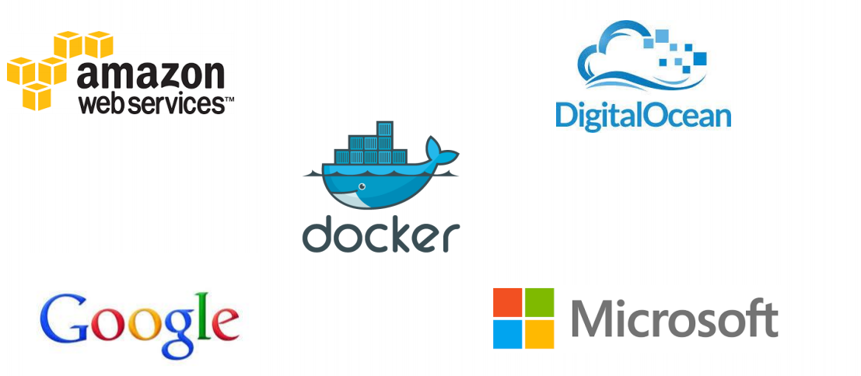
Docker supported in many Cloud platforms

Slide 22
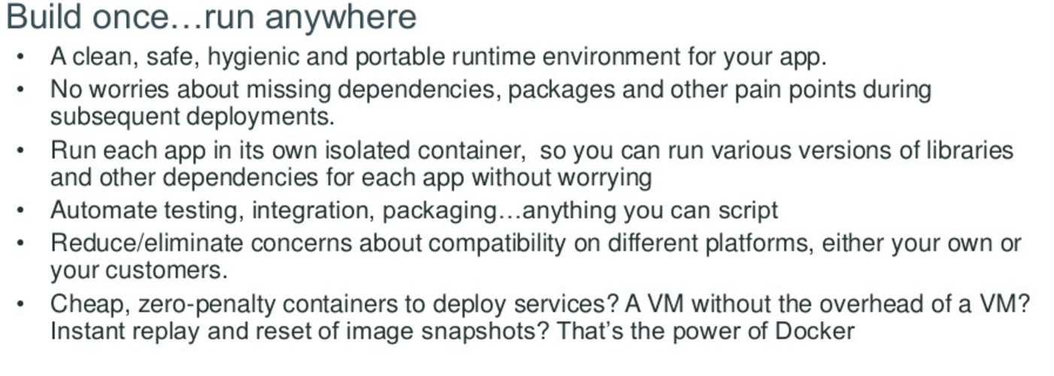
Docker container—developer viewpoint

Slide 23
Developer viewpoint---(doesn’t this quote remind you of Java virtual machine)

Slide 24
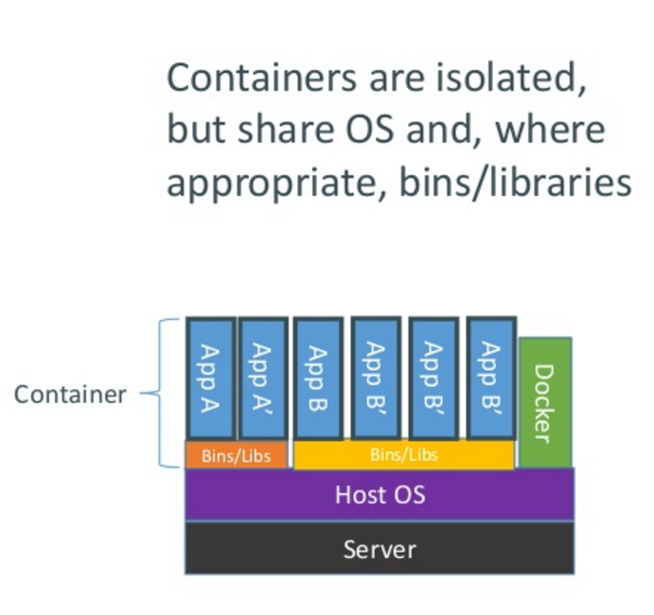
How does Docker containers work?

Slide 25
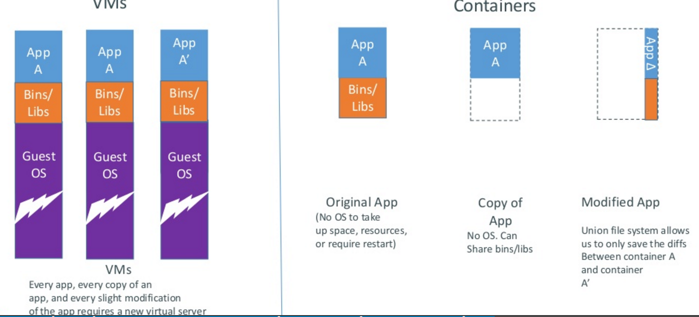
Docker containers are lightweight

Slide 26
WOW –is Docker a PaaS or a replacement for PaaS

Slide 27
Docker versus PaaS
FIRST doesn’t have to be a comparison.. but…
For Docker: “In the case of PaaS you don’t have much control over many of the operational aspects associated with managing your application, for example the way it handles scaling, high availability, performance, monitoring, logging, updates. There is also a much stronger dependency on the platform provider in the choice of language and stack”
For PaaS, “PaaS offers additional benefits beyond application packaging and deployment, including service provisioning and binding, application monitoring and logging, automatic scaling, versioning and rollbacks, and provisioning across cloud availability zones,”

Slide 28
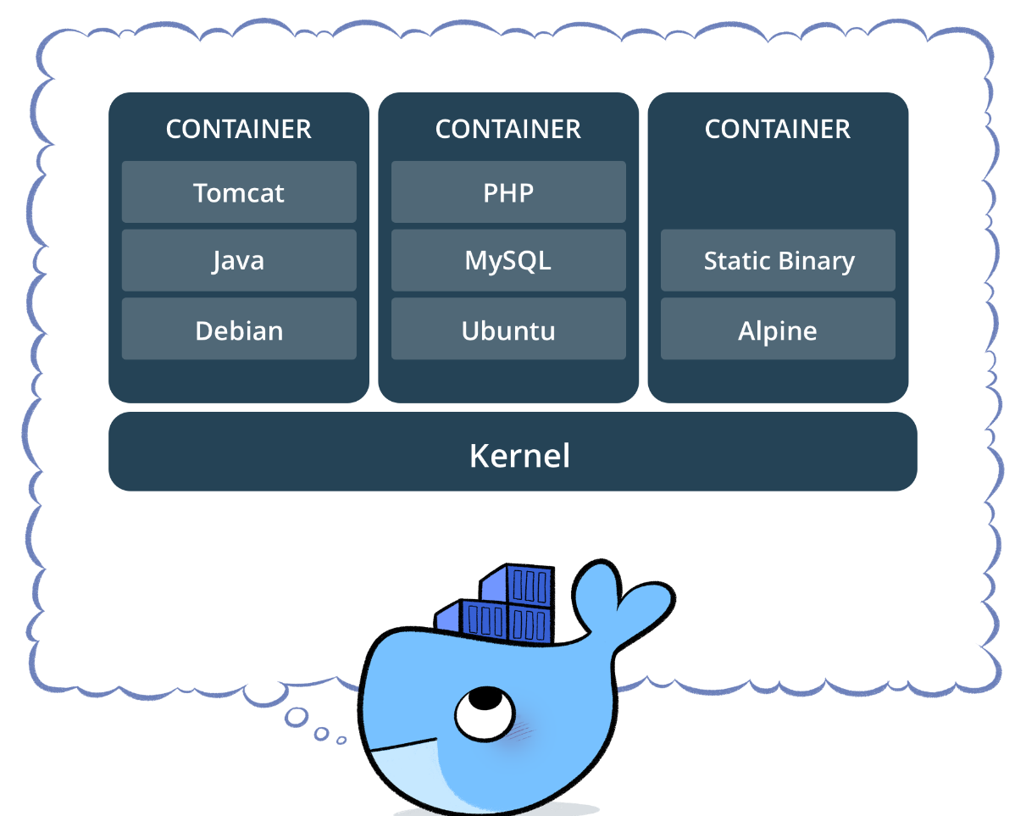
Docker versus PaaS
Containers allows users easily to spawn applications on any virtual or physical infrastructure,
integrating all its dependencies such as code, runtime, system tools and system libraries
STOP
Docker are a “package” container that can be used on IaaS to set it up
You could use a docker to create part of the features a PaaS provides – platforms (virtual machines down to physical) that run certain software (like tomcat, php,
nodeJS, etc)
A PaaS may use docker tech to isolate different applications that users deploy to it

Slide 29
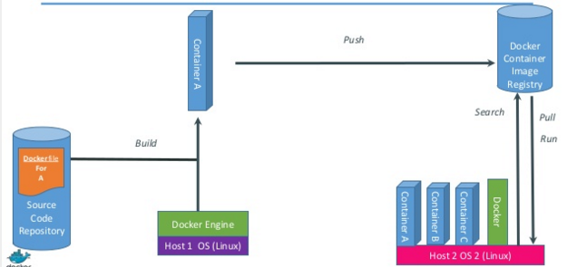
Just how does Docker work

Slide 30
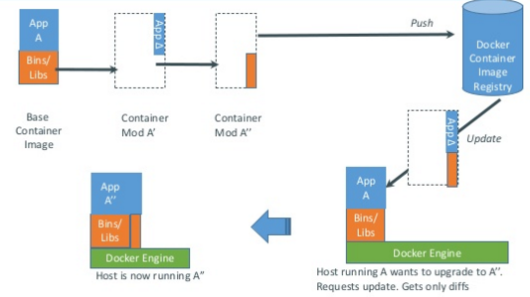
Docker updates/changes

Slide 31
Docker has a repository like github
you can push and pull container images to/from the Docker registry
which is something like a “GitHub” for Docker container images.

Slide 32
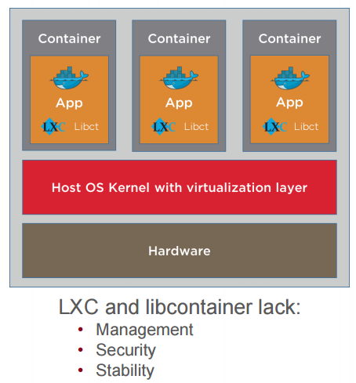
Service providers (public cloud) need containers to run Docker
Docker runs on Containers

Slide 33
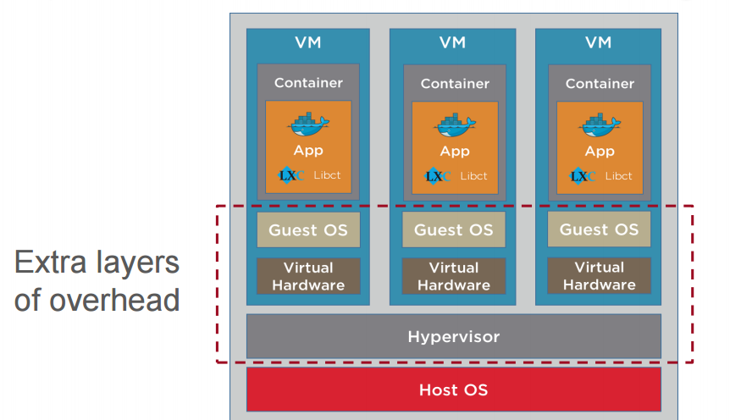
Open source Container inside VM Configuration

Slide 34
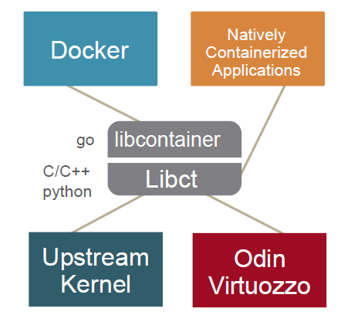
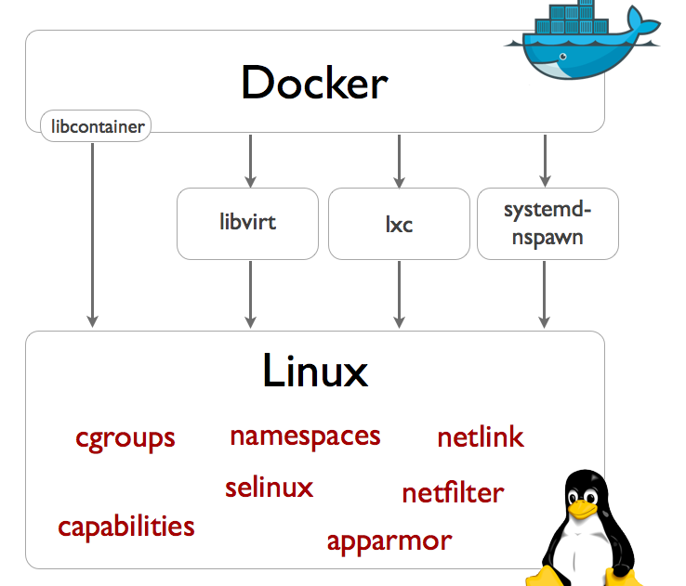
Docker needs containers
As mentioned, Docker has started the wave of new container technologies hitting the market
Odin is helping next ones get there by driving creation of libcontainer library (this is just abstracting away from Lxc – linux based)
NOW other companies like Odin can create their own containers programmers can pick up and modify/use

Slide 35
NEXT STEPS
Get started with using Docker- https://docs.docker.com/get-started/
Tutorial including how to push to Docker hub- https://www.techrepublic.com/article/how-to-create-a-docker-image-and-push-it-to-docker-hub/
Learn about Docker on AWS- http://docs.aws.amazon.com/AmazonECS/latest/developerguide/docker-basics.html
Learn about AWS EC2 Container Service (ECS) with Docker - https://aws.amazon.com/ecs/

Slide 36
Autolab and Docker?

Slide 38
How Autolab Works with Docker
initializeVM - Initializes a VM for that platform.
waitVM - Wait for a VM to be accessible
copyIn - Copy all necessary input files to run the job.
runJob - Invoke the autodriver to run the job. The autodriver instruments the job, runs it in a controlled environment and restores the system state after job completion.
copyOut - Copy feedback file from the VM.
destroyVM - Destroy a given VM.
getVMs - Get a list of VMs in each VM pool.

Slide 39
How Does Autolab Grade an Assignment?

Slide 40
How Does Autolab Grade Many Assignments?

