Slide 1
Collections

Slide 2
Exercise
Write a program that reads a file and displays
the words of that file as a list.
  First display all words.
  Then display them with all plurals (ending in "s") capitalized.
  Then display them in reverse order.
  Then display them with all plural words removed.
Should we solve this problem using an array?
  Why or why not?

Slide 3
Naive solution
String[] allWords = new String[1000];
int wordCount = 0;
Scanner input = new Scanner(new File("data.txt"));
while (input.hasNext()) {
String word = input.next();
allWords[wordCount] = word;
wordCount++;
}
Problem: You don't know how many words the file will have.
  Hard to create an array of the appropriate size.
  Later parts of the problem are more difficult to solve.
Luckily, there are other ways to store data besides in an array.

Slide 4
Collections
collection: an object that stores data
  the objects stored are called elements
  some collections maintain an ordering; some allow duplicates
  typical operations: add, remove, clear, contains (search), size
  examples found in the Java class libraries:
    ArrayList, LinkedList, HashMap, TreeSet, PriorityQueue
  all collections are in the java.util package
    import java.util.*;

Slide 5
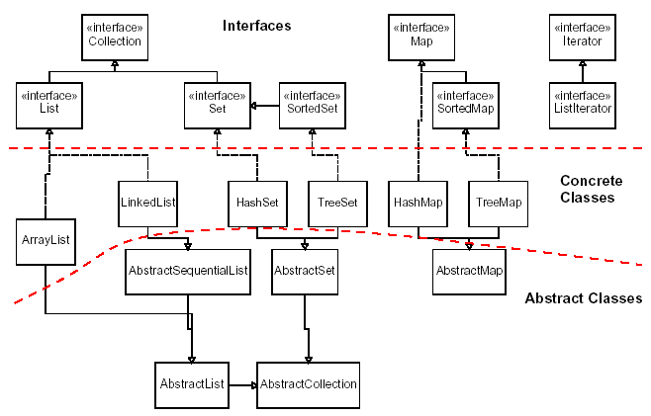
Java Collections Framework

Slide 6
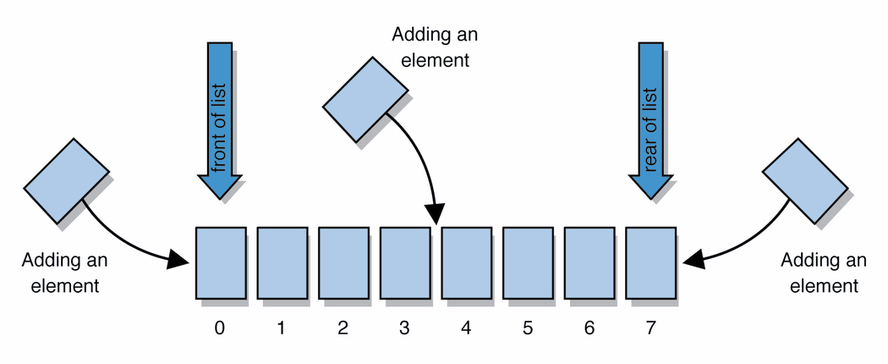
Lists
list: a collection storing an ordered sequence of elements
  each element is accessible by a 0-based index
  a list has a size
  elements can be added to the front, back, or elsewhere
  in Java, a list can be represented as an ArrayList object
Notes:
use jGRASP/DrJava Interactions window to create a list and add some elements, get them, check size

Slide 7
Idea of a list
Rather than creating an array of boxes, create an object that represents a "list" of items. (initially an empty list.)
  []
You can add items to the list.
  The default behavior is to add to the end of the list.
  [hello, ABC, goodbye, okay]
The list object keeps track of the element values that have been added to it, their order, indexes, and its total size.
  Think of an "array list" as an automatically resizing array object.
  Internally, the list is implemented using an array and a size field.

Slide 8
ArrayList methods
add(value) | appends value at end of list
add(index, value) | inserts given value just before the given index, shifting subsequent values to the right
clear() | removes all elements of the list
indexOf(value) | returns first index where given value is found in list (-1 if not found)
get(index) | returns the value at given index
remove(index) | removes/returns value at given index, shifting subsequent values to the left
set(index, value) | replaces value at given index with given value
size() | returns the number of elements in list
toString() | returns a string representation of the list such as "[3, 42, -7, 15]"

Slide 9
ArrayList methods 2
addAll(list) addAll(index, list) | adds all elements from the given list to this list (at the end of the list, or inserts them at the given index)
contains(value) | returns true if given value is found somewhere in this list
containsAll(list) | returns true if this list contains every element from given list
equals(list) | returns true if given other list contains the same elements
iterator() listIterator() | returns an object used to examine the contents of the list (seen later)
lastIndexOf(value) | returns last index value is found in list (-1 if not found)
remove(value) | finds and removes the given value from this list
removeAll(list) | removes any elements found in the given list from this list
retainAll(list) | removes any elements not found in given list from this list
subList(from, to) | returns the sub-portion of the list between indexes from (inclusive) and to (exclusive)
toArray() | returns the elements in this list as an array

Slide 10
Type Parameters (Generics)
ArrayList<Type> name = new ArrayList<Type>();
When constructing an ArrayList, you must specify the
type of elements it will contain between < and >.
  This is called a type parameter or a generic class.
  Allows the same ArrayList class to store lists of different types.
  ArrayList<String> names = new ArrayList<String>();
  names.add("Bert");
  names.add("Ernie");

Slide 11
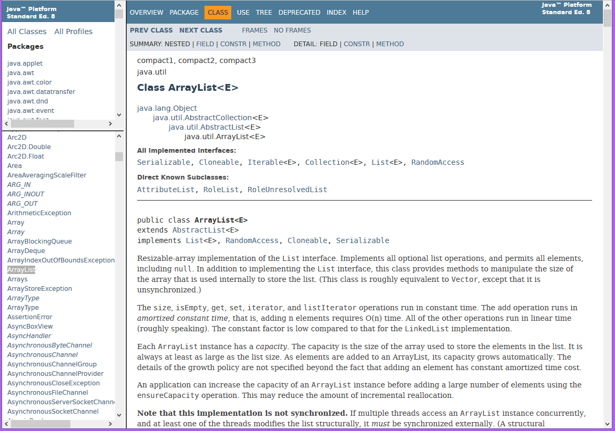
Learning about classes
The Java API Specification is a huge web page containing documentation about every Java class and its methods.
  The link to the API Specs is on the instructor web site (under Resources).

Slide 12
ArrayList vs. array
construction
  String[] names = new String[5];
  ArrayList<String> list = new ArrayList<String>();
storing a value
  names[0] = "Jessica";
  list.add("Jessica");
retrieving a value
  String s = names[0];
  String s = list.get(0);

Slide 13
ArrayList vs. array 2
doing something to each value that starts with "B"
  for (int i = 0; i < names.length; i++) {
  if (names[i].startsWith("B")) { ... }
  }
  for (int i = 0; i < list.size(); i++) {
  if (list.get(i).startsWith("B")) { ... }
  }
seeing whether the value "Benson" is found
  for (int i = 0; i < names.length; i++) {
  if (names[i].equals("Benson")) { ... }
  }
  if (list.contains("Benson")) { ... }

Slide 14
Exercise, revisited
Write a program that reads a file and displays
the words of that file as a list.
  First display all words.
  Then display them in reverse order.
  Then display them with all plurals (ending in "s") capitalized.
  Then display them with all plural words removed.

