Slide 1
Random Numbers
CSCI 161 – Introduction to Programming I

Slide 2
The Random class
Method name | Description
nextInt() | returns a random integer
nextInt(max) | returns a random integer in the range [0, max)
nextDouble() | returns a random real number in the range [0.0, 1.0)
A Random object generates pseudo-random numbers.
  Class Random is found in the java.util package.
  import java.util.*;
  Example:
  Random rand = new Random();
  int randomNumber = rand.nextInt(10);

Slide 3
Generating random numbers
Common usage: to get a random number from 1 to N
  int n = rand.nextInt(20) + 1;
To get a number in arbitrary range [ min, max ] inclusive:
  name.nextInt(size of range) + min
    where (size of range) is (max - min + 1)
  Example: A random integer between 4 and 10 inclusive:
  int n = ?

Slide 4
Random questions
Given the following declaration, how would you get:
  Random rand = new Random();
  A random number between 1 and 47 inclusive?
  A random number between 23 and 30 inclusive?
  A random even number between 4 and 12 inclusive?
Notes:
int random = rand.nextInt(5) * 2 + 4;

Slide 5
Random and other types
nextDouble method returns a double in [0, 1)
  Example: Get a random GPA value between 1.5 and 4.0:
  double randomGpa = rand.nextDouble() * x + y;
  What are x and y?
Any set of possible values can be mapped to integers
  int r = rand.nextInt(3);
  if (r == 0) {
  System.out.println("Rock");
  } else if (r == 1) {
  System.out.println("Paper");
  } else {
  System.out.println("Scissors");
  }

Slide 6
Random question
Write a program that simulates rolling of two 6-sided dice until their combined result comes up as 7.
  2 + 4 = 6
  3 + 5 = 8
  5 + 6 = 11
  1 + 1 = 2
  4 + 3 = 7
  You won after 5 tries!

Slide 7
Random answer
// Rolls two dice until a sum of 7 is reached.
import java.util.*;
public class Dice {
public static void main(String[] args) {
// Create Random object
// Set up sum and tries
// Repeatedly roll dice until get a 7
System.out.println("You won after " + tries
+ " tries!");
}
}

Slide 8
Random question
Write a program that plays an adding game.
  Ask user to solve random adding problems with 2-5 numbers.
  The user gets 1 point for a correct answer, 0 for incorrect.
  The program stops after 3 incorrect answers.
  4 + 10 + 3 + 10 = 27
  9 + 2 = 11
  8 + 6 + 7 + 9 = 25
  Wrong! The answer was 30
  5 + 9 = 13
  Wrong! The answer was 14
  4 + 9 + 9 = 22
  3 + 1 + 7 + 2 = 13
  4 + 2 + 10 + 9 + 7 = 42
  Wrong! The answer was 32
  You earned 4 total points.

Slide 9
Random answer
// Asks the user to do adding problems and scores them.
import java.util.*;
public class AddingGame {
public static void main(String[] args) {
Scanner console = new Scanner(System.in);
Random rand = new Random();
// Play until user gets 3 wrong
int totalPoints = 0;
int numWrong = 0;
while (numWrong < 3) {
// Play one game
int points = play(console, rand);
totalPoints += points;
if (points == 0) {
numWrong++;
}
}
System.out.println("You earned " + totalPoints
+ " total points.");
}

Slide 10
Random answer 2
...
// Builds one addition problem and presents it to the user.
// Returns 1 point if you get it right, 0 if wrong.
public static int play(Scanner console, Random rand) {
// print the operands being added, and sum them
int operands = rand.nextInt(4) + 2;
int sum = rand.nextInt(10) + 1;
System.out.print(sum);
for (int i = 2; i <= operands; i++) {
int n = rand.nextInt(10) + 1;
sum += n;
System.out.print(" + " + n);
}
System.out.print(" = ");
// read user's guess and report whether it was correct
int guess = console.nextInt();
int points = 1;
if (guess != sum) {
points = 0;
System.out.println("Wrong! The answer was " + sum);
}
return points;
}
}

Slide 11
Graphics
CSCI 161 – Introduction to Programming I
William Killian

Slide 12
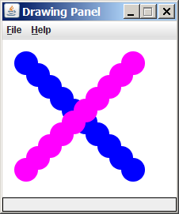
Graphical objects
We will draw graphics in Java using 3 kinds of objects:
DrawingPanel: A window on the screen.
  Not part of Java; provided by the authors. See class web site.
Graphics: A "pen" to draw shapes
and lines on a window.
Color: Colors in which to draw shapes.

Slide 13

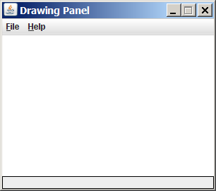
DrawingPanel
"Canvas" objects that represents windows/drawing surfaces
To create a window:
  DrawingPanel name = new DrawingPanel(width, height);
  Example:
  DrawingPanel panel = new DrawingPanel(300, 200);
The window has nothing on it.
  We draw shapes / lines on it with
  another object of type Graphics.

Slide 14

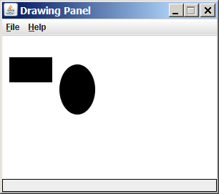
Graphics
"Pen" or "paint brush" objects to draw lines and shapes
  Access it by calling getGraphics on your DrawingPanel.
  Graphics g = panel.getGraphics();
Draw shapes by calling methods
on the Graphics object.
  g.fillRect(10, 30, 60, 35);
  g.fillOval(80, 40, 50, 70);

Slide 15
Coordinate system
Each (x, y) position is a pixel ("picture element").
Position (0, 0) is at the window's top-left corner.
  x increases rightward and the y increases downward.
The rectangle from (0, 0) to (200, 100) looks like this:
  (0, 0) x+
  (200, 100)
  y+

Slide 16
Graphics methods
Method name | Description
g.drawLine(x1, y1, x2, y2); | line between points (x1, y1), (x2, y2)
g.drawOval(x, y, width, height); | outline largest oval that fits in a box of size width * height with top-left at (x, y)
g.drawRect(x, y, width, height); | outline of rectangle of size width * height with top-left at (x, y)
g.drawString(text, x, y); | text with bottom-left at (x, y)
g.fillOval(x, y, width, height); | fill largest oval that fits in a box of size width * height with top-left at (x, y)
g.fillRect(x, y, width, height); | fill rectangle of size width * height with top-left at (x, y)
g.setColor(Color); | set Graphics to paint any following shapes in the given color

Slide 17

Color
Specified as predefined Color class constants:
  Color.CONSTANT_NAME
  where CONSTANT_NAME is one of:
    BLACK, BLUE, CYAN, DARK_GRAY, GRAY,
    GREEN, LIGHT_GRAY, MAGENTA, ORANGE,
    PINK, RED, WHITE, YELLOW
Or create one using Red-Green-Blue (RGB) values of 0-255
  Color name = new Color(red, green, blue);
  Example:
  Color brown = new Color(192, 128, 64);

Slide 18
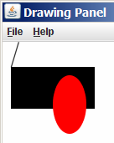
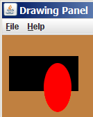
Using colors
Pass a Color to Graphics object's setColor method
  Subsequent shapes will be drawn in the new color.
  g.setColor(Color.BLACK);
  g.fillRect(10, 30, 100, 50);
  g.drawLine(20, 0, 10, 30);
  g.setColor(Color.RED);
  g.fillOval(60, 40, 40, 70);
Pass a color to DrawingPanel's setBackground method
  The overall window background color will change.
  Color brown = new Color(192, 128, 64);
  panel.setBackground(brown);

Slide 19
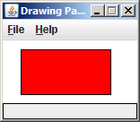
Outlined shapes
To draw a colored shape with an outline, first fill it,
then draw the same shape in the outline color.
import java.awt.*; // so I can use Graphics
public class OutlineExample {
public static void main(String[] args) {
DrawingPanel panel = new DrawingPanel(150, 70);
Graphics g = panel.getGraphics();
// inner red fill
g.setColor(Color.RED);
g.fillRect(20, 10, 100, 50);
// black outline
g.setColor(Color.BLACK);
g.drawRect(20, 10, 100, 50);
}
}

Slide 20
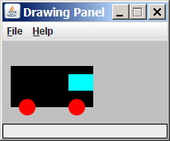
Superimposing shapes
When ≥ 2 shapes occupy the same pixels, the last drawn "wins."
import java.awt.*;
public class Car {
public static void main(String[] args) {
DrawingPanel panel = new DrawingPanel(200, 100);
panel.setBackground(Color.LIGHT_GRAY);
Graphics g = panel.getGraphics();
g.setColor(Color.BLACK);
g.fillRect(10, 30, 100, 50);
g.setColor(Color.RED);
g.fillOval(20, 70, 20, 20);
g.fillOval(80, 70, 20, 20);
g.setColor(Color.CYAN);
g.fillRect(80, 40, 30, 20);
}
}

Slide 21
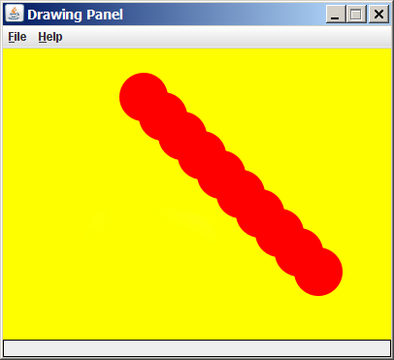
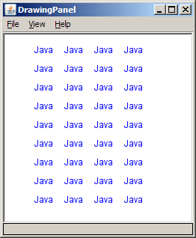
Drawing with loops
The x,y,w,h expressions can use the loop counter variable:
  panel.setBackground(Color.YELLOW);
  g.setColor(Color.RED);
  for (int i = 1; i <= 10; i++) {
  // x y w h
  g.fillOval(100 + 20 * i, 5 + 20 * i, 50, 50);
  }
Nested loops can be used with graphics:
  g.setColor(Color.BLUE);
  for (int x = 1; x <= 4; x++) {
  for (int y = 1; y <= 9; y++) {
  g.drawString("Java", x * 40, y * 25);
  }
  }

Slide 22
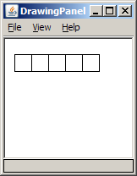
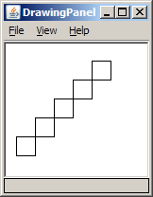
Zero-based loops
Beginning at 0 and using < can make coordinates easier.
  DrawingPanel panel = new DrawingPanel(150, 140);
  Graphics g = panel.getGraphics();
  // horizontal line of 5 20x20 rectangles starting
  // at (11, 18); x increases by 20 each time
  for (int i = 0; i < 5; i++) {
  g.drawRect(11 + 20 * i, 18, 20, 20);
  }
Exercise: Write a variation of the above
program that draws the output at right.
  The bottom-left rectangle is at (11, 98).
  for (int i = 0; i < 5; i++) {
  g.drawRect(11 + 20 * i, 98 - 20 * i, 20, 20);
  }

Slide 23
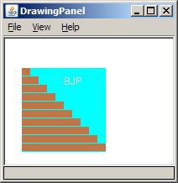
Java book figure
Write a program that draws the following figure:
  drawing panel is size 200x150
  book is at (20, 35), size 100x100
  cyan background
  white "BJP" text at position (70, 55)
  stairs are in color (red=191, green=118, blue=73)
  each stair is 9px tall
    1st stair is 10px wide
    2nd stair is 20px wide ...
  stairs are 10px apart (1 blank pixel between)

Slide 24
Java book solution
// Draws a Building Java Programs textbook with DrawingPanel.
import java.awt.*;
public class Book {
public static void main(String[] args) {
DrawingPanel panel = new DrawingPanel(200, 150);
panel.setBackground(Color.WHITE);
Graphics g = panel.getGraphics();
g.setColor(Color.CYAN); // cyan background
g.fillRect(20, 35, 100, 100);
g.setColor(Color.WHITE); // white "bjp" text
g.drawString("BJP", 70, 55);
g.setColor(new Color(191, 118, 73));
for (int i = 0; i < 10; i++) { // orange "bricks"
g.fillRect(20, 35 + 10 * i, 10 + 10 * i, 9);
}
}
}

Slide 25
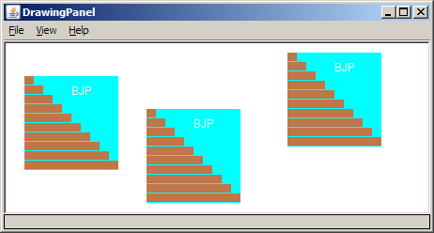
Multiple Java books
Modify the Java book program so that it can draw books at different positions as shown below.
  book top/left positions: (20, 35), (150, 70), (300, 10)
  drawing panel's new size: 450x180

Slide 26
Multiple books solution
To draw in a method, you must pass Graphics g to it.
// Draws many BJP textbooks using parameters.
import java.awt.*;
public class Book2 {
public static void main(String[] args) {
DrawingPanel panel = new DrawingPanel(450, 180);
panel.setBackground(Color.WHITE);
Graphics g = panel.getGraphics();
// draw three books at different locations
drawBook(g, 20, 35);
drawBook(g, 150, 70);
drawBook(g, 300, 10);
}
...

Slide 27
Multiple books, cont'd.
...
// Draws a BJP textbook at the given x/y position.
public static void drawBook(Graphics g, int x, int y) {
g.setColor(Color.CYAN); // cyan background
g.fillRect(x, y, 100, 100);
g.setColor(Color.WHITE); // white "bjp" text
g.drawString("BJP", x + 50, y + 20);
g.setColor(new Color(191, 118, 73));
for (int i = 0; i < 10; i++) { // orange "bricks"
g.fillRect(x, y + 10 * i, 10 * (i + 1), 9);
}
}
}

Slide 28
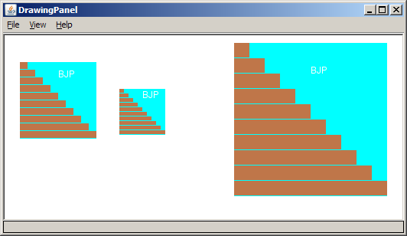
Resizable Java books
Modify the Java book program so that it can draw books at different sizes as shown below.
  book sizes: 100x100, 60x60, 200x200
  drawing panel's new size: 520x240

Slide 29
Resizable books solution
// Draws many sized BJP textbooks using parameters.
import java.awt.*;
public class Book3 {
public static void main(String[] args) {
DrawingPanel panel = new DrawingPanel(520, 240);
panel.setBackground(Color.WHITE);
Graphics g = panel.getGraphics();
// draw three books at different locations/sizes
drawBook(g, 20, 35, 100);
drawBook(g, 150, 70, 60);
drawBook(g, 300, 10, 200);
}
...

Slide 30
Resizable solution, cont'd.
...
// Draws a book of the given size at the given position.
public static void drawBook(Graphics g, int x, int y, int size) {
g.setColor(Color.CYAN); // cyan background
g.fillRect(x, y, size, size);
g.setColor(Color.WHITE); // white "bjp" text
g.drawString("BJP", x + size/2, y + size/5);
g.setColor(new Color(191, 118, 73));
for (int i = 0; i < 10; i++) { // orange "bricks"
g.fillRect(x, // x
y + size/10 * i, // y
size/10 * (i + 1), // width
size/10 - 1); // height
}
}
}

Slide 31
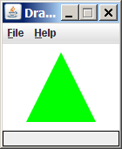
Polygon
Objects that represent arbitrary shapes
Add points to a Polygon using its addPoint(x, y) method.
Example:
  DrawingPanel p = new DrawingPanel(100, 100);
  Graphics g = p.getGraphics();
  g.setColor(Color.GREEN);
  Polygon poly = new Polygon();
  poly.addPoint(10, 90);
  poly.addPoint(50, 10);
  poly.addPoint(90, 90);
  g.fillPolygon(poly);

Slide 32
DrawingPanel methods
panel.clear();
Erases any shapes that are drawn on the drawing panel.
panel.setWidth(width);
panel.setHeight(height);
panel.setSize(width, height);
Changes the drawing panel's size to the given value(s).
panel.save(filename);
Saves the image on the panel to the given file (String).
panel.sleep(ms);
Pauses the drawing for the given number of milliseconds.

Slide 33
Animation with sleep
DrawingPanel's sleep method pauses your program for a given number of milliseconds.
You can use sleep to create simple animations.
  DrawingPanel panel = new DrawingPanel(250, 200);
  Graphics g = panel.getGraphics();
  g.setColor(Color.BLUE);
  for (int i = 1; i <= 10; i++) {
  g.fillOval(15 * i, 15 * i, 30, 30);
  panel.sleep(500);
  }
  Try adding sleep commands to loops in past exercises in this chapter and watch the panel draw itself piece by piece.

