Slide 1
Introduction
CSCI 161 – Introduction to Programming I
William Killian

Slide 2
What is computer science?
Computer Science
the scientific and practical approach to computation and its applications (Wikipedia)
Study of algorithms
Subfields
Graphics
Compilers, Operating Systems
Artificial Intelligence, Natural Language Processing
Databases, Data Mining
...
Computer Engineering
Overlap with CS and EE; emphasizes hardware

Slide 3
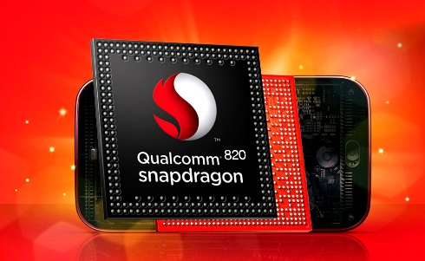
Computers
Components of computer (hardware)
Processor (CPU) – “brain”; Intel Core i7
Main memory (RAM) – volatile, short-term memory
I/O devices – interact w/users
Storage – non-volatile, long-term memory
Notes:
RAM: stores executing program & data
Storage: hard drive, flash, DVD-ROM

Slide 4
Capacity
Perspective on capacity
1 B = 8 bits = 1 character (alphabetic, punctuation, etc.)
1 KB = 2¹⁰ B (~ ½ typewritten page)
1 MB = 2²⁰ B (novel)
1 GB = 2³⁰ B (4/Britannica)
1 TB = 2⁴⁰ B (10/print collection LC)
1 PB = 2⁵⁰ B (200/all printed material)
1 EB = 2⁶⁰ B (5/all words ever spoken)
1 ZB = 2⁷⁰ B (?)
1 YB = 2⁸⁰ B (??)

Slide 5
What is programming?
Program
set of instructions to be carried out by a computer; an example of software
Program Execution
act of carrying out the instructions contained in a program
Programming Language
systematic set of rules used to describe computations in a format that is editable by humans; One is used to specify algorithms

Slide 6
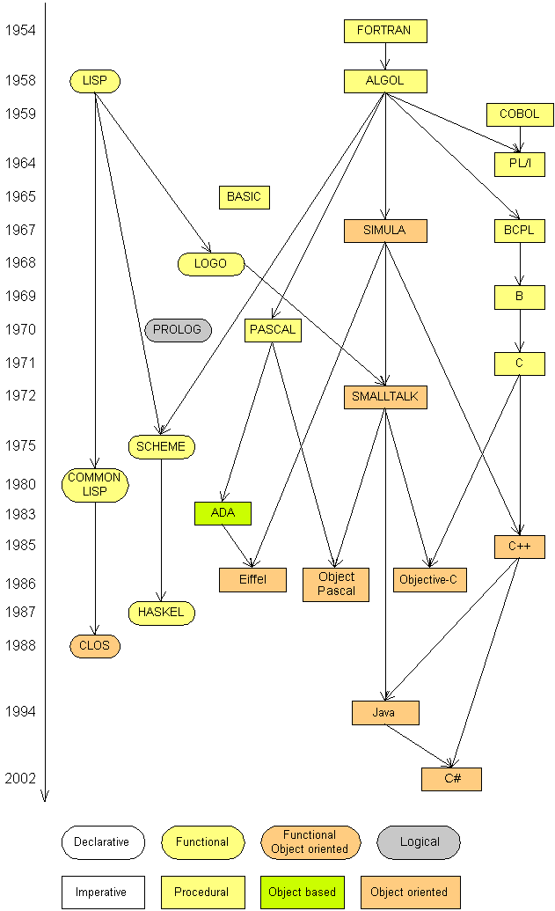
Programming languages
Some influential ones
FORTRAN
science / engineering
COBOL
business data
LISP
logic and AI
BASIC
a simple language

Slide 7
Why Take CS?
Why take CSCI 161?
Learn how to program in Java (plus C/C++, Python, …)
Learn a very marketable skill!
Learn how to become a better problem solver
Learn to become more precise and careful
Learn patience

Slide 8
Some modern languages
procedural languages: programs are a series of commands
Pascal (1970): designed for education
C (1972): low-level operating systems and device drivers
functional programming: functions map inputs to outputs
Lisp (1958) / Scheme (1975), ML (1973), Haskell (1990)
object-oriented languages: programs use interacting "objects"
Smalltalk (1980): first major object-oriented language
C++ (1985): "object-oriented" improvements to C
successful in industry; used to build major OSes such as Windows
Java (1995): designed for embedded systems, web apps/servers
Runs on many platforms (Windows, Mac, Linux, cell phones...)
The language we’ll use

Slide 9
Basic Java programs with println statements

Slide 10
Compile/run a program
Write it
code or source code: the set of instructions in a program
Compile it
compile: translate a program from one language to another
byte code: Java compiler converts your code into a format named byte code that runs on many computer types
Run (execute) it
output: messages printed to the user by a program
source code
byte code
output
compile
run

Slide 11
Eclipse
Eclipse is an Integrated Development Environment (IDE)
IDE provides unified framework for software development
Consists of
Code/Text editor
Interface to compiler and debugger
GUI designer (windows, buttons, menus, etc.)
Console – view textual output
Project management – organize files related to one application
Eclipse not just for Java (also supports C/C++, PHP, UML, etc.)

Slide 12
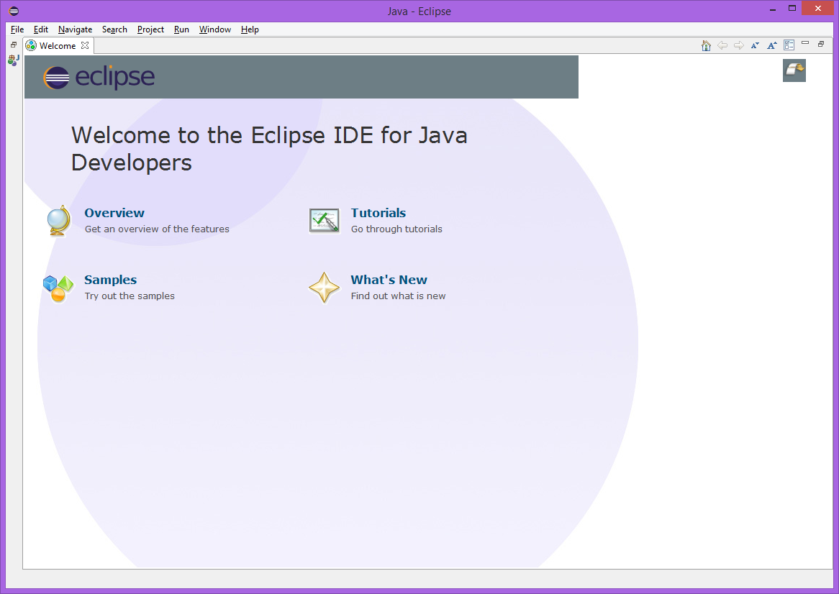

Slide 13
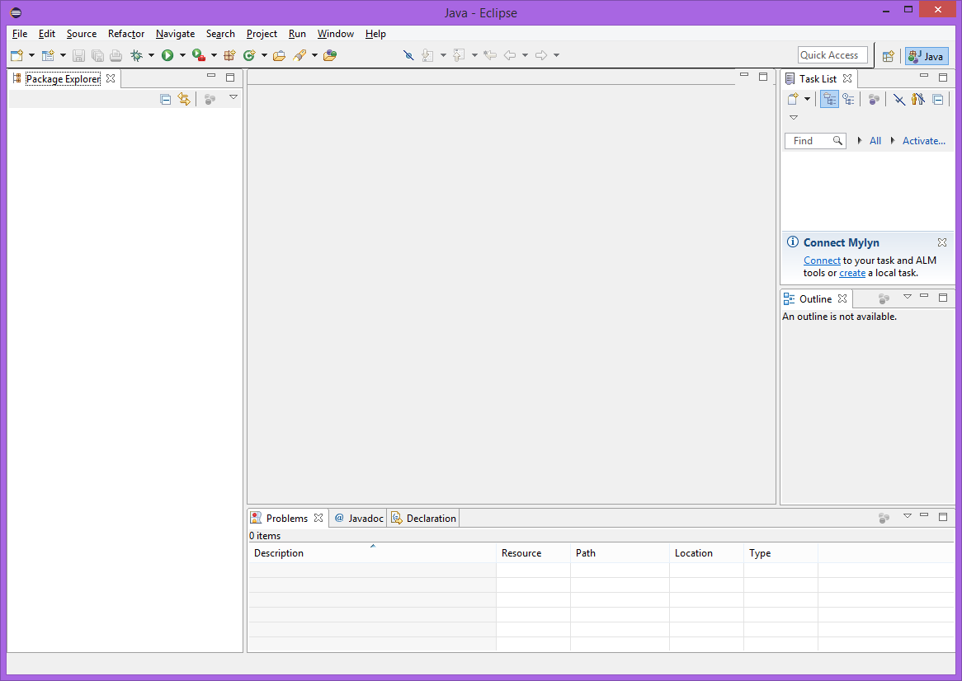

Slide 14
Eclipse (Cont’d)
Eclipse terminology
Workspace – directory that stores all files
Workbench – main work area – offers several Perspectives
Perspective – environment tailored for project type – will use Java perspective (default perspective)
View – window or tab with related functionality
Editor, Package Explorer, Console, Search

Slide 15
Eclipse (Cont’d)
On startup,
Select Workspace – set once; details in Lab 1
May show “Welcome View” – click arrow to go to full Workbench
Start a Java Project – details in Lab 1
Eclipse has extensive Help system
Get into trouble w/workbench layout – choose Window ⇒ Reset Perspective

Slide 16
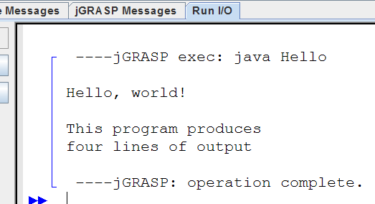
A Java program
public class Hello {
public static void main(String[] args) {
System.out.println("Hello, world!");
System.out.println();
System.out.println("This program produces");
System.out.println("four lines of output");
}
}
Its output:
Hello, world!
This program produces
four lines of output
console: Text box into which the program's output is printed.

Slide 17
Structure of a Java program
class: a program
public class Name {
public static void main(String[] args) {
statement;
statement;
...
statement;
}
}
Every executable Java program consists of a class,
that contains a method named main,
that contains the statements (commands) to be executed.
method: a named group of statements
statement: a command to be executed

Slide 18
System.out.println
A statement that prints a line of output on the console.
pronounced "print-line"
Two ways to use System.out.println :
System.out.println("text");
Prints the given message as output.
System.out.println();
Prints a blank line of output.

Slide 19
Names and identifiers
You must give your program a name.
public class GangstaRap {
Naming convention: capitalize each word (e.g. MyClassName)
Your program's file must match exactly (GangstaRap.java)
identifier: A name given to an item in your program
must start with a letter or _ or $
subsequent characters can be any of those or a number
Are these legal?
me+u _myName TheCure 49ers side-swipe ANSWER_IS_42 $bling$ Ph.D's

Slide 20
Keywords
keyword: An identifier that you cannot use because it already has a reserved meaning in Java
abstract default if private this
boolean do implements protected throw
break double import public throws
byte else instanceof return transient
case extends int short try
catch final interface static void
char finally long strictfp volatile
class float native super while
const for new switch
continue goto package synchronized

Slide 21
Syntax
syntax: set of legal structures and commands that can be used in a particular language
Every basic Java statement ends with a semicolon ;
The contents of a class or method occur between { and }
syntax error (compiler error): A problem in the structure of a program that causes the compiler to fail
Missing semicolon
Too many or too few { } braces
Illegal identifier for class name
Class and file names do not match
...

Slide 22
Syntax error example
1 public class Hello {
2 pooblic static void main(String[] args) {
3 System.owt.println("Hello, world!")_
4 }
5 }
Compiler output:
Hello.java:2: <identifier> expected
pooblic static void main(String[] args) {
^
Hello.java:3: ';' expected
}
^
2 errors
The compiler shows the line number where it found the error.
The error messages can be tough to understand!

Slide 23
Strings
string: A sequence of characters to be printed.
Starts and ends with a " quote " character.
Examples: "o rly?" "This is a string. It's very long!"
Restrictions:
May not span multiple lines. "This is not a legal String."
May not contain a " character. "This is not a "legal" String either."

Slide 24
Escape sequences
escape sequence: A special sequence of characters used to represent certain special characters in a string.
\t tab character
\n new line character
\" quotation mark character
\\ backslash character
Example: System.out.println("\\hello\nhow\tare \"you\"?\\\\");
Output: \hello how are "you"?\\

Slide 25
Questions
What is the output of the following println statements?
System.out.println("\ta\tb\tc");
System.out.println("\\\\");
System.out.println("'");
System.out.println("\"\"\"");
System.out.println("C:\nin\the downward spiral");
Write a println statement to produce this output:
/ \ // \\ /// \\\

Slide 26
Answers
Output of each println statement:
a b c
\\
'
"""
C:
in he downward spiral
println statement to produce the line of output:
System.out.println("/ \\ // \\\\ /// \\\\\\");

Slide 27
Questions
What println statements will generate this output?
This program prints a
quote from the Gettysburg Address.
"Four score and seven years ago,
our 'fore fathers' brought forth on
this continent a new nation."
What println statements will generate this output?
A "quoted" String is
'much' better if you learn
the rules of "escape sequences."
Also, "" represents an empty String.
Don't forget: use \" instead of " !
'' is not the same as "

Slide 28
Answers
println statements to generate the output:
System.out.println("This program prints a");
System.out.println("quote from the Gettysburg Address.");
System.out.println();
System.out.println("\"Four score and seven years ago,");
...
println statements to generate the output:
System.out.println("A \"quoted\" String is");
System.out.println("'much' better if you learn");
System.out.println("the rules of \"escape sequences.\"");
...

Slide 29
Comments
comment: A note written in source code by the programmer to describe or clarify the code.
Comments are not executed when your program runs.
Syntax:
// comment text, on one line or, /* comment text; may span multiple lines */
Examples:
// This is a one-line comment.
/* This is a very long
multi-line comment. */

Slide 30
Using comments
Where to place comments:
at the top of each file (a "comment header")
at the start of every method (seen later)
to explain complex pieces of code
Comments are useful for:
Understanding larger, more complex programs.
Multiple programmers working together, who must understand each other's code.

Slide 31
Comments example
/* Suzie Student, CSCI 161, Spring 2020
This program prints lyrics about ... something. */
public class BaWitDaBa {
public static void main(String[] args) {
// first verse
System.out.println("Bawitdaba");
System.out.println("da bang a dang diggy diggy");
System.out.println();
// second verse
System.out.println("diggy said the boogy");
System.out.println("said up jump the boogy");
}
}

Slide 32
Algorithms and Structured Programming
CSCI 161.03 – Introduction to Programming I

Slide 33
Algorithms
algorithm: a list of steps for solving a problem
Example algorithm: "Bake sugar cookies"
Mix the dry ingredients.
Cream the butter and sugar.
Beat in the eggs.
Stir in the dry ingredients.
Set the oven temperature.
Set the timer.
Place the cookies into the oven.
Allow the cookies to bake.
Spread frosting and sprinkles onto the cookies.
...

Slide 34
Problems with algorithms
lack of structure: Many tiny steps; tough to remember
redundancy: Consider making a double batch...
Mix the dry ingredients.
Cream the butter and sugar.
Beat in the eggs.
Stir in the dry ingredients.
Set the oven temperature.
Set the timer.
Place the first batch of cookies into the oven.
Allow the cookies to bake.
Set the timer.
Place the second batch of cookies into the oven.
Allow the cookies to bake.
Mix ingredients for frosting.
...

Slide 35
Structured algorithms
structured algorithm: Split into coherent tasks.
1 Make the cookie batter.
Mix the dry ingredients.
Cream the butter and sugar.
Beat in the eggs.
Stir in the dry ingredients.
2 Bake the cookies.
Set the oven temperature.
Set the timer.
Place the cookies into the oven.
Allow the cookies to bake.
3 Add frosting and sprinkles.
Mix the ingredients for the frosting.
Spread frosting and sprinkles onto the cookies.
...

Slide 36
Removing redundancy
A well-structured algorithm can describe repeated tasks with less redundancy
1 Make the cookie batter.
Mix the dry ingredients.
...
2a Bake the cookies (first batch).
Set the oven temperature.
Set the timer.
...
2b Bake the cookies (second batch).
3 Decorate the cookies.
...

Slide 37
A program with redundancy
public class BakeCookies {
public static void main(String[] args) {
System.out.println("Mix the dry ingredients.");
System.out.println("Cream the butter and sugar.");
System.out.println("Beat in the eggs.");
System.out.println("Stir in the dry ingredients.");
System.out.println("Set the oven temperature.");
System.out.println("Set the timer.");
System.out.println("Place a batch of cookies into the oven.");
System.out.println("Allow the cookies to bake.");
System.out.println("Set the oven temperature.");
System.out.println("Set the timer.");
System.out.println("Place a batch of cookies into the oven.");
System.out.println("Allow the cookies to bake.");
System.out.println("Mix ingredients for frosting.");
System.out.println("Spread frosting and sprinkles.");
}
}

Slide 38
Static methods
static method: A named group of statements.
denotes the structure of a program
eliminates redundancy by code reuse
procedural decomposition:
dividing a problem into methods
Writing a static method is like adding a new “command” to Java.
class
method A
statement
statement
statement
method B
statement
statement
method C
statement
statement
statement

Slide 39
Using static methods
1. Design the algorithm.
Look at the structure, and which commands are repeated.
Decide what are the important overall tasks.
2. Declare (write down) the methods.
Arrange statements into groups and give each group a name.
3. Call (run) the methods.
The program's main method executes the other methods to perform the overall task.

Slide 40
Design of an algorithm
// This program displays a delicious recipe for baking cookies.
public class BakeCookies2 {
public static void main(String[] args) {
// Step 1: Make the cake batter.
System.out.println("Mix the dry ingredients.");
System.out.println("Cream the butter and sugar.");
System.out.println("Beat in the eggs.");
System.out.println("Stir in the dry ingredients.");
// Step 2a: Bake cookies (first batch).
System.out.println("Set the oven temperature.");
System.out.println("Set the timer.");
System.out.println("Place a batch of cookies into the oven.");
System.out.println("Allow the cookies to bake.");
// Step 2b: Bake cookies (second batch).
System.out.println("Set the oven temperature.");
System.out.println("Set the timer.");
System.out.println("Place a batch of cookies into the oven.");
System.out.println("Allow the cookies to bake.");
// Step 3: Decorate the cookies.
System.out.println("Mix ingredients for frosting.");
System.out.println("Spread frosting and sprinkles.");
}
}

Slide 41
Declaring a method
Gives your method a name so it can be executed
Syntax: public static void name() { statement; statement; ... statement; }
Example: public static void printWarning() { System.out.println("This product causes cancer"); System.out.println("in lab rats and humans."); }

Slide 42
Calling a method
Executes the method's code
Syntax:
name();
Can call same method many times if you like
Example:
printWarning();
Output:
This product causes cancer
in lab rats and humans.

Slide 43
Program with static method
public class FreshPrince {
public static void main(String[] args) {
rap(); // Calling (running) the rap method
System.out.println();
rap(); // Calling the rap method again
}
// This method prints the lyrics to my favorite song.
public static void rap() {
System.out.println("Now this is the story all about how");
System.out.println("My life got flipped turned upside-down");
}
}
Output:
Now this is the story all about how
My life got flipped turned upside-down
Now this is the story all about how
My life got flipped turned upside-down

Slide 44
Final cookie program
// This program displays a recipe for cookies.
public class BakeCookies3 {
public static void main(String[] args) {
makeBatter();
bake(); // 1st batch
bake(); // 2nd batch
decorate();
}
// Step 1: Make the cake batter.
public static void makeBatter() {
System.out.println("Mix the dry ingredients.");
System.out.println("Cream the butter and sugar.");
System.out.println("Beat in the eggs.");
System.out.println("Stir in the dry ingredients.");
}
// Step 2: Bake a batch of cookies.
public static void bake() {
System.out.println("Set the oven temperature.");
System.out.println("Set the timer.");
System.out.println("Place a batch of cookies into the oven.");
System.out.println("Allow the cookies to bake.");
}
// Step 3: Decorate the cookies.
public static void decorate() {
System.out.println("Mix ingredients for frosting.");
System.out.println("Spread frosting and sprinkles.");
}
}

Slide 45
Methods calling methods
public class MethodsExample {
public static void main(String[] args) {
message1();
message2();
System.out.println("Done with main.");
}
public static void message1() {
System.out.println("This is message1.");
}
public static void message2() {
System.out.println("This is message2.");
message1();
System.out.println("Done with message2.");
}
}
Output?

Slide 46
Control flow
When a method is called, the program's execution...
"jumps" into that method, executing its statements, then
"jumps" back to the point where the method was called.
public class MethodsExample {
public static void main(String[] args) {
message1();
message2();
System.out.println("Done with main.");
}
...
}
public static void message1() {
System.out.println("This is message1.");
}
public static void message2() {
System.out.println("This is message2.");
message1();
System.out.println("Done with message2.");
}
public static void message1() {
System.out.println("This is message1.");
}

Slide 47
When to use methods
Place statements into a static method if:
The statements are related structurally, and/or
The statements are repeated.
You should not create static methods for:
An individual println statement.
Only blank lines. (Put blank printlns in main.)
Unrelated or weakly related statements. (Consider splitting them into two smaller methods.)

